Slide 1


Slide 2
PREREQUISITES
1. A system with Node/npm and Git installed
2. HTML, JavaScript or TypeScript experience
3. Editor - Visual Studio Code [ Free. Open source. Runs everywhere ]
4. And most important , Desire to Learn ☺

Slide 3
Course Content
1. ES 6 Basics
2. TypeScript Basics

Slide 4

ES6 / ES 2015 Basics

Slide 5
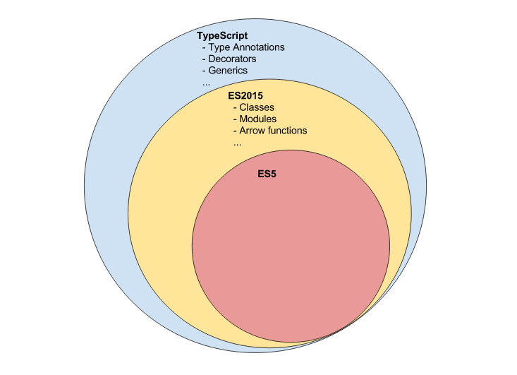

Slide 6
Classes
Syntactic sugar for JavaScript prototypes introduced in ES2015 / ES 6

Slide 7
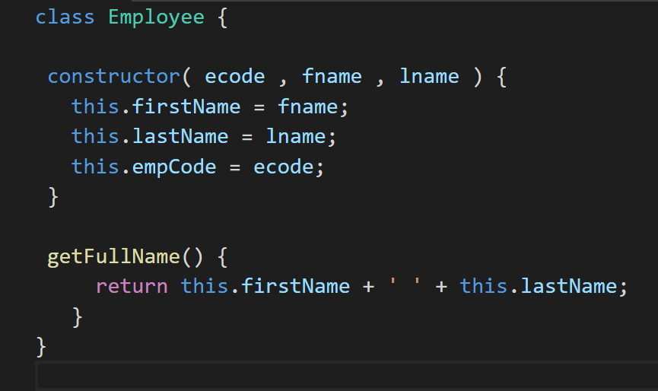

Slide 8
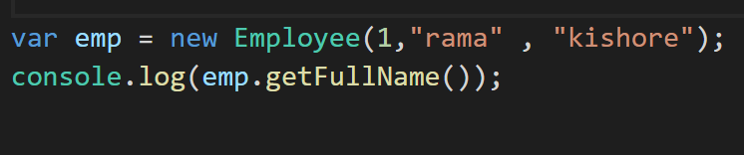

Slide 9
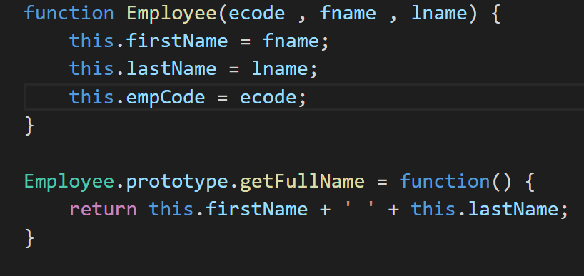

Slide 10
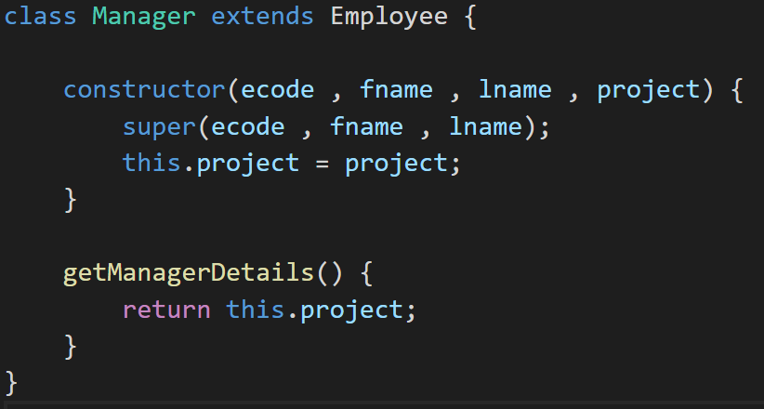

Slide 11
Modules
ES2015 brings a module system to the table that enables us to write modular code

Slide 12
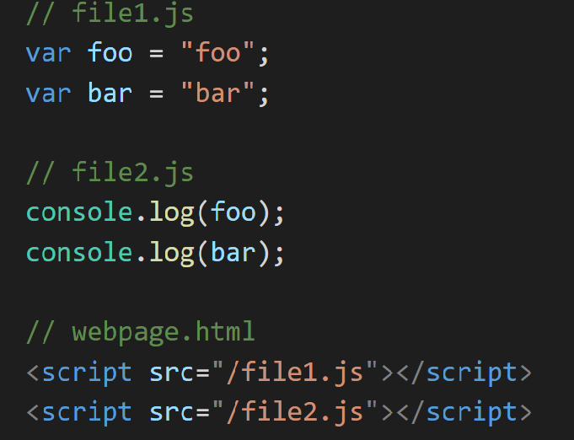

Slide 13
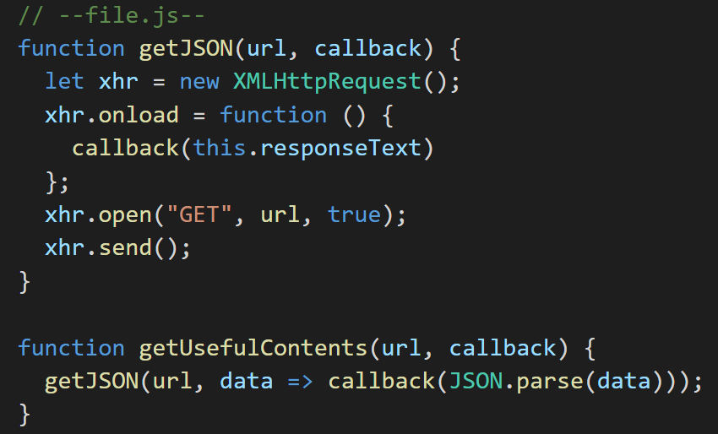

Slide 14
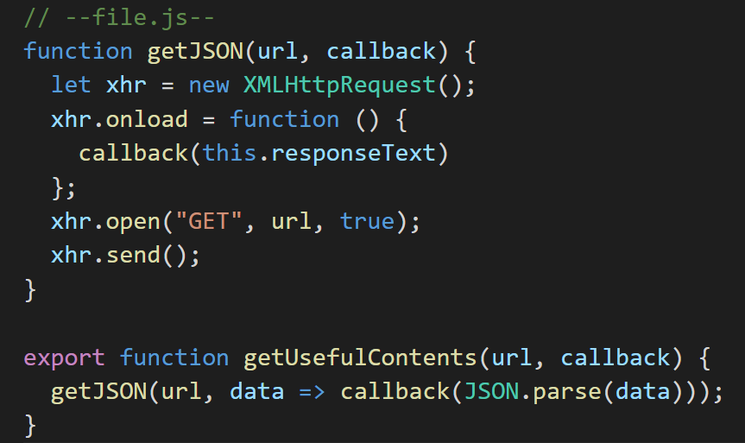

Slide 15
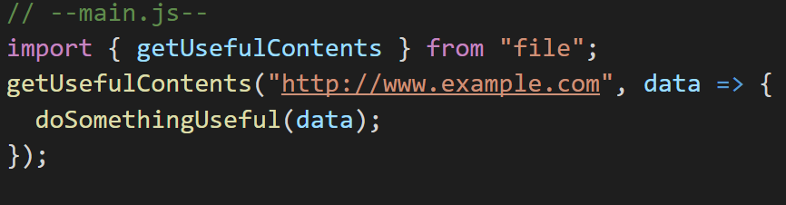

Slide 16
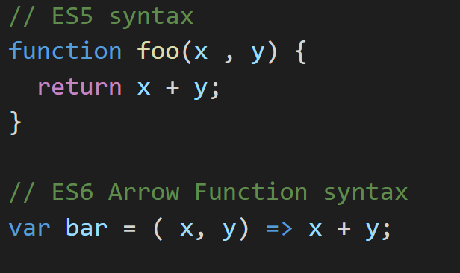
Arrow Functions

Slide 17

TypeScript Basics

Slide 18
TypeScript is a typed superset of JavaScript that compiles to plain JavaScript.

Slide 19
Type Annotations
Type annotations provide optional static typing. Applied using : T syntax

Slide 20
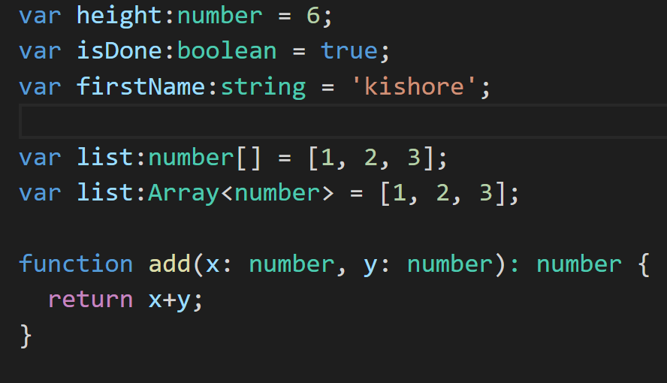

Slide 21
Access Modifiers
Public , Private , Protected modifiers

Slide 22
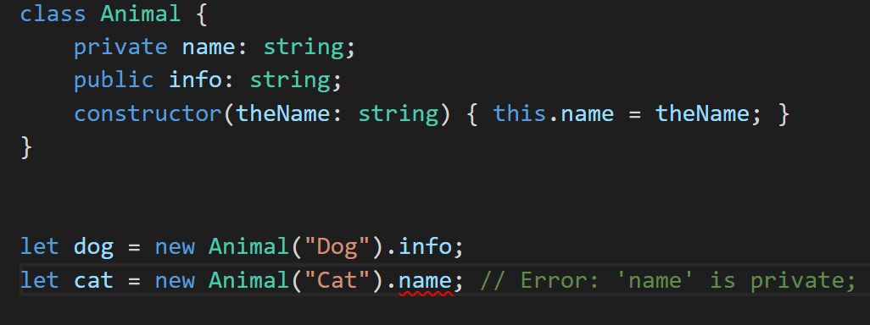

Slide 23
Decorators
A decorator is an expression that is evaluated after a class has been defined, that can be used to annotate or modify the class in some fashion.

Slide 24
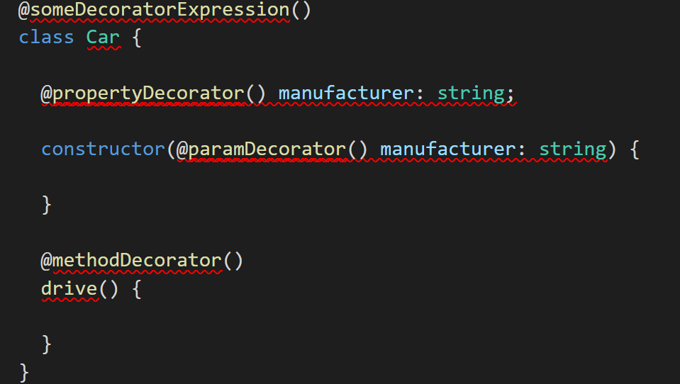

Slide 25
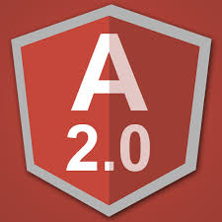
Angular 2

Slide 26
Angular 2 is not a version upgrade, but a complete rewrite.
Angular 2 takes a web component-based approach to building powerful applications for the web. It is used along with Typescript which provides support for ECMAScript 5, ECMAScript 6, and ECMAScript 7
Angular makes it easy to develop Single Page Application (SPA).

Slide 27
Angular 2 Component
A Component in Angular 2 is a class with a @Component decorator.

Slide 28
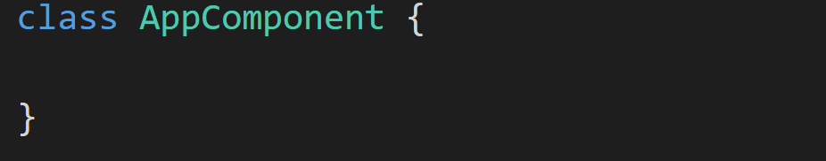
A Component in Angular 2 is a class with a @Component decorator.

Slide 29
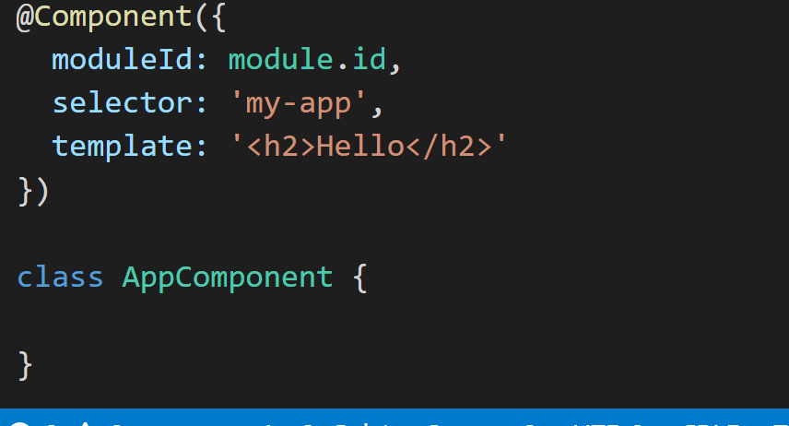
A Component in Angular 2 is a class with a @Component decorator.

Slide 30
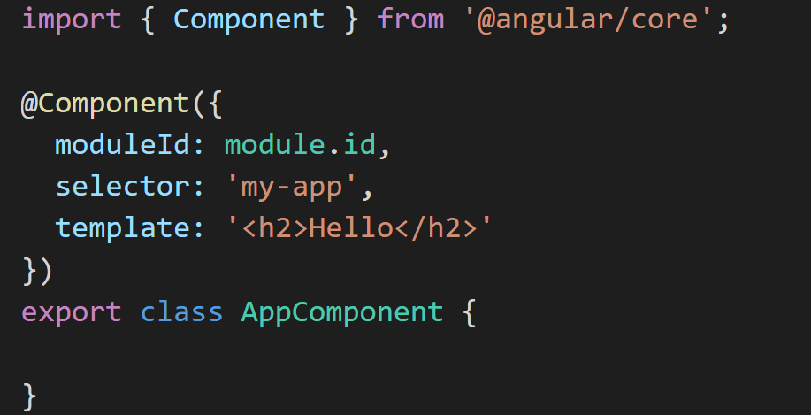
A Component in Angular 2 is a class with an @Component decorator.

Slide 31
How to instantiate the component?

Slide 32
Angular 2 Modules [ NgModule ]
An Angular Module is a class with an @NgModule decorator

Slide 33
An Angular Module is a class with an @NgModule decorator
@NgModule takes a metadata object that tells Angular how to compile and run module code. It identifies the module's own components, directives and pipes,
making some of them public so external components can use them

Slide 34
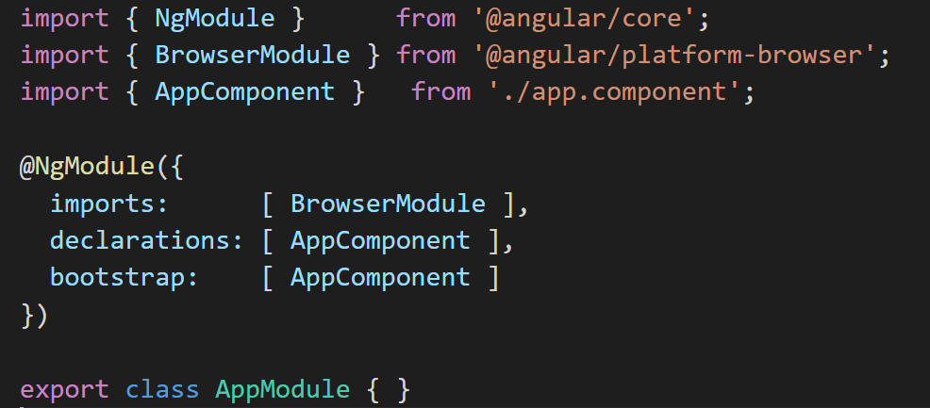

Slide 35
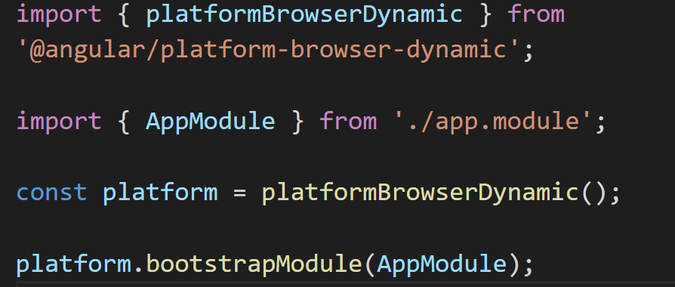

Slide 36
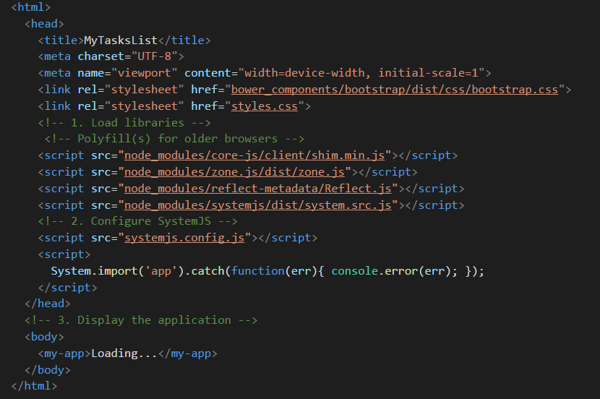

Slide 37


Slide 38
Displaying Data ?

Slide 39
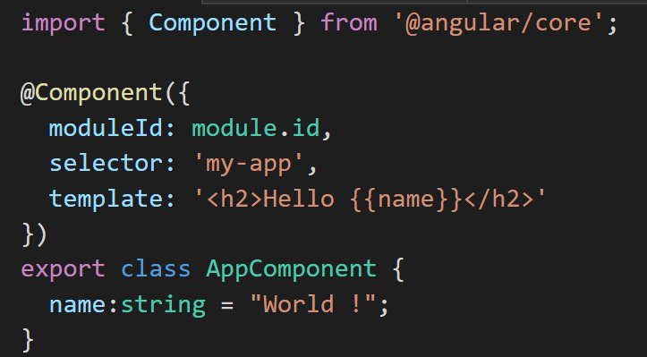

Slide 40
