Slide 1


Slide 2
PREREQUISITES
1. A system with Node/npm and Git installed
2. HTML, JavaScript or TypeScript experience
3. Editor - Visual Studio Code [ Free. Open source. Runs everywhere ]
4. And most important , Desire to Learn ☺

Slide 3
Course Content
1. ES 6 Basics
2. TypeScript Basics

Slide 4

ES6 / ES 2015 Basics

Slide 5
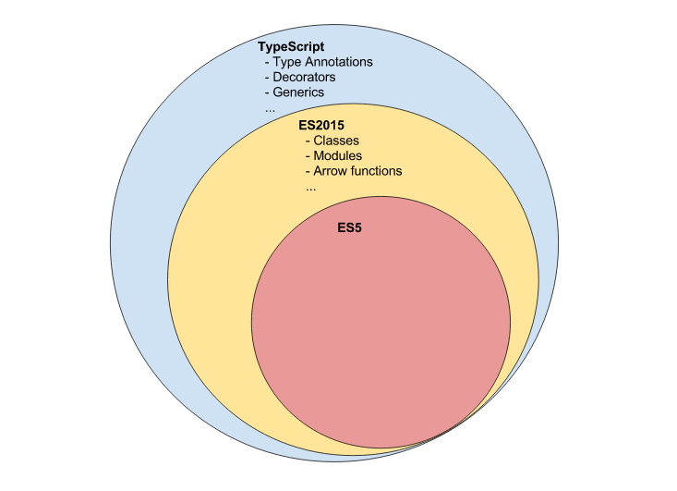

Slide 6
Classes
Syntactic sugar for JavaScript prototypes introduced in ES2015 / ES 6

Slide 7
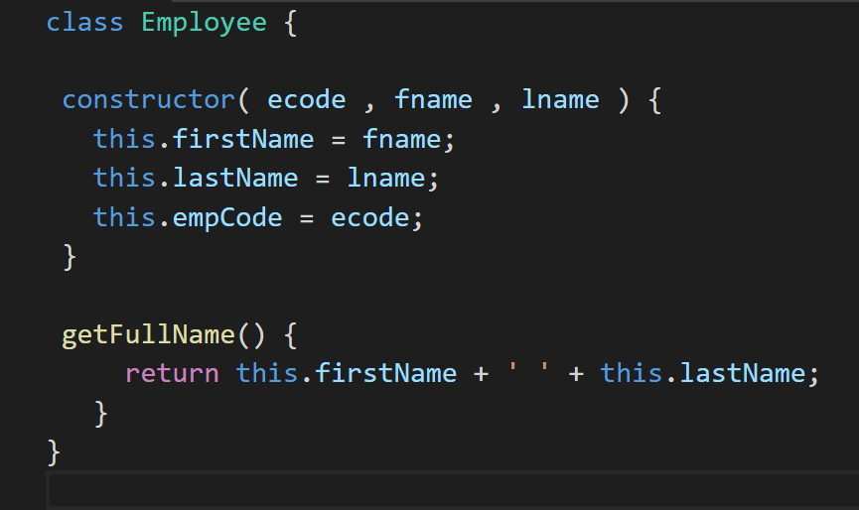

Slide 8
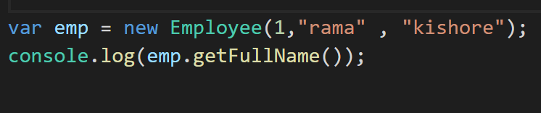

Slide 9
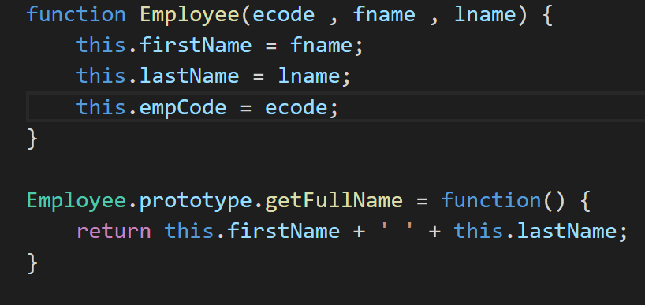

Slide 10
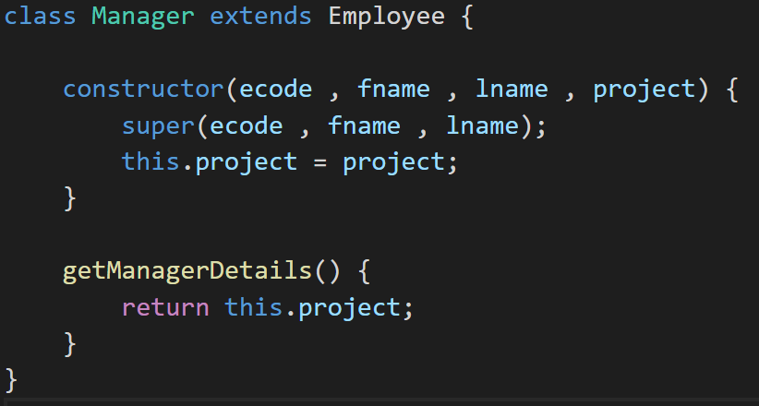

Slide 11
Modules
ES2015 brings a module system to the table that enables us to write modular code

Slide 12
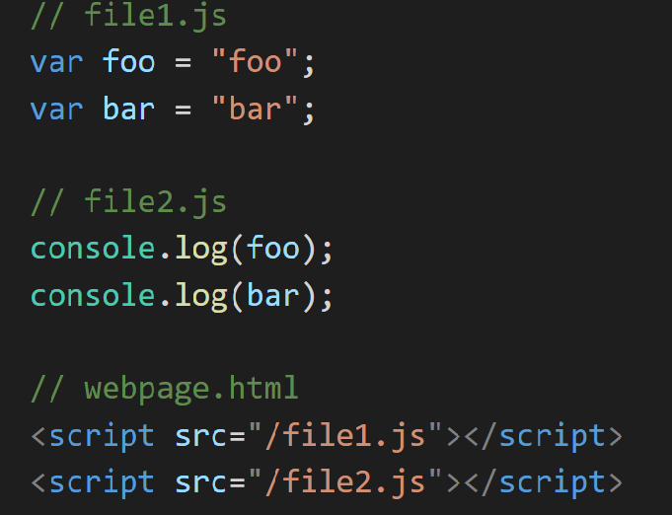

Slide 13
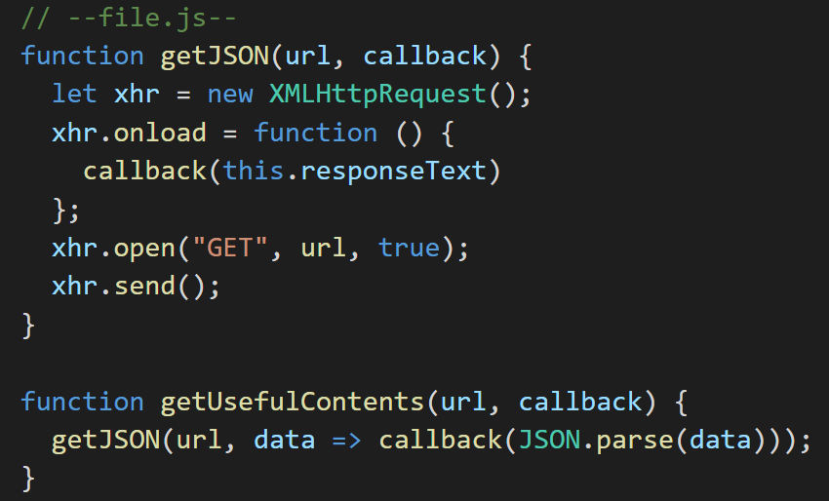

Slide 14
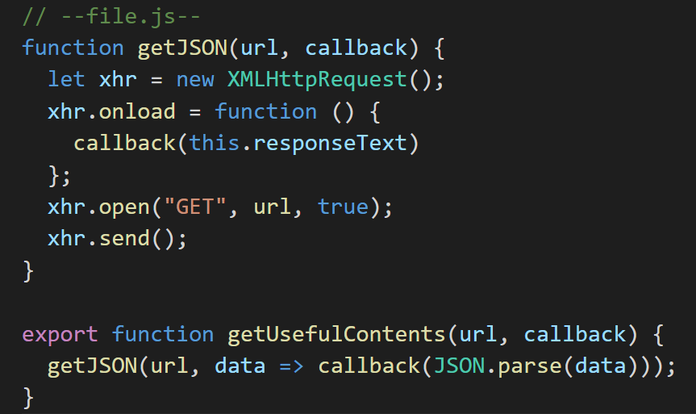

Slide 15
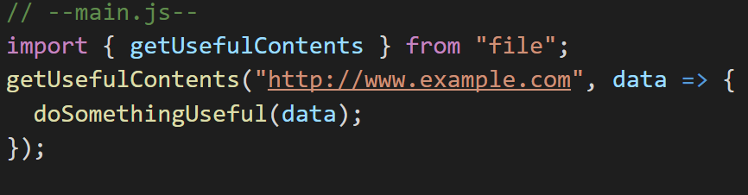

Slide 16
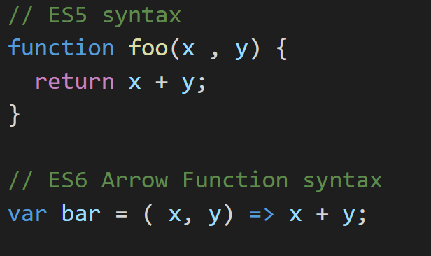
Arrow Functions

Slide 17

TypeScript Basics

Slide 18
TypeScript is a typed superset of JavaScript that compiles to plain JavaScript.

Slide 19
Type Annotations
Type annotations provide optional static typing. Applied using : T syntax

Slide 20
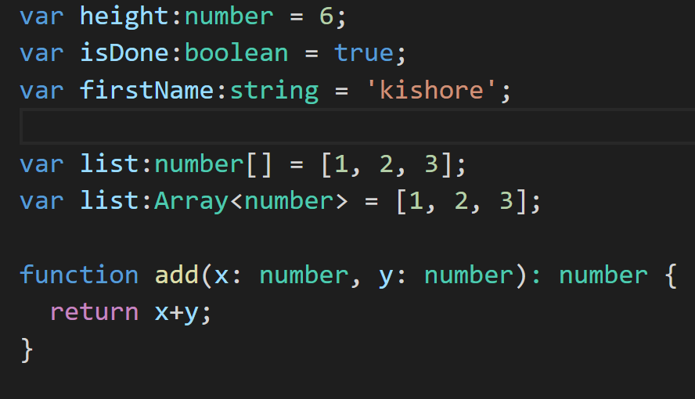

Slide 21
Access Modifiers
Public , Private , Protected modifiers

Slide 22
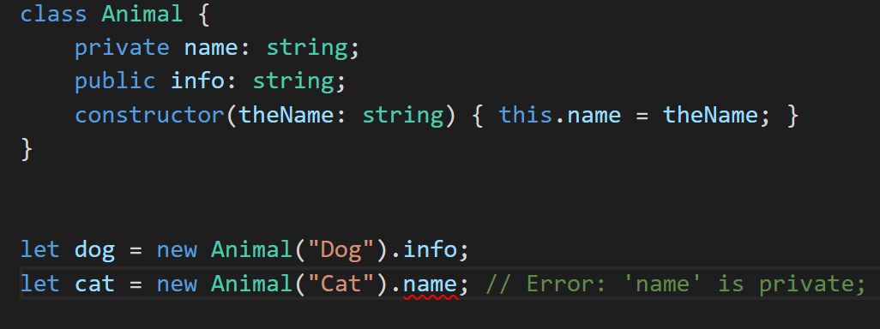

Slide 23
Decorators
A decorator is an expression that is evaluated after a class has been defined, that can be used to annotate or modify the class in some fashion.

Slide 24
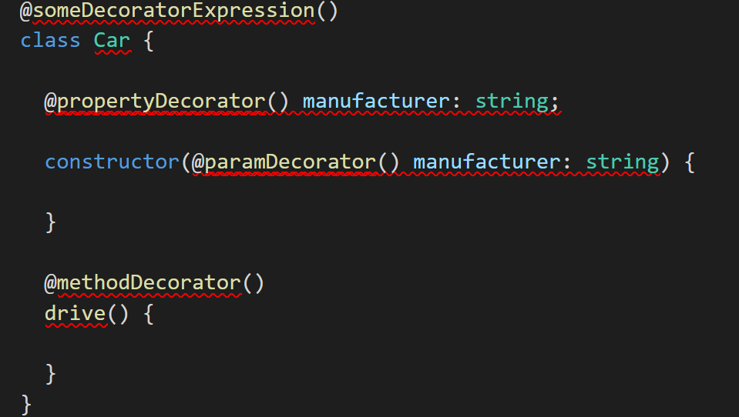

Slide 25
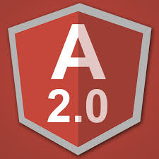
Angular 2

Slide 26
Angular 2 is not a version upgrade, but a complete rewrite.
Angular 2 takes a web component-based approach to building powerful applications for the web. It is used along with Typescript which provides support for ECMAScript 5, ECMAScript 6, and ECMAScript 7
Angular makes it easy to develop Single Page Application (SPA).

Slide 27
Angular 2 Component
A Component in Angular 2 is a class with a @Component decorator.

Slide 28
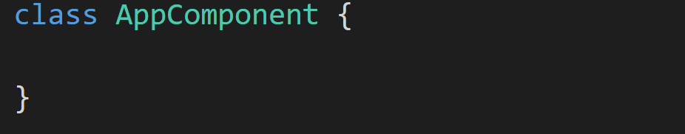
A Component in Angular 2 is a class with a @Component decorator.

Slide 29
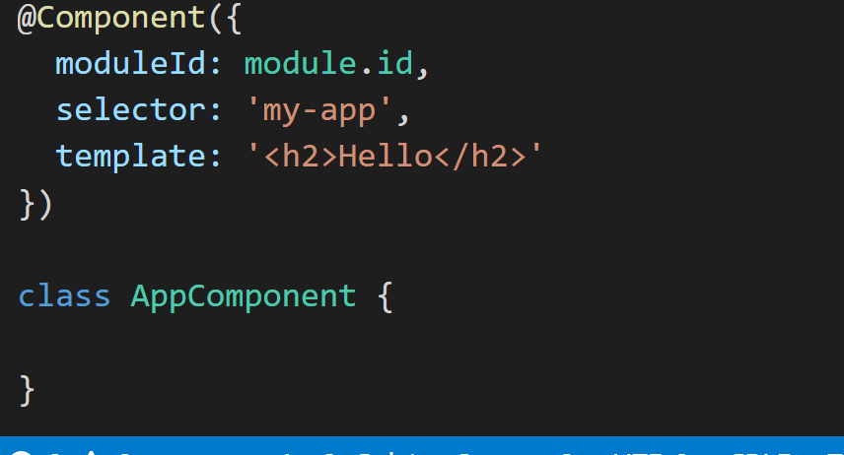
A Component in Angular 2 is a class with a @Component decorator.

Slide 30
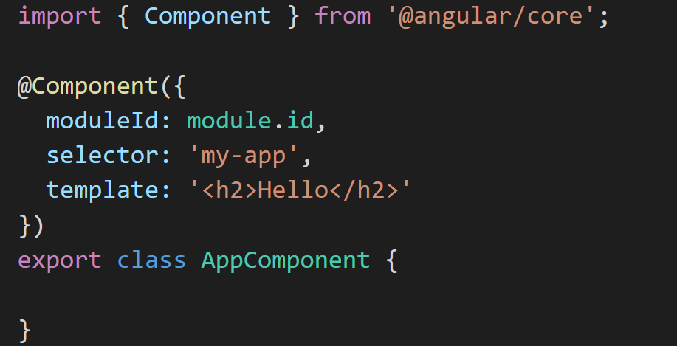
A Component in Angular 2 is a class with an @Component decorator.

Slide 31
How to instantiate the component?

Slide 32
Angular 2 Modules [ NgModule ]
An Angular Module is a class with an @NgModule decorator

Slide 33
An Angular Module is a class with an @NgModule decorator
@NgModule takes a metadata object that tells Angular how to compile and run module code. It identifies the module's own components, directives and pipes,
making some of them public so external components can use them

Slide 34
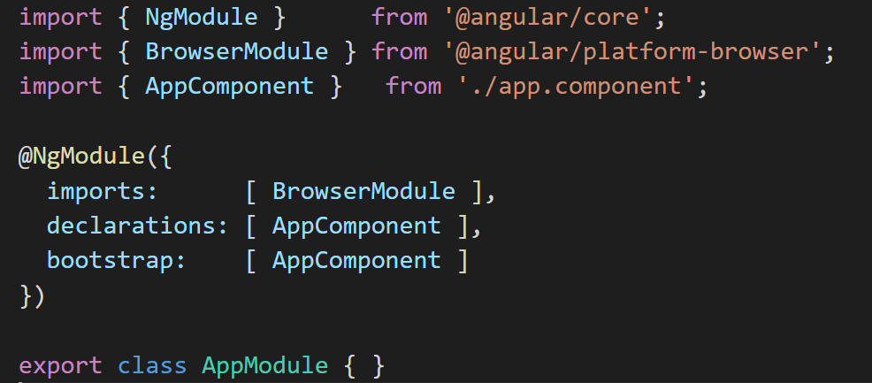
Root Module [ app.module.ts ]

Slide 35
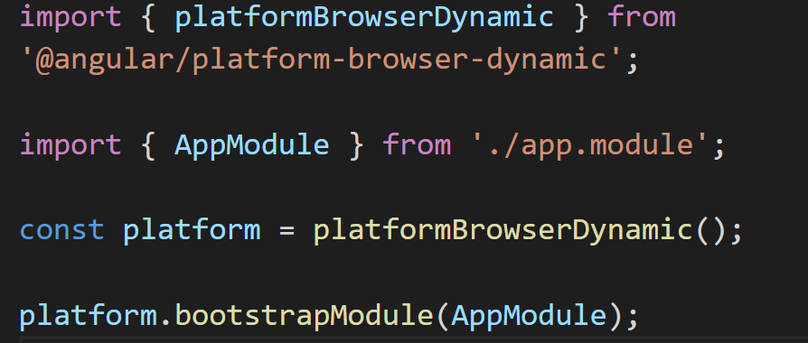

Slide 36
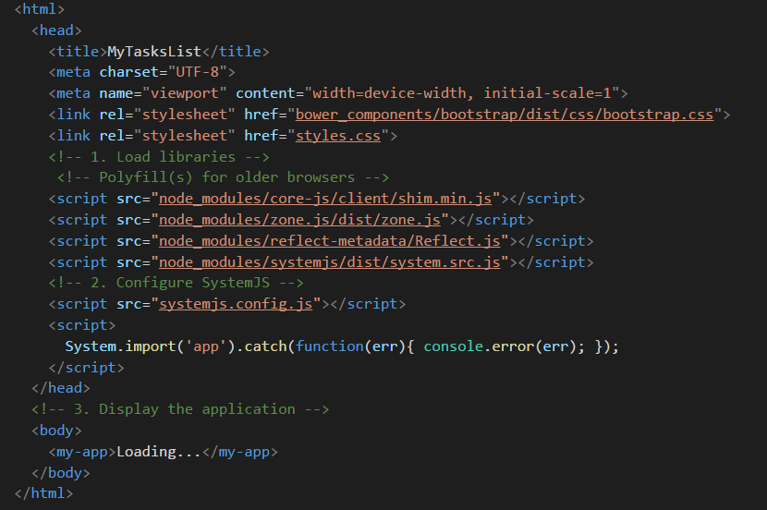

Slide 37
What will be displayed in the Browser ?
Hello

Slide 38


Slide 39
Displaying Data ?

Slide 40
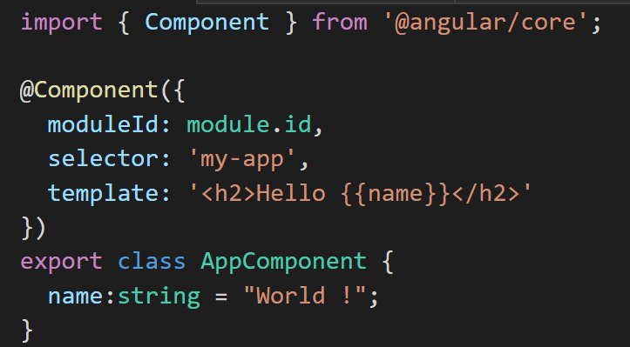
Angular automatically pulls the value of the "name" property
from the component and inserts the value into the browser.
Angular updates the display when the property change.

Slide 41
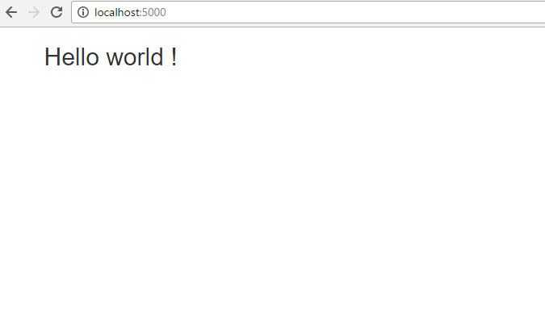

Slide 42
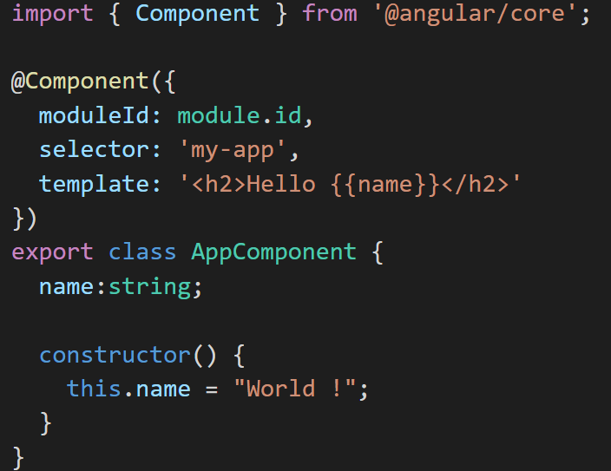

Slide 43
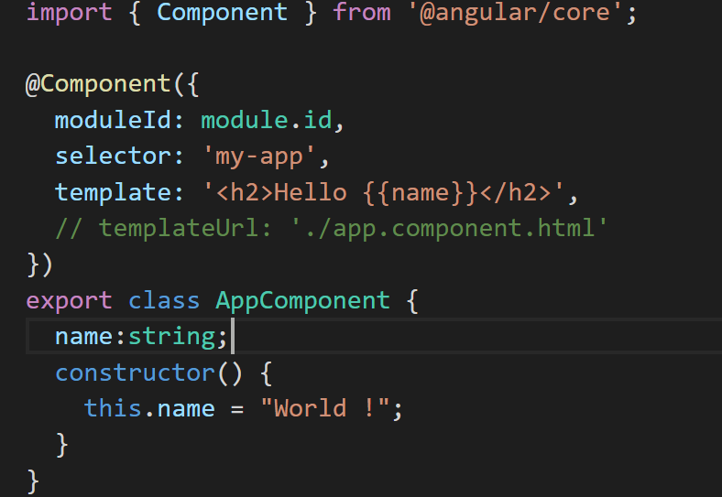
Template inline or template file?

Slide 44
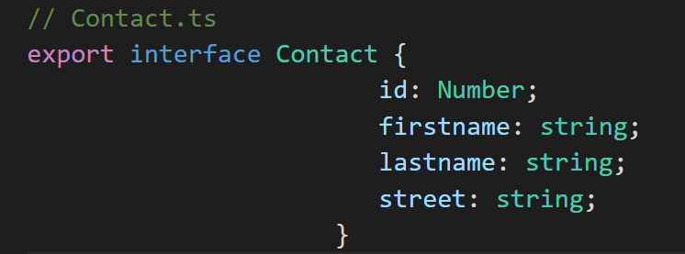

Slide 45
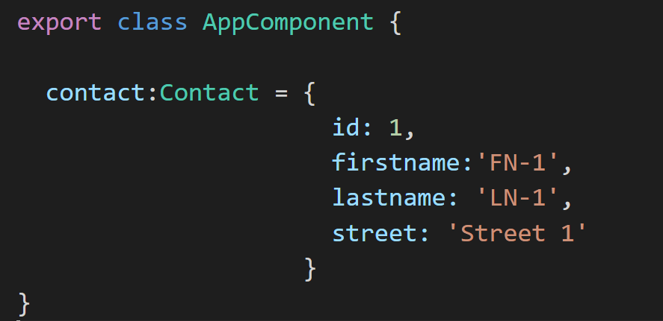

Slide 46
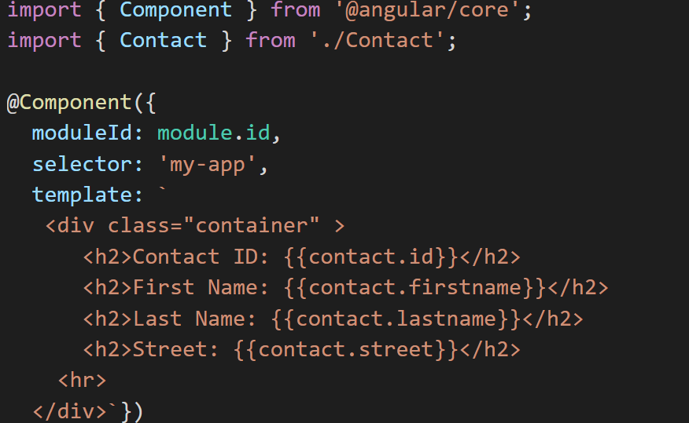

Slide 47
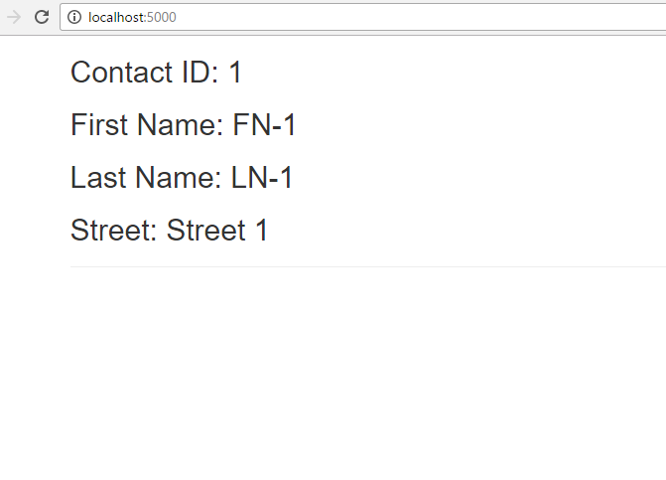

Slide 48
Using Directives [ *ngFor and *ngIf ]

Slide 49
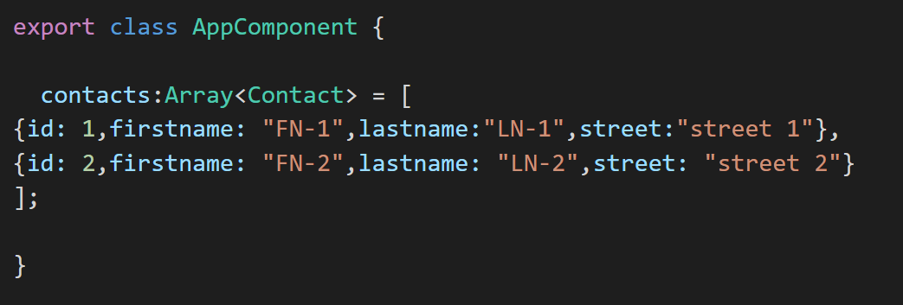

Slide 50
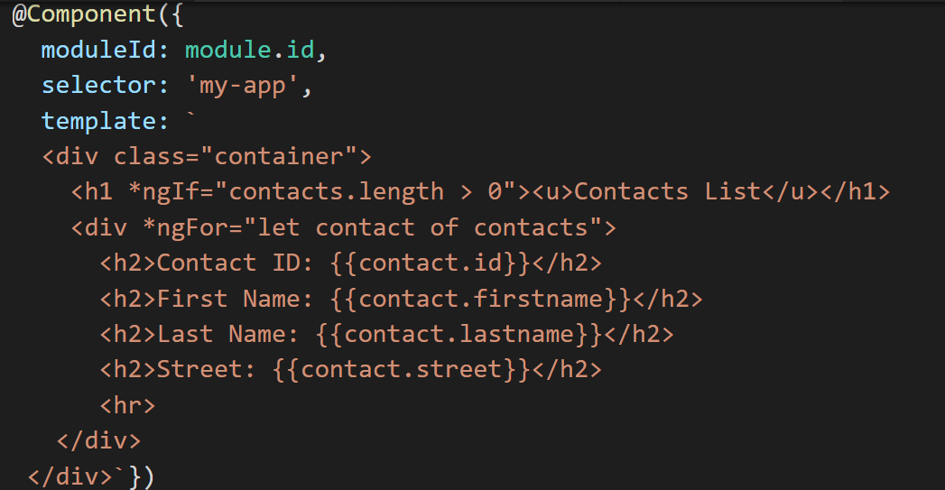

Slide 51
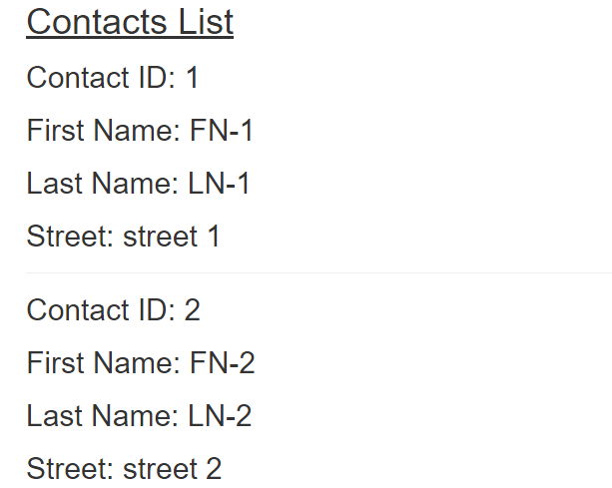

Slide 52
DOM Events
User actions such as clicking a link, pushing a button, and entering text raise DOM events.

Slide 53
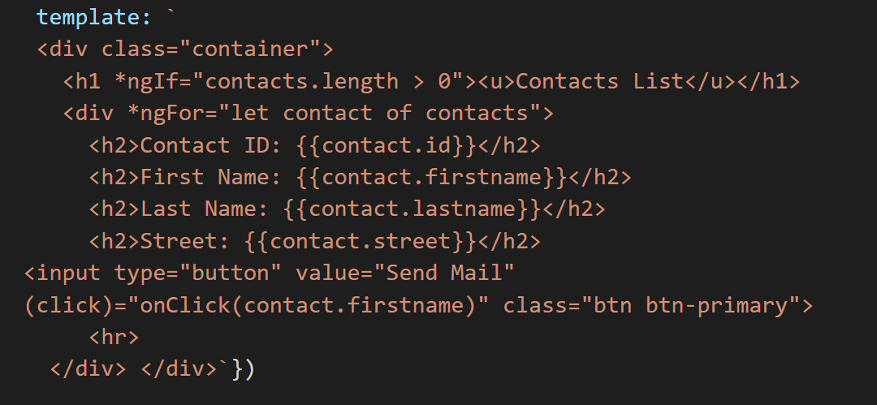

Slide 54
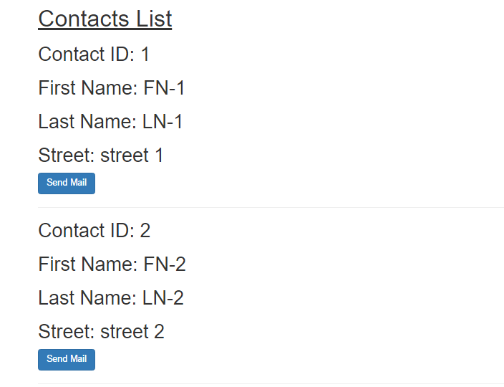

Slide 55
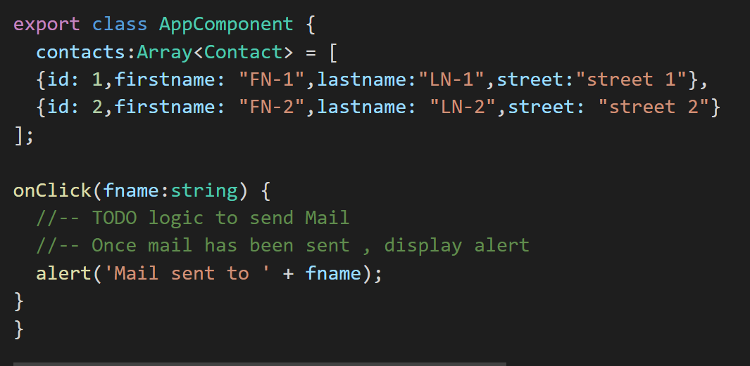

Slide 57
Nested Components

Slide 58
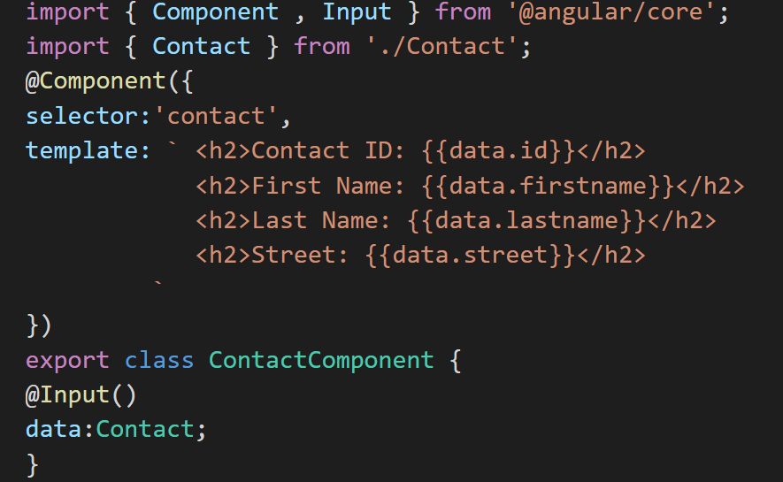

Slide 59
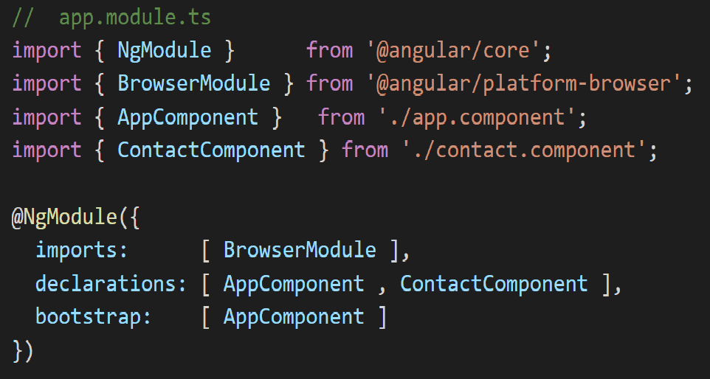

Slide 60
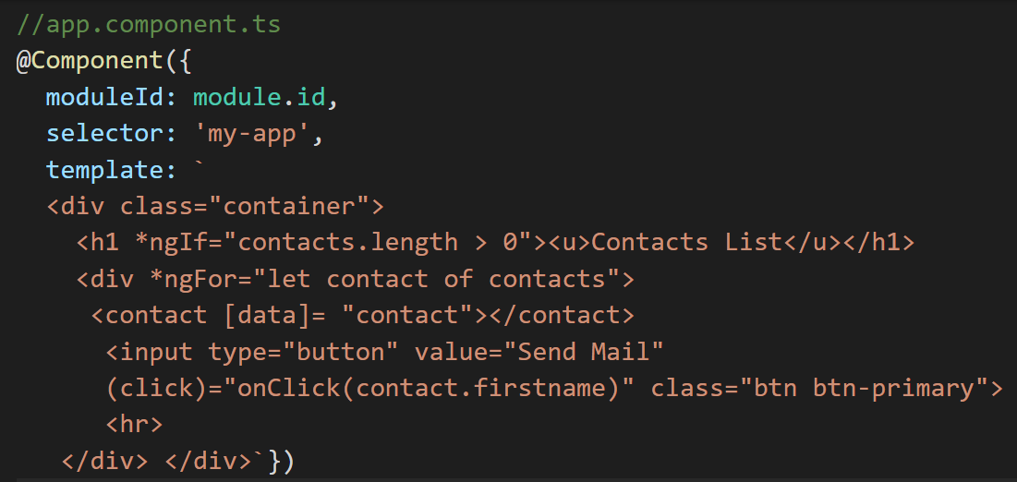

Slide 61
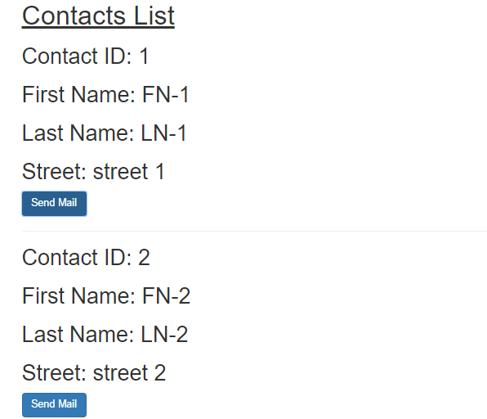

Slide 62
Services
Services in Angular 2 are simply ES2015 classes.

Slide 63
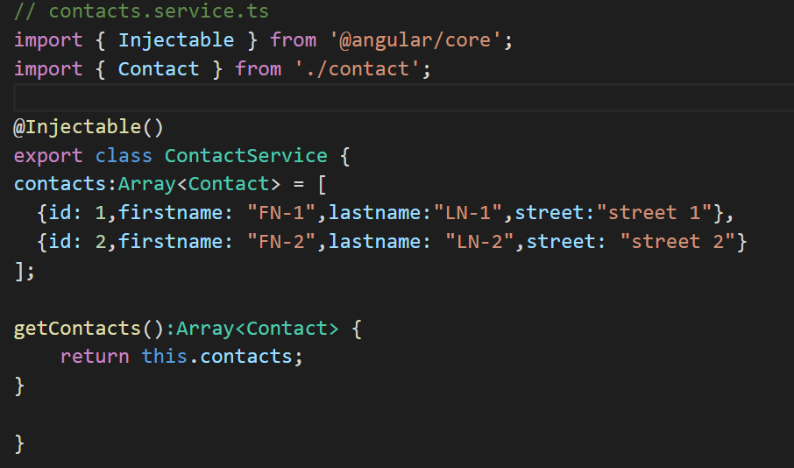

Slide 64
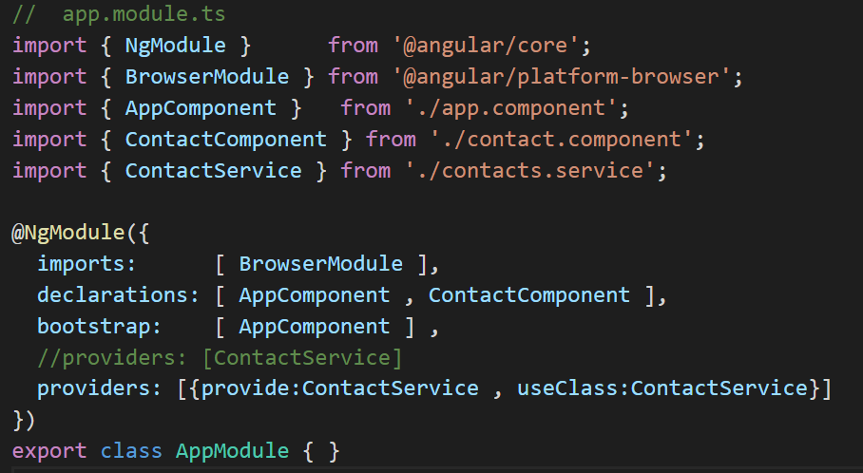

Slide 65
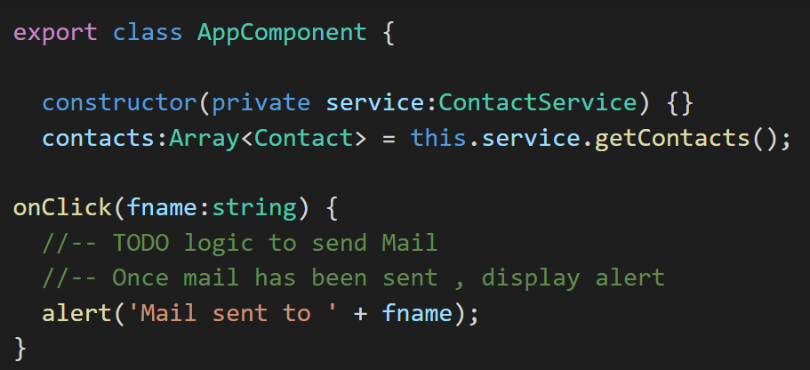

Slide 67
Navigation and Routing

Slide 68
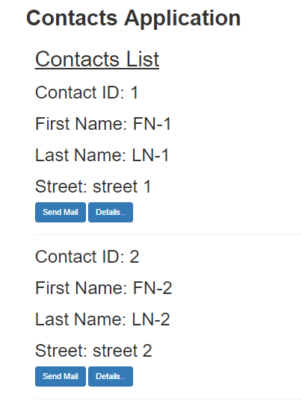
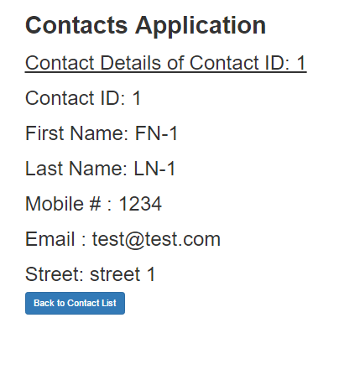

Slide 69
What components do we have ?
AppComponent – The root component. ContactListComponent – A component to list all contacts ContactDetailComponent - A component to show a contact’s details

Slide 70
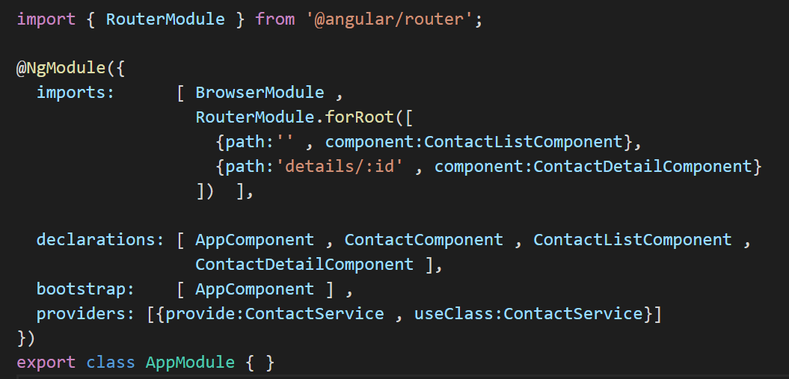

Slide 71
http://localhost:5000
http://localhost:5000/details/1

Slide 72
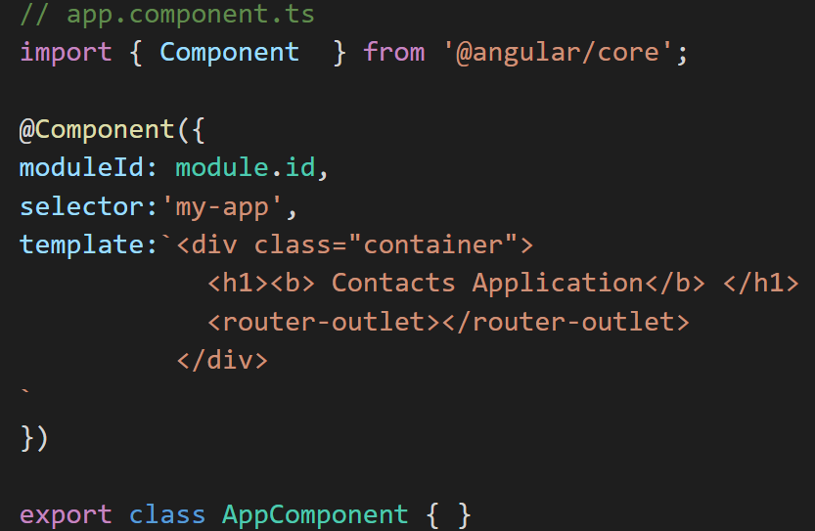

Slide 74
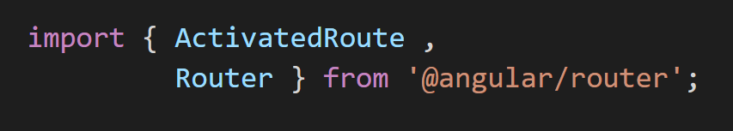

Slide 75
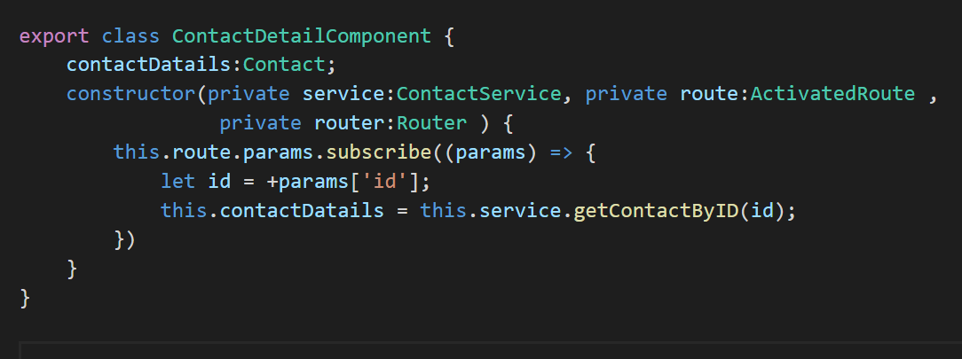

Slide 76
Forms

