Slide 1
Advanced programming

Slide 2
Aims
Understanding the role of servlets
Building Web pages dynamically
Looking at servlet code
Evaluating servlets vs. other technologies
Understanding the role of JSP
Understanding JavaBeans
Comparing JavaBeans to Enterprise JavaBeans

Slide 3
Introduction
Servlets are Java programs
Run on
Web servers
Application servers
Act as a middle layer between requests coming from clients and databases or applications on the HTTP server.
A client could be :
A Web browser
Other HTTP client
Their job is to perform the following tasks, as illustrated in Figure 1

Slide 4
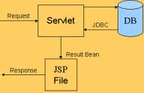
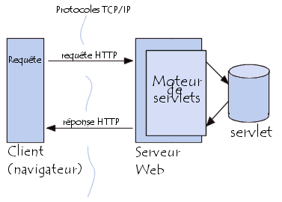
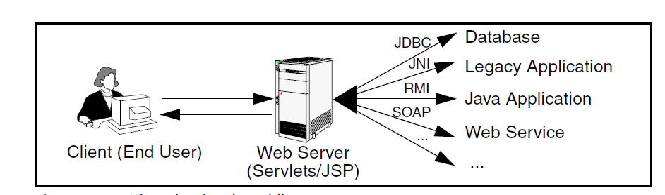

Slide 5
Steps description
1. Read the explicit data sent by the client.
From an HTML form on a Web page.
From an applet
From a custom HTTP client program.
2. Read the implicit HTTP request data sent by the browser.
HTTP information includes :
cookies,
information about media types and compression schemes the browser understands, etc

Slide 6
3. Generate the results.
By talking to a database (browser can’t talk directly to the database or for security reasons)
Executing an RMI or EJB call,
Invoking a Web service,
Computing the response directly.
So the Web middle layer extracts the incoming data from the HTTP stream, talk to the application and embed the results inside a document.
4. Send the explicit data (i.e., the document) to the client.
This document can be sent in a variety of formats :
Text (HTML (is by far the most common format)
Text (XML),
Binary (GIF images),
A compressed format like gzip that is layered on top of some other underlying format.
An important servlet/JSP task is to wrap the results inside of HTML.

Slide 7
5. Send the implicit HTTP response data.
There are really two varieties of data sent:
The document itself
HTTP information (Cookies, Caching parameters, etc)

Slide 8





Four Points for Servlets
It is regular Java code. There are new APIs, but no new syntax.
It has unfamiliar import statements. The servlet and JSP APIs are
not part of J2SE; they are a separate specification (and are also part of the J2EE).
It overrides the doGet method. Servlets have different methods to respond to different types of HTTP commands.
It extends a standard class (HttpServlet). Servlets provide a rich
infrastructure for dealing with HTTP.

Slide 9
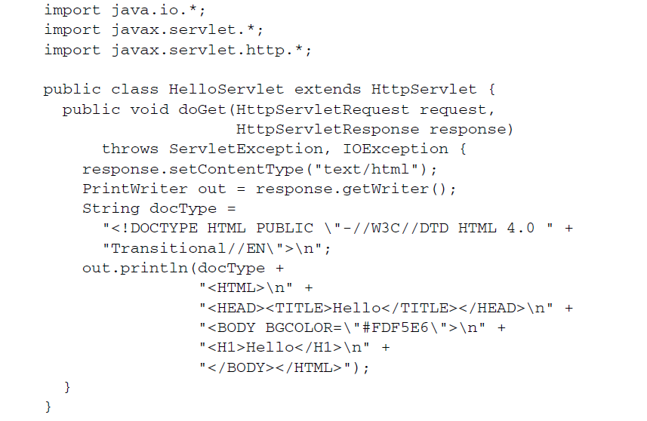
Sample servlet code

Slide 10
Main methods
doDelete(HttpServletRequest req, HttpServletResponse resp),
doGet(HttpServletRequest req, HttpServletResponse resp), qui traite les requêtes HTTP GET. Cette méthode traite également les requêtes de type HEAD, qui renvoient uniquement l'en-tête de la réponse. Les requêtes de type HEAD peuvent être utilisées par les navigateurs pour déterminer si les données qu'ils détiennent sont à jour ou non.
doOptions(HttpServletRequest req, HttpServletResponse resp), qui traite les requêtes HTTP OPTIONS.
doPost(HttpServletRequest req, HttpServletResponse resp), qui traite les requêtes HTTP POST.
doPut(HttpServletRequest req, HttpServletResponse resp), qui traite les requêtes HTTP PUT.
doTrace(HttpServletRequest req, HttpServletResponse resp), qui traite les requêtes HTTP TRACE.
getLastModified(HttpServletRequest req), qui renvoie la date et l'heure de la dernière modification de l'objet req, permettant ainsi à un navigateur de savoir si l'objet qu'il possède en cache est à jour ou non.
service(HttpServletRequest req, HttpServletResponse resp), qui reçoit les requêtes HTTP et les distribue aux méthodes intéressées, en fonction de leur type.

Slide 11
JSPs
JSP | Servlet
HTML pages with Java code embedded inside of them. A normal HTML page | Java programs with HTML embedded inside of them. A regular Java class
A JSP document is just another way of writing a servlet
JSP pages get translated into servlets, the servlets get compiled, and it is the servlets that run at request time.

Slide 12
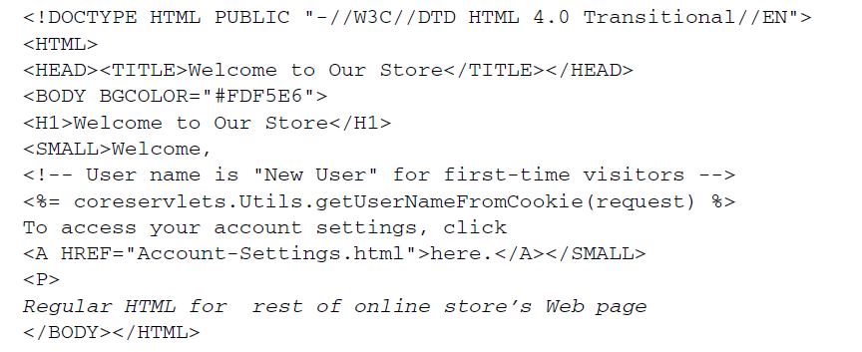
A JSP page

Slide 13
User Inputs and Form Data
URLs like http://host/path?user=Marty+Hall&origin=bwi&dest=sfo.
The part after the question mark is known as form data (or query data) and is the most common way to get information from a Web page to a server-side program.
Form data can be attached to the end of the URL after a question mark (as above) for GET requests; form data can also be sent to the server on a separate line for POST requests.
Example:
<FORM ACTION="...">...</FORM>
If ACTION is omitted, the data is submitted to the URL of the current page.
Input elements to collect user data :
<INPUT TYPE="TEXT" NAME="...">
A submit button
<INPUT TYPE="SUBMIT">
When the button is pressed, the URL designated by the form’s ACTION is invoked.
With GET requests, a question mark and name/value pairs are attached to the end of the URL, where the names come from the NAME attributes in the HTML input elements and the values come from the end user.
With POST requests, the same data is sent, but on a separate request line instead of attached to the URL.

Slide 14
Reading Form Data from Servlets
request.getParameter to get the value of a form parameter
request.getParameterValues if the parameter appears more than once,
request.getParameterNames if you want a complete list of all parameters in the current request.
Reading Single Values: getParameter
To read a request (form) parameter, you simply call the getParameter method of HttpServletRequest, supplying the case-sensitive parameter name as an argument.
You supply the parameter name exactly as it appeared in the HTML source code, and you get the result exactly as the end user entered it; any necessary URL-decoding is done automatically.
Unlike the case with many alternatives to servlet technology, you use getParameter exactly the same way when the data is sent by GET (i.e., from within the doGet method) as you do when it is sent by POST (i.e., from within doPost); the servlet knows which request method the client used and automatically uses the appropriate method to read the data.
An empty String is returned if the parameter exists but has no value, and null is returned if there was no such parameter.
Parameter names are case sensitive so, for example, request.getParameter("Param1") and request.getParameter("param1") are not interchangeable.
Looking Up Parameter Names: getParameterNames and getParameterMap
Note that Enumeration is an interface that merely guarantees that the actual class will have hasMoreElements and nextElement methods: there is no guarantee that any particular underlying data structure will be used. And, since some common data structures (hash tables, in particular) scramble the order of the elements, you should not count on getParameterNames returning the parameters in the order in which they appeared in the HTML form.

Slide 15
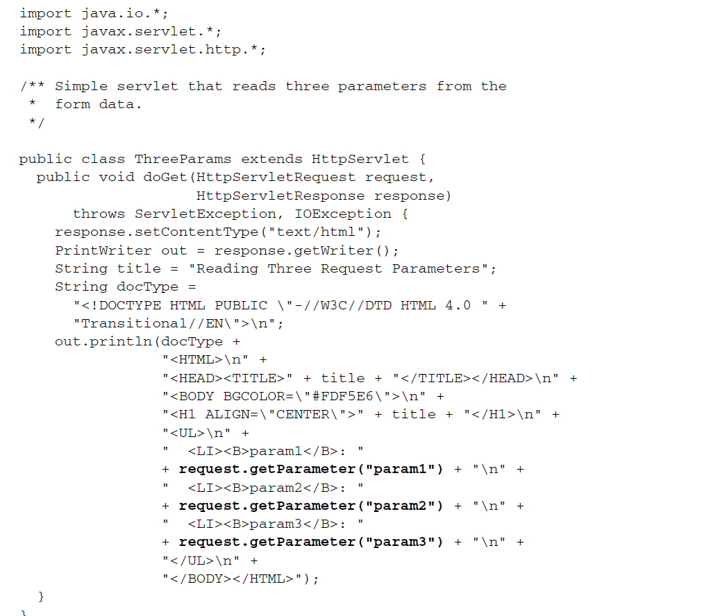

Slide 16
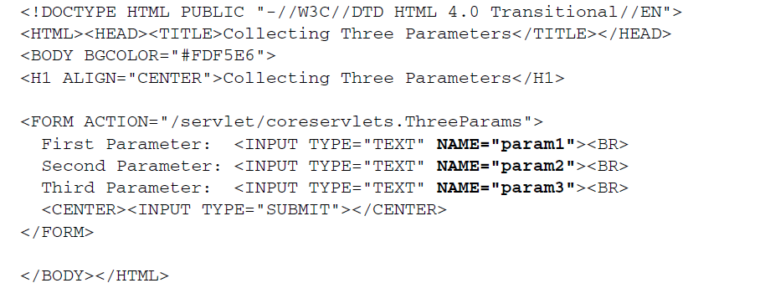

Slide 17
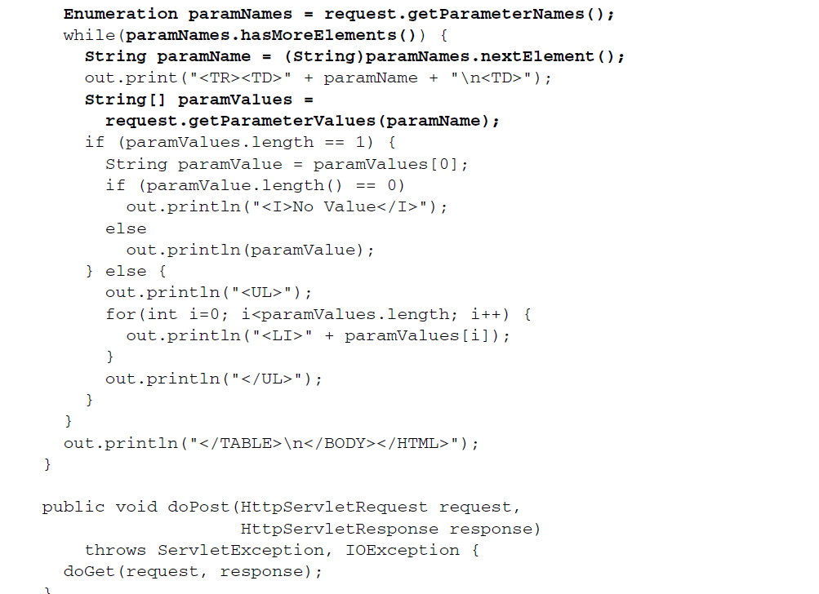

Slide 19
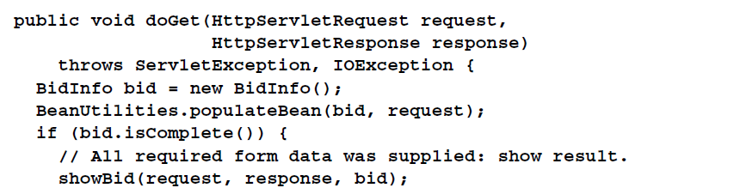
Automatically Populating Java Objects from RequestParameters: FormBeans
It is possible, in JSP, to use the JavaBeans component architecture to greatly simplify the process of reading request parameters, parsing the values, and storing the results in Java objects.
An ordinary Java object is considered to be a bean if the class uses private fields and has methods that follow the get/set naming convention.
The names of the methods (minus the word “get” or “set” and with the first character in lower case) are called properties. For example, an arbitrary Java class with a getName and setName method is said to define a bean that has a property called name.

Slide 20
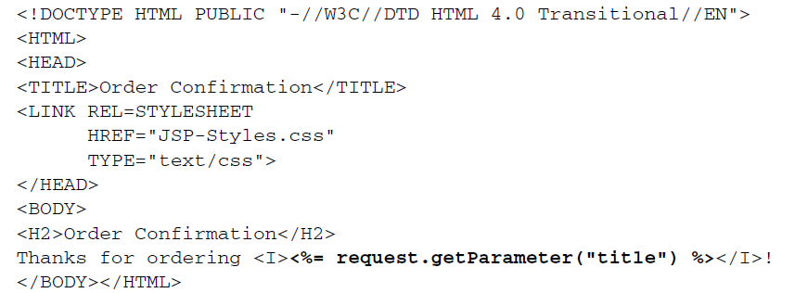
JSP
JavaServer Pages (JSP) technology enables you to mix regular, static HTML with dynamically generated content. You simply write the regular HTML in the normal manner, using familiar Web-page-building tools.
You then enclose the code for the dynamic parts in special tags, most of which start with <% and end with %>.

Slide 21
JSP syntax
Types of JSP Scripting Elements
JSP scripting elements let you insert Java code into the servlet that will be generated from the JSP page.
There are three forms:
Expressions of the form <%= Java Expression %>, which are evaluated and inserted into the servlet’s output.
Scriptlets of the form <% Java Code %>, which are inserted into the servlet’s _jspService method (called by service).
3. Declarations of the form <%! Field/Method Declaration %>, which
are inserted into the body of the servlet class, outside any existing methods.

Slide 22
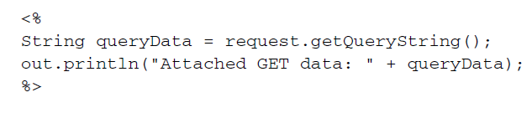
JSP syntax
JSP Expression
Example:
<%= Java Value %> Current time: <%= new java.util.Date() %>
JSP Scriptlet
Example:
<% Java Statement %>
JSP Declaration
Examples:
<%! Field Definition %>
<%! Method Definition %>
JSP Directive
Description:
High-level information about the structure of the servlet code (page), code that is included at page-translation time (include), or custom tag libraries used (taglib)

Slide 23
JSP Directives
A JSP directive affects the overall structure of the servlet that results from the JSP page.
The following templates show the two possible forms for directives :
<%@ directive attribute="value" %>
<%@ directive attribute1="value1"
attribute2="value2"
...
attributeN="valueN" %>
In JSP, there are three main types of directives:
Page : controls the structure of the servlet by importing classes, customizing the servlet superclass, setting the content type, and the like
Include : inserts a file into the JSP page at thetime the JSP file is translated into a servlet
Taglib : defines custom markup tags

Slide 24
The page directive
To define one or more of the following case-sensitive attributes :
import,
contentType,
pageEncoding,
session,
isELIgnored (JSP 2.0 only),
buffer,
autoFlush,
info,
errorPage,
isErrorPage,
isThreadSafe,
language,
extends

Slide 25
The import attribute of the page directive allows specifying the packages that should be imported by the servlet into which the JSP page gets translated.
Using utility classes ➔ they should always be in packages.
By default, the servlet imports java.lang.*, javax.servlet.*, javax.servlet.jsp.*, javax.servlet.http.*, and possibly some number of server-specific entries.
Never write JSP code that relies on any server-specific classes being imported automatically; doing so makes your code nonportable.
Use of the import attribute takes one of the following two forms:
<%@ page import="package.class" %>
<%@ page import="package.class1,...,package.classN" %>
Example :
<%@ page import="java.util.*" %>
The import attribute is the only page attribute that is allowed to appear multiple times within the same document.
The page uses three classes:
<%@ page import="java.util.*,coreservlets.*" %>

Slide 26
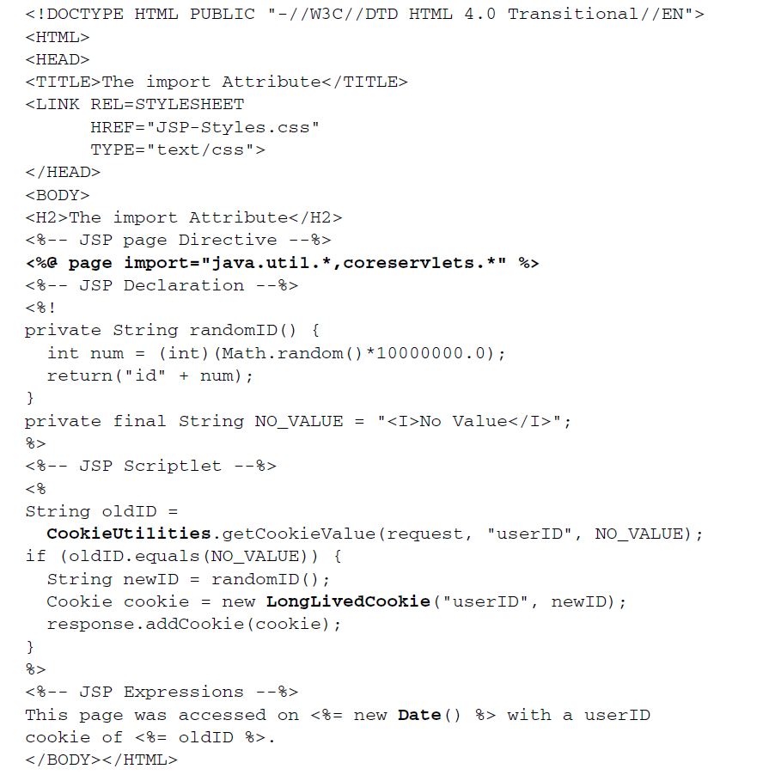

Slide 27
The contentType attribute sets the Content-Type response header, indicating the MIME type of the document being sent to the client.
Use of the contentType attribute takes one of the following two forms:
<%@ page contentType="MIME-Type" %>
<%@ page contentType="MIME-Type; charset=Character-Set" %>

Slide 28
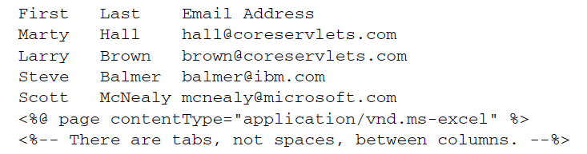
For example, the directive
<%@ page contentType="application/vnd.ms-excel" %> has the same basic effect as the scriptlet
<% response.setContentType("application/vnd.ms-excel"); %>
Unlike regular servlets, for which the default MIME type is text/plain, the default for JSP pages is text/html (with a default character set of ISO-8859-1).
<%@ page contentType="someMimeType; charset=someCharacterSet" %>
only want to change the character set
For example, Japanese JSP pages might use the following
<%@ page pageEncoding="Shift_JIS" %>
Generating Excel:

Slide 29
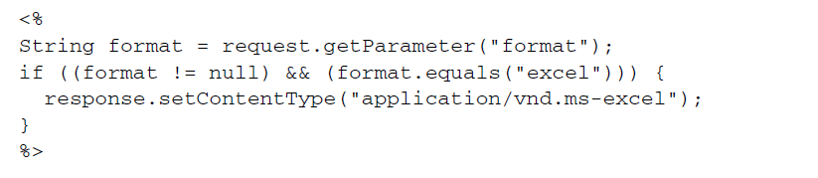
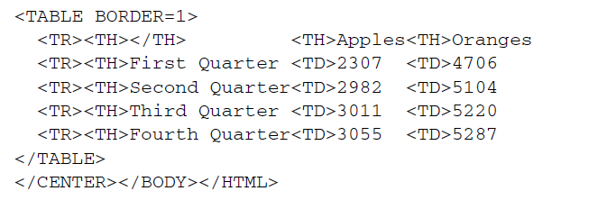

Slide 30
Example:
<%@ directive att="val" %>
JSP Action
Description:
Action that takes place when the page is requested
Example:
jsp:include
jsp:useBean
jsp:invoke
JSP Expression Language Element
Description:
Shorthand JSP expression
Example:
${ EL Expression }

Slide 31
Custom Tag (Custom Action)
Description:
Invocation of custom tag
Example:
<prefix:name>
Body
</prefix:name>
Escaped Template Text
Description:
Text that would otherwise be interpreted specially. Slash is removed and remaining text is sent to the client
Examples:
<\%
%\>

Slide 32
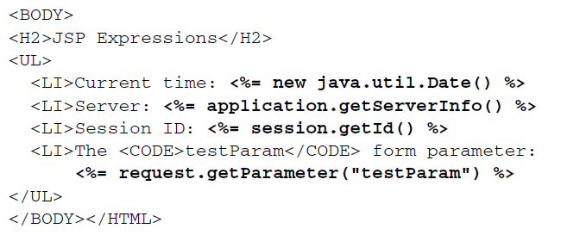

Slide 33
The extends attribute designates the superclass of the servlet that will be generated for the JSP page. It takes the following form.
<%@ page extends="package.class" %>
XML Syntax for Directives
If you are writing XML-compatible JSP pages, you can use an alternative XML-compatible syntax for directives as long as you don’t mix the XML syntax and the classic syntax in the same page.
These constructs take the following form:
<jsp:directive.directiveType attribute="value" />
For example, the XML equivalent of
<%@ page import="java.util.*" %>
is
<jsp:directive.page import="java.util.*" />

Slide 34
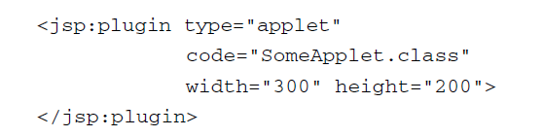
Including external pieces into a JSP document
Three main capabilities :
The jsp:include action:
Includes the output of a page at request time.
The include directive:
Inserts JSP code into the main page before that main page is translated into a servlet. Its main advantage is that it is powerful: the included code can contain JSP constructs such as field definitions and content-type settings that affect the main page as a whole
The jsp:plugin action:
The jsp:plugin element is used to insert applets that use the Java Plug-in into JSP pages.

Slide 35
Forwarding Requests with jsp:forward
jsp:include is used to combine output from the main page and the auxiliary page.
Instead, jsp:forward is used to obtain the complete output from the auxiliary page.
Example:
<% String destination;
if (Math.random() > 0.5) {
destination = "/examples/page1.jsp";
} else {
destination = "/examples/page2.jsp";
}
%>
<jsp:forward page="<%= destination %>" />

Slide 36
USING JAVABEANS COMPONENTS IN JSP DOCUMENTS
Beans are merely regular Java classes that follow some simple conventions defined by the JavaBeans specification (a standard format); beans extend no particular class, are in no particular package, and use no particular interface.
Advantages :
No Java syntax: By using beans, page authors can manipulate Java objects using only XML-compatible syntax: no parentheses, semicolons, or curly braces. This promotes a stronger separation between the content and the presentation and is especially useful in large development teams that have separate Web and Java developers.
2. Simpler object sharing : When you use the JSP bean constructs, you can much more easily share objects among multiple pages or between requests than if you use the equivalent explicit Java code.
3. Convenient correspondence between request parameters and object properties. The JSP bean constructs greatly simplify the process of reading request parameters, converting from strings, and putting the results inside objects.

Slide 37
Rules for developping beans
A bean class must have a zero-argument (default) constructor
A bean class should have no public instance variables (fields) (use of accessor Methods)
Persistent values should be accessed through methods called getXxx and setXxx:
Standard JSP actions for accessing beans can only make use of methods that use the getXxx/setXxx or isXxx/ setXxx naming convention.

Slide 38
Using Beans: Basic Tasks
Three main constructs to build and manipulate JavaBeans components in JSP pages:
• jsp:useBean. In the simplest case, this element builds a new bean.
It is normally used as follows:
<jsp:useBean id="beanName“ class="package.Class" />
This statement usually means “instantiate an object of the class specified by
Class, and bind it to a variable in _jspService with the name specified by id.”
Note, however, that you use the fully qualified class name—the class name with packages included. This requirement holds true regardless of whether you use <%@ page import... %> to import packages.
• jsp:getProperty. This element reads and outputs the value of a bean property. Reading a property is a shorthand notation for calling a method of the form getXxx.
This element is used as follows:
<jsp:getProperty name="beanName“ property="propertyName" />
• jsp:setProperty. This element modifies a bean property (i.e., calls a method of the form setXxx).
It is normally used as follows:
<jsp:setProperty name="beanName“ property="propertyName“ value="propertyValue" />
The following subsections give details on these elements.

Slide 39

jsp:useBean Options:
scope: associates the bean with more than just the current page
beanName: attribute passed to instantiate method of java.beans.Bean instead of class attribute
Type : to precise the super class of the object
Accessing Bean Properties:
jsp:getProperty
Once you have a bean, you can output its properties with jsp:getProperty, which takes a name attribute that should match the id given in jsp:useBean and a property attribute that names the property of interest.

Slide 40
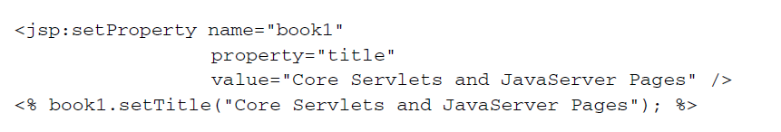
Setting Simple Bean Properties: jsp:setProperty
To modify bean properties, you normally use jsp:setProperty.
This action has several different forms, but with the simplest form you supply three attributes: name (which should match the id given by jsp:useBean), property (the name of the property to change), and value (the new value).

Slide 41
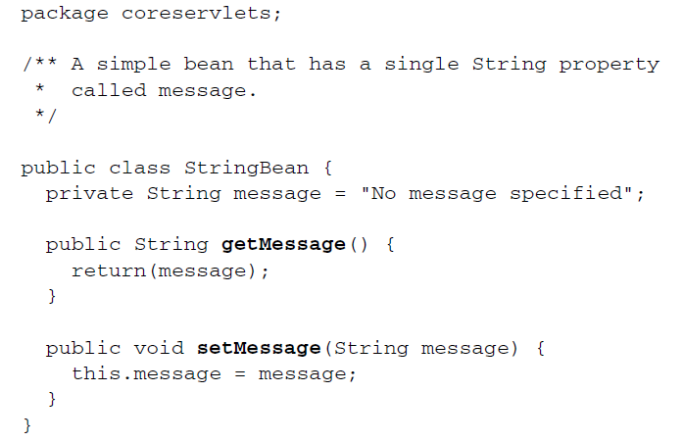

Slide 42
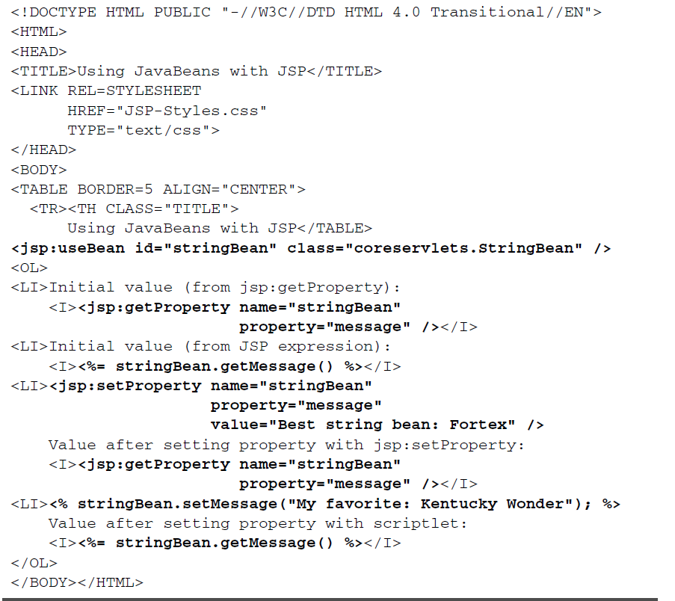

Slide 43
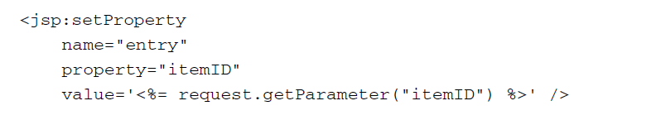

Slide 44
JavaBeans vs. Enterprise JavaBeans
JavaBeans has been at the center of many new paradigms and technologies that have emerged since its inception.
Among emerging technologies, Enterprise JavaBeans has generated tremendous interest in the business computing community.
However, a common misconception is that an Enterprise JavaBean is an extension of a "plain vanilla" JavaBean with enterprise functionality. While both JavaBeans and Enterprise JavaBeans are software component models, their purpose is different:
A JavaBean is a general-purpose component model,
whereas EJB, as the name suggests, is a component model that is enterprise specific.
Even though these models have entirely different architectures, they adhere to certain underlying principles that generally govern a software component model.
We'll use these principles and the basic characteristics of software components to compare JavaBeans and Enterprise JavaBeans.

Slide 45
Basic characteristics of software components
Goals The underlying theme of both JavaBeans and Enterprise JavaBeans is, as Sun puts it, "Write once, run anywhere" (WORA).
Accordingly, the primary objective of both models is to ensure :
portability,
reusability of Java software components.
Interoperability

Slide 46
JB | EJB
Low-level approach to developing reusable software components. Vendors offer JavaBeans in a variety of fields. Some JavaBeans may be common to multiple fields Example : A chart bean. | High-level approach to building distributed systems. Programming only the business logic. Transactional behavior, security, connection pooling, networking or threading are delegated to the server vendor.
It is a reusable software component that can be visually manipulated in a builder tool (to assemble applications by visually connecting beans or customize beans visually). JavaBeans are saved as serialized prototypes (.ser files). They are instantiated differently, though, as saved beans have to be resurrected from their serialized prototypes. | EJBs are reusable server-side software components. EJBs facilitate the development of distributed Java applications, providing an object-oriented transactional environment for building distributed, multitier enterprise components. An EJB is a remote object, which needs the services of an EJB container in which to execute.

Slide 47
JB | EJB
In the JavaBean model (Architecture), the structure and behavior of a bean is described by three basic features: properties (attributes), methods (behavior) and events. Events serve two purposes : Bean connection: When a bean is running in a builder tool, events enable visual connection. Notification: When a bean is running in an application, events notify occurrences and pass data from source to target. When a bean is inserted in a visual builder tool, its exposed properties, methods and events are discovered through the twofold process called introspection, which involves: Discovery from the explicit information, which is provided by the bean provider through a bean-specific class called BeanInfo. | The Enterprise JavaBeans spec defines a server component model and specifies how to create server-side, scalable, transactional, multiuser and secure enterprise-level components. A typical EJB architecture consists of: An EJB server EJB containers that run on these servers Home objects, remote EJB objects and Enterprise beans that run in these containers EJB clients Other auxiliary systems like the Java Naming and Directory Interface (JNDI), the Java Transaction Service (JTS) and Security services Unlike JavaBeans that use introspection, the EJB container uses the EJBMetaData class to query an EJB for its metadata at any given time.

Slide 48
EJB solution advantages
EJB gives developers architectural independence.
EJB is WORA for server-side components.
EJB establishes roles for application development.
EJB takes care of transaction management.
EJB provides distributed transaction support.
EJB helps create portable and scalable solutions.
EJB integrates seamlessly with CORBA.
EJB provides for vendor-specific enhancements.

Slide 49
APIs for development, execution and deployment
JB | EJB
java.beans: java.beans package, includes classes and interfaces needed for both bean providers and visual builder tools. java.beans.beancontext: The APIs from "The Extensible Runtime Containment and Services Protocol" spec are implemented in the java.beans.beancontext package (Java 2), which includes classes and interfaces for implementing bean context services, bean contexts and bean context children. | javax.ejb: The APIs defined in the Enterprise JavaBeans specs are included in the javax.ejb package, which is a Java standard extension. In addition to this, EJB relies on the APIs defined for the Java Transaction API (JTA), the Java Transaction Service (JTS) and the Java Naming and Directory Interface (JNDI).

Slide 50
Bean Characteristics Structure and Behavior
JB | EJB
A Bean’s class, can encapsulate any functionality. It needs to implement the serializable or externalizable interface either directly or through inheritance. Even though a single class identifies a bean, its functionality can be spread over many classes through inheritance and delegation. An important restriction on the bean class is that it should have a no-argument constructor. For the properties, methods and events to be discovered through introspection, the related methods have to follow certain signatures and naming conventions specified in the JavaBeans specs. In addition, a bean provider can also furnish feature descriptors through a design-time-only class called BeanInfo, which is specific to a bean class. | An EJB typically encapsulates business logic that operates on data. An EJB's interface to the outside world is through its Home and Remote interfaces. While the Home interface defines a factory to create new beans and find existing beans, the Remote interface defines the business methods that the bean supports. Each packaged EJB is identified by its: Home interface Home object, Remote interface EJB object, Enterprise bean class implementation Deployment descriptors.

Slide 51
Visibility and types
JB | EJB
A bean can be visible, invisible or both. A Stopwatch bean, for instance, can have the GUI shown when it runs on the client side and turned off if it's running on the server side. Even if a bean is invisible, it can be customized, serialized and connected to other beans in visual builder tools. | An EJB is a nonvisual remote object that resides only on the server side
Beans that conform to JavaBeans 1.0 specs aren't typed. The Glasgow spec, however, allows two types of beans: Simple and Participant. A Simple bean isn't aware of its container, whereas a Participant bean actively participates in its container. A bean that conforms only to the original JavaBeans 1.0 specs falls under the Simple bean category. A Participant bean, however, conforms to "Extensible Runtime Containment and Services Protocol" specs in addition to the original bean specs. A Participant bean can also discover and utilize arbitrary services from its container. | There are two primary types of EJBs: Session and Entity beans. While an Entity bean has a unique identity defined by its primary key class, a Session bean has no unique identity. Multiple clients can thus share an Entity bean. A Session bean, on the other hand, is created, used and destroyed by the client that created it. Each bean has associated with it a context object (Session context or Entity context) for its lifetime. There are two types of Session beans: stateful and stateless. Similarly, there are two types of Entity beans: container-managed persistent entities and bean-managed persistent entities.

Slide 52
Persistence
JB | EJB
Beans are persistent. They are objects that can be saved and resurrected. Persistence is achieved by saving a bean's internal states through serialization. A resurrected serialized prototype of a bean can be included in an application. | Stateful Session beans may have internal states. Therefore, they need to handle activation and passivation. Passivation is the process by which the state of a bean is serialized out into secondary storage. Activation is the process by which it is deserialized from secondary storage. These types of EJBs can be serialized and restored across client sessions. To serialize, a call to the bean's getHandle() method returns a handle object. To restore, a call to the handle object's getEJBObject() method is used to return a bean reference. Entity beans are inherently persistent beans. There are two types of persistence in Entity Beans: Bean-managed persistence: Entity bean is directly responsible for saving its own state. The programmer has to hard-code persistence into the bean through explicit JDBC or embedded SQL calls. Container-managed persistence: The EJB container is responsible for saving the bean's state. The implementation is independent of the data source. The container-managed fields need to be specified in the deployment descriptor and the EJB container automatically handles persistence.

Slide 53
Customization
JB | EJB
Beans are visually customizable by editing their properties. (Visual builder tools typically present property sheets for this purpose). To generate property sheets, builder tools use introspection. The JavaBeans spec also provides an alternative to property sheets. It specifies an interface called Customizer to enable bean providers to build bean-specific customizers. Such a customizer can also be invoked at runtime. | EJB customization is a bit different from JavaBean customization. There's no concept of a property sheet or a custom-written customizer for an EJB. EJBs are customized using deployment descriptors, which define the contract between the ejb-jar provider and the EJB consumer. It captures the declarative information (information not included directly in the EJB code) that's intended for the consumer of the ejb-jar file. The two types of information in the deployment descriptors are the EJB's structural information and application assembly information. In EJB 1.1 XML is used to define the deployment descriptors. EJB vendors may provide tools that can be used by the ejb-jar provider to create deployment descriptors.

Slide 54
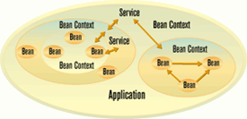
Containment and Nesting
JB | EJB
A bean can contain another bean. The original JavaBeans 1.0 specs didn't explicitly address containment-related issues. The Glasgow specification defines the notion of a logical bean container or BeanContext (see Figure 1). A child bean in a container can itself be a BeanContext, thus allowing nesting of beans. In a BeanContext child beans (Simple and Participant) can be dynamically added and removed. They can also access arbitrary services from the container. | EJBs always run within an EJB container. EJBs request different services from their containers and are aware of their environment. Containers can't contain other containers and therefore there's no concept of nesting in EJBs. Each EJB is associated with a context object (either a SessionContext or an EntityContext that provides information about the EJB). The context object is the component's handle on the container, through which the component can get transaction information, security information and information from the component's deployment descriptor. The EJB component calls into the Context object through the SessionContext or EntityContext interface.

Slide 55
Packaging and Deployment
JB | EJB
Beans are packaged in JAR files. The bean provider has to provide a manifest file with JavaBeans-related attributes in order to identify the bean class. A JAR file can hold more than one bean. However, the JAR entry for each bean class should have the Java-Bean attribute set to true. Example: Name: Spreadsheet.class Java-Bean: True Two more JavaBean-related attributes are Depends-On and Design-Time-Only. A typical bean JAR file contains design-time and runtime bean classes, documentation, resources such as images, and sound files. | EJBs are also packaged in JAR files. To identify the EJB class, the bean provider has to provide a manifest file in which the jar-entry for the EJB class should have the Enterprise-JavaBean attribute set to true. Example: Name: ~gopalan/BankAccountDeployment.ser Enterprise-Bean: True

Slide 56
Application Assembly
JB | EJB
Applications could be composed by visually connecting beans in a builder tool or manually by writing connection programs. The application so developed can be an applet or a stand-alone application. Beans for an application need not come from the same vendor because beans can be developed independent of one another. As we alluded to before, events act as interfaces between beans. Bean connections are performed at design time and are unidirectional. The source bean fires an event and the target bean receives it. When the application assembler chooses a source bean for connection, the builder tool discovers through introspection the events fired by that bean. When the application assembler chooses a target bean for the selected source bean, the builder tool discovers the compatible methods in the target bean, again through introspection. | EJBs are assembled into larger deployable applications. The input of application assembly is one or more ejb-jar files produced by different providers. The output is one or more ejb-jar files that contain Enterprise beans with their assembly instructions. As we mentioned in the Customization section, the application assembly instructions have been inserted into the deployment descriptors. EJBs too can be developed independent of one another. Once an EJB's home and remote interfaces are known, you can use them to create or find them and to invoke methods on them.

Slide 57
Execution
JB | EJB
The execution phase consists of the instantiation and running of beans. Instantiation : Beans.intantiate() method. Running As mentioned earlier, a bean is like any other object when it's running in an application. Normally, methods in a bean aren't directly invoked from other beans. The bean connections determine what methods need to be invoked. Event adapters enable indirect method invocation. Beans can also be executed in a builder tool at design time. As mentioned before, an important requirement for a bean to run in a builder tool is for the bean class to have a constructor with no arguments. This is because the builder tool can't provide the constructor parameters. When there are many constructors, it can't decide which one to use. Java 2 has new Beans.instantiate() methods to facilitate the instantiation of applets and BeanContexts. | The EJB execution phase consists of locating, instantiating and running. Locating the EJB EJB clients locate the specific EJB container that contains the enterprise Bean through the JNDI. They then make use of the EJB container to invoke bean methods. Instantiating the EJBean Once EJB clients obtain a reference to the Home object, they can create the EJB by calling its create() method or find EJBs by calling its find methods. This creates the EJBObject and the EJB component inside the EJB container. Invoking Methods on the EJBean The EJB client can now use the remote object reference to invoke methods on the EJBean by invoking its remote methods, which form the business logic of the component. Example: // get the JNDI naming context Context initialCtx = new InitialContext (); // use the context to lookup the EJB Home interface AccountHome home=(AccountHome)initialCtx.lookup ("com/gopalan/Account"); // use the Home Interface to create a Session Bean object Account account = home.create (1234, "Athul", 1000671.54d); // invoke business methods account.credit (1000001.55d);

Slide 58
Transactions
JB :There is no explicit transactional support
EJB
Declarative transaction management: The EJB container vendor is required to provide transaction control. The EJB developer who is writing the business functionality needn't worry about starting and terminating transactions. However, for maximum flexibility, the EJB spec provides for declarative transaction management. Six declarative modes can be specified by the deployer: TX_NOT_SUPPORTED, TX_BEAN_MANAGED, TX_REQUIRED, TX_SUPPORTS, TX_REQUIRES_NEW, TX_MANDATORY. Distributed transactional support: EJB provides transparency for distributed transactions. This means that a client can begin a transaction and then invoke methods on EJBs present within two different servers running on different machines, platforms or JVMs. Methods in one EJB can call methods in the other EJB with the assurance that they'll execute in the same transaction context.

Slide 59
Security Services
JB : There are no special security APIs for JavaBeans
EJB
EJB provides authorization using the Java security model. EJB server implementations may choose to use connection-based authentication in which the client program establishes a connection to the EJB server. The client's identity is attached to the connection at connection establishment time. The EJB/CORBA mapping specifies that the CORBA principal propagation mechanism be used. This means that the client ORB adds the client's principal to each client request. The communication mechanism between the client and the server propagates the client's identity to the server. Security in EJB 1.1 is declaratively defined in the deployment descriptors and is role based.

Slide 60
Interoperability
JB | EJB
JavaBeans can interact with components built using other models, which includes the widely used Component Object Model (COM). Using The Beans-ActiveX Bridge, a bean can be converted to an ActiveX control. A converted ActiveX control can interoperate with other ActiveX controls in an ActiveX container. | While The EJB spec allows the EJB server vendors to use any communication protocol between the client and the server, The EJB/CORBA mapping document is prescriptive with respect to what goes on the wire. This allows both system-level and application –level interoperability between products from vendors who choose to implement the EJB/CORBA protocol as the underlying communication protocol. Java clients will optionally communicate with server components using IIOP. They'll have a choice of API's - either the Java RMI or the Java mapping of the CORBA IDL interface. Non-Java clients communicate with server components using IIOP and the appropriate language mapping. Clients wishing to use the COM+ protocol communicate with the server component through a COM-CORBA bridge. Also realize that the client of an EJB can itself be a server component (for instance, Java Server Pages or a servlet), so an HTTP-only Web client can use a servlet to make EJB invocations. An EJB can't be deployed as an ACtiveX control because those controls are intended to run at the desktop and EJB's are server-side components. CORBA-IIOP compatibility via the EJB-to-CORBA mapping is defined by the OMG. However, EJB components may be able to communicate with DCOM servers using a DCOM-CORBA bridge.

