Slide 1
CSH2D3 - Database System
Introduction – Database Architecture
16-21 Januari 2017

Slide 2
Introduction
Purpose of Database Systems
Database Users
Database Administrator

Slide 3
Database Management System (DBMS)
Collection of interrelated data
Set of programs to access the data
DBMS contains information about a particular enterprise
DBMS provides an environment that is both convenient and
efficient to use.
Database Applications:
Banking: all transactions
Airlines: reservations, schedules
Universities: registration, grades
Sales: customers, products, purchases
Manufacturing: production, inventory, orders, supply chain
Human resources: employee records, salaries, tax deductions
Databases touch all aspects of our lives

Slide 4
Purpose of Database System
In the early days, database applications were built on top of file systems
Drawbacks of using file systems to store data:
Data redundancy and inconsistency
Multiple file formats, duplication of information in different files
Difficulty in accessing data
Need to write a new program to carry out each new task
Data isolation — multiple files and formats
Integrity problems
Integrity constraints (e.g. account balance > 0) become part of program code
Hard to add new constraints or change existing ones

Slide 5
Purpose of Database Systems (Cont.)
Drawbacks of using file systems (cont.)
Atomicity of updates
Failures may leave database in an inconsistent state with partial updates carried out
E.g. transfer of funds from one account to another should either complete or not happen at all
Concurrent access by multiple users
Concurrent accessed needed for performance
Uncontrolled concurrent accesses can lead to inconsistencies
E.g. two people reading a balance and updating it at the same time
Security problems
Database systems offer solutions to all the above problems

Slide 6
Database Users
Users are differentiated by the way they expect to interact with the system
Application programmers – interact with system through DML calls
Sophisticated users – form requests in a database query language
Specialized users – write specialized database applications that do not fit into the traditional data processing framework
Naïve users – invoke one of the permanent application programs that have been written previously
E.g. people accessing database over the web, bank tellers, clerical staff

Slide 7
Database Administrator
Coordinates all the activities of the database system
Database administrator has a good understanding of the Enterprise’s information resources and needs.
Database administrator's duties include:
Schema definition
Storage structure and access method definition
Schema and physical organization modification
Granting user authority to access the database
Specifying integrity constraints
Acting as liaison with users
Monitoring performance and responding to changes in requirements

Slide 8
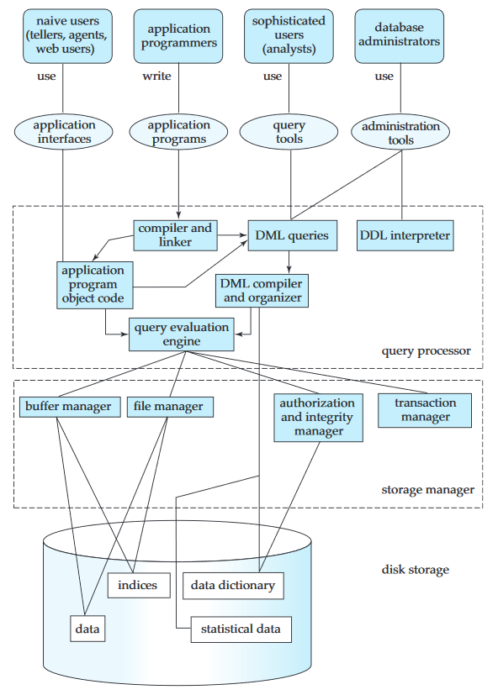
Overall System Structure

Slide 9
Query Processor
The query processor components include:
DDL interpreter, which interprets DDL statements and records the definitions in the data dictionary.
DML compiler, which translates DML statements in a query language into an evaluation plan consisting of low-level instructions that the query evaluation engine understands
A query can usually be translated into any of a number of alternative evaluation plans that all give the same result. The DML compiler also performs query optimization; that is, it picks the lowest cost evaluation plan from among the alternatives.
Query evaluation engine, which executes low-level instructions generated by the DML compiler

Slide 10
Storage Manager
Storage manager is the component of a database system that provides the interface between the low-level data stored in the database and the application programs and queries submitted to the system.
Storage manager is responsible for storing, retrieving, and updating data in the database.

Slide 11
Component of Storage Manager
Authorization and integrity manager, which tests for the satisfaction of integrity constraints and checks the authority of users to access data.
Transaction manager, which ensures that the database remains in a consistent (correct) state despite system failures, and that concurrent transaction executions proceed without conflicting.
File manager, which manages the allocation of space on disk storage and the data structures used to represent information stored on disk.
Buffer manager, which is responsible for fetching data from disk storage into main memory, and deciding what data to cache in main memory. The buffer manager is a critical part of the database system, since it enables the database to handle data sizes that are much larger than the size of main memory.

Slide 12
Disk Storage
The storage manager implements several data structures as part of the physical system implementation:
Data files, which store the database itself.
Data dictionary, which stores metadata about the structure of the database, in particular the schema of the database.
Indices, which can provide fast access to data items. Like the index in this textbook, a database index provides pointers to those data items that hold a particular value. For example, we could use an index to find the instructor record with a particular ID,or all instructor records with a particular name
Hashing is an alternative to indexing that is faster in some but not all cases.

Slide 13
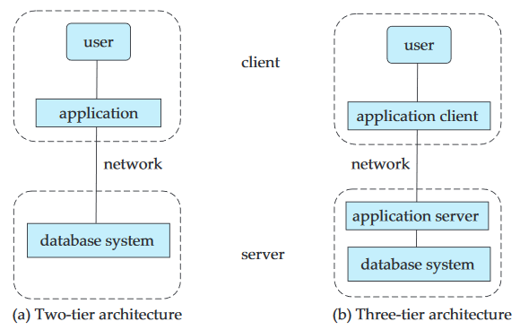
Two-tier and three-tier architecture
Database applications are usually partitioned into two or three parts, as follow:

Slide 14
Two-tier and three-tier architecture
In a two-tier architecture, the application resides at the client machine, where it invokes database system functionality at the server machine through query language statements. Application program interface standards like ODBC and JDBC are used for interaction between the client and the server.
In contrast, in a three-tier architecture, the client machine acts as merely a front end and does not contain any direct database calls. Instead, the client end communicates with an application server, usually through a forms interface.
The application server in turn communicates with a database system to access data. The business logic of the application, which says what actions to carry out under what conditions, is embedded in the application server, instead of being distributed across multiple clients. Three-tier applications are more appropriate for large applications, and for applications that run on the World Wide Web.

Slide 15
Database System Architecture
The architecture of a database system is greatly influenced by the underlying
computer system on which the database system runs.
Centralized Systems
Client--Server Systems
Parallel Systems
Distributed Systems
Network Types
Notes:
The architecture of a database system is greatly influenced by the underlying computer system on which the database system runs. Database systems can be
centralized, or client-server, where one server machine executes work on behalf of multiple client machines. Database systems can also be designed to exploit parallel computer architectures. Distributed databases span multiple geographically separated machines.

Slide 16
Centralized Systems
Run on a single computer system and do not interact with other computer systems.
General-purpose computer system: one to a few CPUs and a number of device controllers that are connected through a common bus that provides access to shared memory.
Single-user system (e.g., personal computer or workstation): desk-top unit, single user, usually has only one CPU and one or two hard disks; the OS may support only one user.
Multi-user system: more disks, more memory, multiple CPUs, and a multi-user OS. Serve a large number of users who are connected to the system vie terminals. Often called server systems.

Slide 17
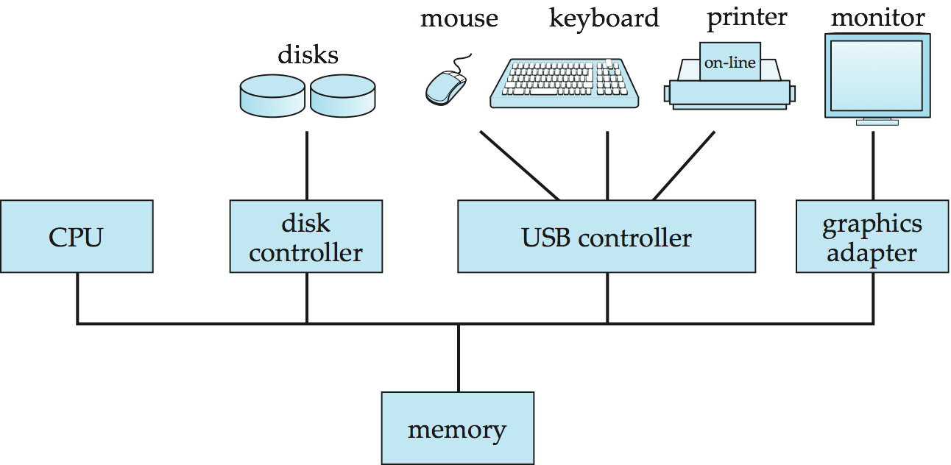
A Centralized Computer System

Slide 18
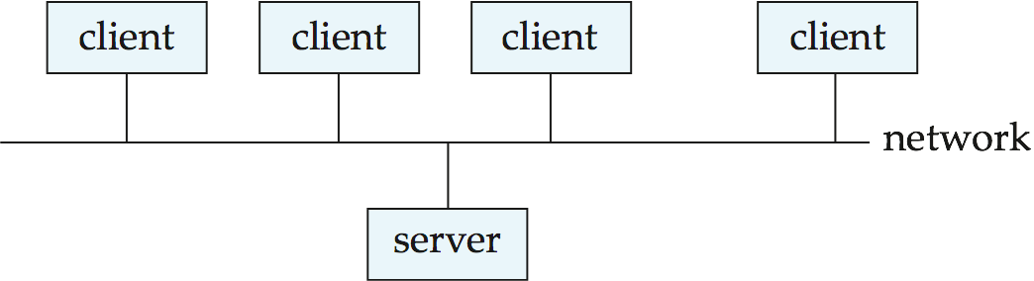
Client-Server Systems
Server systems satisfy requests generated at m client systems, whose general structure is shown below:

Slide 19
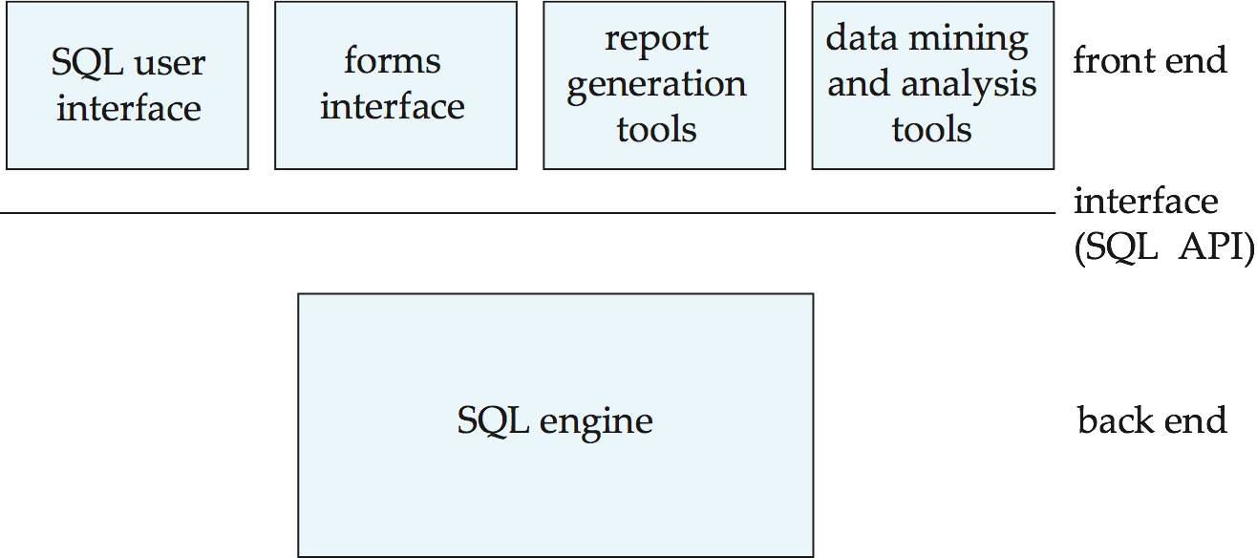
Client-Server Systems (Cont.)
Database functionality can be divided into:
Back-end: manages access structures, query evaluation and optimization, concurrency control and recovery.
Front-end: consists of tools such as forms, report-writers, and graphical user interface facilities.
The interface between the front-end and the back-end is through SQL or through an application program interface.

Slide 20
Client-Server Systems (Cont.)
Advantages of replacing mainframes with networks of workstations or personal computers connected to back-end server machines:
better functionality for the cost
flexibility in locating resources and expanding facilities
better user interfaces
easier maintenance

Slide 21
Server System Architecture
Server systems can be broadly categorized into two kinds:
transaction servers which are widely used in relational database systems, and
data servers, used in object-oriented database systems

Slide 22
Transaction Servers
Also called query server systems or SQL server systems
Clients send requests to the server
Transactions are executed at the server
Results are shipped back to the client.
Requests are specified in SQL, and communicated to the server through a remote procedure call (RPC) mechanism.
Transactional RPC allows many RPC calls to form a transaction.
Open Database Connectivity (ODBC) is a C language application program interface standard from Microsoft for connecting to a server, sending SQL requests, and receiving results.
JDBC standard is similar to ODBC, for Java

Slide 23
Transaction Server Process Structure
A typical transaction server consists of multiple processes accessing data in shared memory.
Server processes
These receive user queries (transactions), execute them and send results back
Processes may be multithreaded, allowing a single process to execute several user queries concurrently
Typically multiple multithreaded server processes
Lock manager process
More on this later
Database writer process
Output modified buffer blocks to disks continually
Transaction Servers
(Cont.)

Slide 24
Transaction Server Processes (Cont.)
Log writer process
Server processes simply add log records to log record buffer
Log writer process outputs log records to stable storage.
Checkpoint process
Performs periodic checkpoints
Process monitor process
Monitors other processes, and takes recovery actions if any of the other processes fail
E.g., aborting any transactions being executed by a server process and restarting it
Transaction System Processes

Slide 25
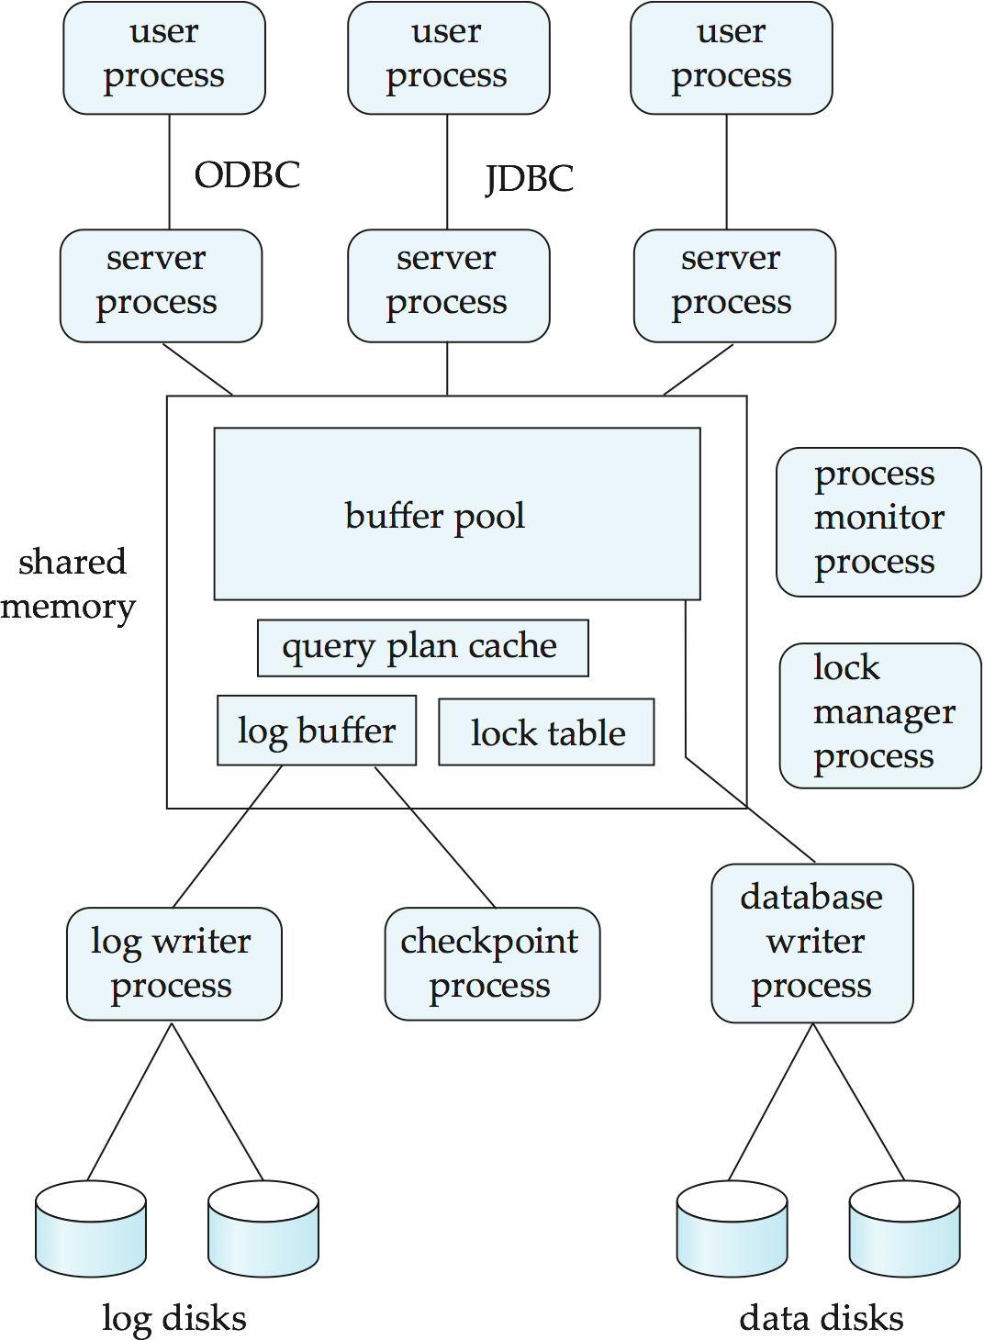
Transaction System Processes
(Cont.)

Slide 26
Transaction System Processes (Cont.)
Shared memory contains shared data
Buffer pool
Lock table
Log buffer
Cached query plans (reused if same query submitted again)
All database processes can access shared memory
To ensure that no two processes are accessing the same data structure at the same time, databases systems implement mutual exclusion using either
Operating system semaphores
Atomic instructions such as test-and-set
To avoid overhead of interprocess communication for lock request/grant, each database process operates directly on the lock table
instead of sending requests to lock manager process
Lock manager process still used for deadlock detection

Slide 27
Data Servers
Used in high-speed LANs, in cases where
The clients are comparable in processing power to the server
The tasks to be executed are compute intensive.
Data are shipped to clients where processing is performed, and then shipped results back to the server.
This architecture requires full back-end functionality at the clients.
Used in many object-oriented database systems
Issues:
Page-Shipping versus Item-Shipping
Locking
Data Caching
Lock Caching

Slide 28
Data Servers (Cont.)
Page-shipping versus item-shipping
Smaller unit of shipping ⇒ more messages
Worth prefetching related items along with requested item
Page shipping can be thought of as a form of prefetching
Locking
Overhead of requesting and getting locks from server is high due to message delays
Can grant locks on requested and prefetched items; with page shipping, transaction is granted lock on whole page.
Locks on a prefetched item can be P{called back} by the server, and returned by client transaction if the prefetched item has not been used.
Locks on the page can be deescalated to locks on items in the page when there are lock conflicts. Locks on unused items can then be returned to server.

Slide 29
Data Servers (Cont.)
Data Caching
Data can be cached at client even in between transactions
But check that data is up-to-date before it is used (cache coherency)
Check can be done when requesting lock on data item
Lock Caching
Locks can be retained by client system even in between transactions
Transactions can acquire cached locks locally, without contacting server
Server calls back locks from clients when it receives conflicting lock request. Client returns lock once no local transaction is using it.
Similar to deescalation, but across transactions.

Slide 30
Parallel Systems
Parallel database systems consist of multiple processors and multiple disks connected by a fast interconnection network.
A coarse-grain parallel machine consists of a small number of powerful processors
A massively parallel or fine grain parallel machine utilizes thousands of smaller processors.
Two main performance measures:
throughput --- the number of tasks that can be completed in a given time interval
response time --- the amount of time it takes to complete a single task from the time it is submitted

Slide 31
Speed-Up and Scale-Up
Speedup: a fixed-sized problem executing on a small system is given to a system which is N-times larger.
Measured by:
speedup = small system elapsed time
large system elapsed time
Speedup is linear if equation equals N.
Scaleup: increase the size of both the problem and the system
N-times larger system used to perform N-times larger job
Measured by:
scaleup = small system small problem elapsed time
big system big problem elapsed time
Scale up is linear if equation equals 1.

Slide 32
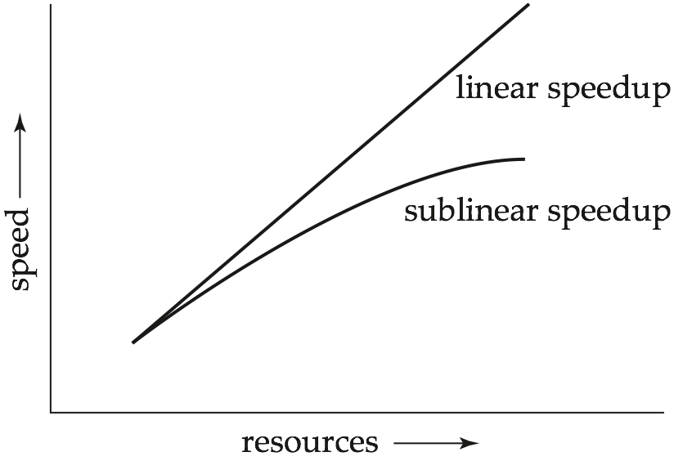
Speedup

Slide 33
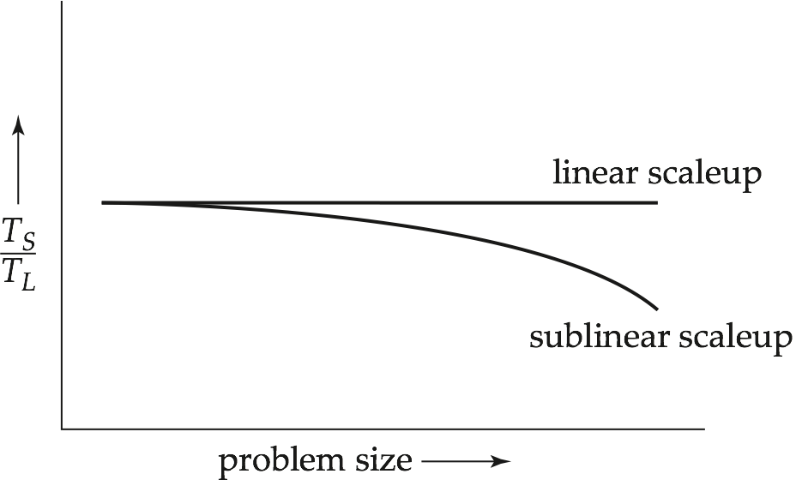
Scaleup

Slide 34
Batch and Transaction Scaleup
Batch scaleup:
A single large job; typical of most decision support queries and scientific simulation.
Use an N-times larger computer on N-times larger problem.
Transaction scaleup:
Numerous small queries submitted by independent users to a shared database; typical transaction processing and timesharing systems.
N-times as many users submitting requests (hence, N-times as many requests) to an N-times larger database, on an N-times larger computer.
Well-suited to parallel execution.

Slide 35
Factors Limiting Speedup and Scaleup
Speedup and scaleup are often sublinear due to:
Startup costs: Cost of starting up multiple processes may dominate computation time, if the degree of parallelism is high.
Interference: Processes accessing shared resources (e.g., system bus, disks, or locks) compete with each other, thus spending time waiting on other processes, rather than performing useful work.
Skew: Increasing the degree of parallelism increases the variance in service times of parallely executing tasks. Overall execution time determined by slowest of parallely executing tasks.

Slide 36
Interconnection Network Architectures
Bus. System components send data on and receive data from a single communication bus;
Does not scale well with increasing parallelism.
Mesh. Components are arranged as nodes in a grid, and each component is connected to all adjacent components
Communication links grow with growing number of components, and so scales better.
But may require 2√n hops to send message to a node (or √n with wraparound connections at edge of grid).
Hypercube. Components are numbered in binary; components are connected to one another if their binary representations differ in exactly one bit.
n components are connected to log(n) other components and can reach each other via at most log(n) links; reduces communication delays.

Slide 37
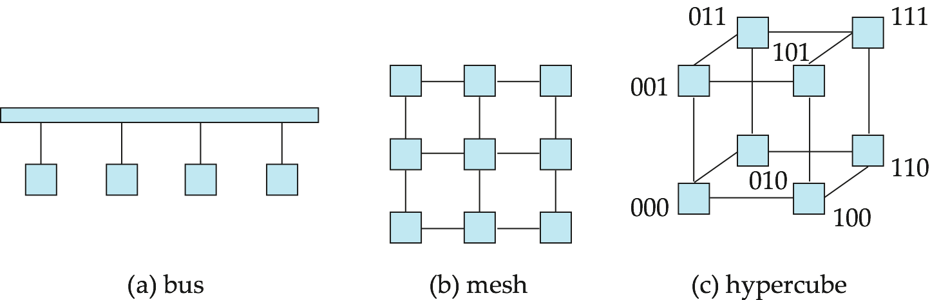
Interconnection Architectures

Slide 38
Parallel Database Architectures
Shared memory -- processors share a common memory
Shared disk -- processors share a common disk
Shared nothing -- processors share neither a common memory nor common disk
Hierarchical -- hybrid of the above architectures

Slide 39
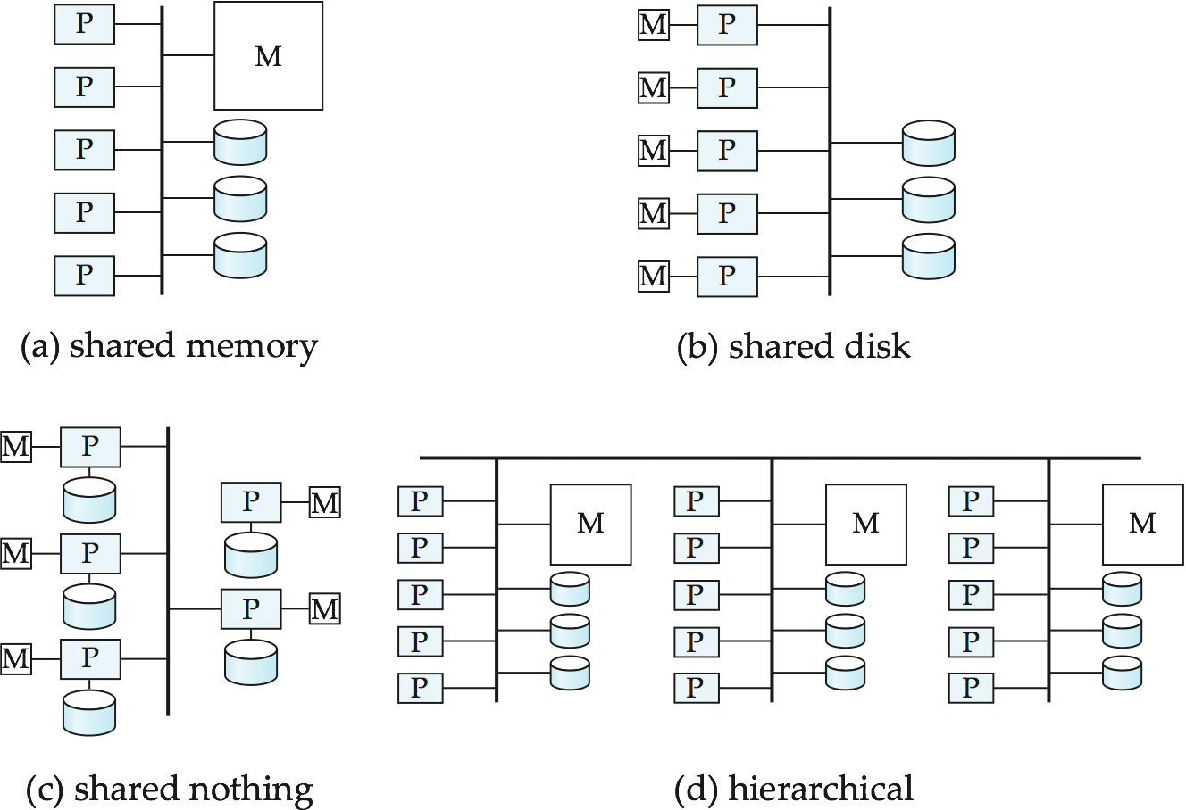
Parallel Database Architectures

Slide 40
Shared Memory
Processors and disks have access to a common memory, typically via a bus or through an interconnection network.
Extremely efficient communication between processors — data in shared memory can be accessed by any processor without having to move it using software.
Downside – architecture is not scalable beyond 32 or 64 processors since the bus or the interconnection network becomes a bottleneck
Widely used for lower degrees of parallelism (4 to 8).

Slide 41
Shared Disk
All processors can directly access all disks via an interconnection network, but the processors have private memories.
The memory bus is not a bottleneck
Architecture provides a degree of fault-tolerance — if a processor fails, the other processors can take over its tasks since the database is resident on disks that are accessible from all processors.
Examples: IBM Sysplex and DEC clusters (now part of Compaq) running Rdb (now Oracle Rdb) were early commercial users
Downside: bottleneck now occurs at interconnection to the disk subsystem.
Shared-disk systems can scale to a somewhat larger number of processors, but communication between processors is slower.

Slide 42
Shared Nothing
Node consists of a processor, memory, and one or more disks. Processors at one node communicate with another processor at another node using an interconnection network. A node functions as the server for the data on the disk or disks the node owns.
Examples: Teradata, Tandem, Oracle-n CUBE
Data accessed from local disks (and local memory accesses) do not pass through interconnection network, thereby minimizing the interference of resource sharing.
Shared-nothing multiprocessors can be scaled up to thousands of processors without interference.
Main drawback: cost of communication and non-local disk access; sending data involves software interaction at both ends.

Slide 43
Hierarchical
Combines characteristics of shared-memory, shared-disk, and shared-nothing architectures.
Top level is a shared-nothing architecture – nodes connected by an interconnection network, and do not share disks or memory with each other.
Each node of the system could be a shared-memory system with a few processors.
Alternatively, each node could be a shared-disk system, and each of the systems sharing a set of disks could be a shared-memory system.
Reduce the complexity of programming such systems by distributed virtual-memory architectures
Also called non-uniform memory architecture (NUMA)

Slide 44
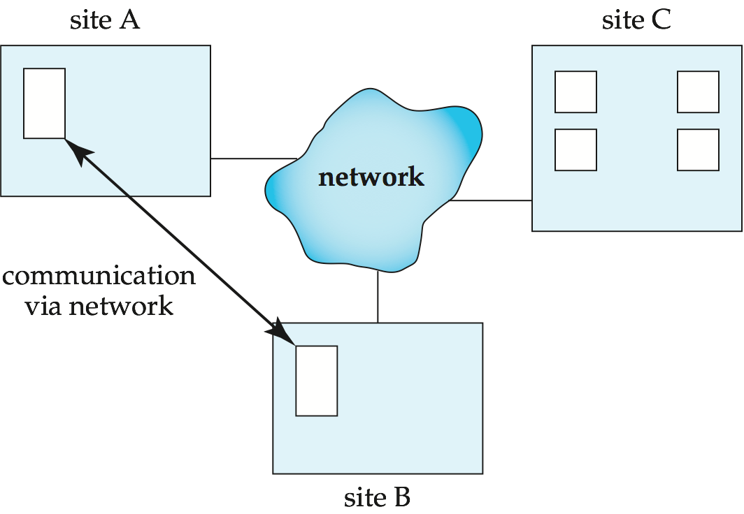
Distributed Systems
Data spread over multiple machines (also referred to as sites or nodes).
Network interconnects the machines
Data shared by users on multiple machines

Slide 45
Distributed Databases
Homogeneous distributed databases
Same software/schema on all sites, data may be partitioned among sites
Goal: provide a view of a single database, hiding details of distribution
Heterogeneous distributed databases
Different software/schema on different sites
Goal: integrate existing databases to provide useful functionality
Differentiate between local and global transactions
A local transaction accesses data in the single site at which the transaction was initiated.
A global transaction either accesses data in a site different from the one at which the transaction was initiated or accesses data in several different sites.

Slide 46
Trade-offs in Distributed Systems
Sharing data – users at one site able to access the data residing at some other sites.
Autonomy – each site is able to retain a degree of control over data stored locally.
Higher system availability through redundancy — data can be replicated at remote sites, and system can function even if a site fails.
Disadvantage: added complexity required to ensure proper coordination among sites.
Software development cost.
Greater potential for bugs.
Increased processing overhead.

Slide 47
Implementation Issues for Distributed Databases
Atomicity needed even for transactions that update data at multiple sites
The two-phase commit protocol (2PC) is used to ensure atomicity
Basic idea: each site executes transaction until just before commit, and the leaves final decision to a coordinator
Each site must follow decision of coordinator, even if there is a failure while waiting for coordinators decision
2PC is not always appropriate: other transaction models based on persistent messaging, and workflows, are also used
Distributed concurrency control (and deadlock detection) required
Data items may be replicated to improve data availability

Slide 48
Network Types
Local-area networks (LANs) – composed of processors that are distributed over small geographical areas, such as a single building or a few adjacent buildings.
Wide-area networks (WANs) – composed of processors distributed over a large geographical area.

Slide 49
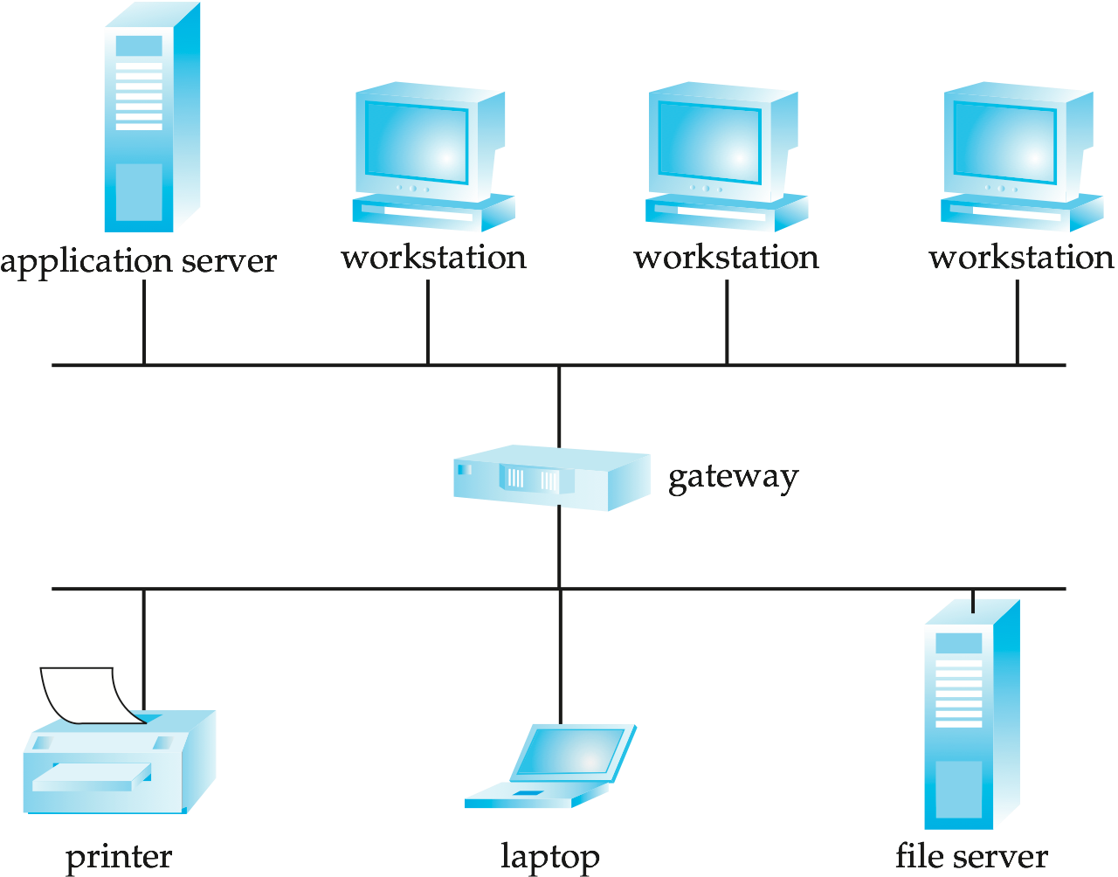
Local-area Network

Slide 50
Networks Types (Cont.)
WANs with continuous connection (e.g., the Internet) are needed for implementing distributed database systems
Groupware applications such as Lotus notes can work on WANs with discontinuous connection:
Data is replicated.
Updates are propagated to replicas periodically.
Copies of data may be updated independently.
Non-serializable executions can thus result. Resolution is application dependent.

Slide 51
References
Silberschatz, Korth, and Sudarshan. 2010. Database System Concepts - Sixth Edition. McGraw-Hill.
Silberschatz,Avi. 2012. Database System Architecture-Slides.
Source: http://codex.cs.yale.edu/avi/db-book/db6/slide-dir/

