Slide 1
CSH2D3 - Database System
Transaction Processing part 1
Tim Dosen

Slide 2
Outline
Transaction
ACID concept
Serializability
Recoverability

Slide 3
Introduction
In most large database systems, many users and application programs will be (and must be) accessing the database at the same time. Having concurrent users updating the database raises a number of problems that, if not properly dealt with by the DBMS, could leave the database in an inconsistent state, even if all users “did the right thing”.

Slide 4
Example 1 : Centralized Database
Ilustration:
A bank application can be used by several users on centralized database
The tables are:
Account (account_no, customer_name, balance)
Deposit (deposit_no, deposit_date, account_no, deposit_amount)
Withdrawal (witdhdrawal_no, withdrawal_date, account_no, withdrawal_amount)
For example: IDR 1,000,000 is taken from account_no “007” which have balance IDR 1,500,000 by two different users.

Slide 5
... Program Written ...
Read account data
Check balance SELECT balance FROM account WHERE account_no = “007”;
If balance is sufficient, update balance; otherwise process end. UPDATE account SET balance = balance – 1000000 WHERE account_no = “007”;
Save data to withdarawal table. INSERT INTO withdrawal VALUES (“W324”, “March,-14-2017”, “007”, 1000000);
COMMIT;

Slide 6
Concurrent Processing Mechanism
If the process sequence is described as following table, then both (user) action can be executed, although when the user #2 is withdrawing, the balance account is no longer sufficient.
WHY?
in T4, balance is still read as 1500000, because update process is executed when T5
THIS CAN HAPPEN because the process is not treated as “a transaction”
User #1 | User #2
T1: read data T2: select T5: update T6: insert T10: commit | T3: read data T4: select T7: update T8: insert T9: commit

Slide 7

it should be
User #1 | User #2
T1: read data T2: | T3: read data T4:
select
update
insert
commit
select
update
insert
commit

Slide 8
What is Transaction (Tx)?
Collection, set or group of SQL statement will be treated as an atomic process. When a transaction is executed, one or more data items which stored on database tables will be updated.
A transaction is a sequence of SQL statements that DBMS treats as a single unit of work. As soon as you connect to the database with sqlplus, a transaction begins. Once the transaction begins, every SQL DML (Data Manipulation Language) statement you issue subsequently becomes a part of this transaction.

Slide 9
Tx – Starts and Ends
STARTS
By the SQL standard, transactions consisting of more than one statement are started by the command START TRANSACTION.
Each statement issued at the generic query interface is a transaction by itself.
In programming interfaces like Embedded SQL or PSM, a transaction begins the first time an SQL statement is executed.
ENDS
The transaction ends in a variety of ways:
With the SQL COMMIT; statement
With the SQL ROLLBACK; statement
When the user ends the session normally, disconnect from the database (implicit commit)
When the user process crashes (implicit rollback)
An exception is generated in the processing of the statements (implicit rollback)

Slide 10
Tx – Commit and Rollback
After the current transaction has ended with a COMMIT or ROLLBACK, the first executable SQL statement that you subsequently issue will automatically begin another transaction.
COMMIT makes permanent any database changes you made during the current transaction. Normally, other users cannot see them until you commit your changes. But this depends on the isolation level of DBMS, which will be studied in next chapter.
ROLLBACK ends the current transaction and undoes any changes made since the transaction began.

Slide 11
Example 2:
For example, the following SQL commands have the final effect of inserting into table R the tuple (3, 4), but not (1, 2):
insert into R values (1, 2);
rollback;
insert into R values (3, 4);
commit;

Slide 12

COMMIT
The SQL statement COMMIT causes a transaction to complete.
It’s database modifications are now permanent in the database.
ROLLBACK
The SQL statement ROLLBACK also causes the transaction to end, but by aborting.
No effects on the database.
Failures like division by 0 can also cause rollback, even if the programmer does not request it.

Slide 13
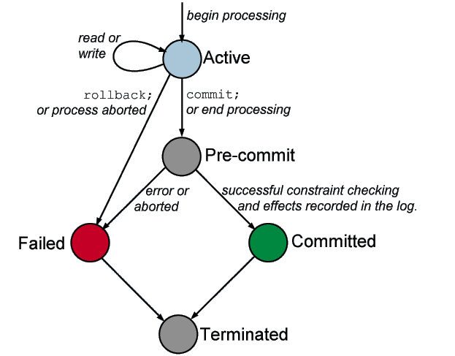
Transaction State
Transaction state describes transaction conditions since they start until the end of processing.
Following figure shows how’s the state of transaction:

Slide 14
Transaction State
Active, the initial state; the transaction stays in this state while it is executing.
Pre-commit or partially committed, after the final statement has been executed.
Failed, after the discovery that normal execution can no longer proceed.
Committed, after successful completion.
Terminated, end of transaction

Slide 15
The ACID Properties of Transactions
Atomicity
As already stated, the transaction should work as a unit. Even though a transaction may involve many updates, the state of the database should look as if either the whole transaction or no part of the transaction has been carried out. All the statements should complete or none.
Consistency
The transaction should take the database from one consistent state to the next. Execution of a transaction in isolation preserves the consistency of the database.
Isolation
Although multiple transactions may execute concurrently, each transaction must be unaware of other concurrently executing transactions. Intermediate transaction results must be hidden from other concurrently executed transactions.
That is, for every pair of transactions Ti and Tj, it appears to Ti that either Tj, finished execution before Ti started, or Tj started execution after Ti finished.
Durability
After a transaction completes successfully, the changes it has made to the database persist (data changed by the transaction will remain permantently), even if there are system failures. We will see that this is accomplished with a system log file.

Slide 16
ACID Transactions
A DBMS is expected to support “ACID transactions,” which are:
Atomic - All or Nothing
Either the whole process is done or none is
Consistent - Before and After
Database constraints are preserved
Isolated - You’re the One
It appears to the user as if only one process executes at a time
Durable - Nothing can change
Effects of a process do not get lost if the system crashes

Slide 17
Description of ACID principle by Transaction
Ilustration: Fund Transfer
account “003" transferring money $50 to account “001”.
UPDATE account
SET balance = balance - 50
WHERE account_no = “003”;
UPDATE account
SET balance = balance + 50
WHERE account_no = “001”

Slide 18
Example 3:
The mechanism of the two statements above in internal algorithm is:
read(A) // read record (tuple) account A from table to buffer variable
A := A – 50 // update account A balance in the buffer variable
write(A) // write update result to table
read(B) // read record (tuple) acoount B from table to buffer variable
B := B + 50 // update account B balance in the buffer variable
write(B) // write update result to table

Slide 19
ACID Test
read(A)
A := A – 50
write(A)
read(B)
B := B + 50
write(B)
Atomicity requirement − if the transaction fails after step 3 and before step 6, the system should ensure that its updates are not reflected in the database, else an inconsistency will result.
Consistency requirement – the sum of A and B is unchanged by the execution of the transaction.
Isolation requirement − if between steps 3 and 6, another transaction is allowed to access the partially updated database, it will see an inconsistent database (the sum A + B will be less than it should be). Can be ensured trivially by running transactions serially, that is one after the other. However, executing multiple transactions concurrently has significant benefits, as we will see.
Durability requirement − once the user has been notified that the transaction has completed (i.e., the transfer of the $50 has taken place), the updates to the database by the transaction must persist despite failures.

Slide 20

ACID principle implementation in DBMS
How DBMS implement ACID properties in a transaction?
Atomicity dan Durability
 RECOVERY MANAGER
Consistency dan Isolation
 CONCURRENCY CONTROL

Slide 21
Atomicity dan Durability
Shadow-database schema is used as an implementation of atomicity and durability principle
Assume that only one transaction is active at a time. A pointer called db_pointer always points to the current consistent copy of the database.

Slide 22
Atomicity dan Durability Cont’d
All updates are made on a shadow copy of the database, and db_pointer is made to point to the updated shadow copy only after the transaction reaches partial commit and all updated pages have been flushed to disk. In case transaction fails, old consistent copy pointed to by db_pointer can be used, and the shadow copy can be deleted.
But, this mechanism is only good and efficient if applied to transactions with small number of data. Why? Because executing a single transaction requires copying the entire database.
How to do it, if the number of data is large??

Slide 23
Consistency dan Isolation
Concurrency control schemes is a mechanisms to control the interaction among the concurrent transactions in order to prevent them from destroying the consistency of the database. Main issues in concurrency control are serializability, transaction processes scheduling, and locking.

Slide 24
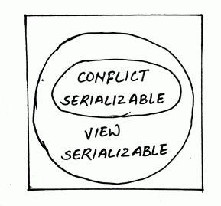
Serializability

Slide 25
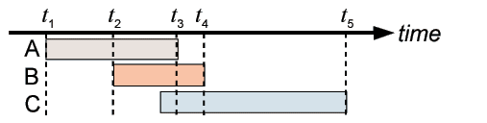

Serializability
Even though many transactions may be performed at the same time, the state of the database should look as if transactions were performed one by one (i.e., in a serial schedule). Each transaction preserves database consistency.
Ilustration:
The transactions A, B, C are all running at the same time.
We want to make it seem like A, B, C are each running on their own and don't overlap even though they do.

Slide 26
Why Serialization?
The reason for serialization and the requirements on transactions that were presented is to prevent the following:
1. Lost update (non-repeatable read)
2. Dirty read
3. Phantom read

Slide 27
Lost update (non-repeatable read)
select county.votetotal into votes from county where county.name = 'Palm Beach'; votes := votes + 300; update county set county.votetotal = votes where county.name = 'Palm Beach';commit;
select county.votetotal into votes from county where county.name = 'Palm Beach'; votes := votes + 2500; update county set county.votetotal = votes where county.name = 'Palm Beach'; commit;
A
B

Slide 28
Lost update ^{Cont’d}
Lost updates occur when two or more transactions selects the same row and then update the row based on the value originally selected. Each transactions is unaware of other transactions. The last update overwrites updates made by the other transactions, which results in lost data.
A's update of 300 votes was over written by B's update to the table. This is also known as a non-repeatable read, since at the time that B is updating the county table, if B was to read the value of votetotal again it would be different. B could not repeat the original read.

Slide 29
Dirty Read (Uncommited Dependency)
select county.votetotal into votes from county where county.name = 'Palm Beach'; votes := votes + 3000000; update county set county.votetotal = votes where county.name = 'Palm Beach'; rollback;
select county.votetotal into votes from county where county.name = 'Palm Beach'; commit;
A
B

Slide 30
Dirty Read Cont’d
A dirty read means that another process reads a value that will might have been an error and later will undone by a rollback.
A dirty reads occurs when a second transactions selects a row that is being updated by another transaction. The second transaction is reading data that has not been commited yet and may be changed by the transaction updating the row.
Here some body accidentally entered 3000000 votes. This error was undone by a rollback but not before B reads the value and uses it in future processing.

Slide 31
Phantom Read
select count(*) into numvotes from vote where vote.county = 'Palm Beach'; select count(*) into numdem from vote where vote.county = 'Palm Beach' and vote.canidate = 'Gore' perdemo := numdem / numvotes; insert into percentvote values ('Gore', perdemo); commit;
insert into vote values ('Nader', 'Palm Beach', 2342); insert into vote values ('Bush', 'Palm Beach', 2343); commit;
A
B

Slide 32
Phantom Read Cont’d
In this case records are inserted by a commited transaction while another transaction is processsing records that match the information inserted.
The new records are called phantom records since they appear out of nowhere.

Slide 33
Conclusion
Problems: Lost update, Dirty Read, and Phantom Read
All three of these problems could have been avoided if only one transaction was allowed to run at a time. Of course this is practically impossible.
So the responsibility of the database system is to ensure that transactions running at the same time seem to be running in serial, one after the next.

