Slide 1
CUSTOMER ANALYTICS PROJECT
Customer Shopping
Behavior Analysis
Data Cleaning in Python • SQL Analysis in PostgreSQL • Power BI Dashboard
3,900 transactions • 18 features • 4 product categories

Slide 2
INTRODUCTION
Dataset at a Glance
3,900
18
4
37
Transactions
Features
Categories
Missing Values (imputed)
Demographics
Purchase Details
Behavior
Age, Gender, Location, Subscription Status
Item, Category, Amount, Season, Size, Color
Discount, Frequency, Review Rating, Shipping Type
This project analyzes customer shopping behavior across 3,900 transactions to uncover spending patterns, customer segments, and subscription trends that guide strategic business decisions.
Customer Shopping Behavior Analysis
2

Slide 3
METHODOLOGY
Data Cleaning & Preparation
Performed in Python using pandas, prior to loading into PostgreSQL.
1
Load & Explore
2
Handle Missing Data
Imported the dataset with pandas; used df.info() and .describe() to check structure and summary statistics.
Imputed 37 missing Review Rating values using the median rating within each product category.
3
Standardize Columns
4
Engineer Features
Renamed all columns to snake_case for readability and consistent downstream use.
Created age_group (binned ages) and purchase_frequency_days from purchase cadence.
5
Check Consistency
6
Load to Database
Verified discount_applied and promo_code_used were redundant; dropped promo_code_used.
Connected Python to PostgreSQL and loaded the cleaned DataFrame for SQL analysis.
Customer Shopping Behavior Analysis
3

Slide 4
SQL ANALYSIS
Revenue by Gender
KEY INSIGHT
Male customers generated 2.1× more revenue than female customers — a critical segment for targeted campaigns.
Male: $157,890 • Female: $75,191
Customer Shopping Behavior Analysis
4

Slide 5
SQL ANALYSIS
Subscribers vs. Non-Subscribers
AVERAGE SPEND
Subscribers: $59.49 Non-Subscribers: $59.87
TOTAL REVENUE
Subscribers: $62,645 Non-Subscribers: $170,436
Only 27% of customers subscribe — a major growth opportunity.
Customer Shopping Behavior Analysis
5

Slide 6
SQL ANALYSIS
Customer Segmentation
🏆
Loyal
3,116 customers
🔁
Returning
701 customers
🆕
New
83 customers
839 high-spending discount users identified. 958 repeat buyers (>5 purchases) hold subscriptions, vs. 2,518 who do not.
Customer Shopping Behavior Analysis
6

Slide 7
SQL ANALYSIS
Top Products & Discount Patterns
Customer Shopping Behavior Analysis
7

Slide 8
SQL ANALYSIS
Revenue by Age Group
KEY INSIGHT
Young Adults lead revenue across all age groups. Express shippers spend slightly more on average — a premium segment worth targeting.
Standard: $58.46 avg • Express: $60.48 avg
Customer Shopping Behavior Analysis
8

Slide 9
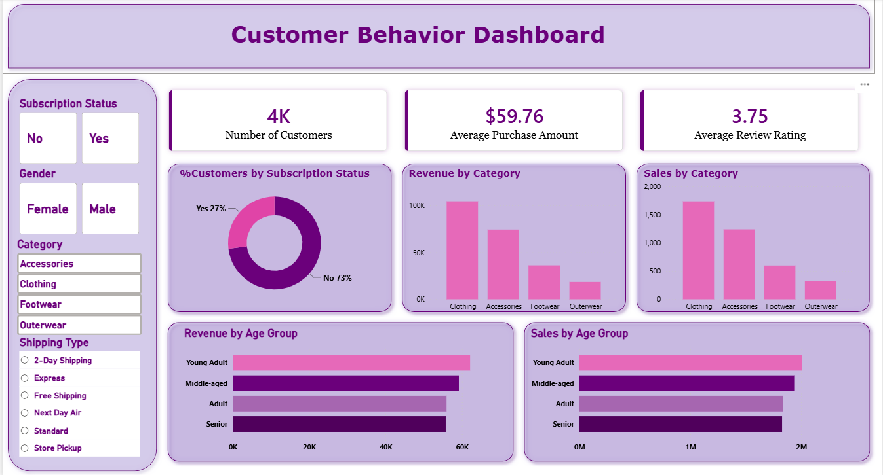
VISUALIZATION
Interactive Power BI Dashboard
Final insights consolidated into an interactive dashboard for stakeholder exploration.
Customer Shopping Behavior Analysis
9

Slide 10
STRATEGY
Business Recommendations
📈
💎
💰
Boost Subscriptions
Loyalty Programs
Review Discount Policy
Promote exclusive benefits to grow the 27% subscriber base.
Reward repeat buyers to grow the “Loyal” segment.
Balance sales lift with margin control.
🎯
🏅
Targeted Marketing
Product Positioning
Focus on high-revenue age groups & express shippers.
Highlight top-rated, best-selling items in campaigns.
Customer Shopping Behavior Analysis
10

Slide 11
Thank You
Questions & discussion welcome.
Customer Shopping Behavior Analysis • Python • PostgreSQL • Power BI

