Slide 1

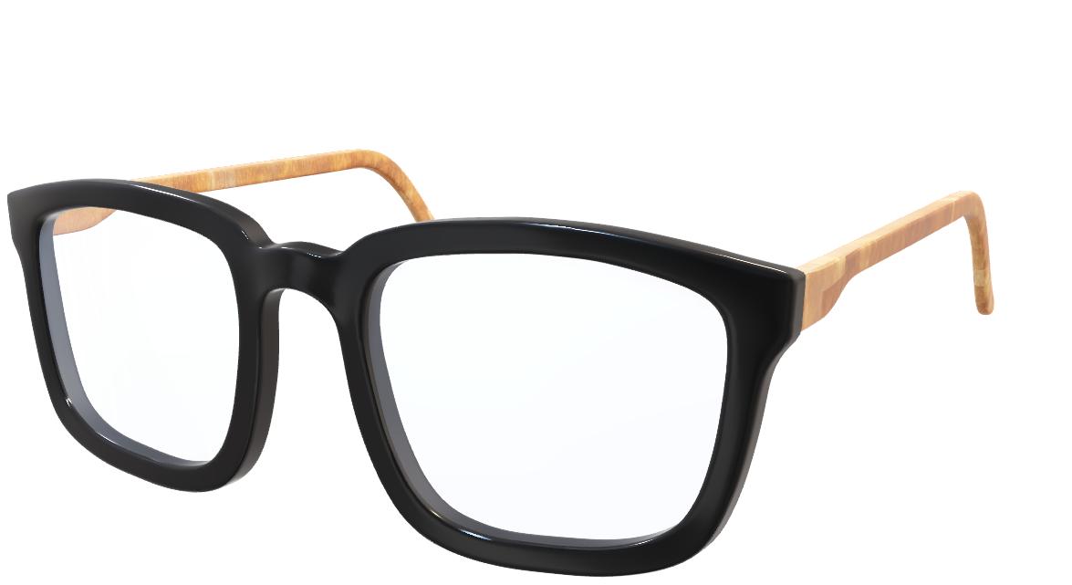
Concept
built for people who have lost their ability to speak or move due to war injuries, neurological trauma, or complete paralysis. The glasses restore communication using only eye movements, enabling natural interaction without any physical effort or touch.
A SMART GLASSES FOR SILENT VOICES.

Slide 2

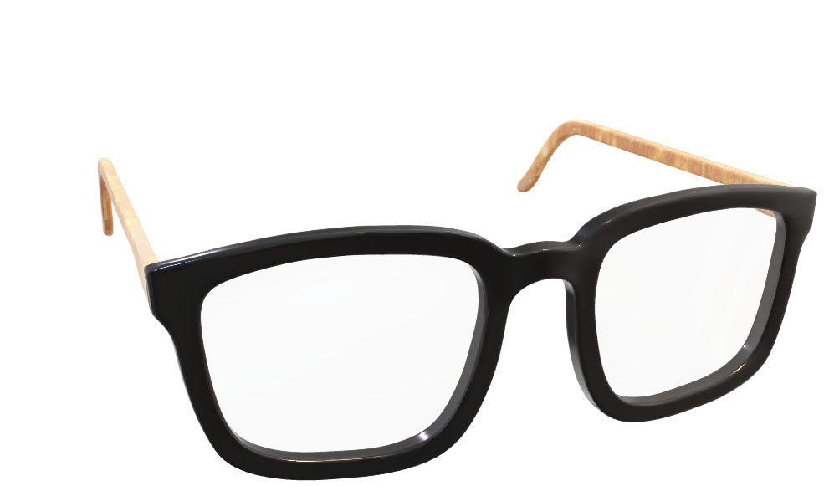
A SMART GLASSES FOR SILENT VOICES.

Slide 3
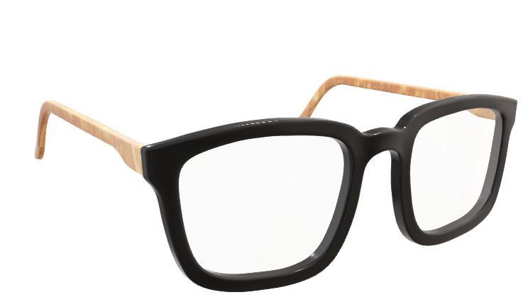
The glasses track eye movements with precision. When a user fixes their gaze on a phrase or symbol displayed inside the lens, Eyecan instantly converts it into speech. The output voice is natural and human-like, making the communication feel authentic and personal.
How it works?
A SMART GLASSES FOR SILENT VOICES.

Slide 4
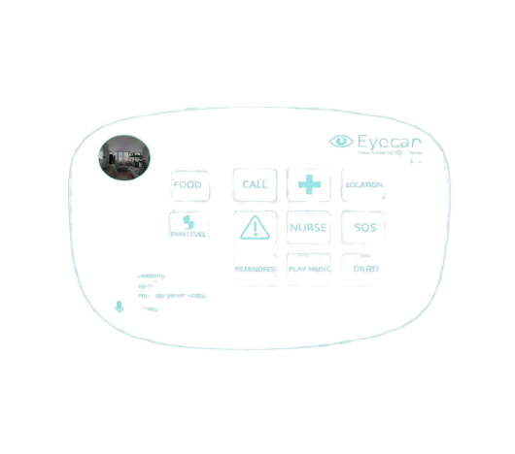
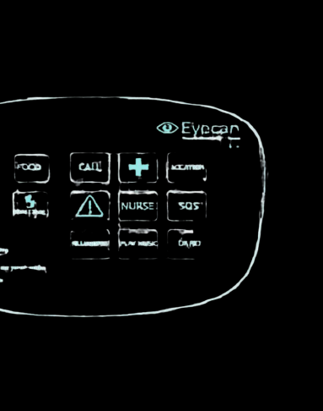
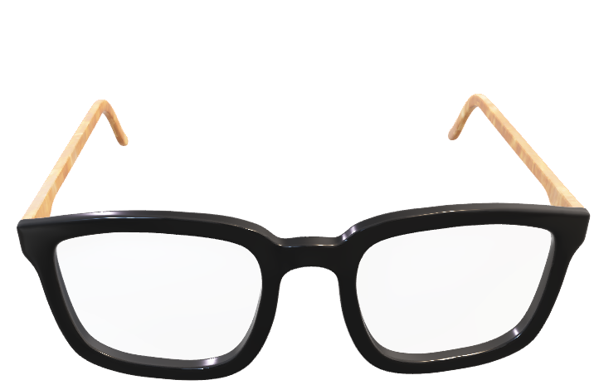
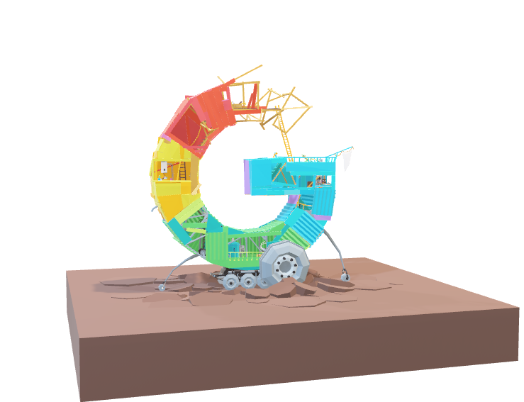
User Interface
Inside the transparent lens, a digital interface displays a set of icons, phrases, and symbols. The user interacts by simply looking at the desired element. This eye-controlled selection replaces physical gestures, keyboards, or touch, ensuring accessibility even for those with full-body paralysis.
A SMART GLASSES FOR SILENT VOICES.

Slide 5
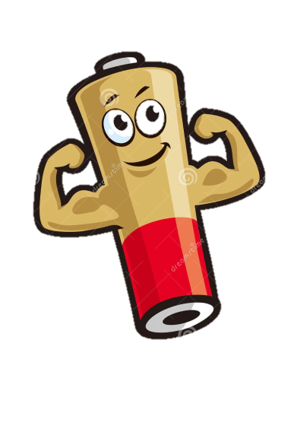


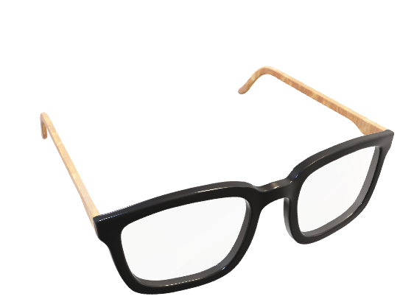
Technology Stack
The system is powered by cutting-edge technologies. Google Vision API enables environment recognition, while Text-to-Speech generates natural-sounding voices in both Arabic and English. Firebase manages data and personalization, and OpenCV provides accurate eye-tracking to ensure seamless interaction.
A SMART GLASSES FOR SILENT VOICES.

Slide 6




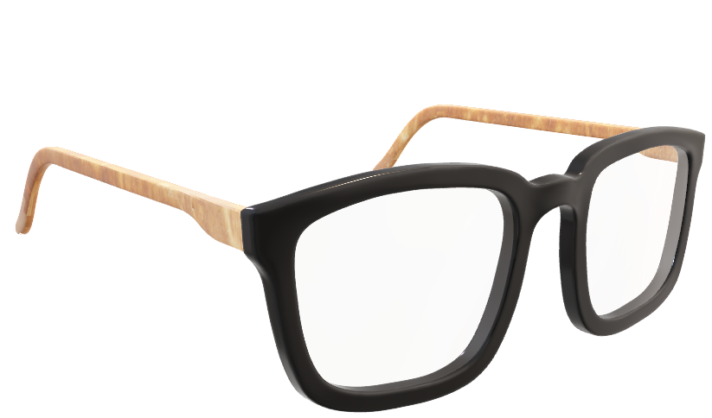
Reliability & Adaptability
Eyecan is designed for real-world conditions. Its long-lasting battery makes it reliable in daily use, even in low-resource environments such as conflict zones. The system is open to future updates, making it a scalable and evolving humanitarian technology..
A SMART GLASSES FOR SILENT VOICES.

Slide 7
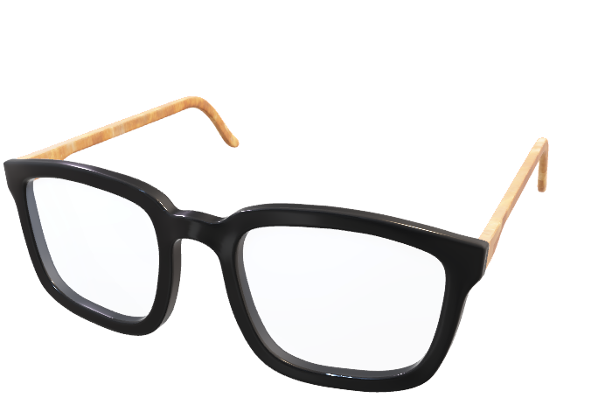
Targeted Users?
The primary beneficiaries of Eyecan are individuals with severe disabilities. This includes war victims who lost speech or mobility, people with partial or complete paralysis, and those who suffer from trauma-induced speech loss. It is also intended for anyone who remains cognitively aware but is unable to communicate through movement or voice.

Slide 8

Maryam aljelekh || Rama alnajjar || Najwa aljulani || Aya algharaibeh

