Slide 1
AI Pharmacy Agent: Transforming Pharmacy Operations
Aspirational State

Slide 2
What is an AI Pharmacy Agent?
An AI system assisting pharmacy operations — handling patient queries, refills, insurance checks, and basic counseling.

Slide 3
Key Types of AI Pharmacy Roles
- AI Pharmacy Agent: Patient-facing interactions
- AI Pharmacist Assistant: Internal pharmacist support
- AI Prior Authorization Agent: Insurance paperwork automation
- AI Patient Engagement Agent: Patient follow-up
- AI Intake Agent: Processing prescriptions

Slide 4
Typical Functions
- Prescription refill handling
- Medication counseling (FAQs)
- Side-effect triage
- Insurance eligibility checking
- Prior authorization management
- Patient education and reminders

Slide 5
Compliance and Safety
- Human-in-the-loop systems
- Audit trails for all interactions
- Strict HIPAA compliance (PHI protection)
- FDA guidelines for therapy recommendations

Slide 6
Patient Communication
Tools: NLP, API Integrations (EHR, PBM Systems), Audit Logs
AI Triage Layer
Human Pharmacist Queue
Record Keeping

Slide 7
Real-World Examples
- Amazon Pharmacy: Speeding up service using AI
- Truepill: AI-driven prescription intake
- Memora Health: Medication follow-up via AI
- CVS Health: AI call centers for pharmacy

Slide 8
AI Patient Engagement Agent
Enhancing Patient Follow-up with AI Technology

Slide 9
What is an AI Patient Engagement Agent?
AI Patient Engagement Agents use natural language processing and automation to handle follow-up tasks such as:
- Reminders for medication and appointments
- Wellness checks
- Side-effect monitoring
- Collecting patient feedback

Slide 10
How It Works
1. Patient Interaction Initiated
2. AI Processes Patient Data
3. Personalized Messages Sent
4. Alerts Triggered for Human Review if Needed

Slide 11
Real-World Benefits
- Improved medication adherence
- Early detection of side effects
- Reduced burden on healthcare staff
- Enhanced patient satisfaction

Slide 12
Patient Follow-up
Technical roadmap

Slide 13
Implementing AI for Patient Engagement
Models, Tools, Integration Strategies, and GenAIOps
Why AI Patient Engagement?
Improve patient follow-up and satisfaction
Automate reminders, feedback collection, triage
Increase operational efficiency
High-Level Implementation Approach
Strategy and Use Case Definition
Data Collection and Preprocessing
Model Selection (NLP/ML/DL)
API and System Integrations
Deployment, Testing, and Monitoring
GenAIOps (Governance and Lifecycle Management)

Slide 14
Core AI Models for Patient Engagement
NLP Models: Chatbots, virtual agents (e.g., OpenAI, Cohere, Google Dialogflow)
Sentiment Analysis Models: Classify patient emotions
Summarization Models: Shorten patient notes
Voice AI Models: Speech-to-text for phone follow-ups
Predictive Models: Predict no-shows, medication non-compliance
AI Tools and Frameworks
Model Training: TensorFlow, PyTorch, Hugging Face
Pre-built AI Services: Azure Health Bot, Google Healthcare API, AWS Comprehend Medical
Communication APIs: Twilio, WhatsApp Business API, email APIs
MLOps Platforms: MLflow, Vertex AI, SageMaker

Slide 15
API Integration Strategies
RESTful APIs to EHR Systems (FHIR standard)
API Gateway for scaling (e.g., AWS API Gateway)
Authentication: OAuth2, JWT, HIPAA-compliant security layers
Event-Driven Architecture: Webhooks for appointment reminders, health alerts
Data Requirements
Structured Data: EHR, medication history, appointment schedules
Unstructured Data: Patient emails, chat transcripts, call recordings
Consent and Privacy: Explicit patient consent, PHI encryption
Data Labeling: Annotate for model training (intent, sentiment, urgency)
Specific API Integration Examples
Patient Messaging: Twilio Conversations API, WhatsApp Business API, SendGrid Email API
EHR Data: SMART on FHIR APIs
Insurance & Benefits: Availity APIs, Change Healthcare APIs
Voice Bot Integration: Amazon Lex, Google Dialogflow CX
Appointment Scheduling: Calendly API, Zocdoc API

Slide 16
Quality Assurance and Testing
Model Evaluation Metrics: Precision, Recall, F1 Score, ROC AUC
User Testing: A/B testing messages, patient surveys
Failover Plans: Escalate to human if AI confidence < threshold
Continuous Learning: Model retraining with feedback loop

Slide 17
GenAIOps for Patient Engagement
Continuous Monitoring: Drift detection, accuracy tracking
Versioning: Dataset, model, API versions tracked
Compliance Checks: HIPAA, GDPR audits
Auto-Rollback: Fail-safe if models underperform
Observability: Logging, tracing AI decisions
Data Drift Detection using tools like Evidently AI
Feature Store Management with tools like Feast
Explainability with SHAP, LIME for model transparency
Automated Retraining based on performance thresholds
ML/DL Model Recommendations
BERT/DistilBERT for patient text understanding
T5 or GPT fine-tuning for conversational agents
BiLSTM + Attention models for sequence prediction (e.g., medication compliance)
Audio Models like Whisper for call transcription

Slide 18
Architecture
Patient Devices (Mobile, Web, Phone Call)
AI Engagement Engine (NLP Bot + Voice Bot)
Healthcare API Gateway (FHIR, HL7)
Core Services: Patient Profile Manager, Follow-up Scheduler, Alert/Notification Service, Feedback Analyzer
EHR/EMR Systems (Epic, Cerner)
MLOps/GenAIOps Platform: Model Registry, Drift Detector, Auto-Retraining Pipelines, XAI Layer
Security Layer: OAuth2, HIPAA-compliant logging, PHI encryption
Monitoring and Observability: Datadog, Prometheus, OpenTelemetry
Data Flow: Patient interaction triggers AI responses, API data pulls from EHR, AI action, monitoring, and feedback loop

Slide 19
Patient Devices (Mobile, Web, Phone Call)
AI Engagement Engine (NLP Bot + Voice Bot)
Healthcare API Gateway (FHIR + HL7)
Core Services:
Patient Profile Manager
Follow-up Scheduler
Alert/Notification Service
Feedback Analyzer
EHR/EMR Systems (Epic, Cerner, AthenaHealth)
MLOps/GenAIOps Platform:
Model Registry
Drift Detector
Auto-Retraining Pipelines
XAI Layer
Security Layer:
OAuth2, JWT-Auth HIPAA-compliant logging, PHI encryption
Monitoring and Observability:
Datadog, Prometheus, OpenTelemetry

Slide 20
Requirements
Data Flow:
Patient message triggers the AI agent.
AI Agent queries patient data via FHIR APIs.
AI Engine processes interaction using NLP models.
Actions are triggered (e.g., send reminder, escalate if concerning symptoms are detected).
Responses are logged for auditability.

Slide 21
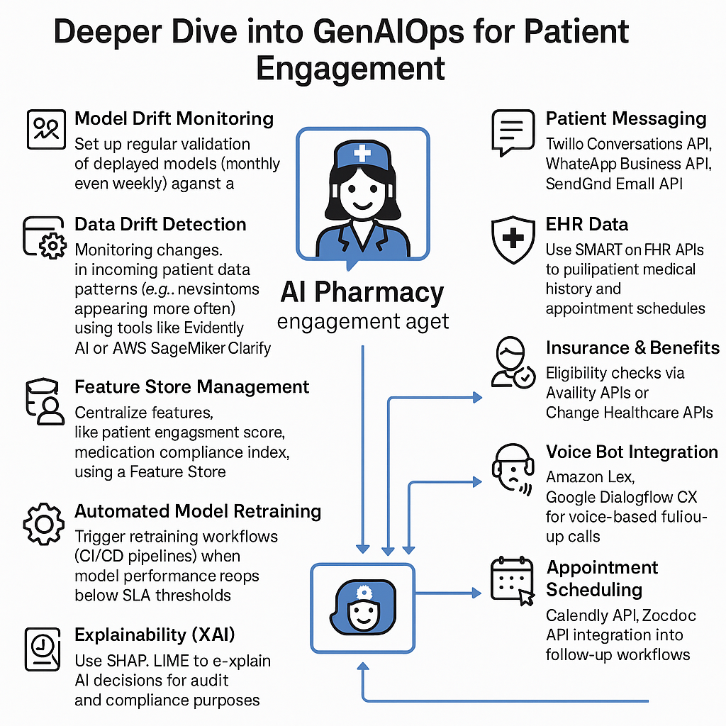

Slide 22
Deeper Dive into GenAIOps for Patient Engagement
Model Drift Monitoring: Set up regular validation of deployed models (monthly or even weekly) against a holdout patient dataset.
Data Drift Detection: Monitor changes in incoming patient data patterns (e.g., new symptoms appearing more often) using tools like Evidently AI or AWS SageMaker Clarify.
Feature Store Management: Centralize features like patient engagement score, medication compliance index, etc., using a Feature Store (e.g., Feast).
Security and Access Management: Role-based access control (RBAC) for models and patient data with audit logging.
Automated Model Retraining: Trigger retraining workflows (CI/CD pipelines) when model performance drops below SLA thresholds.
Explainability (XAI): Use SHAP, LIME to explain AI decisions for audit and compliance purposes.
Slide: Specific API Integration Examples
Patient Messaging: Twilio Conversations API, WhatsApp Business API, SendGrid Email API.
EHR Data: Use SMART on FHIR APIs to pull patient medical history and appointment schedules.
Insurance & Benefits: Eligibility checks via Availity APIs or Change Healthcare APIs.
Voice Bot Integration: Amazon Lex, Google Dialogflow CX for voice-based follow-up calls.
Appointment Scheduling: Calendly API, Zocdoc API integration into follow-up workflows.

