Slide 1
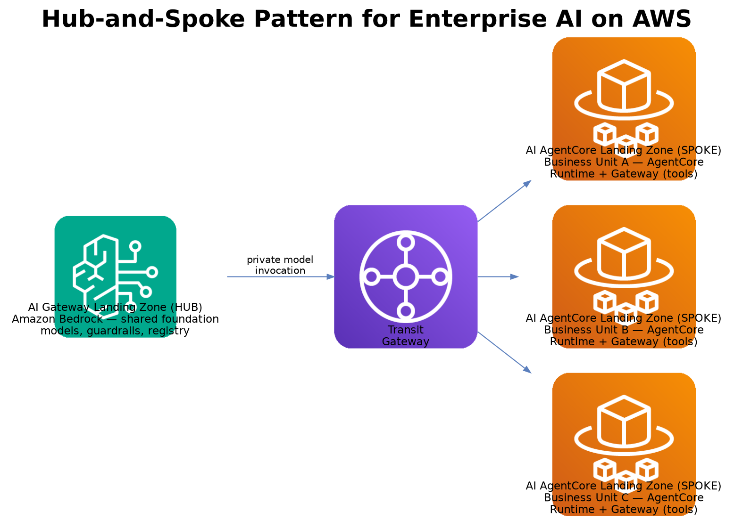
AWS AI LANDING ZONE
Enterprise Guide & Reference Architecture
A hub-and-spoke pattern for enterprise generative AI on AWS
AI Gateway Landing Zone — HUB for centralized Amazon Bedrock model access
AI AgentCore Landing Zone — SPOKE for agent runtime, tools, and identity
Prepared for Architecture Review Board | Enterprise Architecture | September 2026

Slide 2
EXECUTIVE SUMMARY
Why a hub-and-spoke pattern for enterprise AI
Centralize what should be shared: model access, safety guardrails, usage metering, and chargeback belong in one governed hub — not duplicated per team.
Decentralize what should be owned: agent logic, tools, and business data belong close to the team that builds and operates them, in their own account.
AWS AgentCore Gateway is purpose-built for the spoke: it turns internal APIs and Lambda functions into MCP-compatible tools for agents — it is an agent-to-tool connector, not a model gateway.
Amazon Bedrock, fronted by a governed API Gateway, is the natural hub: one place to manage model access, cost, and safety policy for every consuming business unit.
At a glance
1 hub
AI Gateway Landing Zone — shared Bedrock access
N spokes
AI AgentCore Landing Zone per business unit
Transit Gateway
connects every spoke back to the hub
AgentCore Gateway
lives in the spoke, not the hub
AWS AI Landing Zone — Enterprise Guide
2

Slide 3
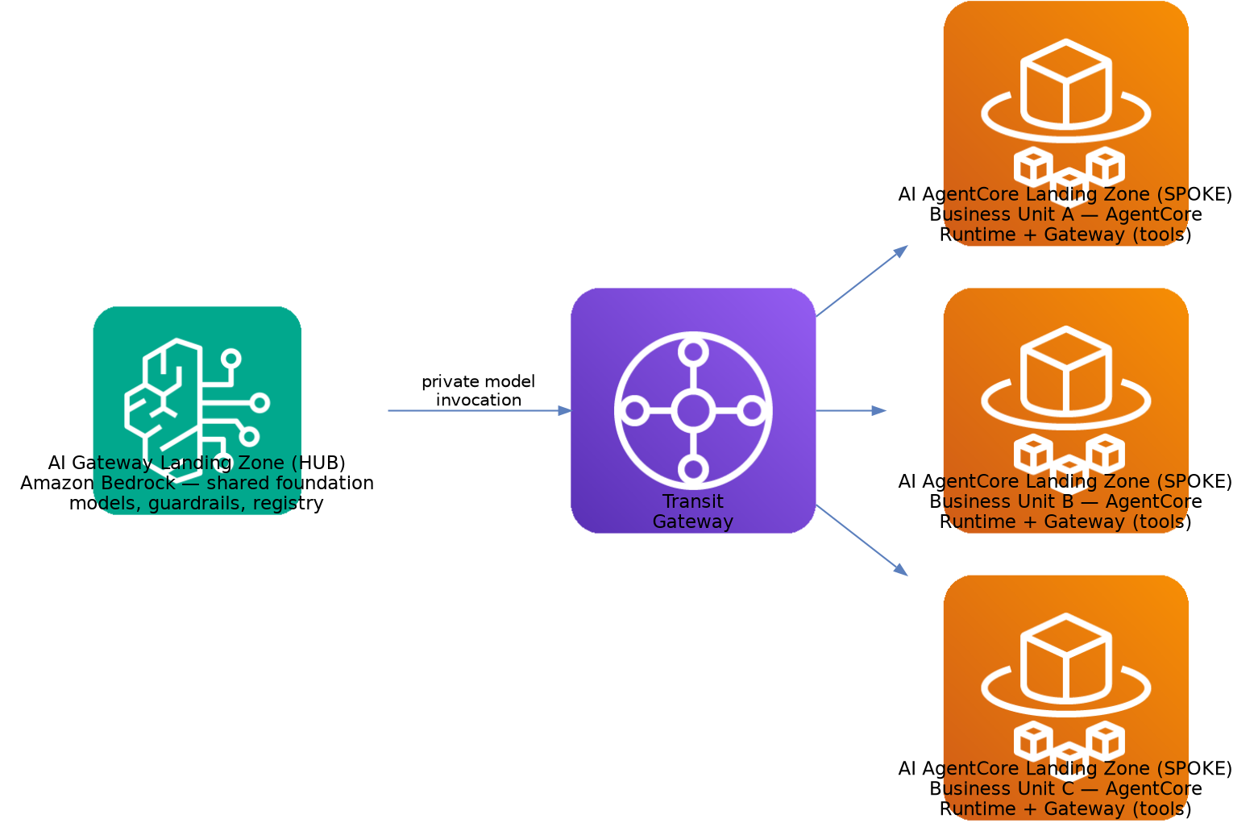
REFERENCE PATTERN
Hub-and-spoke for enterprise AI on AWS
The hub owns shared Bedrock model access and governance; each spoke owns its own agents, tools, and data — connected over a private Transit Gateway path.
AWS AI Landing Zone — Enterprise Guide
3

Slide 4
THE HUB
AI Gateway Landing Zone — centralized Bedrock model access
Lives in its own AWS account, peer to every spoke, under a Workloads OU.
Amazon Bedrock foundation models, cross-region inference, and provisioned throughput are provisioned once here and shared across business units.
A regional Amazon API Gateway + WAF is the single governed entry point every spoke calls for model invocation — no spoke talks to Bedrock's public endpoint directly.
Pluggable safety services (Bedrock Guardrails, Comprehend PII detection, Macie) sit in the request path as swappable, policy-driven controls.
Usage metering (EventBridge, DynamoDB), a semantic cache (ElastiCache for Redis), and a chargeback workflow (Step Functions) give per-consumer cost attribution without instrumenting every spoke.
A Service Catalog-backed model registry tells every spoke which models and versions are approved for use.
Owned by the hub
Model access & versioning
Guardrails & PII policy
Usage metering & chargeback
Approved-model registry
AWS AI Landing Zone — Enterprise Guide
4

Slide 5
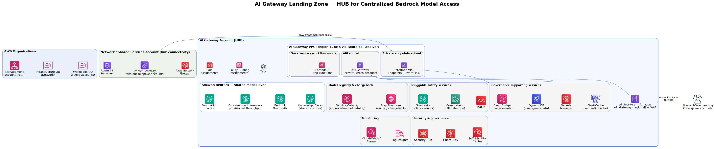
THE HUB — ARCHITECTURE
AI Gateway Landing Zone
Single entry point
Guardrails apply centrally
Usage is metered automatically
One regional API Gateway + WAF fronts Bedrock for every consuming spoke.
Safety, PII, and content policy enforced once, not per business unit.
EventBridge + Step Functions drive chargeback without per-spoke instrumentation.
AWS AI Landing Zone — Enterprise Guide
5

Slide 6
THE SPOKE
AI AgentCore Landing Zone — agent runtime, tools & identity
One account per business unit or workload, under the same Workloads OU, attached to the same Transit Gateway hub.
Amazon Bedrock AgentCore Runtime hosts the agent code itself in a dedicated Firecracker microVM per session — not a shared container — and works with any agentic framework (Strands, LangChain, LangGraph, CrewAI) and any model.
AgentCore Gateway is the spoke's tool server: it turns internal REST APIs and Lambda functions into MCP-compatible tools, with built-in OAuth-based inbound/outbound authorization and semantic tool discovery — this is where Gateway belongs, next to the agents that use it.
When an agent runs generated code or drives a browser, AgentCore Code Interpreter and Browser Tool give that action its own sandboxed microVM — untrusted, dynamic execution never shares a kernel with the agent's own process.
AgentCore Identity and Memory round out the standard setup — credential management plus session/long-term memory, with Observability providing OpenTelemetry-based tracing across all of it.
The spoke calls back to the hub only for model invocation — everything else (tools, business data, application logic) stays local to the team that owns it.
Owned by the spoke
Agent logic & orchestration
Tool integration (Gateway)
Sandboxed code / browser execution
Business data & memory
AWS AI Landing Zone — Enterprise Guide
6

Slide 7
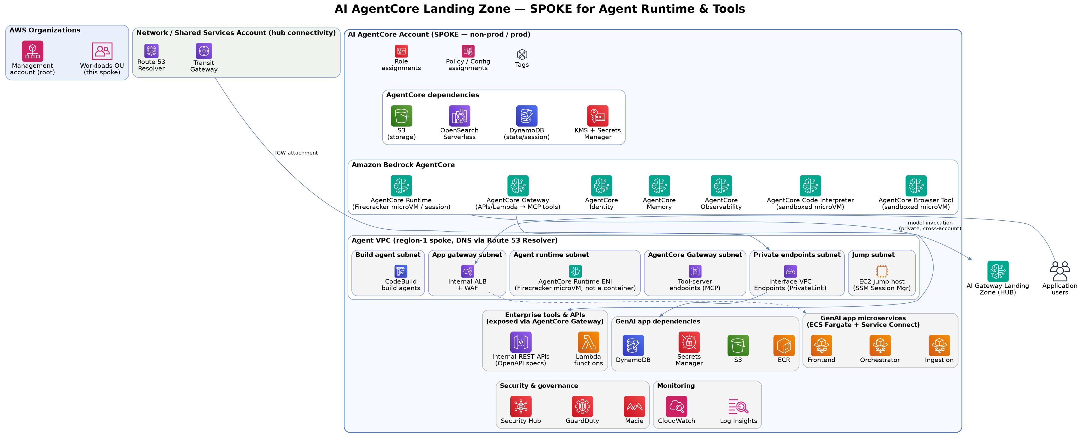
THE SPOKE — ARCHITECTURE
AI AgentCore Landing Zone
Tools stay local
One model call leaves the account
Standard shape, per team
AgentCore Gateway exposes this team's own APIs and Lambda functions as MCP tools — not shared with other spokes.
The only cross-account hop is Runtime → hub API Gateway for inference; everything else stays inside the spoke.
Every spoke repeats the same account structure — Runtime, Gateway, Memory, Identity, Observability — so onboarding a new business unit is templated.
AWS AI Landing Zone — Enterprise Guide
7

Slide 8
AVOIDING A NAMING COLLISION
Two different “gateways” — by design
Both landing zones have something called a “Gateway.” They solve different problems and sit in different accounts — keep them distinct.
Amazon API Gateway
Bedrock AgentCore Gateway
Lives in: AI Gateway Landing Zone (HUB)
Lives in: AI AgentCore Landing Zone (SPOKE)
Fronts Amazon Bedrock model invocation
Callers are spoke accounts (agents), not tools
Enforces guardrails, quota, and chargeback policy
One instance shared by every business unit
Fronts internal APIs and Lambda functions as tools
Callers are agents (via MCP), not end users
Enforces per-tool OAuth in/out authorization
One instance per spoke, scoped to that team's tools
AWS AI Landing Zone — Enterprise Guide
8

Slide 9
COMPONENT REFERENCE
AWS services used in each landing zone
Layer | AI Gateway Landing Zone (HUB) | AI AgentCore Landing Zone (SPOKE)
Model / agent runtime | Amazon Bedrock (foundation models) | Bedrock AgentCore Runtime (Firecracker microVM per session)
Tool / API integration | — (not applicable at the hub) | Bedrock AgentCore Gateway (APIs, Lambda → MCP)
Code execution / sandboxing | — (not applicable at the hub) | AgentCore Code Interpreter & Browser Tool (sandboxed microVM)
Identity | IAM Identity Center (workforce) | AgentCore Identity (agent-to-tool)
Memory / state | DynamoDB (usage metadata) | AgentCore Memory, DynamoDB, OpenSearch Serverless
Safety & PII | Bedrock Guardrails, Comprehend, Macie | Inherited from hub at invocation time
Edge / entry point | Amazon API Gateway (regional) + WAF | Internal ALB + WAF (app-facing)
Governance | Service Catalog registry, Step Functions chargeback | Security Hub, GuardDuty, Config
Observability | CloudWatch, Log Insights | AgentCore Observability (OTEL) + CloudWatch, X-Ray
AWS AI Landing Zone — Enterprise Guide
9

Slide 10
ENTERPRISE GUIDANCE
Design principles for adoption
01
02
03
One hub, many spokes
Model access never bypasses the hub
Tools stay local to the spoke
Stand up a single AI Gateway account before onboarding the first business unit — retrofitting central governance after spokes exist is far more disruptive.
Spokes call Bedrock only through the hub's private API Gateway path; direct public-endpoint access defeats guardrails, metering, and chargeback.
AgentCore Gateway targets (APIs, Lambda) are owned and secured by the team that built them — don't centralize tool integration in the hub.
04
05
06
Guardrail policy is versioned, not forked
Cost attribution is automatic, not requested
Validate before scaling out
Let each spoke select a guardrail policy variant from the hub's catalog rather than maintaining its own safety configuration.
Every model call carries spoke identity through to the hub's usage-metering pipeline — chargeback shouldn't require a manual report.
Confirm HIPAA eligibility, current AgentCore feature maturity (GA vs. preview), and DR strategy with one spoke before replicating the pattern broadly.
AWS AI Landing Zone — Enterprise Guide
10

Slide 11
ADOPTION ROADMAP
Suggested rollout sequence
Phase 1
Phase 2
Phase 3
Phase 4
Stand up the hub
Pilot one spoke
Harden & template
Scale out spokes
AI Gateway account, Bedrock model access, guardrails, and usage metering — no spokes yet.
→
Onboard a single business unit's AgentCore account; validate the model-invocation path and cost attribution end to end.
→
Turn the pilot spoke into an account-vending template (network, IAM, AgentCore setup) via AWS Control Tower / Account Factory.
→
Onboard additional business units from the template; the hub's guardrail and registry catalog governs all of them centrally.
Open items before build: region/DR strategy, CIDR allocation, HIPAA/BAA coverage per service, and current AgentCore GA-vs-preview feature boundaries.
AWS AI Landing Zone — Enterprise Guide
11

Slide 12
Questions & Discussion
References
Amazon Bedrock AgentCore — docs.aws.amazon.com/bedrock-agentcore
AgentCore Gateway launch blog — aws.amazon.com/blogs/machine-learning
AWS Well-Architected — Generative AI Lens
Enterprise Architecture | September 2026

