Slide 1
Purpose
| 2 |
Clearly describe how Security and Testing can be integrated into a DevSecOps environment without compromising speed, security, or quality
Provide a baseline of the terminology, methodologies, processes, environments, and automation technologies used in DevSecOps programs

Slide 2
Bottom Line Upfront
| 3 |
DevSecOps Value Proposition
Programs can realize significant value by implementing DevSecOps. But,
testing and security should not be sacrificed
Shift Left
Programs must truly shift Security and Test to the left to realize time and cost savings
Agile and DevSecOps go together
DevSecOps must be fed by Agile software development. Security user stories must be part of each sprint
Automation is key
Security and test automation can reduce delivery time, improve quality and security, and eliminate human error

Slide 3
Outline

Slide 4
Test Oversight Influence Areas
Type | Artifacts to Influence | Proactive Measures
Input | Acquisition Strategy, SOW Technical Requirements, Program TEMP | Acquisition. Develop and communicate the Test Strategy (including security test activities), including: major test events, automation strategy and requirements (e.g., needed tools / standards), required access to Dev/Test environments, plan for test data Required Test Artifacts. Ensuring the contract(s) mandates test plans, test cases, test reports, traceability matrices, shared with the govt. Formats, ability to comment are important Testability. Requirement for testability of contractor-derived requirements, testable code including security
Pre- Develop | Architecture, Use Cases, Scenarios, System/Functional Requirements | Interfaces. Understand and define interfaces, both internal and external systems Test Environment. To model / influence the test environment to closely mirror production (and development) Test Data. Identify test data sources and ability to access (or emulate); security use cases
During- Develop | Design Specs, Demos, Test Events, Test Cases | New Interfaces and Data Sources. What is the developer changing? Understand how the developer is deriving requirements, interfaces, and functionality Traceability. Do the developer’s changes align to the system-level requirements and architecture? Observe. Automated testing, live test events / demos Risk Assessment. Is the evolving design going to work? What new risks have been introduced?
Output | Test Reports, Working Software, Data Model(s) | Review of Test Outputs. Increased visibility to stakeholders of metrics around tests (automated test suite vs manual test time, code coverage, etc.) Recommendations. How can we reduce risk without killing the benefits of “agility”? TEST AUTOMATION!

Slide 5
Focus Areas
Test Level | Conducted By | Overseen By | Focus Area | Challenges (bolded words are important) | DevSecOps
Unit | Contractor | App Engr Team | Code | Automation Access and Tools Test Output Access Test Traceability | Automate unit tests Any failed unit tests fail the DevSecOps Pipeline Development, security, and test work together
Integration | Contractor | Dev, Test & Evaluation Team | Interface / API | Interfaces / Interface Design Test Environment Test Data External Systems | User Stories are the “requirements” to be tested Each User Story should have corresponding automated tests and acceptance criteria, including Security User Stories
System | Mission Owner | Dev, Test Evaluation Team & Operation, Test Evaluation Team | End-to-End Functionality | Test Environment Test Data External Systems | Automated user functional tests via tools (e.g., UFT, Selenium, OWASP Zap )
Acceptance | Operator | Operation Test, Evaluation Team | End-to-End Operations | Not slowing everything down! Timely Validation, Feedback Loop Feasibility (what can actually be changed) | Automated acceptance tests
Release | Contractor | Operation Test, Evaluation Team | Deployment | Successful delivery of working software | Minimize manual system installation Treat Infrastructure as Code and use deployment automation

Slide 6
Continuous Delivery Testing – Software Release Approaches
Continuous Delivery Test Techniques | Description
Blue Green Deployment | This requires 2 identical infrastructures to host the application. Green environment runs the current version of the application. Blue environment hosts the new version of the software to be tested. User load is then incrementally shifted from the previously accepted version to the new version. If there are any issues encountered in the new version, rollback can be done easily to the older accepted version. This technique increases availability and reduces risk of the application.
Canary Releases | This testing is often automated and includes a limited set of early adopter users. These users assist in identifying issues before the application is released to a wider range of users.
A/B Testing | This method compares two versions of a single webpage or app to determine which one performs better over the other. A/B testing is an experiment in which 2 variants of a page are shown to users randomly and then determine which version performs better.

Slide 7
Additional Test Types – Leveraged as Needed
Smoke Testing
Functional Testing
Security Testing
Performance Testing
Load Testing
Stress Testing
Spike Testing
Regression Testing
Compliance Testing

Slide 8




Agile + DevSecOps Pipeline
Agile Development
Developing functionality based upon user needs
DevSecOps Pipeline
Automating build, secure / test, deploy, and monitor
Product Backlog
Security
Continuous Integration
Continuous Delivery
Sprint Backlog
2 weeks
Final Product
Logging and Monitoring
Security: is part of the entire process, from Backlog through Production Operations

Slide 9
Testing Tool | Description | DT&E Applicability | URL | Focus Area
JUnit | Open source, automated unit test framework for Java programming language | Applicable for DT and OT | http://junit.org | Unit Testing
Selenium | Suite of tools to automate web application testing across many platforms. Supported by many popular browsers such as Firefox, Chrome. Robot framework built on top of Selenium enables continuous testing. | Applicable for DT and OT | http://docs.seleniumhq.org | Unit, System, Integration Testing
SoapUI | Open-source web service testing application framework for SOAP and REST APIs | Applicable for DT and OT | https://www.soapui.org | Unit, Functional and Integration Testing
Rational Functional Tester | It is capable of Functional, API, Performance Testing and Regression testing. | Applicable for DT and OT | https://www.ibm.com/us- en/marketplace/rational- functional-tester | Functional Testing
JMeter | Load testing tool for analyzing and measuring performance of services, with a focus on web applications | Applicable for DT and OT | http://jmeter.apache.org/ | Performance (Load) Testing
TestNG | Testing framework to cover all categories of tests: unit, functional, end-to-end, integration etc. | Applicable for DT and OT | http://testng.org/doc/index.html | Unit and Integration Testing
Unified Functional Test (UFT) | Automates functional and regression testing for applications and environments. | OT only | https://www.microfocus.com/en- us/products/unified-functional- automated-testing/overview | System Testing

Slide 10


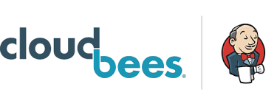












Continuous Integration(CI)
Security
Shift Left through Agile
Development Team Builds and Tests secure functionality
Feedback
Check
Source
Control ^{Build}
Static Code
Analysis
Artifact
Repository
in
Unit Test
Packaging
*DoD programs will typically have multiple Agile teams developing in
parallel. Security user stories are part of the backlog
Logging and Monitoring
Feedback loop ensures continuous error correction and vulnerability remediation at each stage in the DevSecOps pipeline

Slide 11
Microservice & Container : Scalability & Security Agile Stories
Handling Error Budget in SRE | Threat modeling & Security Boundaries | Recovery Designing
Initial Velocity vs Sustained Velocity | Cryptographic API (Tink Crypto framework) | Rate limiting mechanisms (limiting dependencies)
Design for least privilege | Dependency management | Rollbacks (arbitrary vs never-allow)
Classifying access based risks | Zero day vulnerability vs Change improvement system | Security versioning
Diagnosing access denials | Controlling degradation | Rotating signing keys & certificates
Failure & Break glass mechanisms | Cost of failure | Emergency Access
Multi-Party Authorizations/3 Factor Authorization/Temporary Access | Response mechanisms | Mitigating Denial of Service attacks
Common Object (Kubernetes) – Mental model reasoning | Role modelling | Testing code

Slide 12










Continuous Delivery
Security
Configuration
Deployment
Dynamic
Code Analysis
Integration &
Performance Testing
Production
Release
Monitoring tools like appdynamics
Logging | Monitoring
Continuous Delivery promotes the working software from lower environments to higher environments after security and tests are satisfied

Slide 13
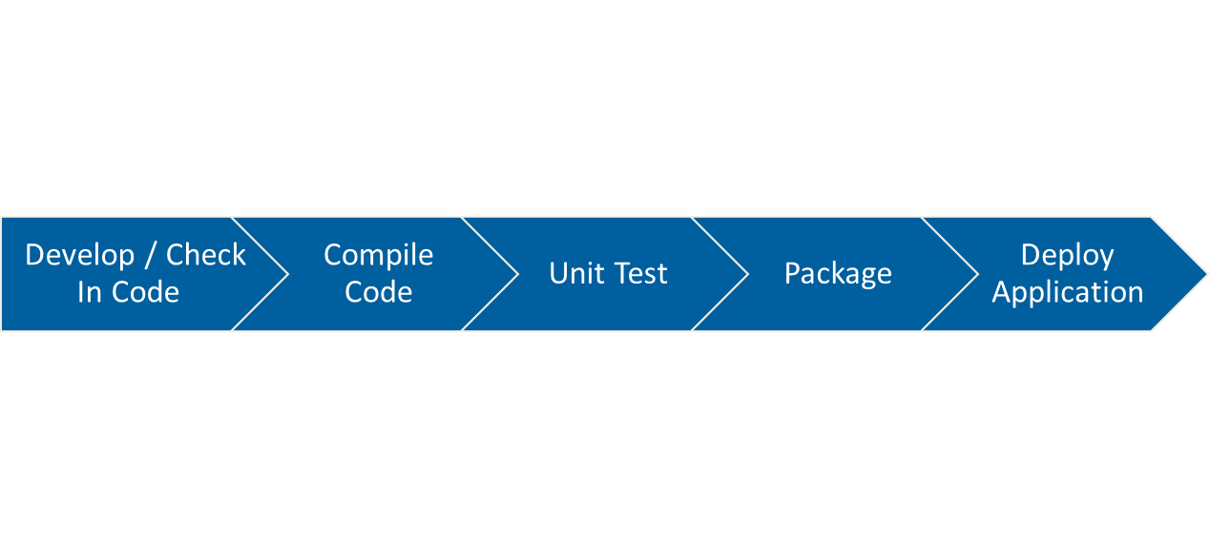

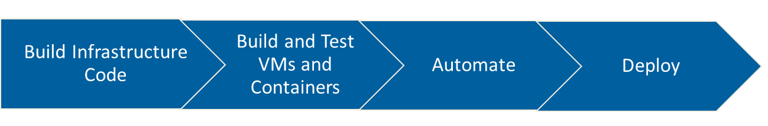


Hybrid Cloud Infrastructure testing
Dev
User
Risk: User Identity Compromised
Mitigation: Ensure all accounts and devices are continuously validated
Application Development (CI/CD)
Multiple Environments
Dev Test
Pre-Prod Prod
Identity Access Mgmt
Risk: Privilege Accounts
compromised
Mitigation: Deploy identity governance and PAM tools
Version Control
Artifact Repository
Cloud Service Provider
Risk: Misconfiguration of SaaS Mitigation: Perform scans to identify and fix potential misconfigurations and identify shadow IT
Environment Provisioning
Cloud Access Security
Broker
Risk: API is not secure Mitigation: API security testing and continuous monitoring
CSPs (IaaS/PaaS)
Cloud
Access Point
Risk: CAP becomes bottleneck Mitigation: Direct connect to CSP (policy dependent), or use VPN with split tunnel + whitelisted IPs

Slide 14
DevSecOps Security Tools – Examples
Security Tool | Description | Focus Area | Test Oversight | Open Source
Snort | It is a Network intrusion detection and prevention system. Scrutinizes each packet on the network for anomalies and monitors traffic real time. | IDS | Operations | Yes
Fortify SCA | Static code analyzer helps to identify security vulnerabilities efficiently in source code during development. | Code Security | Development | No
Gauntlt | Gauntlt provides hooks to a variety of security tools and puts them within reach of security, dev and ops teams to collaborate to build rugged software. | Security Test Automation | Development | Yes
HashiCorp Vault | Improves how software teams store important keys, tokens, passwords, and other secrets in their projects. Vault is an environment- and infrastructure-agnostic open toolset for secrets management. | Credential Protection | Development | Yes
Sonar Qube | Continuous inspection of code quality to perform automatic reviews with static analysis of code to detect bugs, code smells, and security vulnerabilities. | Code Security | Development | Yes
OWASP Zap | Used to identify security vulnerabilities in an application while it is being developed. Useful in penetration testing. | Vulnerability Scanning | Development & Operations | Yes

Slide 15
Security Considerations
Security should be built into the entire DevSecOps process
Agile process that feeds DevSecOps also must be secure
Security user stories must be in the backlog
Embed security throughout software lifecycle to identify vulnerabilities
earlier, perform faster fixes therefore reduce cost
Continuous monitoring to ensure devices, tools, accounts, etc. are continuously discovered and validated

Slide 16
Shift Left: Security and Test Considerations
Security
Security processes
Security tools
Security access (i.e., to DevSecOps environment)
Security tool visibility (i.e., across the pipeline)
Security reporting
Test
Test events
Test environments
Test tools
Test access (i.e., to DevSecOps environment)
Test data
Test reporting
Acceptance & Evaluation: plan/budget for these items, integrate them into architectures, and write them into RFPs

