Slide 1
CPS 499/573: Security and Safety in Autonomous Systems FINAL PROJECT
B y:
Rama Bhargavi Vempolu – 1017440230
Saivarshitha Thammera - 101745272

Slide 2
IDEA 1: Model and Analyze simple case studies using at least 3 tools
Mass-Spring-Damper using MATLAB/Simulink and Flow*
Railway Control System using UPPAAL
Ticket Vending Machine using UPPAAL
Glycaemic control using Flow*

Slide 3
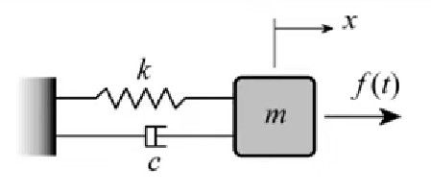
Mass-Spring-Damper using MATLAB/Simulink
Spring-mass-damper systems can be found in many mechanical systems. One common example is the suspension of a car. The car itself is the mass; it is suspended by an elastic spring. A damper (the actual shock absorber) prevents oscillations.

Slide 4
Equations to solve
mx’’+cx’+kx = f(t)
x’’ = 1/m(f(t)-cx’-kx)
Consider
m = 2 kg
c = 2 N.s/m
k = 8 N/m
f(t) = 2 sin(2t)

Slide 5
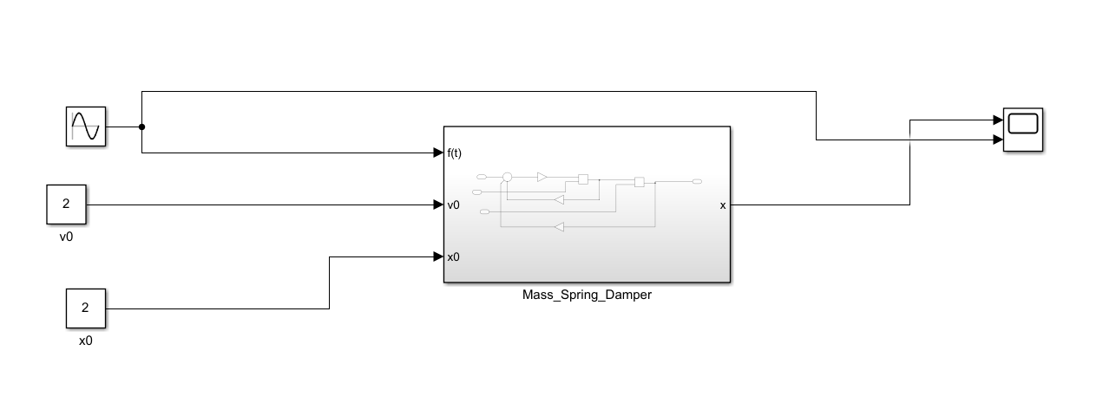
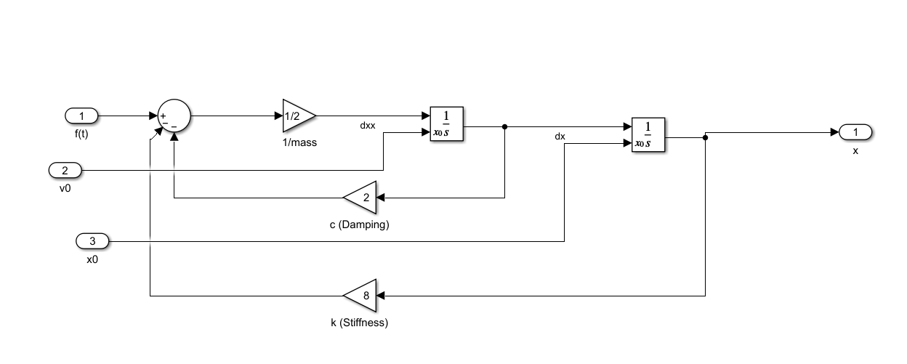
mx’’+cx’+kx = f(t)
x’’ = 1/m(f(t)-cx’-kx)

Slide 6
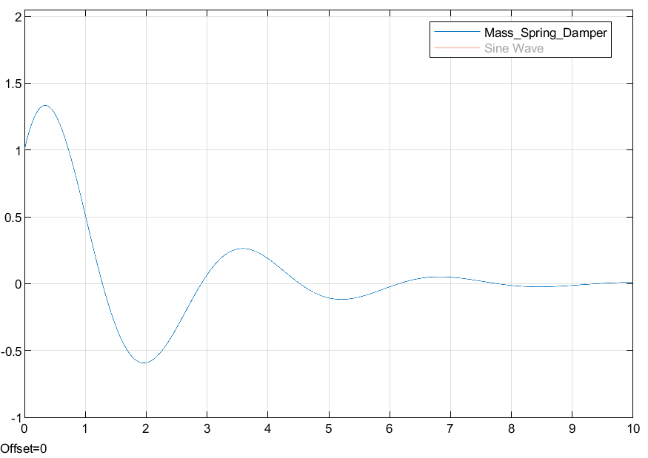

Slide 7
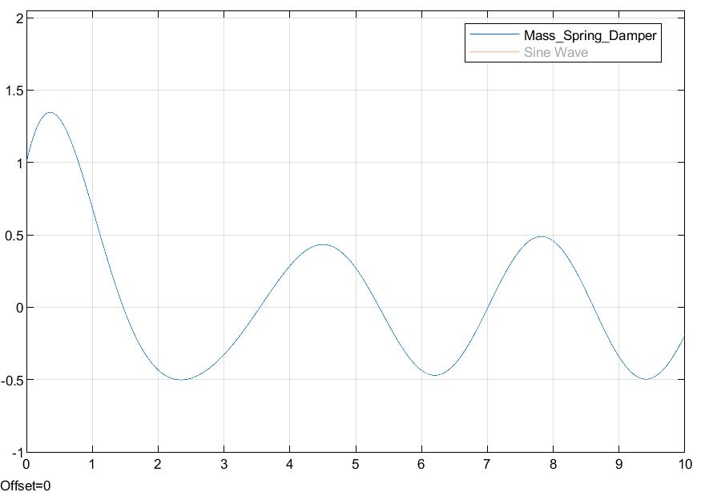
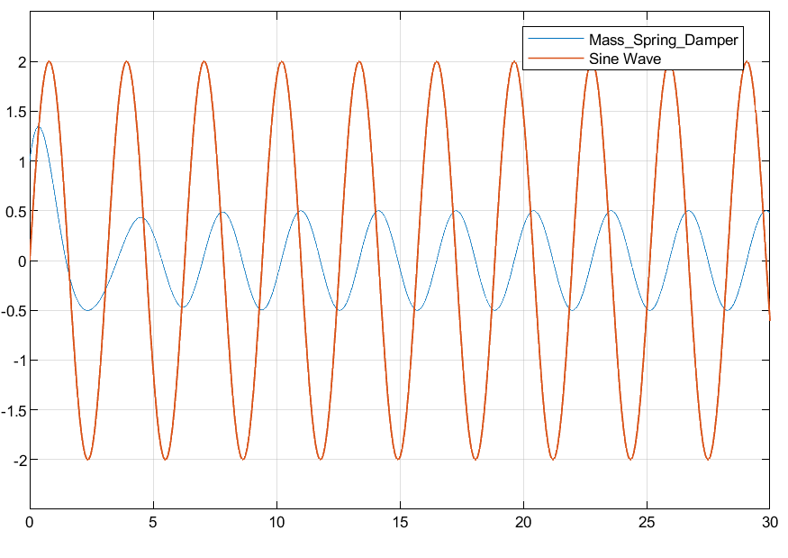
Stop Time = 10
Stop Time = 30

Slide 8
Mass Spring Damper using Flow*
System Dynamics
• x′=v: The rate of change of position x is equal to the velocity
• v′=(−((2)∗v)−((8)∗x))/2: This represents the dynamics of the spring and damper, where the velocity v changes over time due to the spring force and damping.
• t′=1: Time progresses uniformly. The invariant condition t<=6 ensures that the system operates within this mode for a maximum of 6 time units.
Initial Conditions
The initial conditions of the system are set as follows:
• Position x is initialized in the range [1, 1.001].
• Velocity v is within [2, 2.0001].
• Time t starts from [0, 0.01].

Slide 9
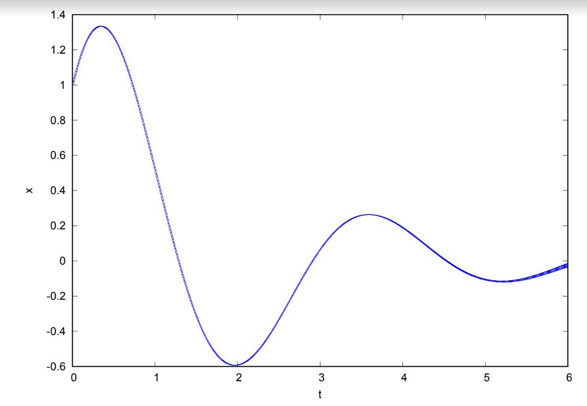

Slide 10
Railway Control System using UPPAAL
There are 3 parallel railways equipped with sensors.
Sensors detect approaching or leaving trains.
On train approach, lights turn red, and gates close; when trains leave, gates open, and lights turn green.
Trains take 15-30 seconds to approach/leave. The gate takes 5 seconds to open/close, and lights take 2 seconds to change.

Slide 11
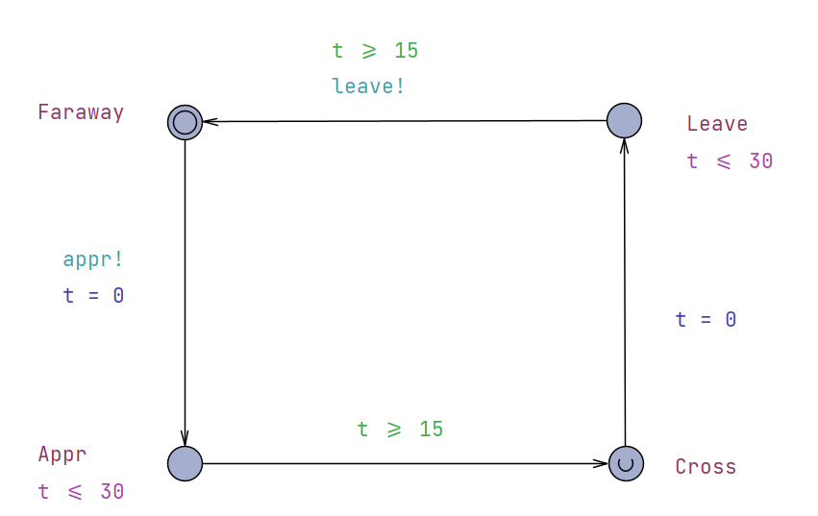
Trace: Represents train positions, transitioning from "Faraway" to "Appr" and back to "Faraway".

Slide 12
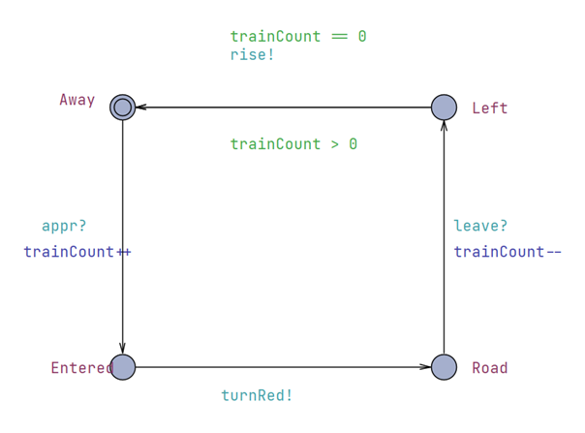
Sensor: Monitors trains, controlling the light and gate based on train presence.

Slide 13
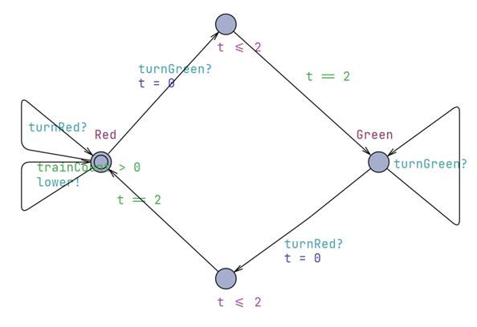
Light: Begins at "Red" and toggles between red and green based on sensor signals.

Slide 14
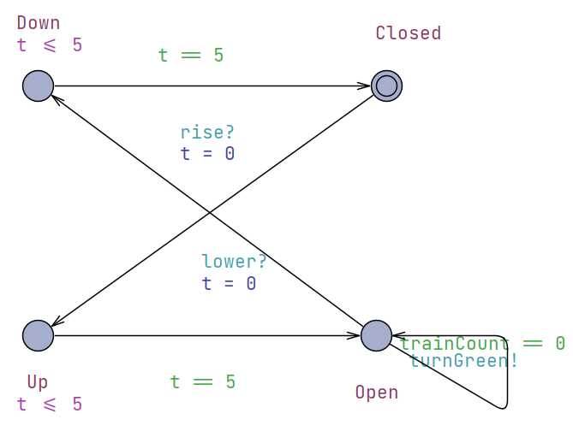
Gate: Starts "Closed" and moves between open and closed states as instructed by sensor signals.

Slide 15
Train Detection: Sensor increases "trainCount" when a train approaches.
Light Control: Stays red if a train is detected; turns green when tracks are clear.
Gate Control: Opens when no trains are detected; closes when a train approaches.
From Sensor to Light/Gate: Sends "turnRed" or "rise" signals based on train presence.
From Light to Gate: Sends "lower" signal if no train is on the track.
From Gate to Light: Sends "turnGreen" signal when it is open and no trains are present.

Slide 16
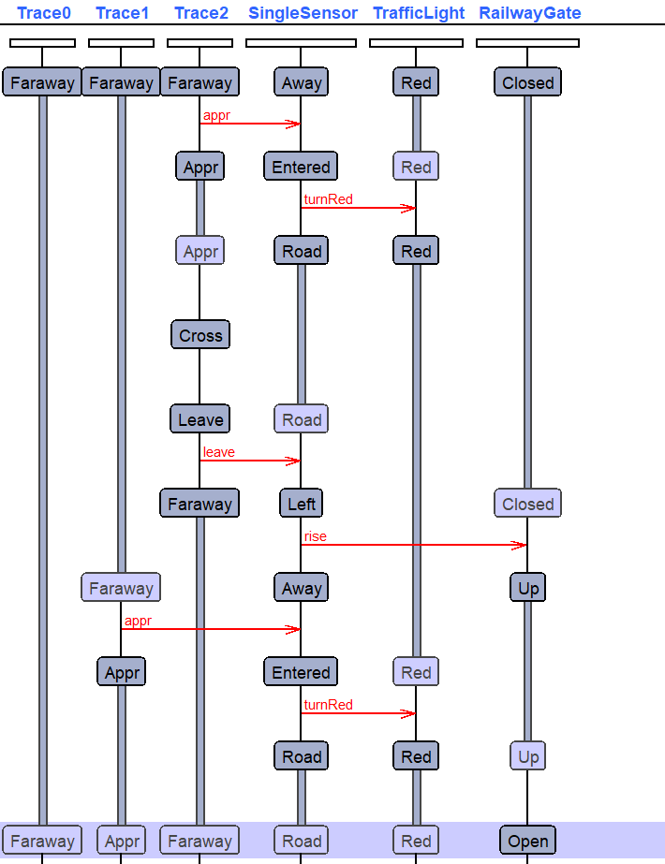

Slide 17
TICKET VENDING MACHINE USING UPPAAL
The model simulates a Ticket Vending Machine (TVM) system and a User interacting with it.
The system is designed to ensure a sequence of events from ticket selection to receipt printing.

Slide 18
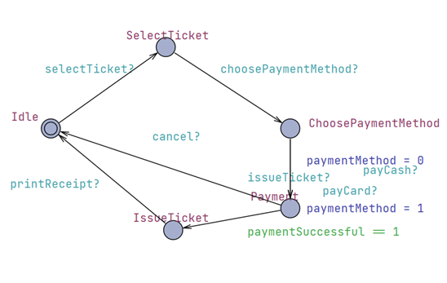
TVM Template

Slide 19
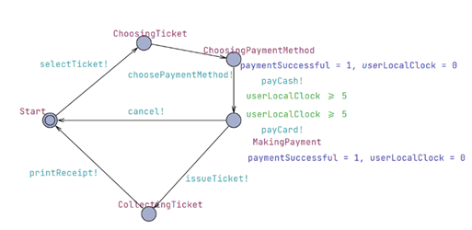
USER Template

Slide 20
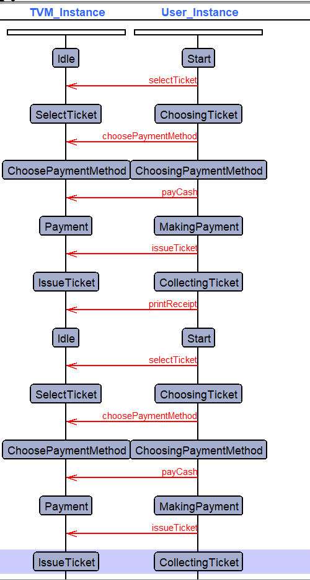

Slide 21
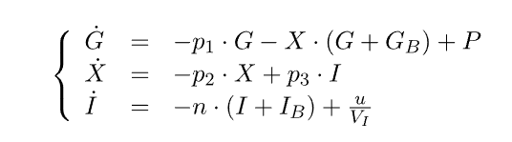
Glycaemic control using Flow*
The model studies the dynamics of glucose and insulin interaction in the blood system, defined by a set of Ordinary Differential Equations (ODEs).

Slide 22


p_1,p_2,p_3 are constant parameters:
The values of G_B and I_B are the basal values of plasma glucose concentration and free plasma insulin concentration respectively,
G_B = 4.5 mmol L^{-1}, I_B = 0.015 U L^{-1}.
The constant V_I is the insulin distribution volume = V_I = 12 L , and the value of n denotes the fractional disappearance rate of insulin =

Slide 23
Variables Explanation:
G: Difference in plasma glucose concentration.
I: Free plasma insulin concentration.
X: Insulin concentration in an interstitial chamber.
P: Rate of infusion of exogenous glucose.
u: Rate of infusion of exogenous insulin.
Insulin Infusion Rate (P): Defined as P=0.5⋅exp(−0.05⋅t)

Slide 24
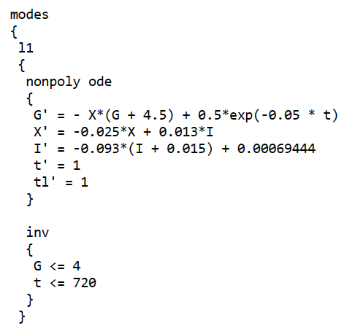
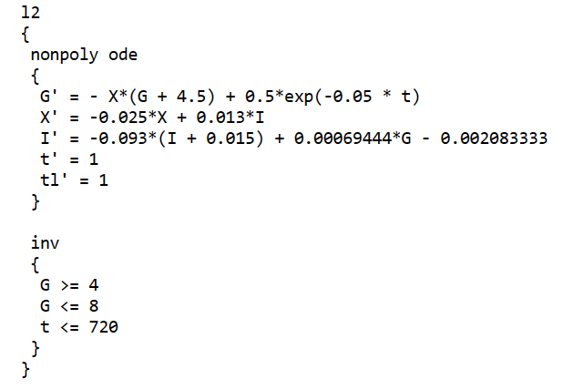
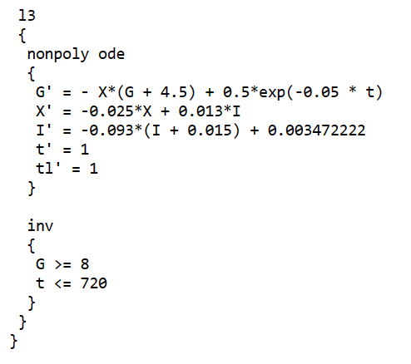
The modes here represent different states in the model
of glucose and insulin interaction in the blood system.
Each mode has its own set of dynamics, defined by ordinary
differential equations (ODEs), and conditions for transitioning
between modes.

Slide 25
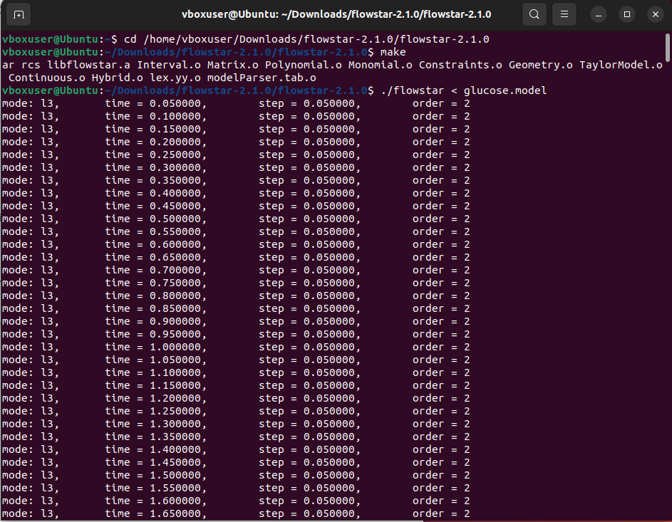
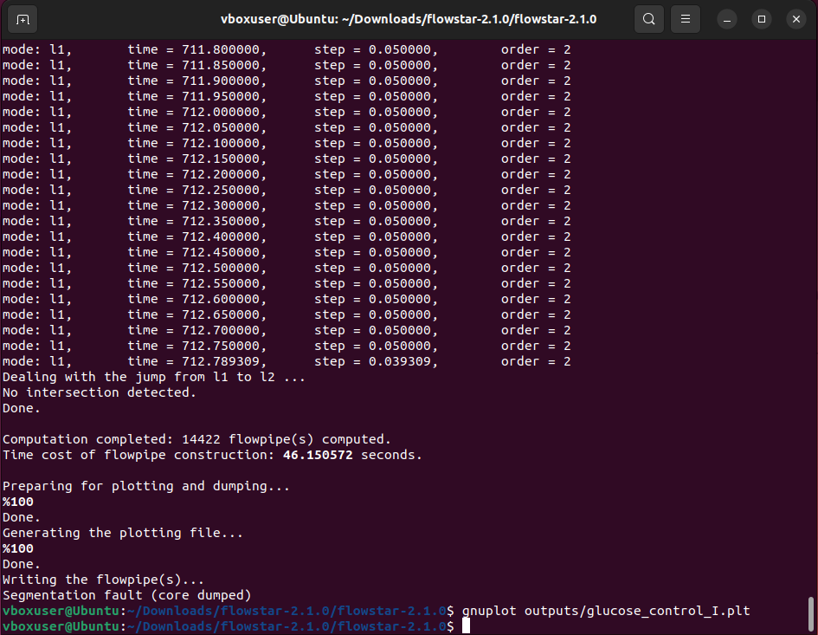

Slide 26
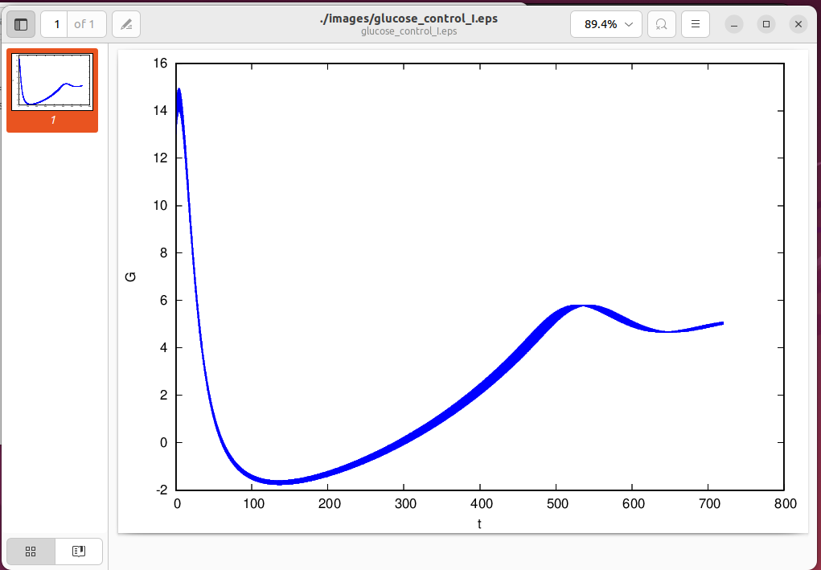
Initial Values (init):
For G (Glucose), [13, 14].
For X (Insulin concentration), [0, 0]
For I (Insulin ,[0.5, 0.5].
For t (time), [0,0]
For tl, [0,0].

Slide 27
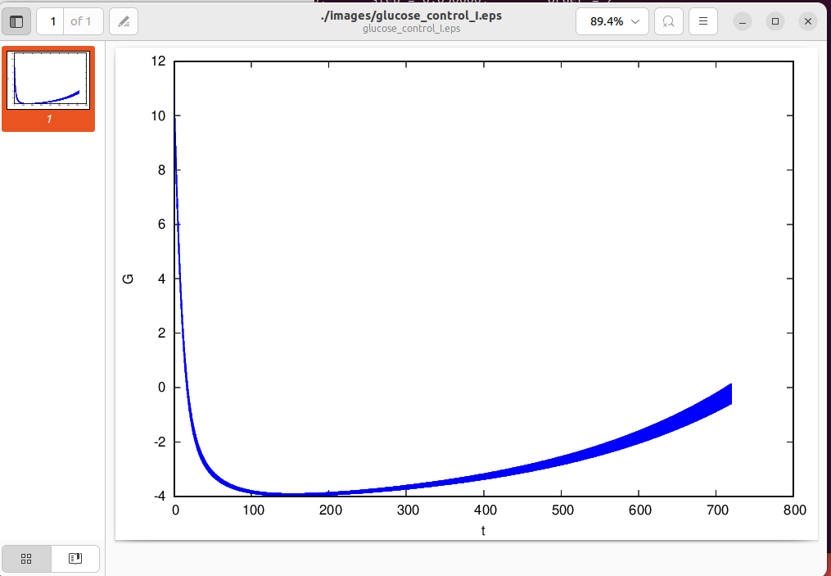
Initial Values (init):
For G (Glucose), [10, 11].
For X, [0.1, 0.1]
For I (Insulin ,[0.5, 0.5].
For t (time), [0,0]
For tl, [0,0].

Slide 28
THANK YOU

