Slide 1
Python Basics

Slide 2
Topics Covered
Python Intro
Python Syntax
Python Comments
Python Variables
Python Data Types
Python Numbers
Python Casting
Python Strings
Python Booleans
Python Operators
Python Lists
Python Tuples
Python Sets
Python Dictionaries

Slide 3
Python Intro
What is Python?
Python is a popular programming language created by Guido van Rossum and released in 1991.
It is used for:
Web development (server-side)
Software development
Mathematics
System scripting
What Can Python Do?
Create web applications on a server.
Integrate with software to create workflows.
Connect to database systems, read, and modify files.
Handle big data and perform complex mathematics.
Facilitate rapid prototyping or production-ready software development.
Why Python?
Works on different platforms: Windows, Mac, Linux, Raspberry Pi, etc.
Simple syntax similar to English, enabling fewer lines of code.
Interpreter-based, allowing code execution as soon as it is written for faster prototyping.
Supports procedural, object-oriented, and functional programming styles.

Slide 4
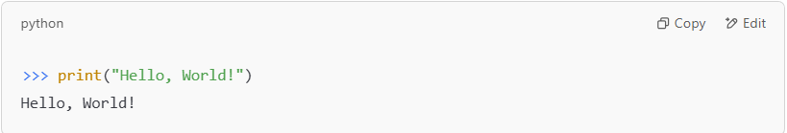
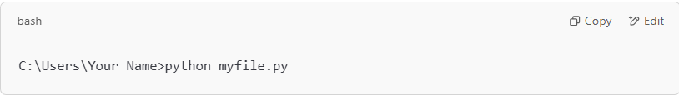
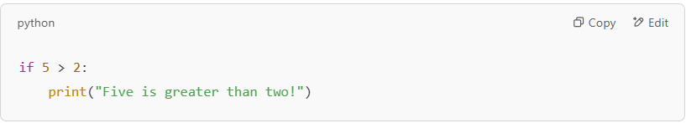
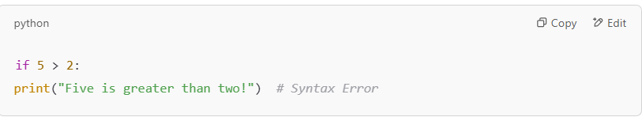
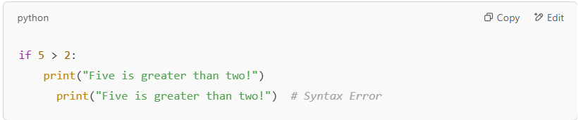
Python Syntax
Execute Python Syntax
Python syntax can be executed directly in the Command Line:
Alternatively, create a Python file (.py) and run it in the Command Line:
Python Indentation
Indentation refers to spaces at the beginning of a code line.
In Python, indentation is required to define a block of code. Example:
Common Rules for Indentation:
The number of spaces is up to the programmer (commonly 4 spaces).
Consistency is key—use the same number of spaces within the same block of code.
Errors in Indentation:
Skipping indentation causes a syntax error
Inconsistent spaces within the same block also cause an error:

Slide 5
Python Syntax
Execute Python Syntax
Python syntax can be executed directly in the Command Line:
Alternatively, create a Python file (.py) and run it in the Command Line:
Python Indentation
Indentation refers to spaces at the beginning of a code line.
In Python, indentation is required to define a block of code. Example:
Common Rules for Indentation:
The number of spaces is up to the programmer (commonly 4 spaces).
Consistency is key—use the same number of spaces within the same block of code.
Errors in Indentation:
Skipping indentation causes a syntax error
Inconsistent spaces within the same block also cause an error:

Slide 6
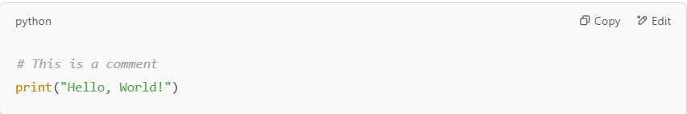
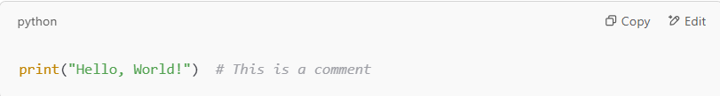
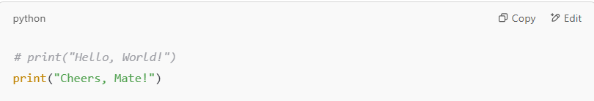
Python Comments
Why Use Comments?
Explain code for better understanding.
Improve readability for yourself and others.
Prevent code execution when testing or debugging.
Creating a Comment
Comments start with #, and Python ignores anything written after it.
Comments can also be added at the end of a line
Preventing Execution with Comments
Comments can be used to disable code:

Slide 7
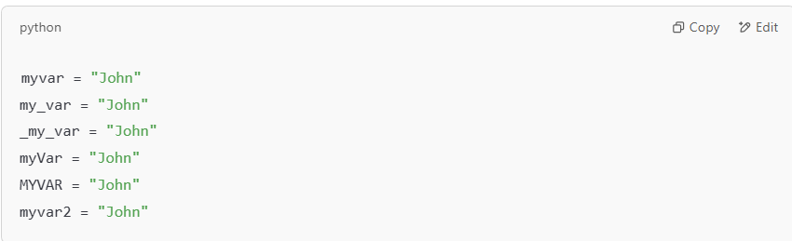
Python Variables
What are Variables?
Variables are containers for storing data values.
Variable Names
Variables can have short names (e.g., x, y) or descriptive names (e.g., age, carname, total_volume).
Rules for Variable Names:
Must start with a letter or an underscore (_).
Cannot start with a number.
Can only contain alphanumeric characters and underscores (A-z, 0-9, _).
Variable names are case-sensitive (age, Age, and AGE are different).
Cannot use Python keywords as variable names.
Legal Variable Names:

Slide 8
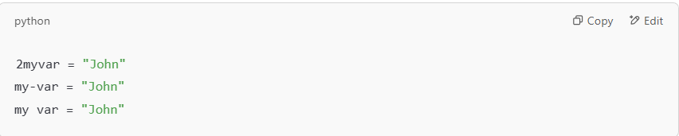
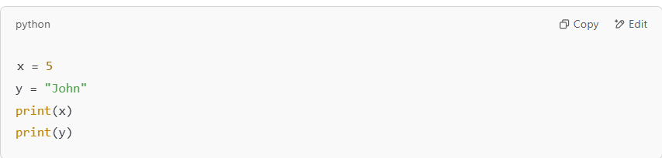
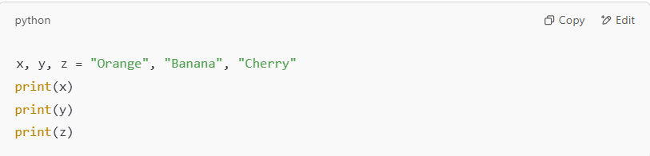
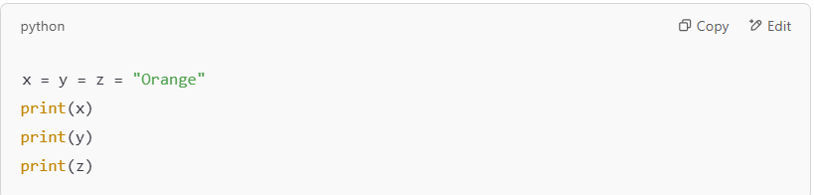
Python Variables
Illegal Variable Names:
Creating Variables
No need to declare a variable in Python.
A variable is created the moment you assign a value to it.
Assign Multiple Values
Assign Many Values to Multiple Variables
Assign values to multiple variables in one line:
Assign One Value to Multiple Variables
Assign the same value to multiple variables in one line:

Slide 9
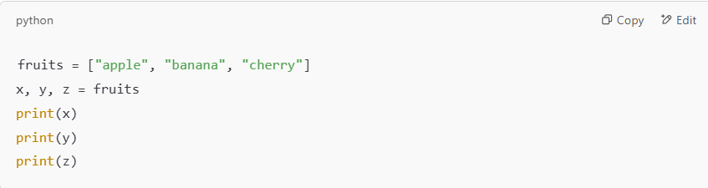
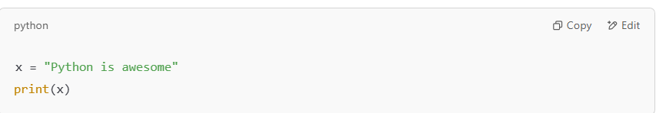
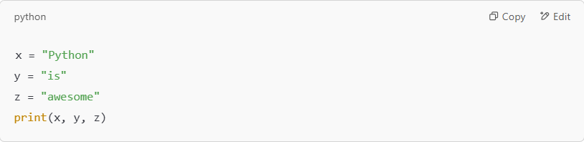
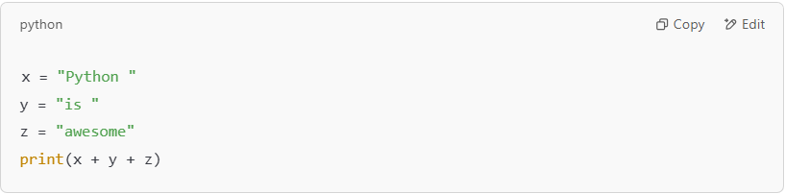
Python Variables
Unpack a Collection
Extract values from a list, tuple, or other collection into variables. This is called unpacking.
Output Variables
Use the print() function to output variables
Output multiple variables, separated by a comma .
Using + Operator
Concatenate strings:

Slide 10
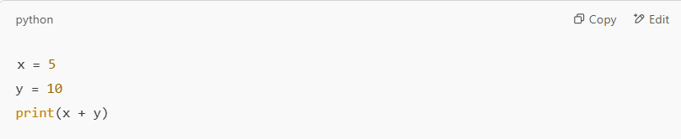
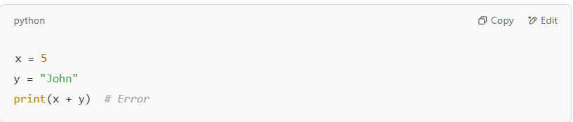
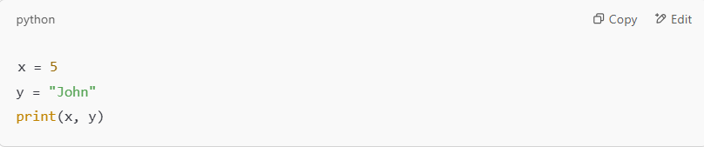
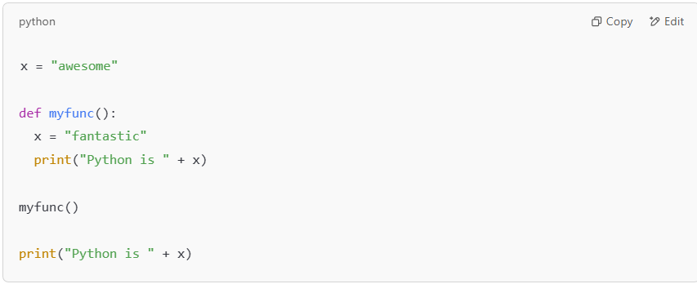
Python Variables
For numbers, the + operator works as a mathematical operator:
Combining a string and a number with + results in an error:
Best practice: Use commas to output variables of different data types:
Global Variables
Global variables are created outside a function and can be accessed both inside and outside functions.
Local vs Global Variables
Variables created inside a function are local and can only be used
inside that function.
A global variable with the same name will remain unaffected.

Slide 11
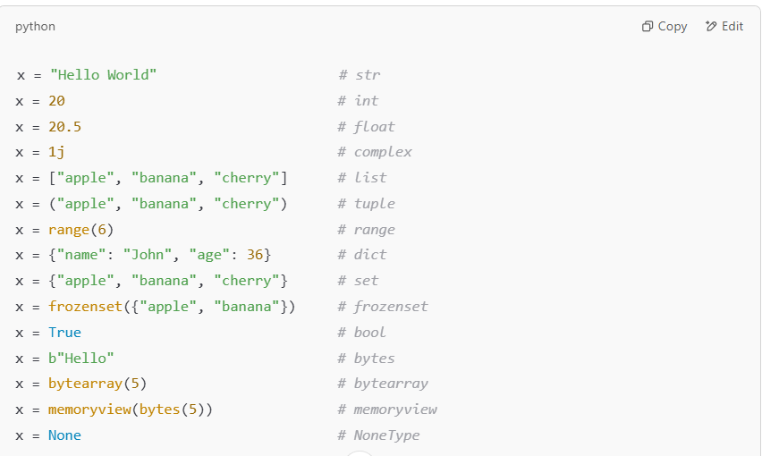
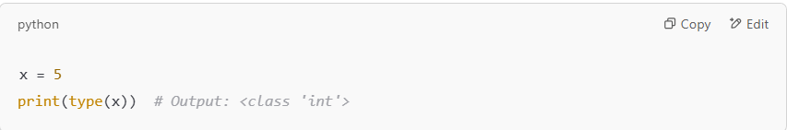
Python Data Types
Built-in Data Types
In programming, data types define the kind of data a variable can hold.
Variables in Python can store different types of data, and each type serves specific purposes.
Categories of Python Built-in Data Types
Text Type: str
Numeric Types: int, float, complex
Sequence Types: list, tuple, range
Mapping Type: dict
Set Types: set, frozenset
Boolean Type: bool
Binary Types: bytes, bytearray, memoryview
None Type: NoneType
Getting the Data Type
Use the type() function to check the data type of a variable.
Setting the Data Type
Python determines the data type automatically when you assign a value to a variable.

Slide 12
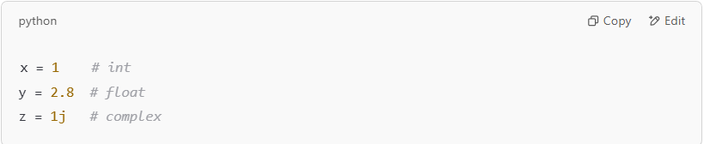
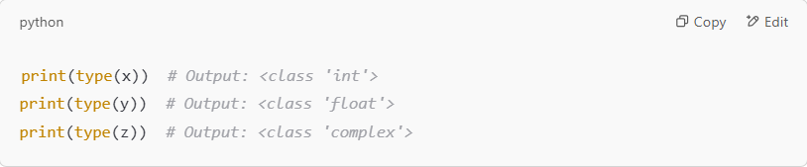
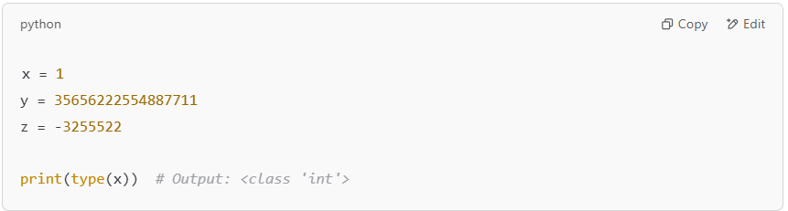
Python Numbers
Numeric Types in Python
Python has three numeric types:
int: Integer (whole numbers, positive or negative, without decimals).
float: Floating-point numbers (numbers with decimals).
complex: Complex numbers (numbers with a real and imaginary part).
Creating Numeric Variables
Python automatically assigns a numeric type when you assign a value:
Use the type() function to check the type of a variable:
int (Integer)
Whole numbers without decimals.
Can be positive, negative, or zero.
Unlimited length.

Slide 13
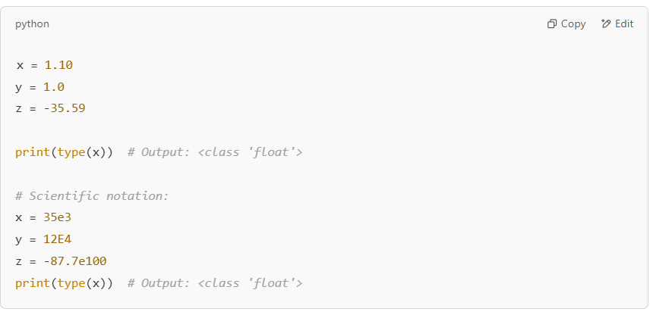
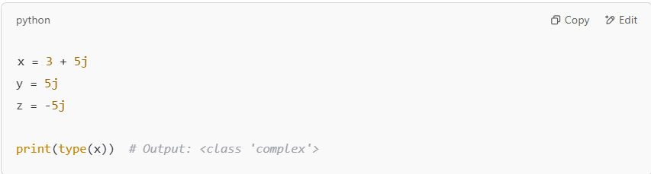
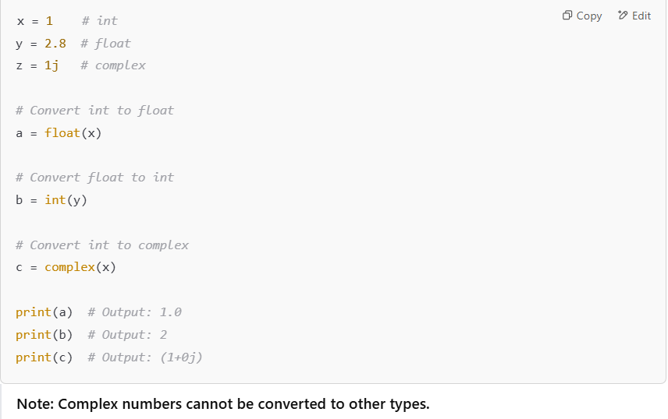
Python Numbers
Numeric Types in Python
float (Floating-Point Numbers)
Numbers with one or more decimals.
Can represent scientific notation using e (power of 10).
.
complex (Complex Numbers)
Written with a real part and an imaginary part using j.
Type Conversion
Convert between numeric types using int(), float(), and complex().

Slide 14
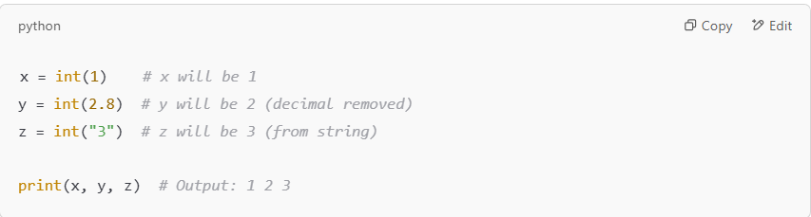
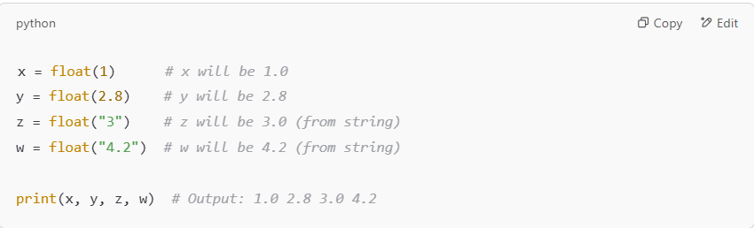
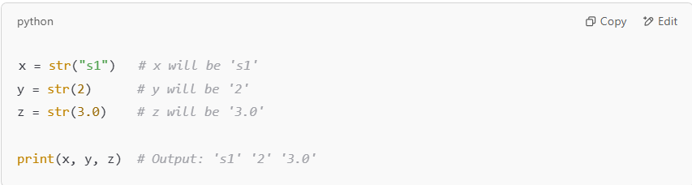
Python Casting
Specify a Variable Type
In Python, you can explicitly define the type of a variable using casting.
Python uses classes to define data types, including its primitive types.
Casting in Python
Casting is done using constructor functions:
int() Converts a value to an integer.
Accepts integer literals, float literals (removes decimals), or string literals (if the string represents a whole number).
float() Converts a value to a floating-point number.
Accepts integer literals, float literals, or string literals (if the string represents a number).
str() Converts a value to a string.
Accepts a wide variety of data types (e.g., integers, floats, or strings).
Why Use Casting?
To ensure a variable is of a specific type.
To prevent errors when performing operations that require specific data types.

Slide 15
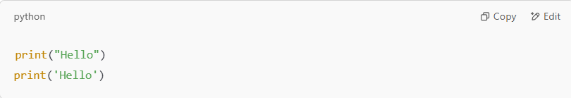
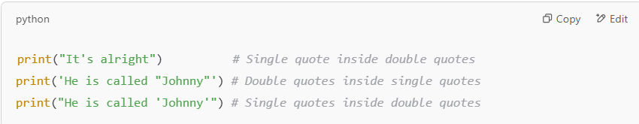
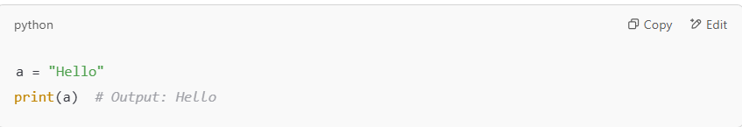
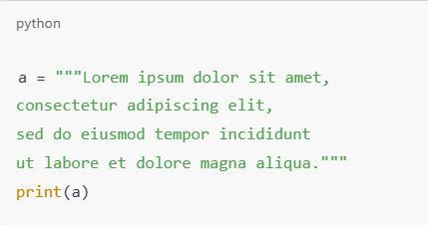
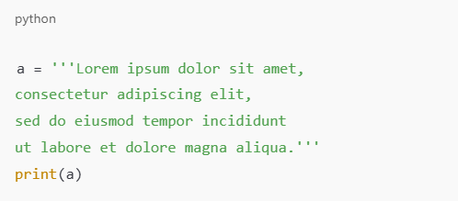
Python Strings
What are Strings?
Strings in Python are surrounded by quotation marks:
Single quotes ('hello')
Double quotes ("hello")
Quotes Inside Strings
You can include quotes inside a string if they do not match the surrounding quotes.
Assigning Strings to Variables
Use the = operator to assign a string to a variable.
Multiline Strings
Use triple quotes (""" or ''') to define multiline strings.

Slide 16
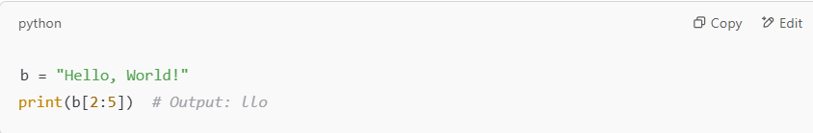
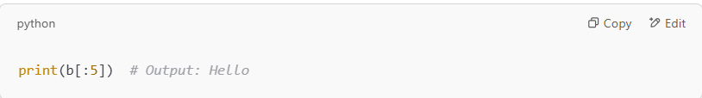
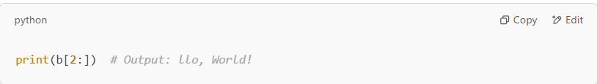
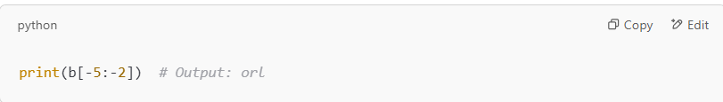
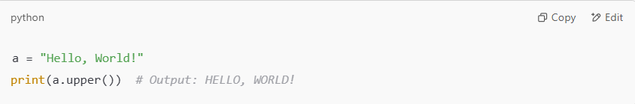
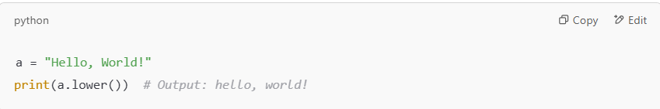
Python Strings
Slicing Strings
Use the slice syntax string[start:end] to return a range of characters.
The start index is inclusive, and the end index is exclusive.
Slice From the Start:
Omit the start index to start from the beginning:
Slice To the End:
Omit the end index to slice until the end
Negative Indexing:
Use negative indexes to slice from the end of the string:
Modify Strings
Python provides several built-in methods to modify strings:
1. Convert to Upper Case
2. Convert to Lower Case

Slide 17
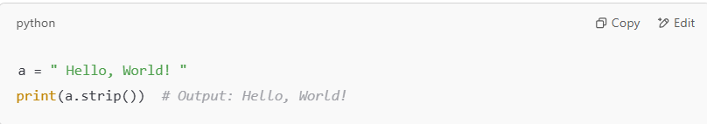
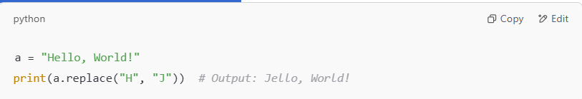
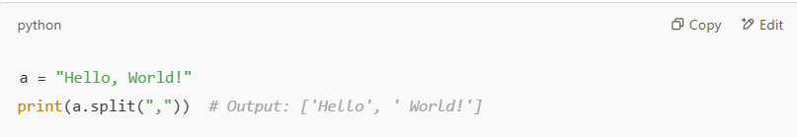
Python Strings
3. Remove Whitespace
Removes leading and trailing spaces
4. Replace a String
Replaces a substring with another string
5. Split a String
Splits a string into a list of substrings based on a separator:

Slide 18
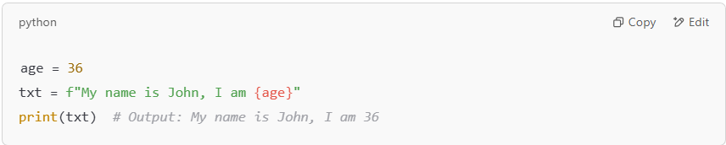
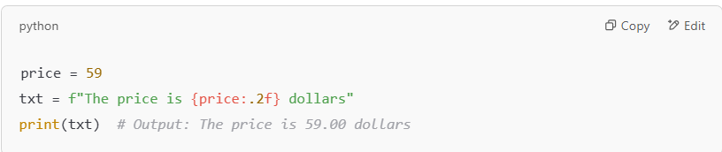
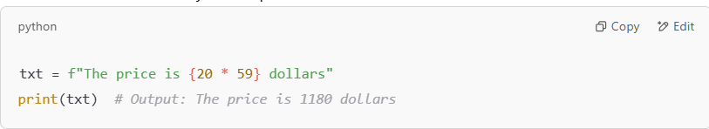
Python Strings
String Format
When combining strings and variables, Python provides two primary ways: f-strings and the format() method.
F-Strings (Preferred Method)
Introduced in Python 3.6, f-strings allow you to embed variables and expressions directly in strings.
Use an f before the string literal and enclose placeholders in {}.
Using Modifiers:
Add a colon : followed by a format specifier (e.g., .2f for two decimal places):
Performing Operations in Placeholders:
Placeholders can include Python expressions like mathematical calculations

Slide 19
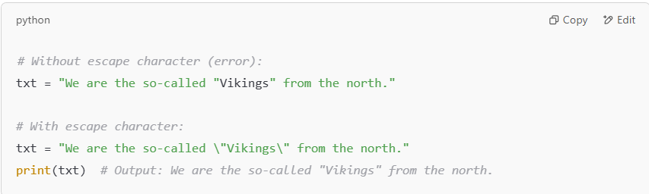

Python Strings
Escape Character
Use an escape character (\) to insert special or illegal characters in a string.

Slide 20


Python Booleans
What are Booleans?
Booleans represent one of two values: True or False.
Boolean Values
In programming, you often need to determine if an expression is True or False.
Python can evaluate any expression and return a Boolean value.
Booleans in if Statements
Boolean values are often used in conditional statements to control the flow of a program.

Slide 21


Python Operators
What are Operators?
Operators are used to perform operations on variables and values.
Types of Operators in Python
Arithmetic Operators
Assignment Operators
Comparison Operators
Logical Operators
Membership Operators
1. Python Arithmetic Operators
Arithmetic operators are used with numeric values to perform mathematical operations.

Slide 22


Python Operators
2. Python Assignment Operators
Assignment operators are used to assign values to variables.
3. Python Comparison Operators
Comparison operators are used to compare two values.

Slide 23


Python Operators
4. Python Logical Operators
Logical operators are used to combine conditional statements.
5. Python Membership Operators
Membership operators test if a value is in a sequence (e.g., list, string).

Slide 24

Python Lists
Four Collection Data Types in Python:
List:
Ordered and changeable.
Allows duplicate members.
Example: ["apple", "banana", "cherry"]
Tuple:
Ordered and unchangeable.
Allows duplicate members.
Example: ("apple", "banana", "cherry")
Set:
Unordered, changeable, and unindexed.
Does not allow duplicate members.
Example: {"apple", "banana", "cherry"}
Dictionary:
Ordered and changeable.
Does not allow duplicate members.
Example: {"name": "John", "age": 36}
What are Lists?
Lists are used to store multiple items in a single variable.
Lists are created using square brackets

Slide 25



Python Lists
List Length
Use the len() function to determine the number of items in a list:
List Items - Data Types
List items can be of any data type:
A list can also contain different data types:

Slide 26




Python Lists
Type of a List
Lists are objects of the data type 'list':
The list() Constructor
You can also create a list using the list() constructor
Access List Items
1. Access by Index:
Use the index to access items in a list:
2. Negative Indexing:
Use negative indexing to access items from the end:

Slide 27




Python Lists
3. Range of Indexes:
Specify a range of indexes to create a new list:
Leave out the start value to begin at the first item:
Leave out the end value to continue to the end of the list:
4. Range of Negative Indexes:
Use negative indexes to specify a range from the end of the list:

Slide 28



Python Lists
Check if Item Exists
Use the in keyword to check if an item exists in the list:
Change List Items
1. Change Item Value: To modify a specific item, refer to its index number
2. Change a Range of Item Values: Replace multiple items by specifying a range and providing new values

Slide 29


Python Lists
Insert Items
To insert a new item without replacing existing values, use the insert() method.
The insert() method inserts an item at the specified index.
Remove List Items
Remove Specified Item:
Use the remove() method to remove a specific item.

Slide 30



Python Lists
If the specified item occurs multiple times, remove() removes the first occurrence:
2. Remove Specified Index:
Use the pop() method to remove an item at a specific index:
If no index is specified, pop() removes the last item:

Slide 31



Python Lists
Use the del keyword to remove an item at a specific index:
3. Delete the Entire List: The del keyword can delete the list entirely:
4. Clear the List: Use the clear() method to empty the list while keeping it intact:
Use the clear() method to empty the list while keeping it intact

Slide 32


Python Lists
Join Lists
1. Join Two Lists Using + Operator:
One of the easiest ways to join two or more lists is by using the + operator.
.
2. Join Lists by Appending Items:
Append all items from list2 to list1, one by one.

