Slide 1


Automation

Slide 2


Automation topics
Sending glue job status mail
Collecting stats of yesterday’s job runs
Monitoring the lambda function ran successful or not

Slide 3
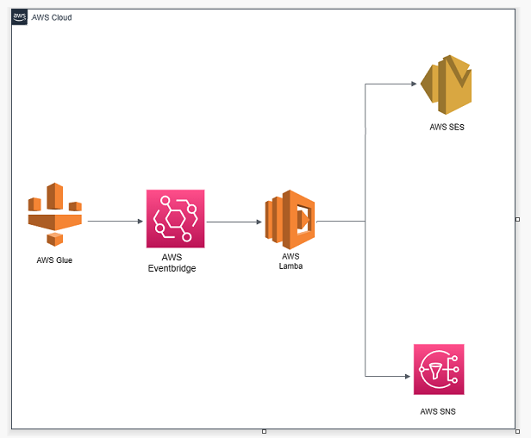
Sending glue job status mail
Services involved:
Eventbridge – generate event after every glue job run
Lambda – process the event and create the mail details
SES/SNS – send the mail to the recipient list

Slide 4
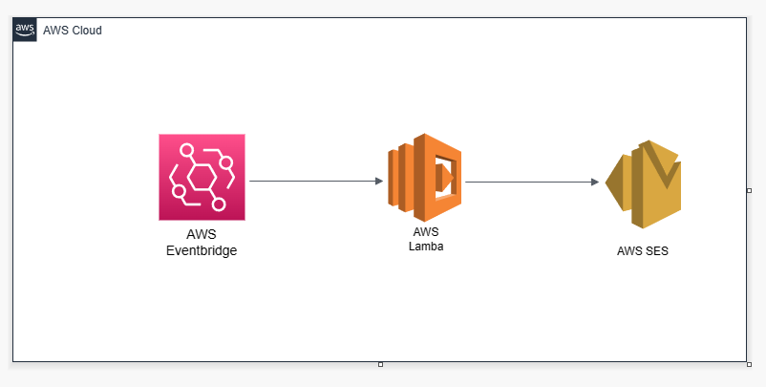
Collection of daily stats
Services involved:
Eventbridge – generate event on defined schedule
Lambda – process the event and create the excel file with stats
SES – send the mail with attachment to the recipient list

