Slide 1

AI Powered Solution for Assisting Visually Impaired Individuals

Slide 2
About me
Iam R.Radhika , I completed my Masters in Data science in the year 2023.
To acquire more knowledge in coding,projects I joined in Innomatics
Linked in and Github urls:
https://www.linkedin.com/in/ramachandrapuram-radhika/
https://github.com/ramachandrapuram-radhika/

Slide 3
Introduction
Millions face challenges in accessing visual content.
The Visually Impaired Assistant empowers users with visual impairments by providing tools for image description, text extraction, and audio playback.
This application leverages AI for scene interpretation, text recognition, and voice feedback.

Slide 4
Key Features
1.Scene Interpretation :
1. Detects objects, actions, and context in images.
2. Provides detailed descriptions for better understanding.
2. Text Extraction :
1. Reads text from images with high accuracy.
2. Supports documents, signs, and handwritten notes.
3.Text-to-Speech Conversion:
Converts extracted text into natural-sounding audio.
Offers hands-free interaction for convenience.

Slide 5
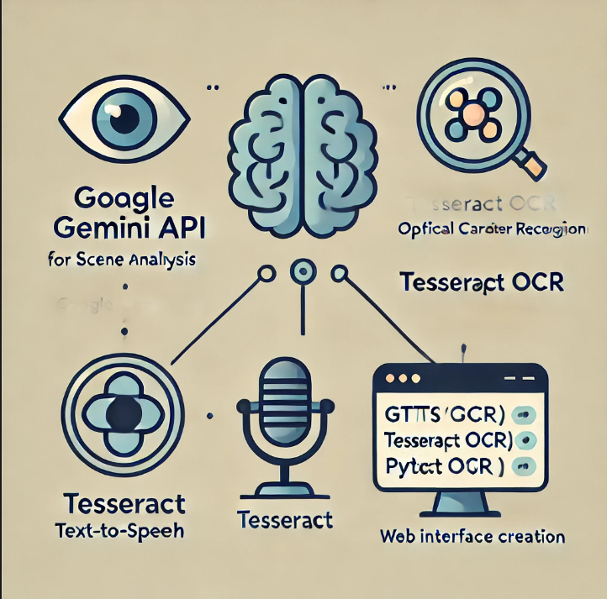
Technologies Used
Google Gemini API: For scene analysis
and image interpretation.
Tesseract OCR: An open-source tool for
optical character recognition.
Text-to-Speech Libraries:
gTTS : Generates natural speech outputs.
pyttsx3: Provides an alternative offline speech engine.
Streamlit : Framework for creating an
interactive web interface.

Slide 6
WORKFLOW
Image Upload :
Users upload an image via an intuitive interface.
Feature Selection :
Choose between scene description , text extraction, or text to speech conversion.
AI Processing :
The app processes the image using integrated AI tools.
Output Delivery :
Provides actionable insights , text, or audio feedback.

Slide 7
1.Scene Interpretation :
The user uploads the image.
The image is converted into a suitable format and sent to Google Gemini API.
A predefined prompt instructs the AI to analyze the image.
The API uses advanced computer vision and generative AI to identify objects, activities, and surroundings.
The API generates a textual description based on the analysis.
A detailed description of the scene is displayed to the user.

Slide 8
2. Text Extraction :
The Tesseract OCR library reads the uploaded image and performs optical character recognition (OCR).
OCR identifies characters, words, and lines in the image and converts them into plain text.
The text is formatted for user readability.
The extracted text is displayed in a text area.

Slide 9
3.Text-to-Speech Conversion:
Extracted text from an image or a custom input provided by the user.
The gTTS (Google Text-to-Speech) library takes the text as input.
The text is synthesized into an audio file in .mp3 format.
Temporary storage is used to save the audio file for playback.
The generated audio is played back using an audio player integrated into the application.

Slide 10
Conclusion :
The Visually Impaired Assistant is a user-friendly tool that combines AI-powered scene interpretation, text extraction, and text-to-speech conversion to make visual content accessible. By leveraging advanced technologies like Google Gemini API, Tesseract OCR, and gTTS , it empowers visually impaired individuals to better understand and interact with the world around them, promoting independence and inclusivity.

Slide 11

THANK YOU

