Slide 1

JDBC Request
JDBC Request sampler lets you execute Database Performance Testing. It sends a JDBC Request (an SQL query) to a database.
Prepared By: Mounika Sarikonda

Slide 2
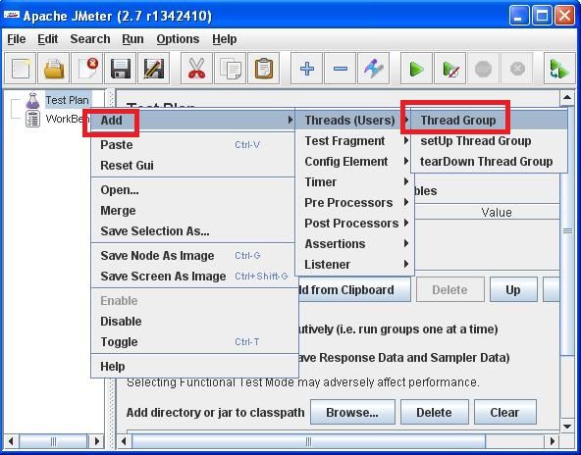
JDBC Request
JDBC Connection Configuration
Step1:Right click on Test Plan in left-hand side pane. And add a thread group. In the right-hand side pane, set a name for thread-group (eg. JDBC Test).

Slide 3

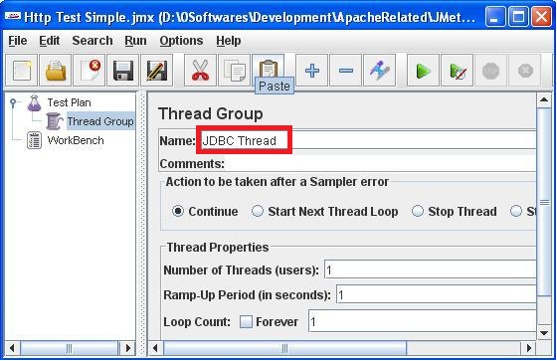
JDBC Request
Change the Thread Group name as shown in below figure.

Slide 4
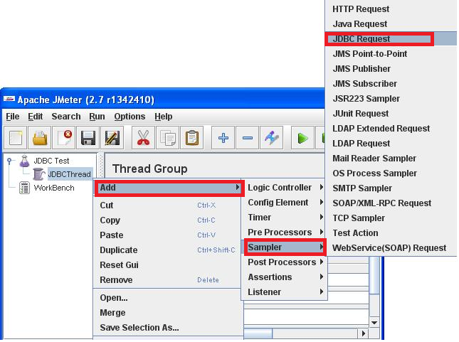
JDBC Request
Step2:Now, right-click on the thread-group created above, and add Sampler JDBC Request.

Slide 5
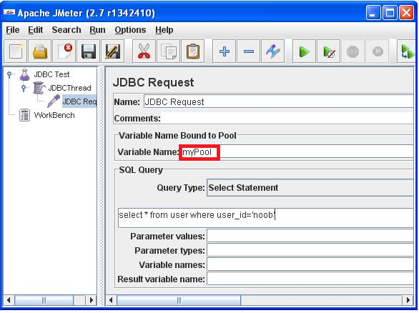
JDBC Request
JDBC Connection Configuration
In the pool name field, put myPool (we will reuse the pool name when defining JDBC Config Defaults).

Slide 6
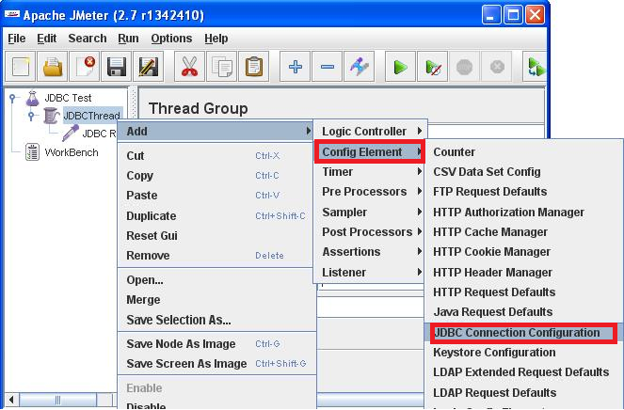
JDBC Request
Step3:Now let's configure the database url, driver etc. Right-click of "Test Plan" in left-hand side pane and add Config Element JDBC Request Defaults.

Slide 7
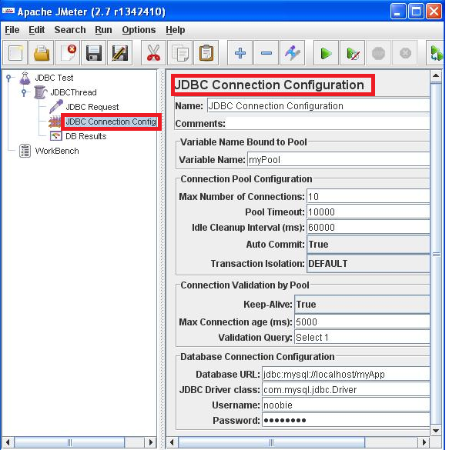
JDBC Request
In this jdbc config element, add the pool name (same name myPool used above )db url driver name, username and password as shown in the image.

Slide 8
JDBC Request
JDBC Connection Configuration
Step4: Since JMeter will execute queries using JDBC, we need to provide the database specific driver class to JMeter's classpath $JMETER_HOME/lib. You will need to restart JMeter after adding this jar file for the classpath to get reloaded.

Slide 9
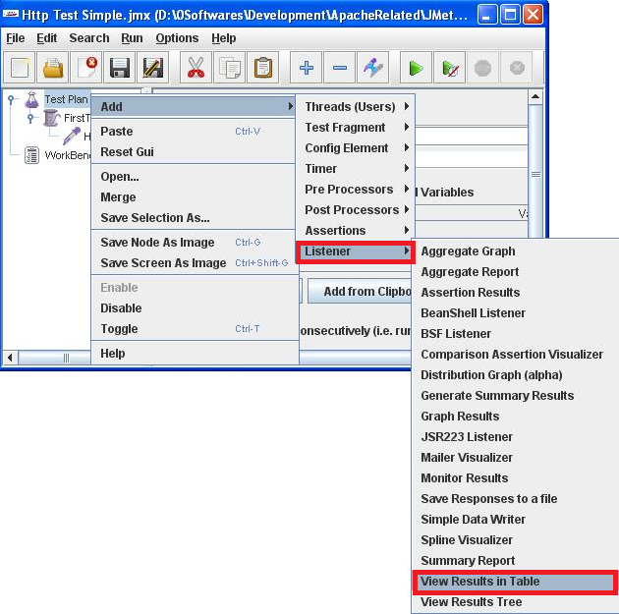
JDBC Request
JDBC Connection Configuration
Step5: Now in order to view the test results, you need a Listener. We will use a tabular listener. Right click on Test Plan and add Listener View Results in Table. Give it a name and let other fields keep default value.

Slide 10
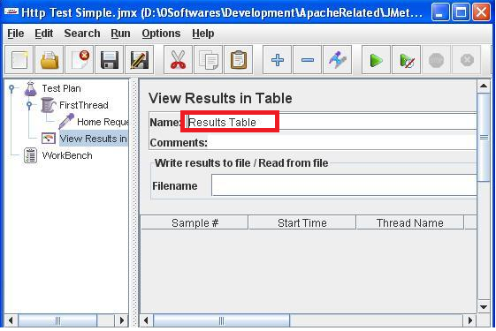
JDBC Request
JDBC Connection Configuration
Give a name to listener and run the test.

Slide 11
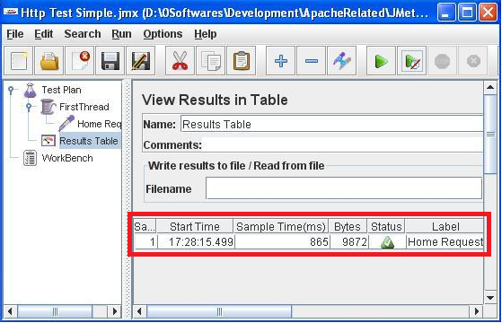
JDBC Request
JDBC Connection Configuration
Step6: Just hit the start button (green arrow head) from the menu bar. In the View Results in Table page, the result will be displayed. It will contain timestamp, response time, response size in bytes etc.

Slide 12

Thank You

