Slide 1

Parameterization
Parameterization is a process of generalizing some user input, so as to use it for multiple users or executions that means we can execute one test plan for more than one user at the same time.
Prepared By: Hemalatha M

Slide 2
Parameterization
Concept of Parameterization
Suppose, we need to do load test of a search engine for 100 users, for this effective load test we cannot record the script for 100 times. So in order to overcome this problem we use parameterization concept, wherein we can use a CSV file that contains 100 different items instead of the static search item that we had recorded in our script we can include the search items from the CSV file dynamically.

Slide 3
Parameterization
Configuration Elements in JMeter
Configuration elements can be used to set up defaults and variables for later use by samplers.
Configuration element which is used to parameterize JMeter is CSV Data set Config.

Slide 4
Parameterization
CSV Data Set Config
CSV Data Set Config is a element that allows you to read different parameters from text file, it reads lines from a file and splits them into variables.
It is well suited to handling large numbers of variables, and is also useful for testing with "random" and unique values.

Slide 5
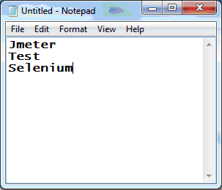
Parameterization
CSV Data Set Config
Consider an example to parameterize the simple search scenario in a search engine.
Step 1: Store the values in a notepad which we want to search and save the file as “search.csv” as shown in the below figure

Slide 6
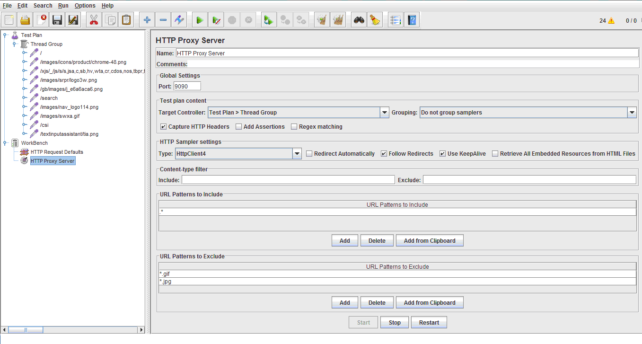
Parameterization
CSV Data Set Config
Step 2: Record a script for searching a single word using JMeter by using HTTP Proxy server as shown in below figure

Slide 7
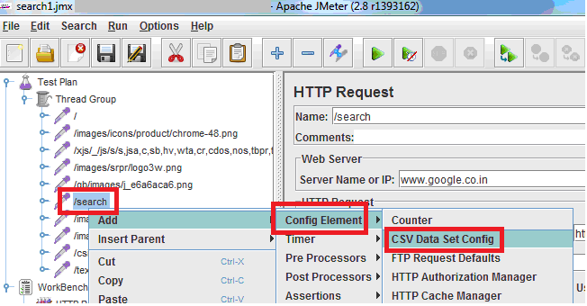
Parameterization
CSV Data Set Config
Step 3: Add CSV Data set config element to the HTTP request(search) as shown in the below figure

Slide 8
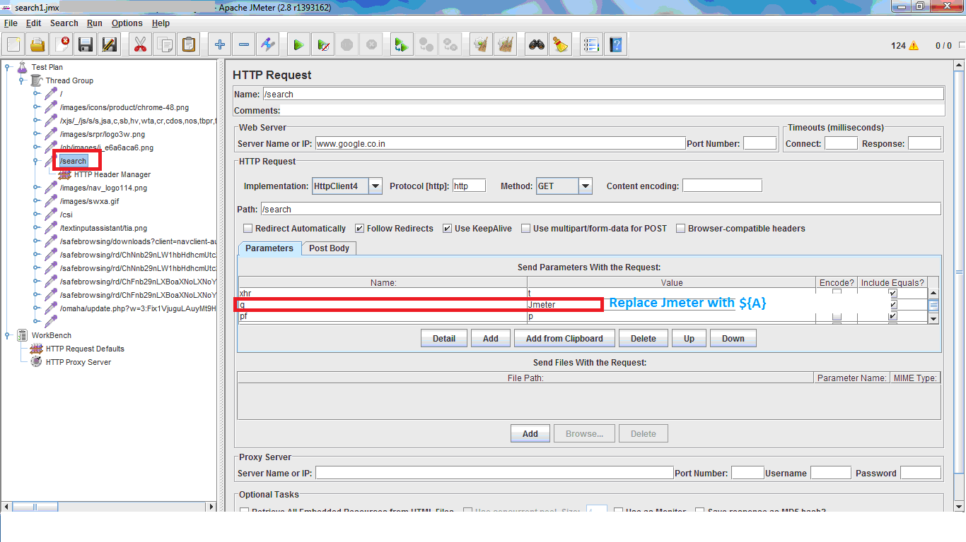
Parameterization
CSV Data Set Config
Step 4: Click on the thread name “search” and change “q” parameter as “${A}”, here ‘A’ is the variable to store different parameters for the search as shown in the below figure

Slide 9
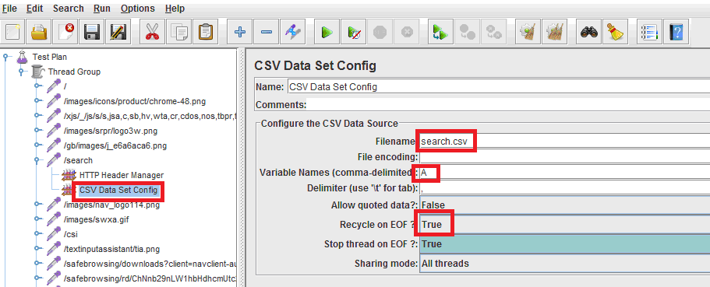
Parameterization
CSV Data Set Config
Step 4: Open the CSV data set config element which had attached to the search request and now give the filename (path of the search.csv) variable name as “A” and change Stop thread on EOF as “True” as shown in the below figure

Slide 10
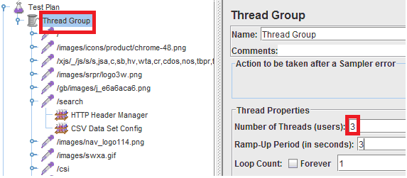
Parameterization
CSV Data Set Config
Step 4: Click on Thread Group and change Number of Threads as 3 and Ramp-Up Period as 3 as we are searching for 3 words as shown in the below figure

Slide 11
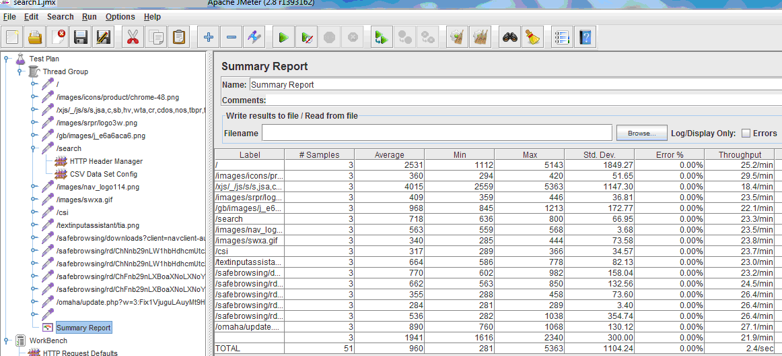
Parameterization
CSV Data Set Config
Finally we can add listeners to view the results
Add a Summary report to the thread group as shown in the below figure

Slide 12

Thank You

