Slide 1
Correlation in JMeter
Correlation is the most important aspect of scripting. It generally includes fetching dynamic data from preceding requests/calls and posting it to the subsequent requests.
Let's take an example to find out why exactly we need correlation-
Suppose we have recorded a scenario in which - >User enters login details and click OK button >Home page opens and user take further actions.
Now, if we just playback this script, the test will fail even for a single user. This is because of the authentication mechanism.
When we login to a website, session variables are dynamically created. These session variables are passed to the subsequent requests and help validation and authentication of the actions performed.
Prepared By: Mounika Sarikonda

Slide 2
Correlation in JMeter
Regular Expressions
So, one cannot just record and playback the requests having these variables. Here, we need to correlate the web requests with the dynamic variables. And for correlation, we need to use the "Regular Expression Extractor" which makes use of regular expressions.
Regular expressions are used to fetch data from a string based on a search pattern.
Basically, what we do is- in order to extract any value (generally a dynamically created value) from a string (text response), we define a left bound of the variable then some wildcard characters and then right bound- (Left Bound)(Wildcard Characters)(Right Bound).
If you do not want to get deeper into regular expressions, then the wildcard characters (.+?) would suffice in most of the cases.

Slide 3
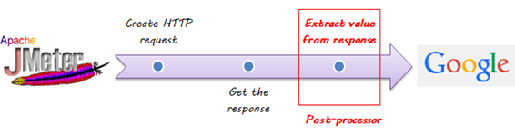
Correlation in JMeter
Postprocessor
Post-processor executes some action after making a Sampler Request.
Consider a simple example:
JMeter send HTTP request to the web server under test (etc www.google.com) and get the response.
You want JMeter to stop the test if the server response is error. You can use the post-processor to do above task as following:

Slide 4
Correlation in JMeter
Regular Expression Extractor
consider an example where we have two operations- 1. User launch website 2. User fill details and click on OK button Now, the call user launch website creates a dynamic variable event validation that we can check in Response Data tab of "View Result Tree" listener for the call.
The value of this variable is then passed to subsequent call related to "User fill details and click on OK button" as Http post parameter.

Slide 5
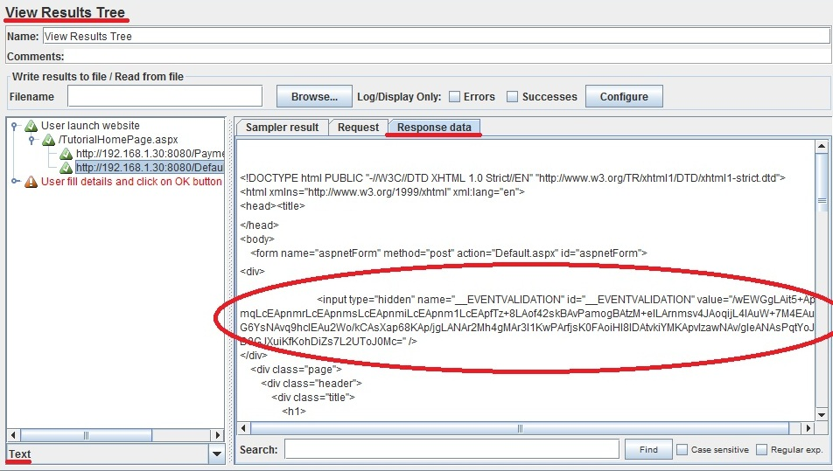
Correlation in JMeter
Regular Expression Extractor
Steps for correlating the Event validation values- 1. Run the script containing the both the above stated operations 2. Go to Response tab (Text mode) in "View Result Tree" listener of "User launch website" operation. BTW, we see the second operation "User fill details and click on OK button" in red because it is not yet correlated.

Slide 6
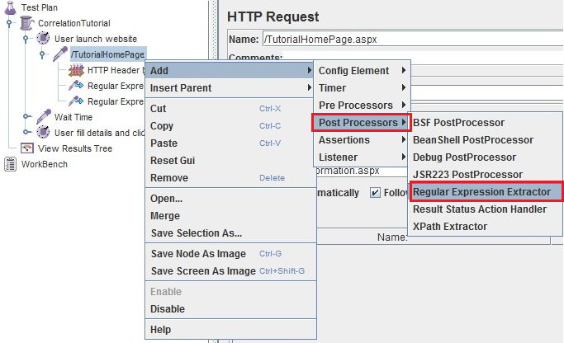
Correlation in JMeter
Regular Expression Extractor
3. Create a Regular expression for extracting the value of Event validation variable's value. As stated above the R.E. for this will be- __EVENTVALIDATION" value="(.+?)" />
4. Go to http request under "User Launch Website" transaction controller-> Add -> Post Processor -> Regular Expression Extractor.

Slide 7
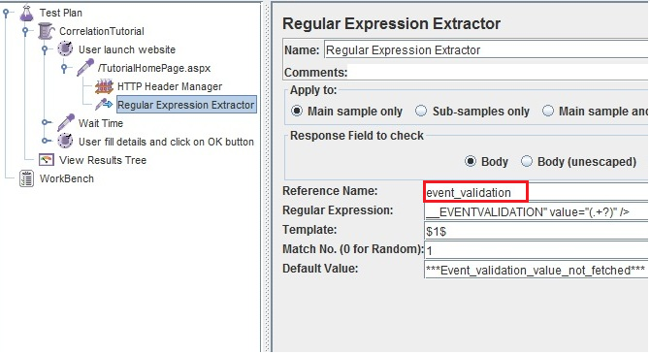
Correlation in JMeter
Regular Expression Extractor
5. The reference name inserted is the name of the variable created that will capture the Event validation value generated by the http request under "User launch website" operation. 6. Now pass this variable to the subsequent http request under "User fill details and click on OK button" as post request- overriding the already present hardcoded value of Event Validation variable.

Slide 8
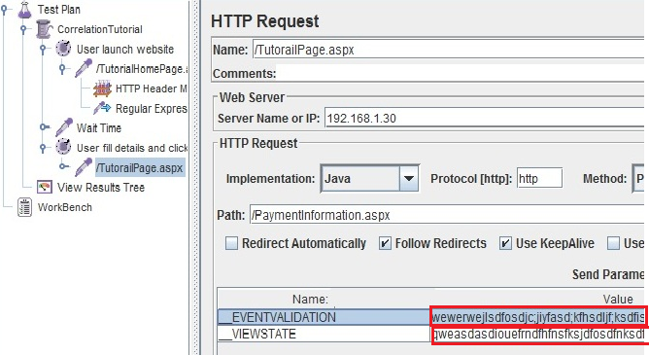
Correlation in JMeter
Regular Expression Extractor
Request without correlation (Hardcoded values).

Slide 9
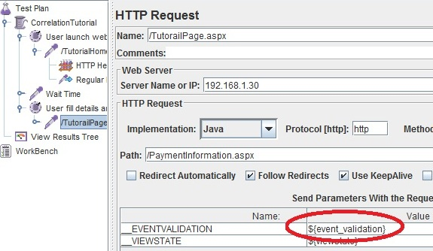
Correlation in JMeter
Regular Expression Extractor
Request with correlation (Dynamic values).

Slide 10
Correlation in JMeter
Regular Expression Extractor
7. Run the Test plan again.
In order to get good understanding of correlation (or scripting for that matter) we need to have a good understanding of two things- the dynamic variables generated by the programming languages and Regular expressions.

Slide 11
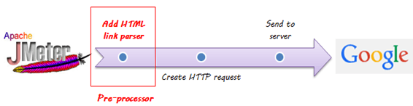
Correlation in JMeter
Preprocessor
Pre-processor executes some action before making Sampler Request.
Consider a simple example: let's say you wanted JMeter to "spider" through website under test, parse link(check all links on the page) and return the HTML. You would add some action such as "HTML link parser" to your controller before creating an HTTP request.

Slide 12

Thank You

