Slide 1

Building a Web Service Test Plan
Test plan describes a series of steps JMeter will execute when run a script. A complete test plan will consists of one or more thread group, logic controllers, listeners, timers, assertions and configuration elements.
Prepared By: Hadi Mohammed

Slide 2
Building a Web Service Test Plan
Test Plan Preparation
To create a Test Plan to test a Web Service. You have to create five users that send requests to One page and run their tests twice
So, the total number of requests is (5 users) x (1 requests) x (repeat 2 times) = 10 HTTP requests.
To construct the Test Plan, you will use the following elements: Thread Group, HTTP Request, and Aggregate Graph.
If the sampler appears to be getting an error from the web service, double check the SOAP message and make sure the format is correct. In particular, make sure the xmlns attributes are exactly the same as the WSDL. If the xml namespace is different, the web service will likely return an error.

Slide 3
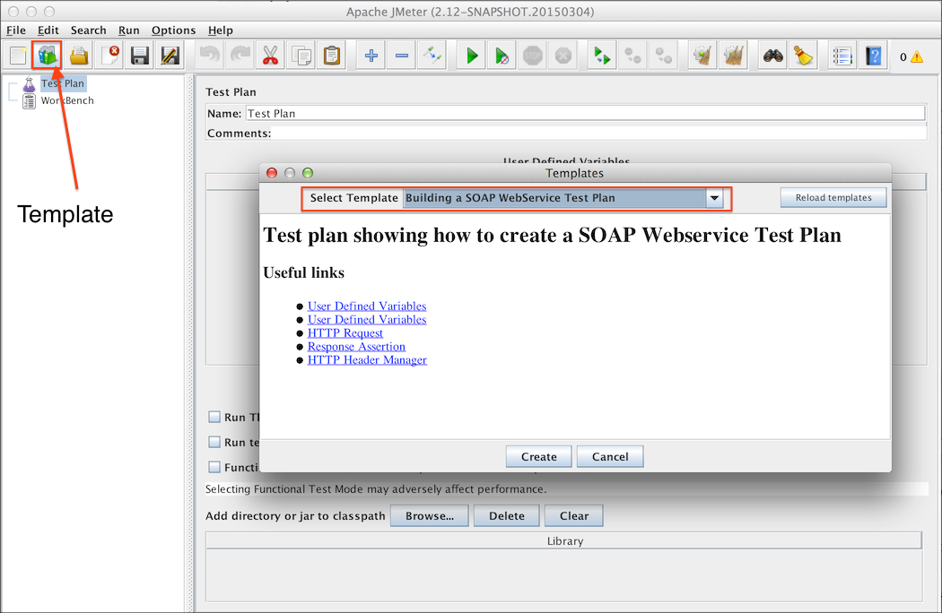
Building a Web Service Test Plan
Test Plan Preparation
Step1:Start by using menu File > "Templates..." and select template "Building a SOAP Webservice Test Plan". Then, click "Create" button as shown below

Slide 4
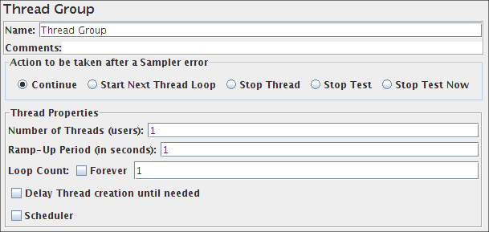
Building a Web Service Test Plan
Adding Users
Step 2:The Thread Group tells JMeter the number of users you want to simulate, how often the users should send requests, and the how many requests they should send as shown below.

Slide 5
Building a Web Service Test Plan
Adding a listener to view and store the results
The final element you need to add to your Test Plan is a Listener.
This element is responsible for storing all of the results of your HTTP requests in a file and presenting a visual model of the data.
Select the JMeter Users element and add a Aggregate Graph listener (Add --> Listener --> Aggregate Graph).
Next, you need to specify a directory and filename of the output file.
You can either type it into the filename field, or select the Browse button and browse to a directory and then enter a filename.

Slide 6
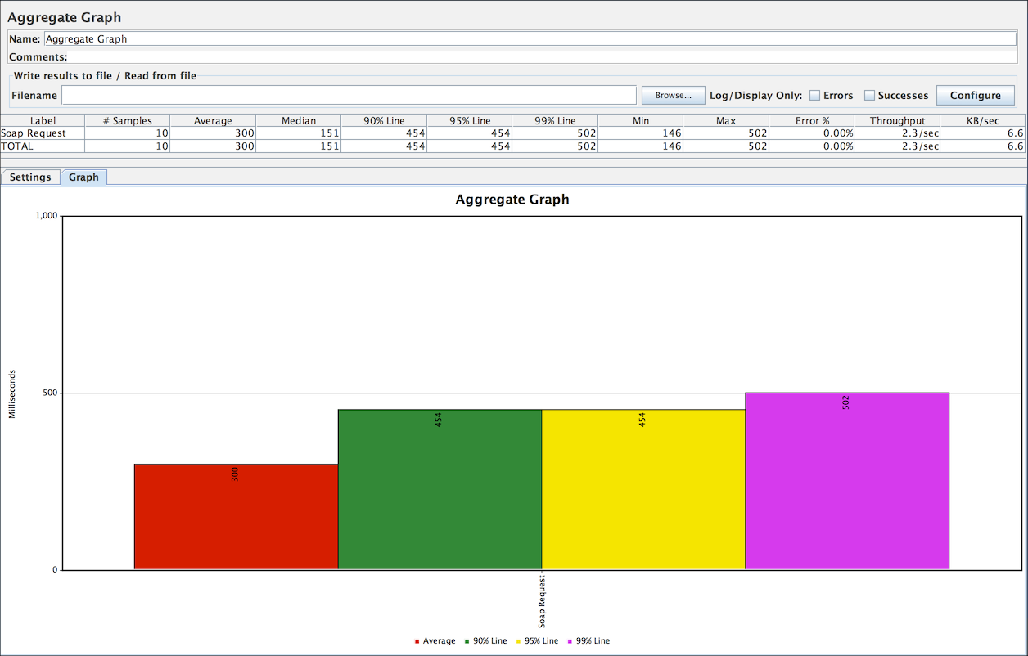
Building a Web Service Test Plan
Graph Result Listener
If the test uses any data files, note that these are not sent across by the client so make sure that these are available in the appropriate directory on each server.
If necessary you can define different values for properties by editing the user.properties or system.properties files on each server.

Slide 7
Building a Web Service Test Plan
Rest Web Service
Testing a REST Webservice is very similar as you only need to modify in HTTP Request
Method: to select the one you want to test
Body Data: which can be JSON, XML or any custom text
You may also need to modify "HTTP Header Manager" to select the correct "Content-Type"

Slide 8
Building a Web Service Test Plan
Building a JMS Point-Point Test Plan
To create a Test Plan to test a JMS Point-to-Point messaging solution :-
The setup of the test is 1 thread group with 5 threads sending 4 messages each through a request queue.
A fixed reply queue will be used for monitoring the reply messages.
To construct the Test Plan, you will use the following elements:
1.Thread Group
2.JMS Point-to-Point
3.Graph Results.

Slide 9
Building a Web Service Test Plan
Adding a Thread group
Add the ThreadGroup element by first selecting the Test Plan
Then select Add --> Thread Group.

Slide 10
Building a Web Service Test Plan
Adding a JMS Point-Point Sampler
Start by adding the sampler JMS Point-to-Point to the Point-to-Point element (Add --> Sampler --> JMS Point-to-Point).
Then, select the JMS Point-to-Point sampler element in the tree as shown in below figure.

Slide 11
Building a Web Service Test Plan
Adding a listener to view and store the test results
The final element you need to add to your Test Plan is a Listener.
This element is responsible for storing all of the results of your JMS requests in a file and presenting a visual model of the data.
Select the Thread Group element and add a Graph Results listener (Add --> Listener --> Graph Results).
Next, you need to specify a directory and filename of the output file.
You can either type it into the filename field, or select the Browse button and browse to a directory and then enter a filename.

Slide 12
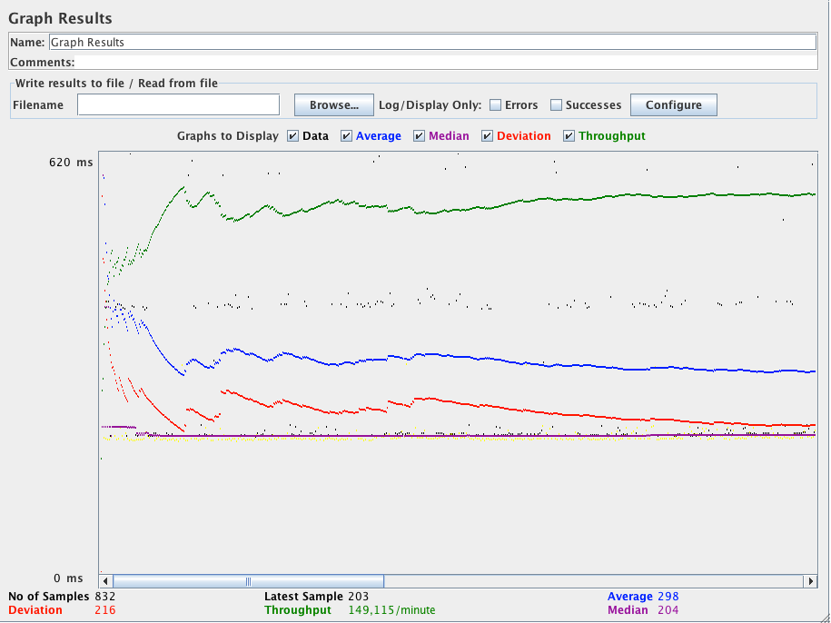
Building a Web Service Test Plan
Graph results

Slide 13
Remote Testing
Steps to configure Remote Testing doing Manually
In some cases, the JMeter-server script may not work for you (if you are using an OS platform not anticipated by the JMeter developers). Here is how to start the JMeter servers (step 1 above) with a more manual process:
Step 1: Start the RMI Registry
Since JMeter 2.3.1, the RMI registry is started by the JMeter server, so this section does not apply in the normal case. To revert to the previous behavior, define the JMeter property server.rmi.create = false on the server host systems and follow the instructions below.

Slide 14
Remote Testing
Steps to configure Remote Testing doing Manually
JMeter uses Remote Method Invocation (RMI) as the remote communication mechanism. Therefore, you need to run the RMI Registry application (which is named, "rmiregistry") that comes with the JDK and is located in the "bin" directory. Before running rmiregistry, make sure that the following jars are in your system claspath:
JMETER_HOME/lib/ext/ApacheJMeter_core.jar
JMETER_HOME/lib/jorphan.jar
JMETER_HOME/lib/logkit-2.0.jar
The rmiregistry application needs access to certain JMeter classes. Run rmiregistry with no parameters. By default the application listens to port 1099

Slide 15
Remote Testing
Steps to configure Remote Testing doing Manually
Step2:
Start the JMeter Server
Once the RMI Registry application is running, start the JMeter Server. Use the "-s" option with the jmeter startup script ("jmeter -s").
Steps 2 and 3 remain the same.

Slide 16
Remote Testing
Tips
JMeter/RMI requires a connection from the client to the server. This will use the port you chose, default 1099.
JMeter/RMI also requires a reverse connection in order to return sample results from the server to the client.
This will use a high-numbered port. This port can be controlled by jmeter property called client.rmi.localport in jmeter.properties.
If there are any firewalls or other network filters between JMeter client and server, you will need to make sure that they are set up to allow the connections through. If necessary, use monitoring software to show what traffic is being generated.
If you're running Suse Linux, these tips may help. The default installation may enable the firewall. In that case, remote testing will not work properly. The following tips were contributed by Sergey Ten.

Slide 17
Remote Testing
Tips
If you see connections refused, turn on debugging by passing the following options.
rmiregistry -J-Dsun.rmi.log.debug=true -J- Dsun.rmi.server.exceptionTrace=true -J- Dsun.rmi.loader.logLevel=verbose -J- Dsun.rmi.dgc.logLevel=verbose -J- Dsun.rmi.transport.logLevel=verbose -J- Dsun.rmi.transport.tcp.logLevel=verbose
Since JMeter 2.3.1, the RMI registry is started by the server; however the options can still be passed in from the JMeter command line. For example: "jmeter -s -Dsun.rmi.loader.logLeve l= verbose" (i.e. omit the -J prefixes). Alternatively the properties can be defined in the system.properties file.
The solution to the problem is to remove the loopbacks 127.0.0.1 and 127.0.0.2 from etc/hosts. What happens is JMeter-server can't connect to rmiregistry if 127.0.0.2 loopback is not available.

Slide 18
Remote Testing
Settings to fix a problem
Replace :
`dirname $0`/jmeter -s "$@"
With
HOST="-Djava.rmi.server.hostname=[computer_name][computer_domain]
-Djava.security.policy=`dirname $0`/[policy_file]"
`dirname $0`/jmeter $HOST -s "$@"
Also create a policy file and add [computer_name][computer_domain] line to /etc/hosts.

Slide 19
Remote Testing
Settings to fix a problem
In order to better support SSH-tunneling of the RMI communication channels used in remote testing, since JMeter 2.6:
a new property "client.rmi.localport" can be set to control the RMI port used by the RemoteSampleListenerImpl
To support tunneling RMI traffic over an SSH tunnel as the remote endpoint using a port on the local machine, loopback interface is now allowed to be used if it has been specified directly using the Java System Property "java.rmi.server.hostname" parameter.

Slide 20
Remote Testing
Dealing with the Failed nodes
For large-scale tests there is a chance that some part of remote servers will be unavailable or down.
For example, when you use automation script to allocate many cloud machines and use them as generators, some of requested machines might fail booting because of cloud's issues. Since JMeter 2.13 there are new properties to control this behavior.

Slide 21
Remote Testing
Dealing with the Failed nodes
First what you might want is to retry initialization attempts in hope that failed nodes just slightly delayed their boot.
To enable retries, you should set client.tries property to total number of connection attempts.
By default it does only one attempt. To control retry delay, set the client.retries_delay property to number of milliseconds to sleep between attempts.
Finally, you might still want to run the test with those generators that succeeded initialization and skipping failed nodes. To enable that, set the client.continue_on_fail=true property.

Slide 22

Thank You

