Slide 1

Building a LDAP Test Plan
Test plan describes a series of steps JMeter will execute when run a script. A complete test plan will consists of one or more thread group, logic controllers, listeners, timers, assertions and configuration elements.
Prepared By: Hadi

Slide 2
Building a LDAP Test Plan
LDAP Test Plan Preparation
To create a LDAP Test Plan on LDAP Server following elements are required
Thread Group
LDAP Request
LDAP Request Defaults
View Results in Table

Slide 3
Building a LDAP Test Plan
Test Plan Preparation
Step1:We need to create four users that sends requests for four tests on the LDAP server and the user has to run tests four times, so the total number of requests will be as follows
(4 users) x (4 requests) x (repeat 4 times) = 64 LDAP requests.

Slide 4
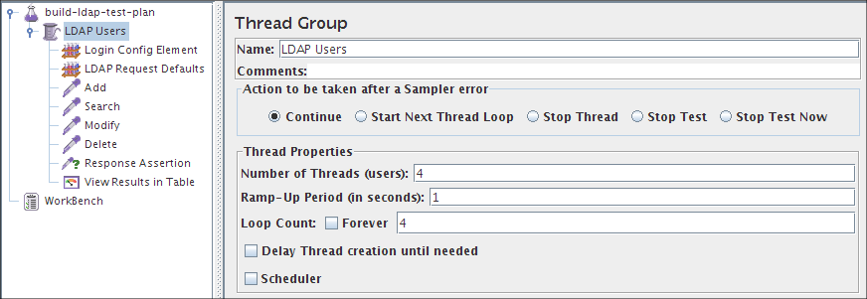
Building a LDAP Test Plan
Adding Users
Step 2:Add a thread group element to the test plan and specify number of threads as 4 and loop count as 4 as shown in the below figure

Slide 5
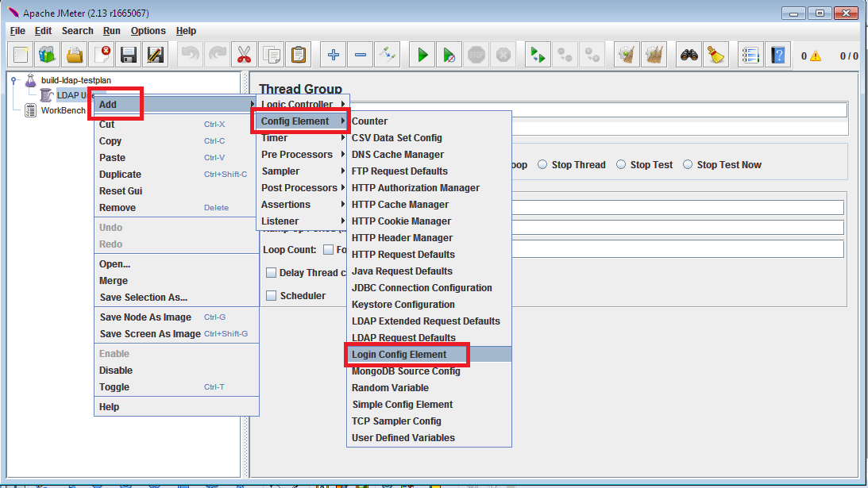
Building a LDAP Test Plan
Adding Login Config Element
Step 3:Add a Login config element to the thread group as shown in the below figure.

Slide 6
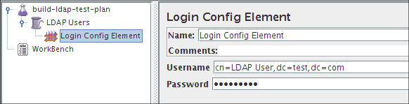
Building a LDAP Test Plan
Adding Login Config Element
Step 3:Enter the your LDAP Username and Password, these values will be used by the LDAP requests.

Slide 7
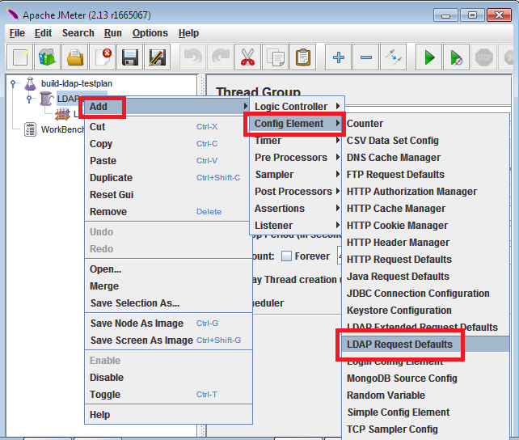
Building a LDAP Test Plan
Adding LDAP Requests Defaults
Step4:Add LDAP requests defaults to the thread group as shown in the below figure

Slide 8
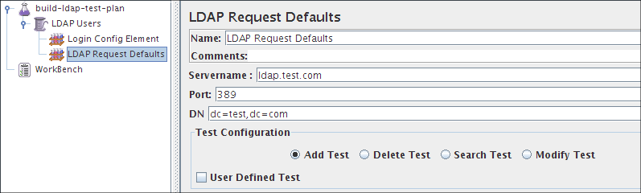
Building a LDAP Test Plan
Adding LDAP Requests Defaults
Step5:Specify the server name, port number and DN as shown in the below figure.

Slide 9
Building a LDAP Test Plan
LDAP Requests
Four LDAP requests :-
Inbuilt Add Test
Inbuilt Search Test
Inbuilt Modify Test
Inbuilt Delete Test
JMeter sends requests in the order that we add them to the tree.
Start by adding the first LDAP Request to the LDAP Users element (Add> Sampler>LDAP Request). Then, select the LDAP Request element in the tree and edit the following properties

Slide 10
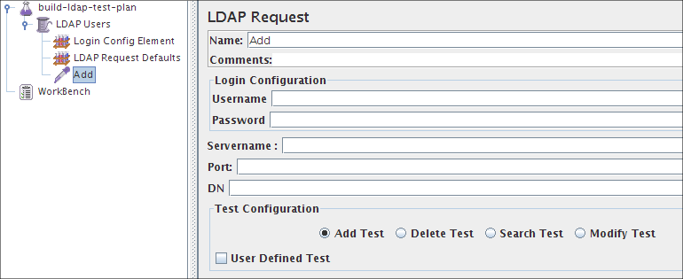
Building a LDAP Test Plan
LDAP Request for Inbuilt Add test

Slide 11
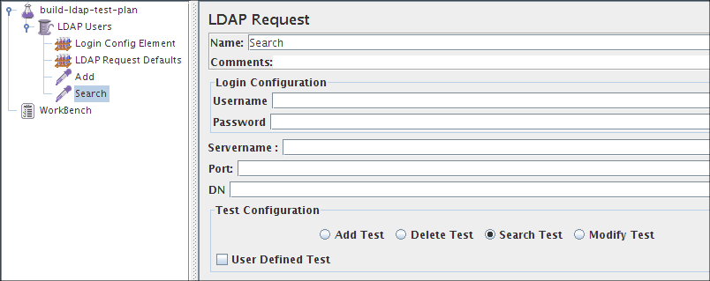
Building a LDAP Test Plan
LDAP Request for Inbuilt Search test

Slide 12
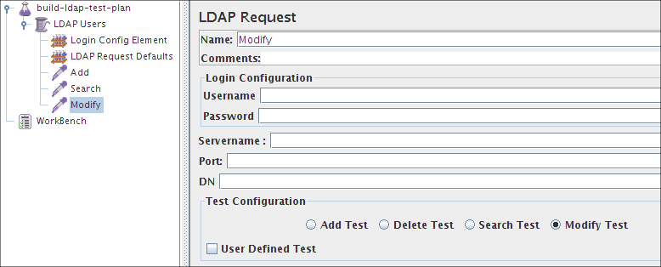
Building a LDAP Test Plan
LDAP Request for Inbuilt Modify test

Slide 13
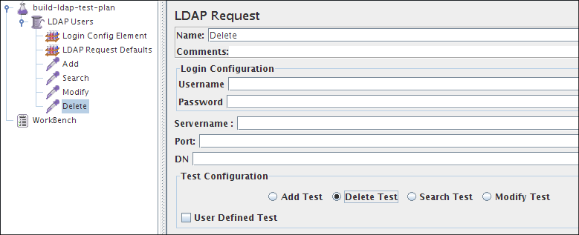
Building a LDAP Test Plan
LDAP Request for Inbuilt Delete test

Slide 14
Building a LDAP Test Plan
Adding Response Assertion
Response Assertion element will check the received response data by verifying if the response text is "successful". (Add>Assertion>Response Assertion).
Select Text Response Radio button in Response Field to Test group.
Select Substring Radio button in Pattern Matching Rules group.
Click on Add button and add the string "successful" in Pattern to Test field.

Slide 15
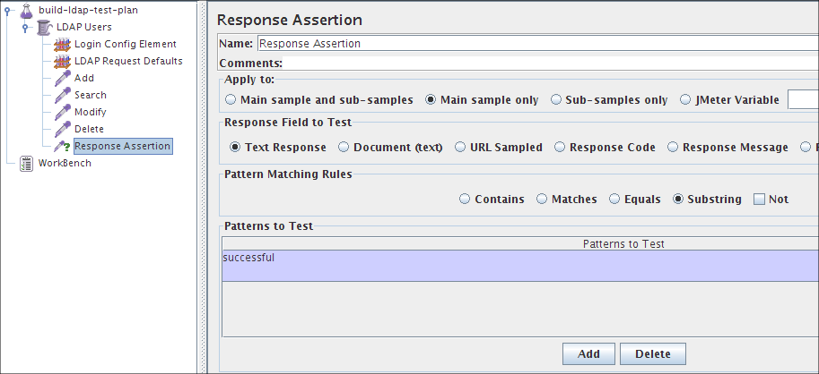
Building a LDAP Test Plan
Adding a Response Assertion
Step2:
Start the JMeter Server
Once the RMI Registry application is running, start the JMeter Server. Use the "-s" option with the jmeter startup script ("jmeter -s").
Steps 2 and 3 remain the same.

Slide 16
Building a LDAP Test Plan
Adding a Listener to view/store the results
The final element we need to add to the Test Plan is a Listener.
This element is responsible for storing all of the results of LDAP requests in a file and presenting a visual model of the data.
Select the LDAP Users element and add a View Results in Table (Add>Listener>View Results in Table)

Slide 17
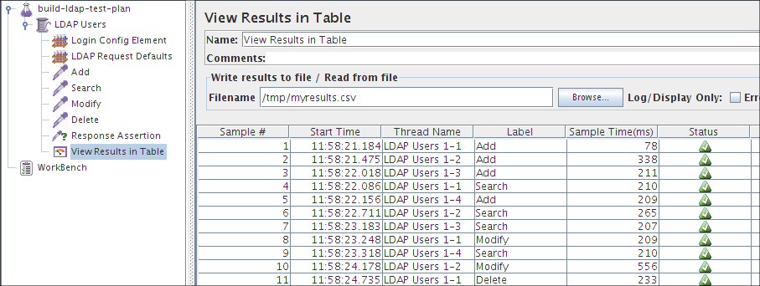
Building a LDAP Test Plan
Adding a Listener to view/store the results
Adding a Listener to view/store the results

Slide 18

Thank You

