Slide 1

JMeter – Introduction , Advantages & drawbacks
JMeter is an open source performance test tool developed by Stefano Mazzocchi of Apache software foundation.
Prepared By: Hadi Mohammed

Slide 2
JMeter – Introduction , Advantages & drawbacks
Introduction of JMeter
It is a java desktop application and runs on JVM which requires JDK 7 or later versions.
It supports different protocols such as
Web and FTP, Java, SOAP/XML-RPC, JDBC applications.
It can be used to simulate a heavy load on a server, group of servers, network or object to test its strength or to analyze overall performance under different load types.

Slide 3
JMeter – Introduction , Advantages & drawbacks
JMeter is used for
Performance Testing (Establish the base line for the system and detect the bottleneck of system)
Load Testing (To find the maximum load that the system is designed to operate under)
Stress Testing (An attempt to break the system by overwhelming its resources)
Scalability Testing (To determine whether adding another ‘Y’ resource will increase the speed of ‘X’ proportionally)

Slide 4
JMeter – Introduction , Advantages & drawbacks
Advantages
It is an Open Source tool.
It is a platform-independent tool.
The distributed testing can be done easily.
JMeter store its test plans in XML format. i.e. you can generate a test plan using a text editor.
Extensibility: Pluggable samplers allow unlimited testing capabilities.

Slide 5
JMeter – Introduction , Advantages & drawbacks
More Advantages
JMeter supports all kinds of application (not only Java).
Multi-protocol support
JMeter supports web applications, SOAP web services, REST, XML-RPC, JAR files, LDAP, Databases (via JDBC Request), JMS, SMTP & FTP etc.
Test results can be captured in various formats like graphs, csv table and plain text.

Slide 6
Types of Performance Testing
Drawbacks
Chart representation is quite confusing.
Terminology is not very clear.
Necessary to start remote machine one by one only and can’t be started simultaneously.
Remote machines must be declared in JMeter property file before starting application.

Slide 7
Types of Performance Testing
Drawbacks (Contd.)
It does not support recording SSL (https).
Its only for web applications & doesn’t support windows applications.
User can't write its own script, or change any recorded script

Slide 8
JMeter – Introduction , Advantages & drawbacks
Key features of JMeter
Cross-platform. JMeter can be run on any operating system with Java.
Scalable. Using JMeter , we can emulate huge load on the server in distributed mode.
Multiple implementations of pre and post processors around sampler. It also provides parameterization & correlation capabilities.

Slide 9
JMeter – Introduction , Advantages & drawbacks
Key features
Various assertions are there to verify desired criteria.
Multiple built-in and external listeners are available to visualize and analyze performance test results.
Integration with major build and continuous integration systems - making JMeter performance tests part of the full software development life cycle.

Slide 10
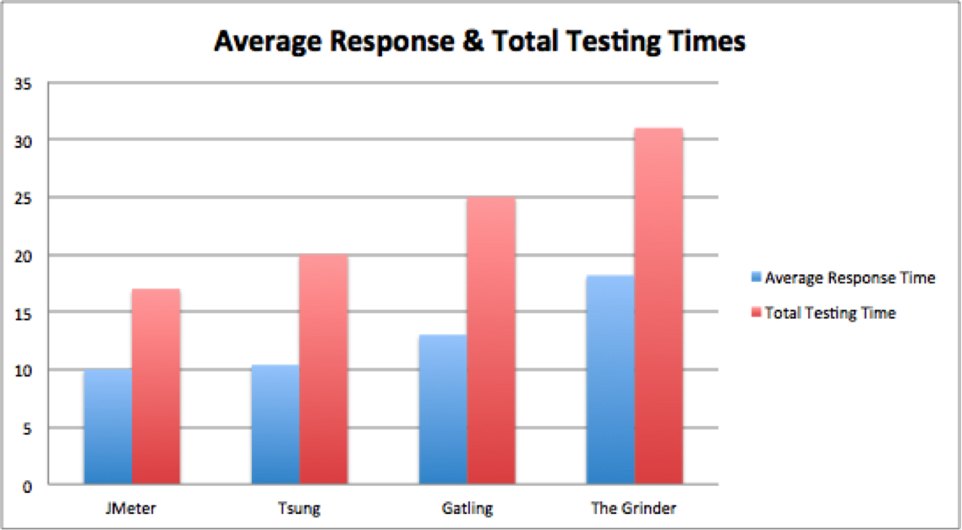
JMeter – Introduction , Advantages & drawbacks
Tool Comparison

Slide 11
JMeter – Introduction , Advantages & drawbacks
Limitations of JMeter
JMeter doesn’t support all the actions supported by browsers such as JavaScript present in HTML pages.
It doesn’t render the html page as a browser does.
It has limited support for JavaScript, AJAX and complicated frameworks.
It supports only 220-250 threads (virtual users) per machine.
It consumes a lot of memory as it is a single console application.
It shows out of memory and disconnection logs more frequently in case of huge load is emulated.

Slide 12

Thank You

