Slide 1

Performance Testing – What, Why & How ?
Software performance testing is the process of determining the speed or effectiveness of a computer, network or software program or device.
Prepared By: Hadi Mohammed

Slide 2
Performance Testing – What, Why & How ?
Goal of Performance Testing
The goal of performance testing is not to find bugs but to eliminate performance bottlenecks.

Slide 3
Performance Testing – What, Why & How ?
Performance bottlenecks
There is a long list of web applications potential performance bottlenecks and some of them are as follows:
Extended response time
High CPU usage
Invalid data returned
HTTP errors (4xx, 5xx)

Slide 4
Performance Testing – What, Why & How ?
Performance bottlenecks
Lots of open connections
Lengthy queues of requests
Memory leaks
Extensive table scans of database
Database deadlocks
Pages unavailable

Slide 5
Performance Testing – What, Why & How ?
Performance Testing will
Improve user experience on sites and web apps
Increase revenue generated from websites
Gather metrics useful for tuning the system
Identify bottlenecks such as database configuration

Slide 6
Performance Testing – What, Why & How ?
Features or Characteristics of Performance Testing Tools are as follows:
To generate load on the system to be tested.
To measure the timing of specific transactions as the load on the system varies.
To measure average response times.
To produce graphs or charts of responses over time.

Slide 7
Performance Testing – What, Why & How ?
Why do we do Performance Testing ?
Before going live in the market, the software system should be tested against the Speed, Stability and scalability under variety of load conditions.

Slide 8
Performance Testing – What, Why & How ?
Non-functional requirements
Target User load
No. of concurrent users (Concurrency)
Response Time
Throughput (No. of transactions/second)
Latency (Network delays accepted)
Peak Load timing

Slide 9
Performance Testing – What, Why & How ?
Establishing the benchmark of a System
The Primary goal of performance testing includes establishing the benchmark behavior of the system.
It can demonstrate that the system meets performance criteria.
It can compare two systems to find which performs better.
It can measure which parts of the system or workload cause the system to perform badly.

Slide 10
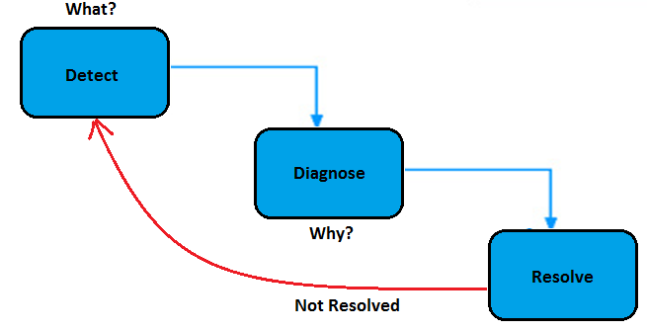
Performance Testing – What, Why & How ?
Performance Testing in a nutshell

Slide 11
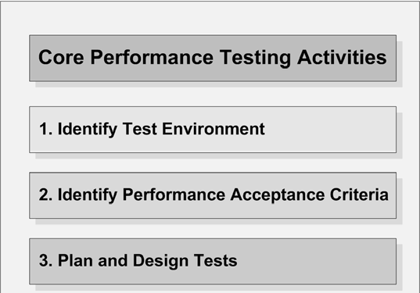
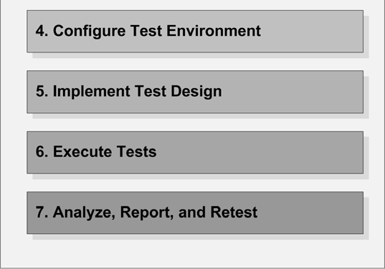
Performance Testing – What, Why & How ?
Core activities of Performance Testing

Slide 12
Performance Testing – What, Why & How ?
What do we want to achieve ?
Performance Testing Determines…
- Speed
- Scalability
- Stability
- Confidence
…while focusing on
- User Expectations
- System Constraints
- Costs
Specifically, it answers:
- How many…?
- How much…?
- What happens if…?

Slide 13
Performance Testing – What, Why & How ?
Performance testing addresses Speed related risks
Is the application fast enough to satisfy end users?
Is the business able to process and utilize data collected by the application before that data becomes outdated?

Slide 14
Performance Testing – What, Why & How ?
Scalability related risks
Can the application provide consistent and acceptable response times for the entire user base?
Can the application store all of the data that will be collected over the life of the application?
Are there warning signs to indicate that the application is approaching peak capacity?

Slide 15

Thank You

