Slide 1

Types of Performance Testing
Performance testing can be categorized as various types of testing such as load testing, stress testing, volume testing, endurance testing & spike testing etc.
Prepared By: Hadi Mohammed

Slide 2

Types of Performance Testing
Types of Performance Testing
Load Testing
Stress Testing
Capacity Testing
Endurance Testing
Spike Testing

Slide 3

Types of Performance Testing
Load Testing
It checks the application's ability to perform under anticipated user loads. The objective is to identify performance bottlenecks before the software application goes live.

Slide 4
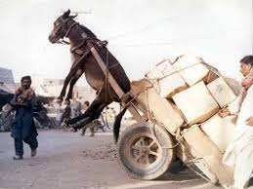
Types of Performance Testing
Stress Testing
It involves testing an application under extreme workloads to see how it handles high traffic or data processing .The objective is to identify breaking point of an application.

Slide 5

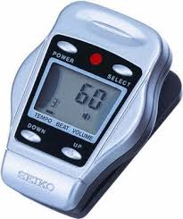
Types of Performance Testing
Endurance testing
It is usually conducted to make sure that the software can handle the expected load over a long period of time.

Slide 6

Types of Performance Testing
Spike Testing
It tests the software's reaction to sudden large spikes in the load generated by users.

Slide 7

Types of Performance Testing
Volume Testing
It is being conducted with the help of huge data and the overall software system's behavior is monitored. The objective is to check software application's performance under varying database volumes.

Slide 8

Types of Performance Testing
Scalability Testing
The objective of scalability testing is to determine the software application's effectiveness in "scaling up" to support an increase in user load. It helps plan capacity addition to your software system.

Slide 9
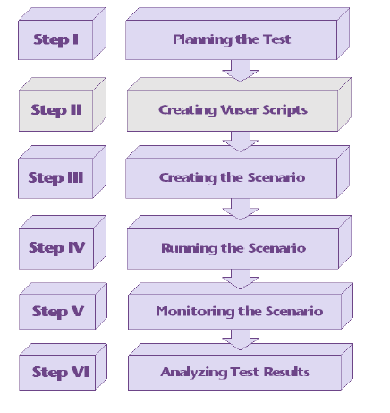
Types of Performance Testing
Performance Testing Life Cycle

Slide 10
Types of Performance Testing
Performance Test Planning
Scope
Approach
Performance Goals
Load test types
Schedules
Tools evaluation
Test Lab setup
Identification of Test scenarios
Script development
Execution
Monitoring
Analysis
Bench marking
Test Closure Report

Slide 11
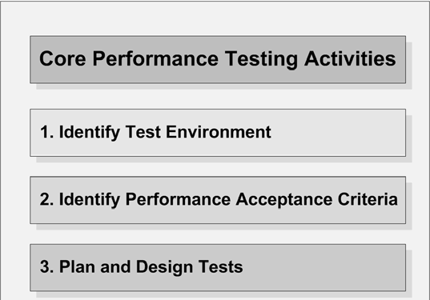
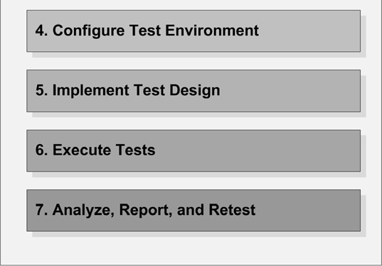
Types of Performance Testing
Core activities of Performance Testing

Slide 12
Types of Performance Testing
Types of Performance Test tools
Open Source | Commercial
OpenSTA | Load Runner
Diesel Test | Silk Performer
TestMaker | Visual Studio Team System
Grinder | NeoLoad
LoadSim | WebLoad
JMeter | LoadUI Pro
Rubis | Rational Performance Tester

Slide 13
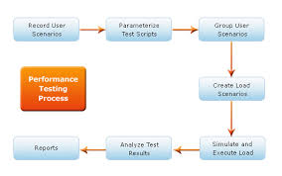
Types of Performance Testing
Performance testing addresses Speed related risks
Performance Testing starts parallel with Software Development Life Cycle (SDLC). NFR elicitation happens parallel with System Requirement Specification (SRS).

Slide 14
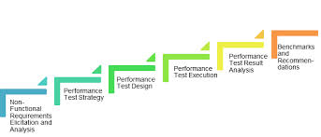
Types of Performance Testing
Performance Test Life Cycle

Slide 15
Types of Performance Testing
Performance Test Planning
Determining Performance Testing Objective
Quantifying End-User Response Time Goals
Consolidating Various Types of Performance Acceptance Criteria

Slide 16
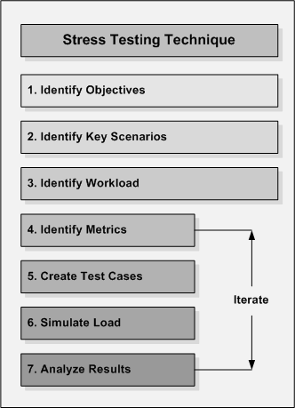
Types of Performance Testing
Stress Testing Technique

Slide 17

Thank You

