Slide 1

JMeter – Installation & Configuration
JMeter is an open source performance test tool developed by Stefano Mazzocchi of Apache software foundation.
Prepared By: Hadi Mohammed

Slide 2
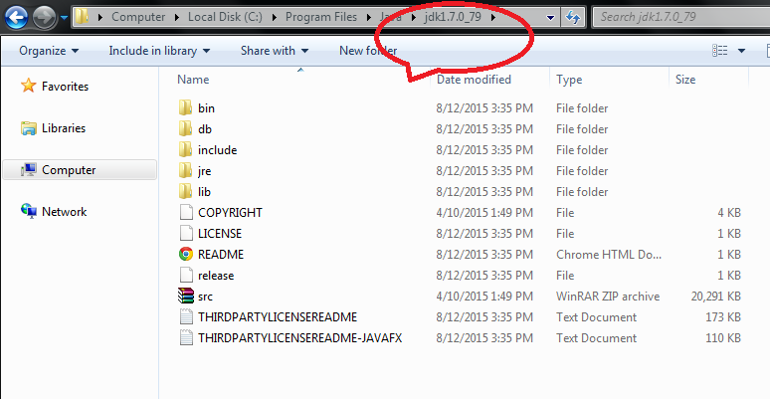
JMeter – Installation & Configuration
Prerequisite
It is a java desktop application and runs on JVM which requires JDK 7 or later versions.
Prerequisite: To download java, install and configure It.

Slide 3
JMeter – Installation & Configuration
Java Configuration
Give paths as:
Variable name
Value.
Java_Home
give JDK path, with out bin
Path
jdk up to bin path ;

Slide 4
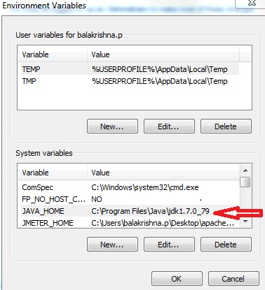
JMeter – Installation & Configuration
Environment variables

Slide 5
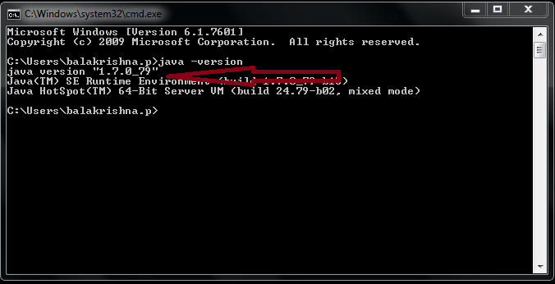
JMeter – Installation & Configuration
Verification of Java configuration
Check Java installation
cmd>>javac
Check java version
cmd>>java -version.

Slide 6
JMeter – Installation & Configuration
Operating systems & JMeter
Operating system | Java Virtual Machine | Architecture
Free BSD 9.0 | Open JDK 6 | amd64
Linux 2.4, 2.6, 3.1 | Sun JDK 5, 6, 7 and Open JDK 6 | i386, amd64
Mac OS | JDK6
Window XP | Sun JDK6, Sun JDK 7 | 32/64 bits
Window 7 | Sun JDK 5, 6, 7. | 32 bits

Slide 7
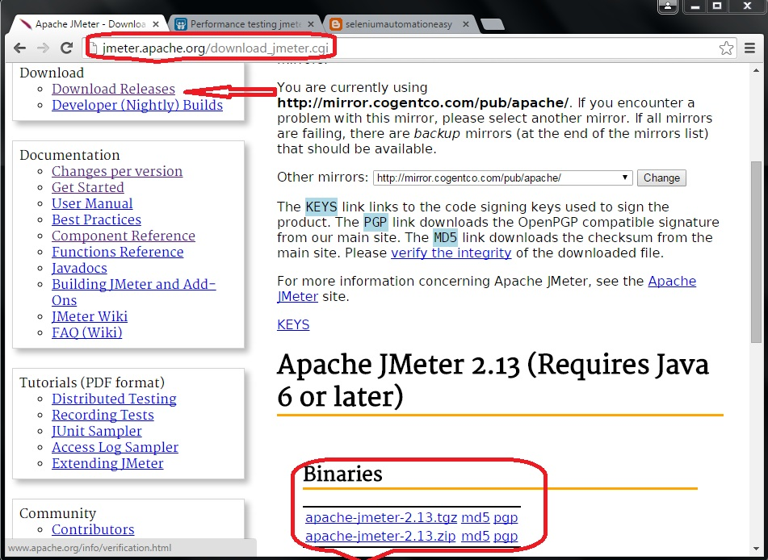
JMeter – Installation & Configuration
JMeter download
JMeter download ( Installation is not required).
Go through http://jmeter.apache.org/download_jmeter.cgi and then click on Download Releases>>Binaries>>click on apache-jmeter-2.13.tgz md5 pgp.

Slide 8
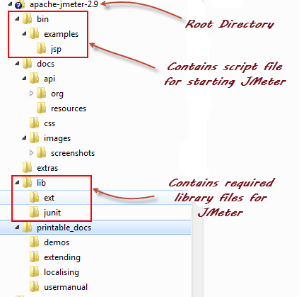
JMeter – Installation & Configuration
JMeter folder structure

Slide 9
JMeter – Installation & Configuration
Files & directories
Given below is the description of the JMeter directories and its importance JMeter directory contains many files and directory
/bin: Contains JMeter script file for starting JMeter
/docs: JMeter documentation files
/extras: ant related extra files
/lib/: Contains the required Java library for JMeter
/lib/ext: contains the core jar files for JMeter and the protocols
/lib/junit: JUnit library used for JMeter
/printable_docs:

Slide 10
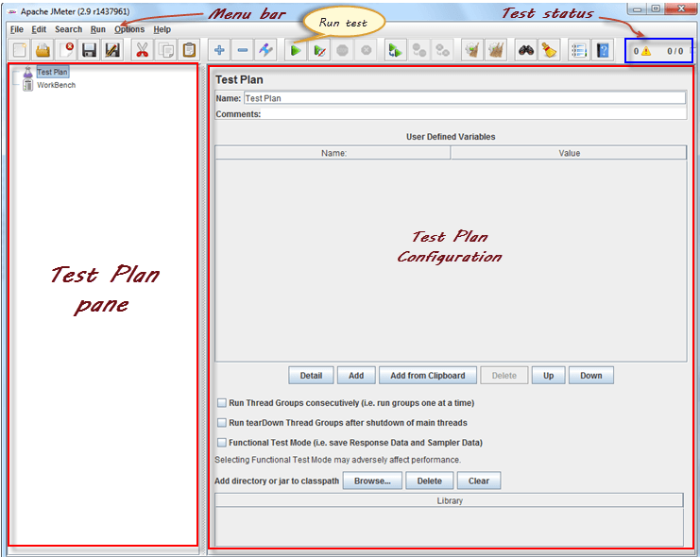
JMeter – Installation & Configuration
JMeter Control Panel
Click on “ jmeter.bat” batch file to invoke JMeter. See the control panel of JMeter when it is invoked.

Slide 11

Thank You

