Slide 1
Object Repository

Slide 2
Object Repository
Object Repository is a file in which QTP can stores the properties of objects from a window/web application.

Slide 3
Types of Object Repositories
Local Object Repository : For every action by default qtp will create and manage one local repository can be used only by that action.
Shared Object Repository : When ever we feel some common object info is required by many actions present in diff test(Scripts)then the corresponding objects info is suggested to be stored in the Shared Repository.

Slide 4
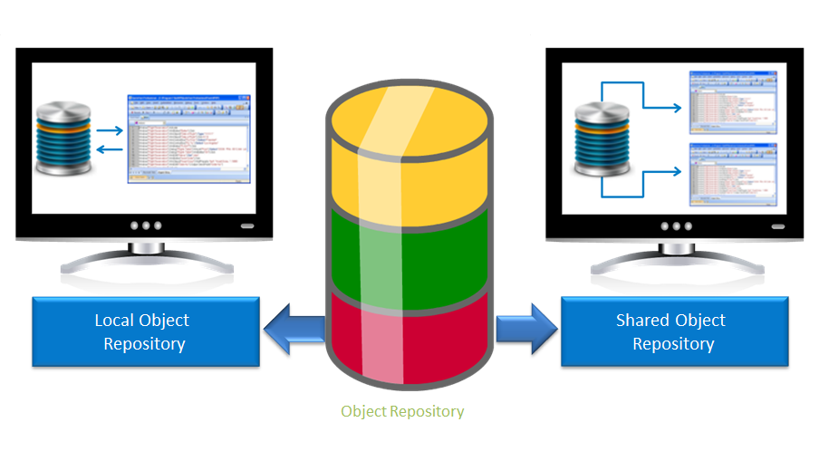
Types of Object Repositories
Notes:
You can find two types of Object repositories in QTP. They are:
Local Object Repository – To store details of objects associated with a specific action, and accessed by only that action.
Shared Object Repository – To store details of objects in an action so that it can be accessed by multiple tests.
Let us now learn about each type of repository.

Slide 5
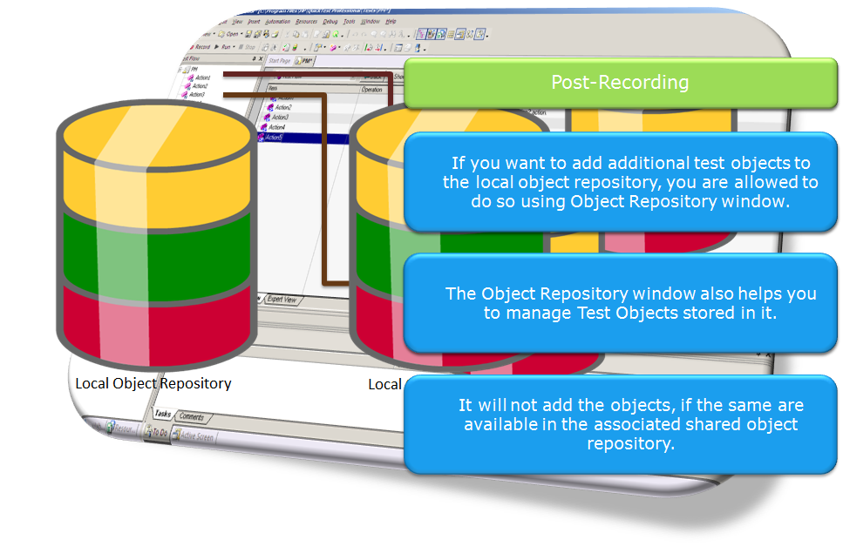
Introduction to Local Object Repository
Notes:
Local object repository is the default object repository in QTP. For each action, Quick Test uses a separate local object repository.
While recording a test:
Quick Test creates a new, empty object repository.
When Quick Test learns new objects, it automatically stores the information about those objects in the corresponding local object repository.
However, it will not add the objects, if the same are available in the associated shared object repository.
Post-recording:
If you want to add additional test objects to the local object repository, you are allowed to do so using Object Repository window.
Apart from allowing to add new test objects, the Object Repository window helps you to manage Test Objects stored in it.
Let us now learn how to access and use Object Repository window for adding new test objects and managing them.

Slide 6
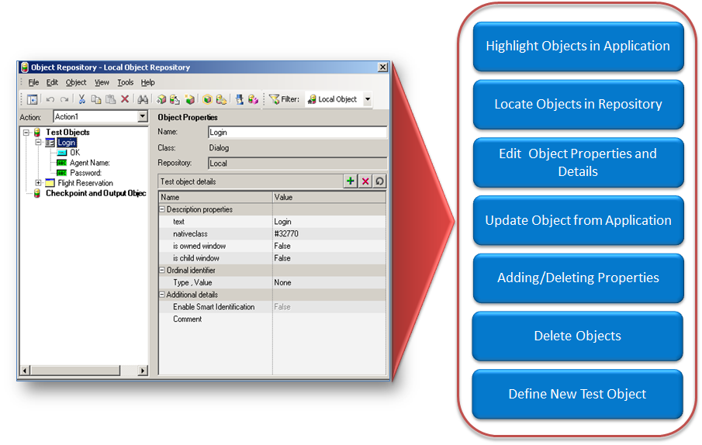
Handling Objects in the Local Object Repository
Notes:
Using Object Repository window, you can:
Highlight an object in the application,
Locate an object in the repository
Edit object properties and details,
Update objects from Application,
Add or delete additional description properties of an object,
Delete unwanted objects, and
Define New Test Objects.
Let us learn about each of these object handling tasks in detail.

Slide 7
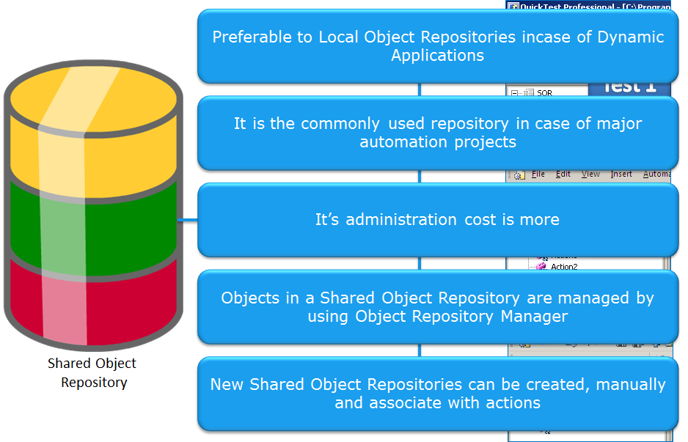
Introduction to Shared Object Repository
Notes:
Shared object repository is a place where properties of objects from each action in several tests are stored. Shared Object Repositories are preferable to Local Object Repositories, when application is dynamic and objects description changes frequently.
It is the commonly used repository, particularly in the cases of major automation projects. However, it’s administration cost is more than that of local object repository. Objects in a Shared Object Repository are managed by using Object Repository Manager.
Unlike, Local Object Repository, you can manually create new Shared Object repositories and associate them with the actions.
Let us now learn how to create shared object repositories.

