Slide 1
Object Identification and Object Spy

Slide 2
Object Identification
Object Identification is a default mechanism followed by QTP to recognize objects from a Application
Using Object Identification QTP recognize an object with its Mandatory Assistive and Ordinal Identifier properties.

Slide 3
Object Spy
Object Spy enables you to view both the run-time object methods and the test object methods associated with an object and to view the syntax for a selected method. You use the Object Spy pointer to point to an object.
The Object Spy displays the object hierarchy tree and the run-time object methods or test object methods associated with the selected object in the Methods tab of the Object Spy dialog box.

Slide 4
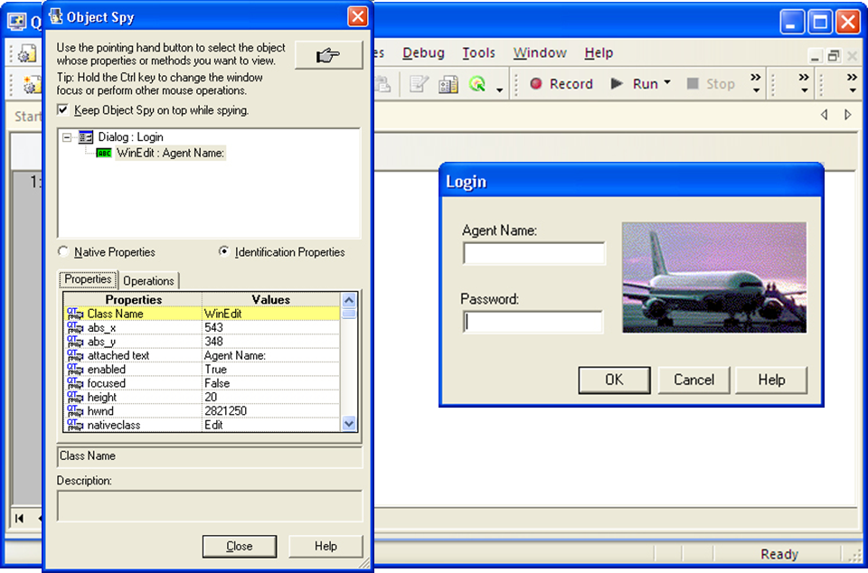
Object Spy

