Slide 1

Department of Computer Science and Engineering
Title of the Project
“Real Time Fraud Detection System for Online Financial Transactions”
Under the esteemed guidance of
Mrs. M Malli M.Tech ,
Asst. Professor, Department of CSE,
SVPCET, Puttur.
Presented By
Batch : CS22A11
C SAILAJA 22G01A0539
A RAJESH 22G01A0510
C RAMA CHARAN 22G01A0537
K LINGAMAIAH 22G01A0570

Slide 2
Abstract
The rapid growth of digital wallets and online payment systems has increased the number of financial transactions over the internet. However, these systems are vulnerable to fraudulent activities such as unauthorized transactions. The proposed Real-Time Fraud Detection System analyzes transaction behavior using factors like transaction amount, frequency, velocity, and daily limits. Based on the risk level, suspicious transactions are blocked while genuine transactions are processed safely, improving security and user trust.

Slide 3
Introduction
Digital payment systems and online financial platforms are widely used for everyday transactions.
However, the increasing number of transactions also increases the risk of fraudulent activities and financial cybercrime.
Traditional fraud detection systems rely on static rules and manual verification, which are often slow and inefficient.
A real-time fraud detection system can analyze transaction patterns instantly and detect suspicious behavior before financial loss occurs.
This approach improves security, transparency, and reliability in digital financial systems.

Slide 4
Literature Survey
Implementing a Java Microservice for Credit Fraud Detection Using Machine Learning (2024)
Credit Card Fraud Detection Using Machine Learning Techniques
Real-Time Fraud Detection in Financial Systems (E-Commerce & Banking Studies)
Machine Learning-Based Fraud Detection with Data Preprocessing Techniques
Microservice-Based Financial Fraud Detection Systems

Slide 5
Objectives
The main objectives of the proposed system are:
To develop a secure and user-friendly digital wallet system
To monitor financial transactions in real time
To detect fraudulent activities based on transaction behavior
To reduce financial losses caused by unauthorized transactions
To automate fraud detection without manual intervention
To improve transaction security and reliability
• To analyze transaction patterns such as amount, frequency, and velocity

Slide 6
Problem Statement
Digital payment systems handle a large number of transactions everyday. Traditional systems mainly focus on completing transactions quickly but often fail to detect suspicious activities. Fraud can occur through high-value transactions, repeated transfers, or unusual payment patterns. Manual verification is slow and usually identifies fraud only after financial loss has occurred. Therefore, a real-time fraud detection system is needed to quickly analyze transactions and prevent suspicious activities.

Slide 7
Existing System
In current digital payment systems and online financial platforms, transactions are primarily processed with a focus on speed and convenience rather than security.
Most existing systems use basic rule-based fraud detection mechanisms, such as predefined limits or simple conditions (e.g., transaction amount exceeding a threshold). These systems are often static and do not adapt to changing fraud patterns.
In many cases, fraud detection is performed after the transaction is completed, through manual review or delayed analysis. This reactive approach results in fraud being detected only after financial loss has already occurred. Additionally, many systems do not analyze user behavior patterns such as transaction frequency, velocity, or spending habits in real time.

Slide 8
Drawbacks
No real-time fraud detection mechanism
Static rules cannot adapt to new fraud techniques
High dependency on manual verification
Unable to analyze transaction velocity effectively
High chances of false alerts and missed fraud cases
Increased financial risk due to delayed detection

Slide 9
Proposed System
The proposed system is a Real-Time Fraud Detection System for Online Financial Transactions, designed as a dynamic web-based application using Java based web technologies including JSP, Servlets, and MySQL for developing a complete transaction processing and fraud detection system. The system integrates digital wallet functionality with an intelligent fraud detection engine to provide a secure and efficient financial transaction platform.

Slide 10
Architecture
The architecture of the system consists of the following components:
User Interface - Allows users to register, login, and perform wallet transactions.
Transaction Processing Module - Handles money transfers and validates transaction details.
Fraud Detection Engine - Analyzes transaction behavior and calculates risk scores.
Decision System - Classifies transactions as safe or suspicious.
Database System - Stores user information and transaction history.

Slide 11
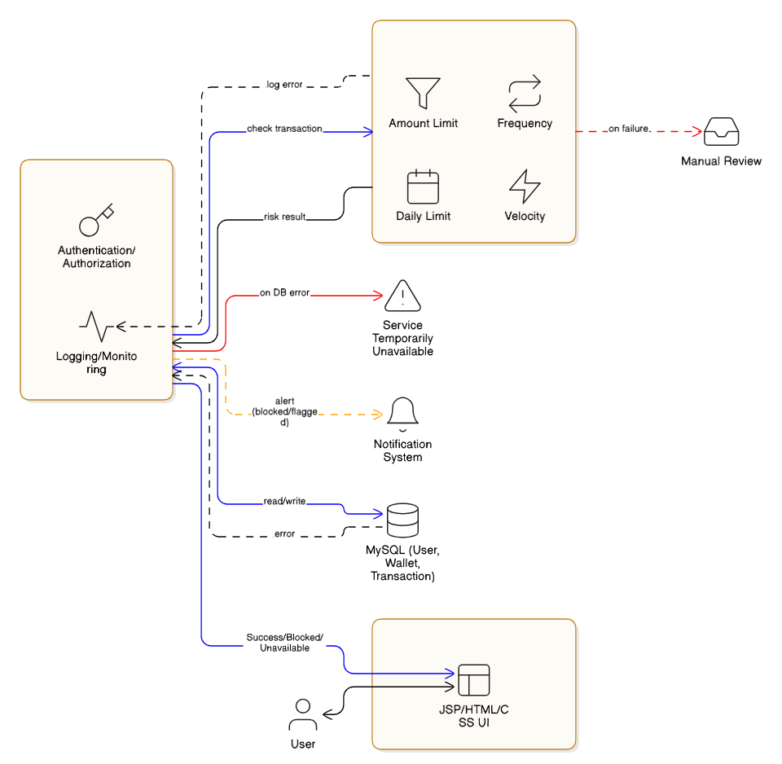
Architecture Flow & Diagram
User Transaction Request
↓
Transaction Validation
↓
Real-Time Risk Calculation
↓
Fraud Detection Decision
↓
Allow / Flag / Block Transaction
↓
Transaction History Storage

Slide 12
Modules
User Registration and Authentication Module Allows users to create an account and login securely using their credentials.
Wallet Management Module Manages wallet balance, allows users to add money, and displays available funds.
Transaction Processing Module Handles money transfers between users after verifying receiver details and balance.
Real-Time Fraud Detection and Risk Analysis Module Analyzes transactions and assigns a risk score to detect and block suspicious activities.
Transaction History and Monitoring Module Stores and displays all transaction records for monitoring and security purposes.

Slide 13
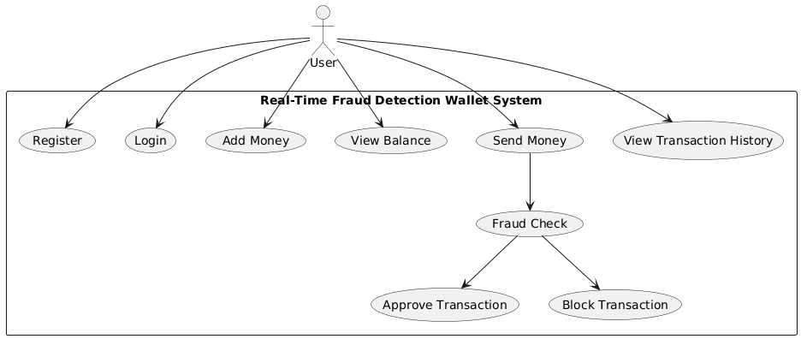
UML Diagrams
Use Case Diagram – Shows interaction between users and system functions.

Slide 14
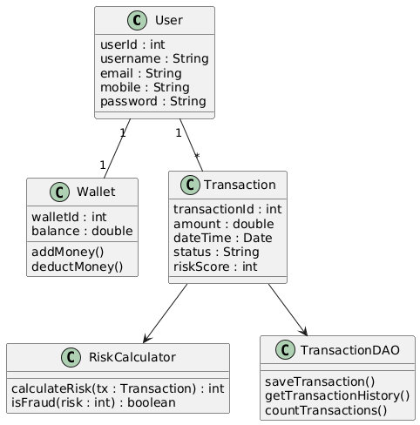
Class Diagram – Shows system classes and relationships.

Slide 15
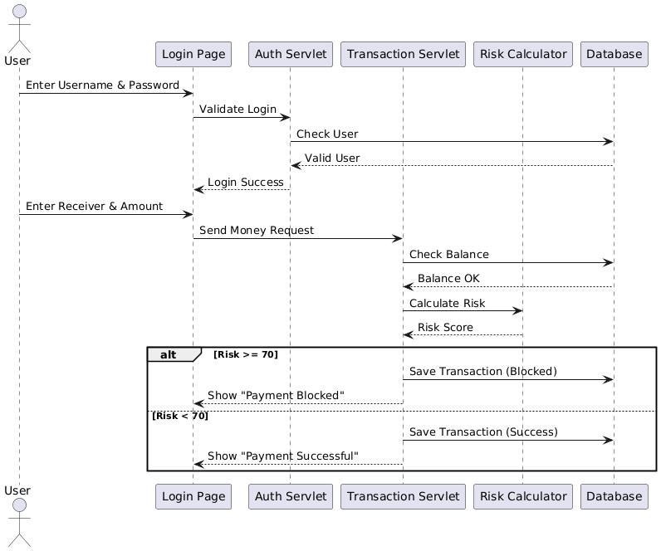
Sequence Diagram – Shows communication between system components.

Slide 16
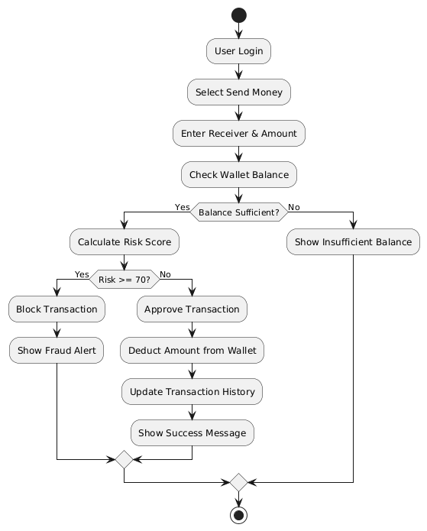
Activity Diagram – Shows workflow of transaction processing

Slide 17
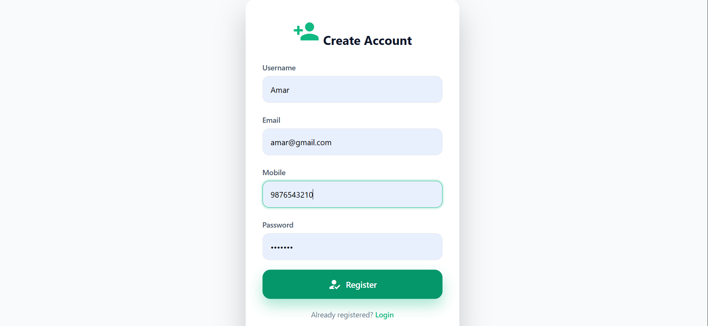
Results (Output Screens)
Screen 1: Registration Page

Slide 18
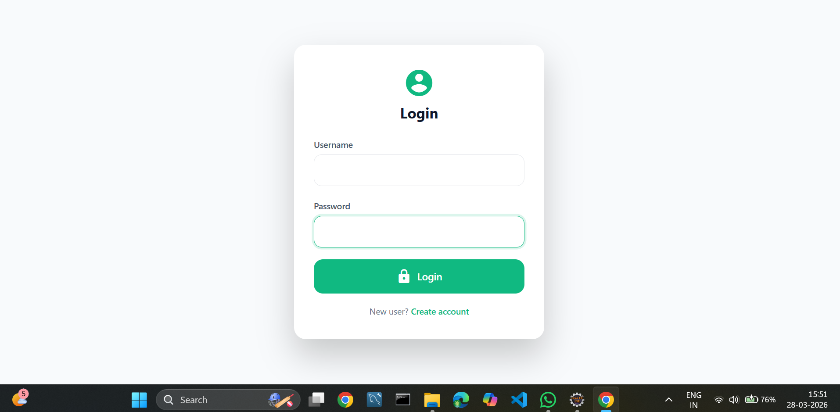
Screen 2 Login Page

Slide 19
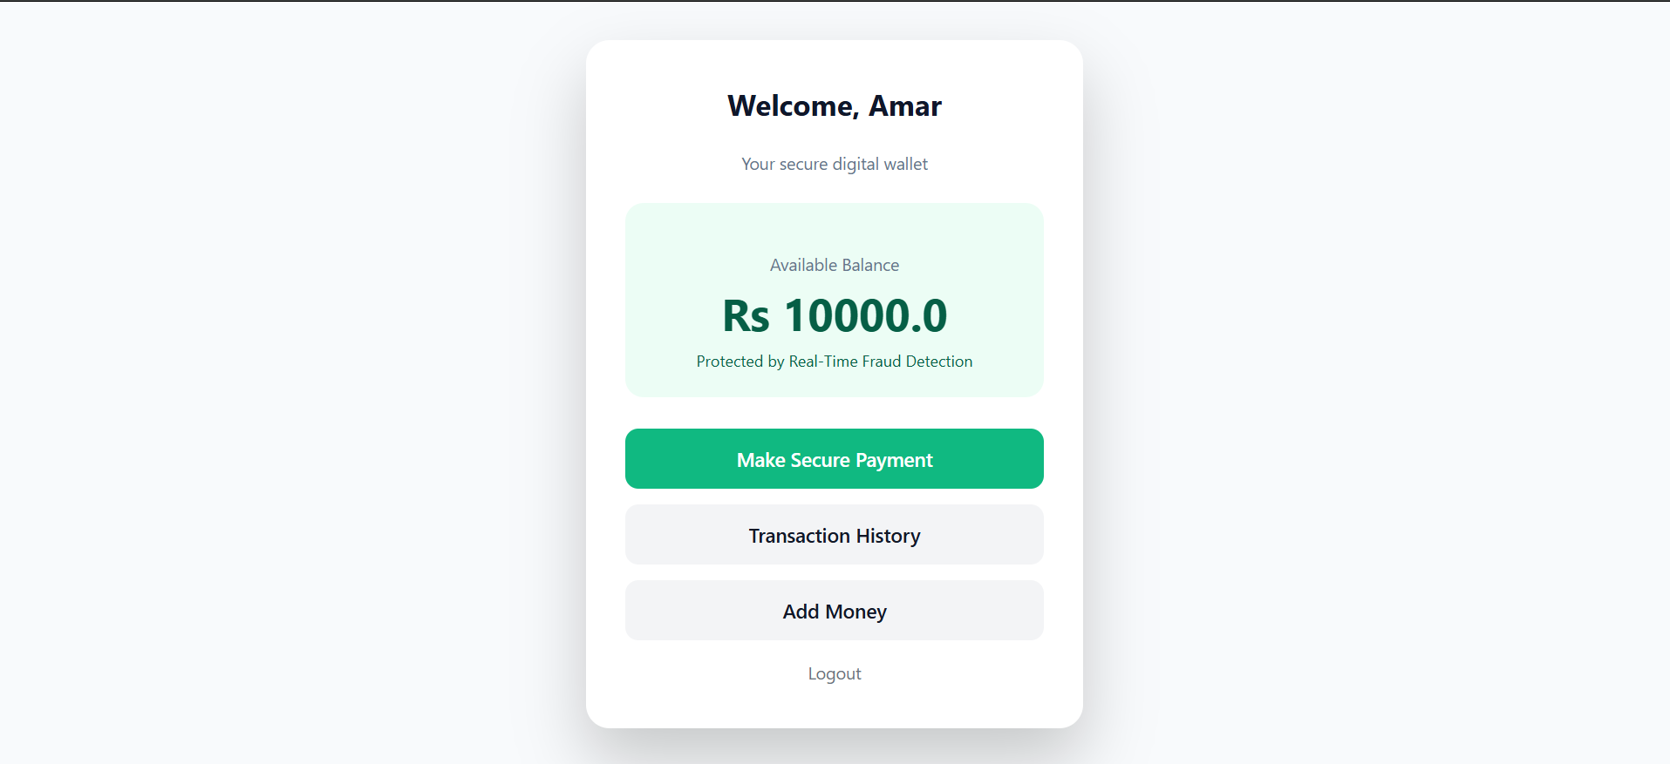
Screen 3 Home page

Slide 20
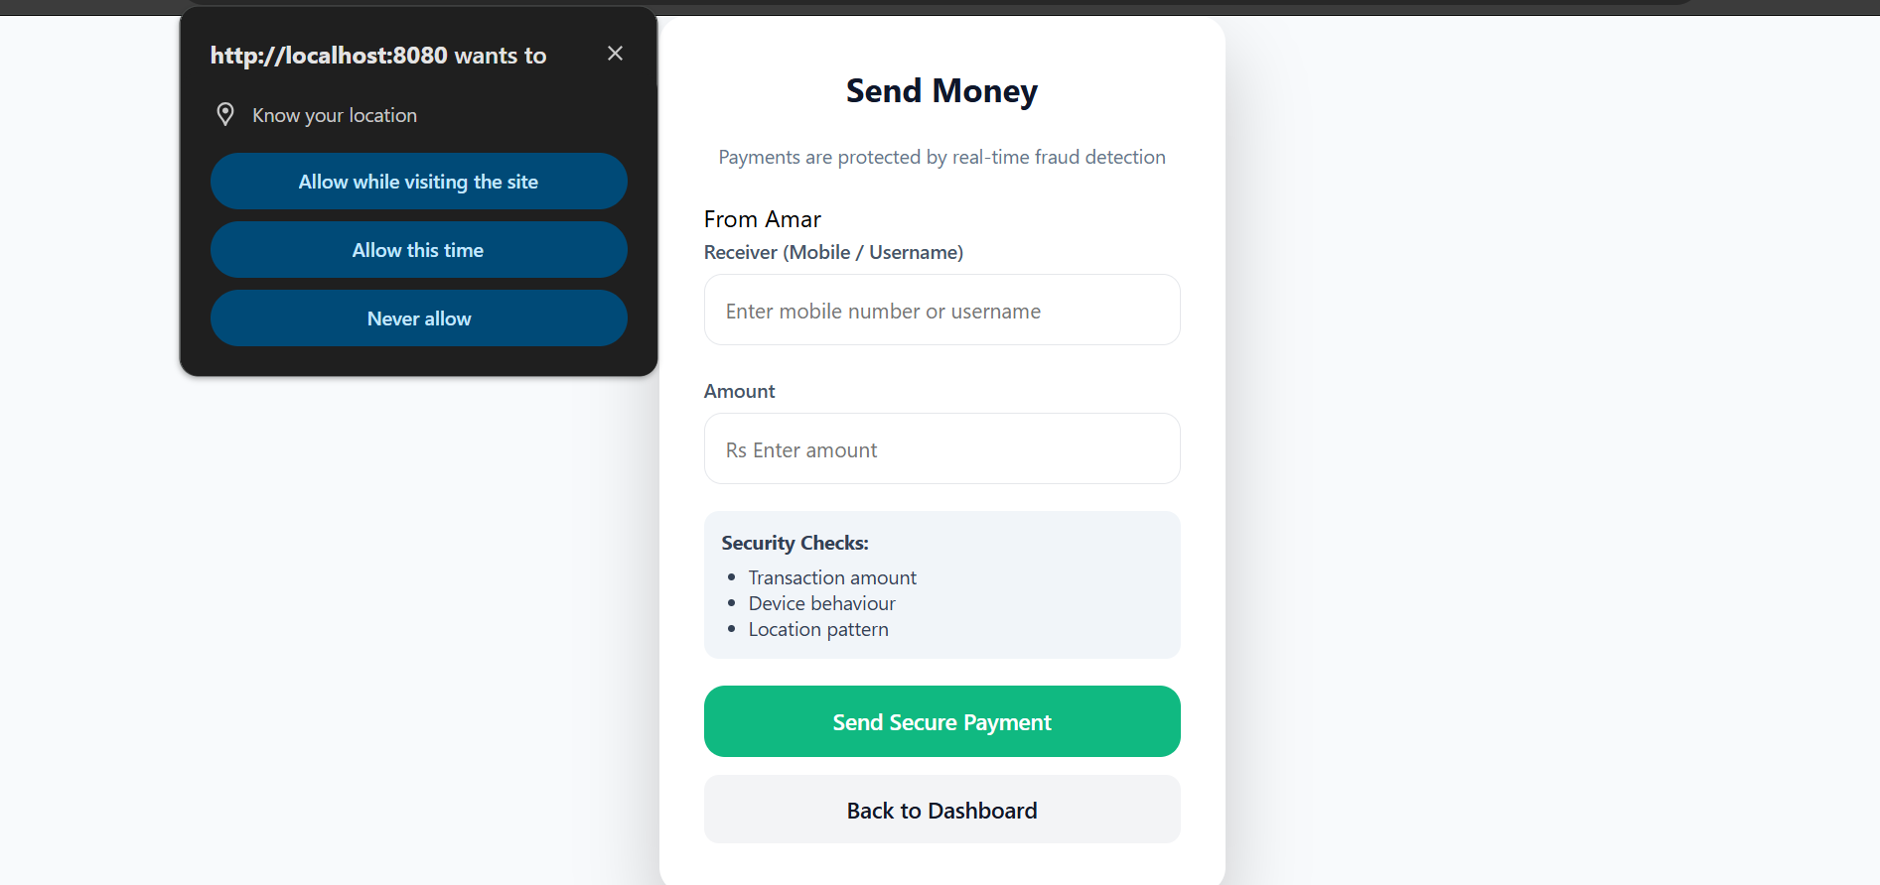
Screen 4 Sending Money
Allows users location to enter receiver details and transfer money from their wallet.

Slide 21
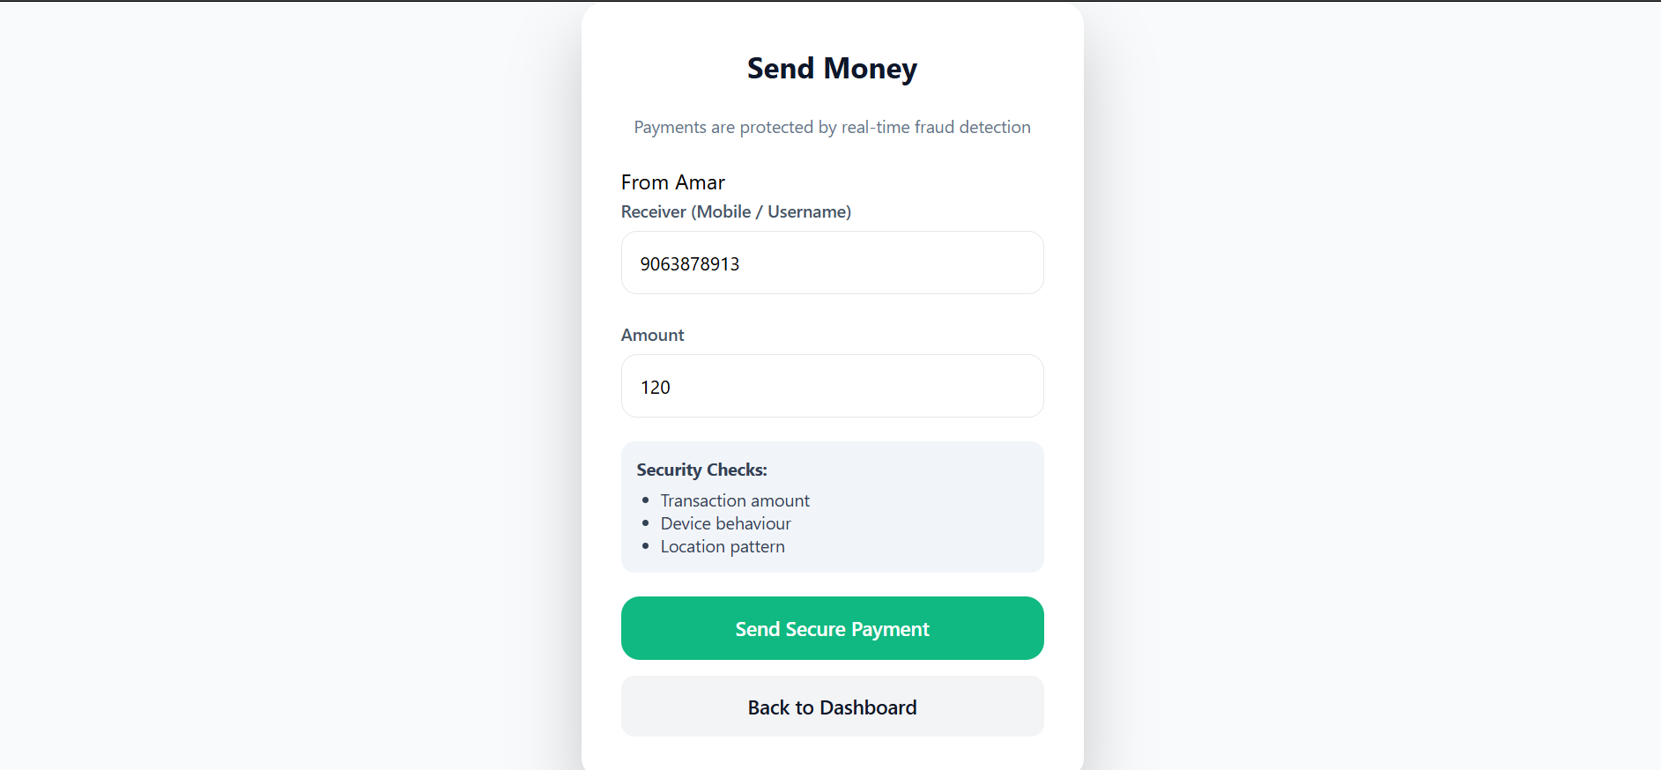
Screen 4 Sending Money

Slide 22

Screen 5: Payment Confirmation

Slide 23

Screen 6: Transaction History

Slide 24
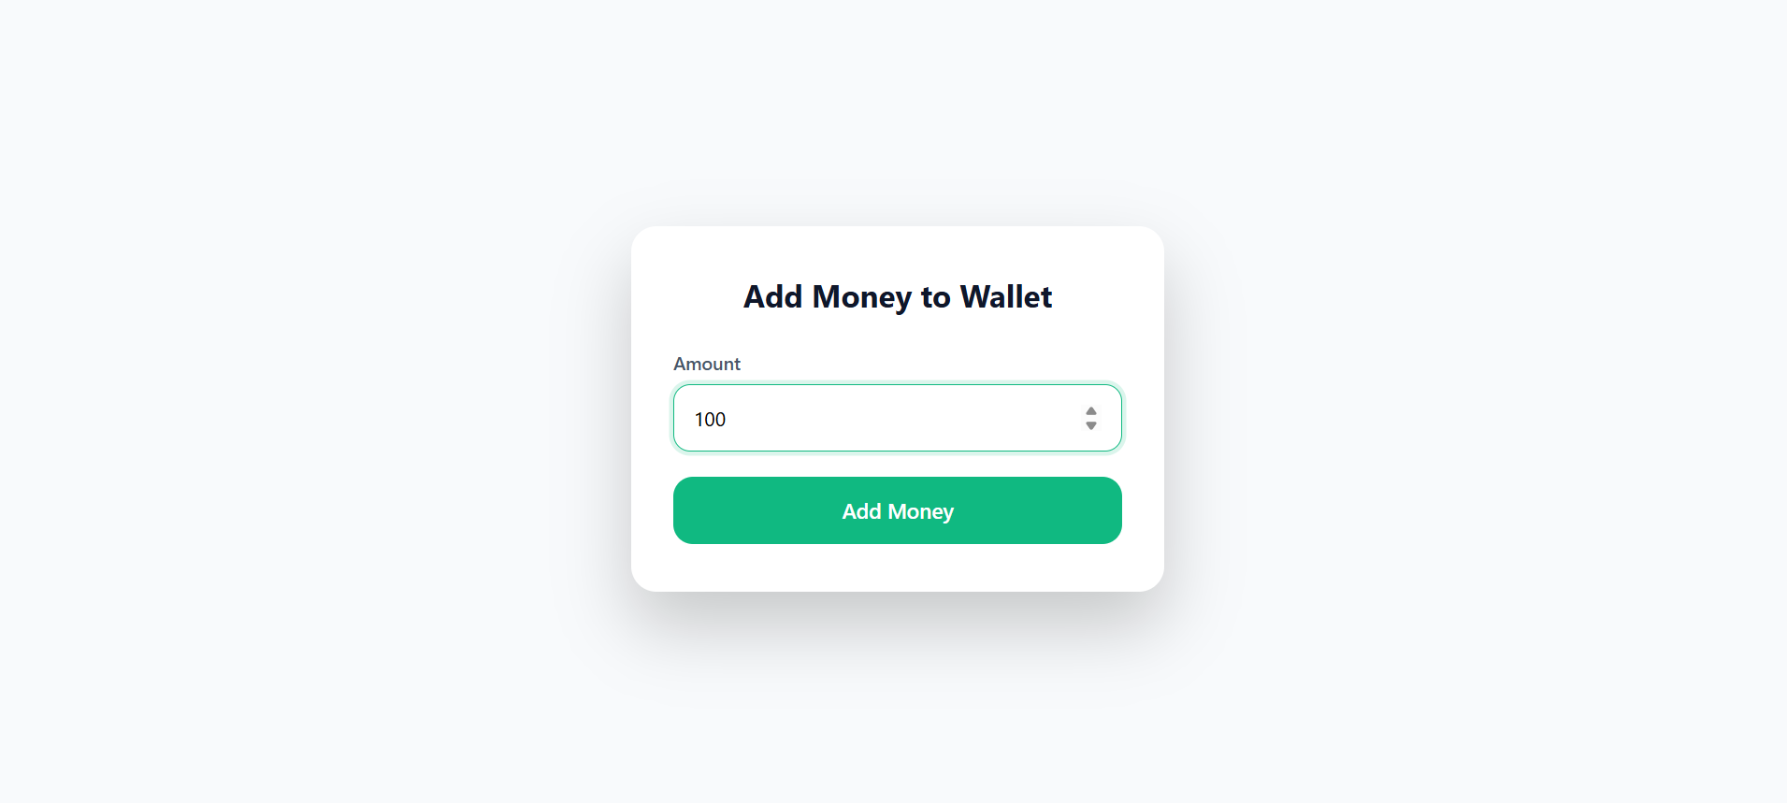
Screen 7: Money Wallet

Slide 25

Screen 8: Payment Blocked

Slide 26
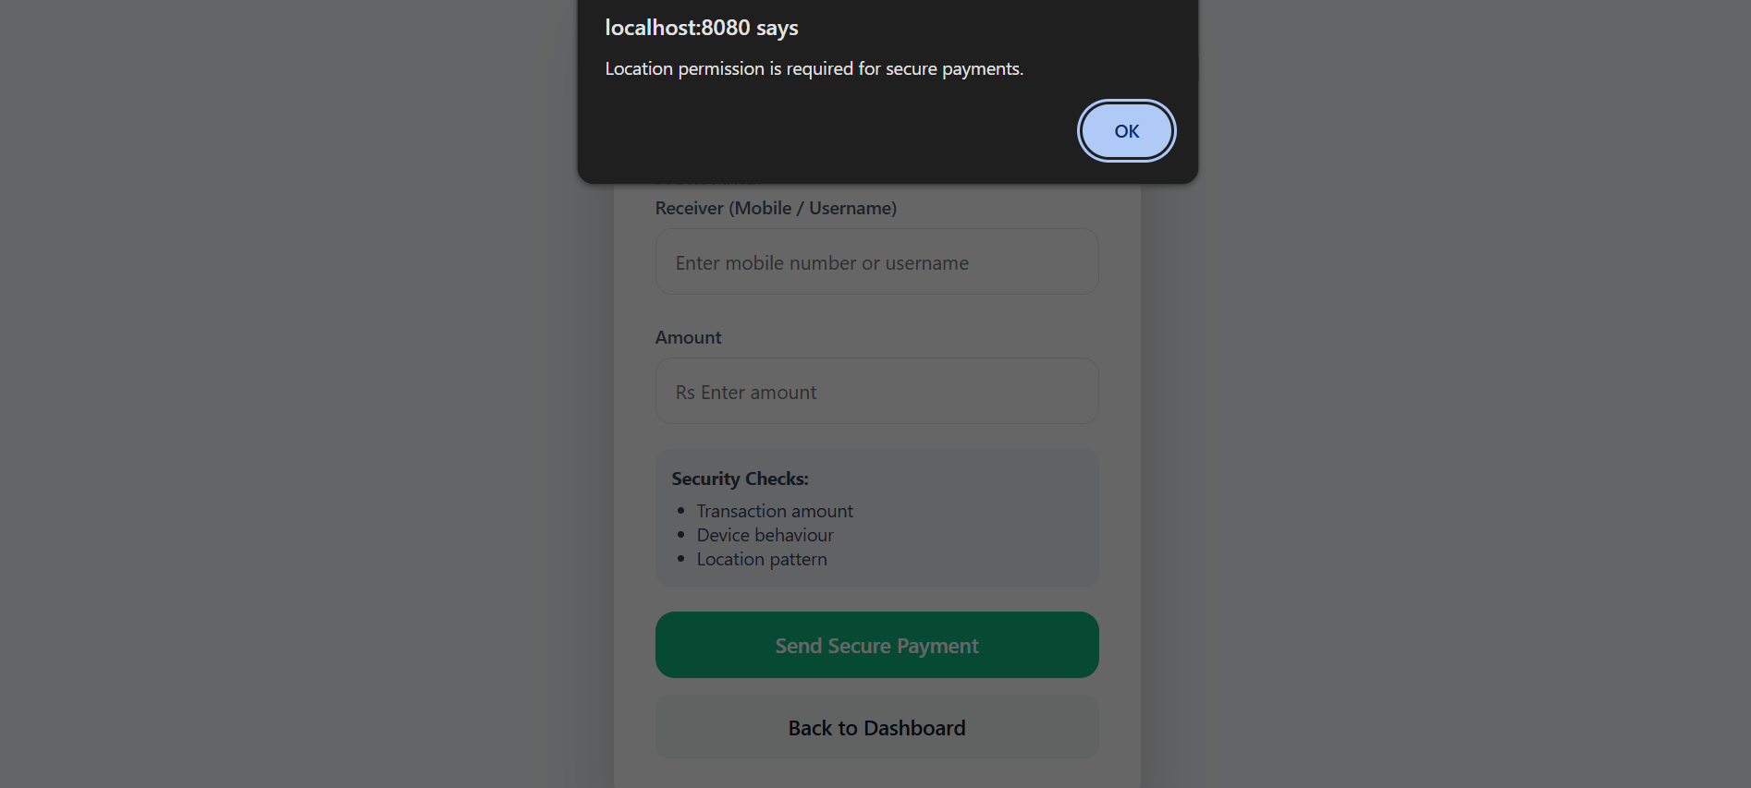
Screen 9: Allows users location to enter receiver details

Slide 27
Conclusion
The project successfully developed a Real-Time Fraud Detection Enabled Digital Wallet System.
The system monitors financial transactions and analyzes transaction behavior in real time.
The risk scoring mechanism helps detect suspicious activities before financial loss occurs.
By integrating automated fraud detection with secure transaction processing, the system improves financial security and user trust.

Slide 28
Future Enhancement
The system can be further enhanced with advanced technologies such as:
• Machine learning models for adaptive fraud detection
• Multi-factor authentication for high-value transactions
• Mobile application integration
• Real-time SMS or email alerts
• Cloud-based deployment for scalability
These improvements will make the system more secure and intelligent.

Slide 29
References
A.M. Aburbeian, H.I. Ashqar, “Credit Card Fraud Detection Using Enhanced Random Forest Classifier for Imbalanced Data”.
Bahnsen et al. – Cost Sensitive Decision Trees for Fraud Detection.
E. Ileberi, Y. Sun, and Z. Wang, “A machine learning based credit card fraud detection using the GA algorithm for feature selection”. in Journal of Big Data 9, 25 February 2022.
J. K. Afriyie et al., “A supervised machine learning algorithm for detecting and predicting fraud in credit card transactions”, in Decision Analytics Journal.
A. Bansal, H. Garg, “An Efficient Techniques for Fraudulent detection in Credit Card Dataset: A Comprehensive study”, in IOP Conference Series: Materials Science and Engineering, Vol. 1116, April 2021.

Slide 30
Thank you…

