Slide 1
The guess game
This game a fun game for 3 players.
The system will choose a random number from 1-30.
Now there are 3 players playing the game, they have to guess the number,
The player who takes least number of options will be winner.
In this game after a number is selected , if it matches with the random number, you will get a message that correct.
Else it will give a message saying the number you have guessed is lesser
or greater than the random number

Slide 2
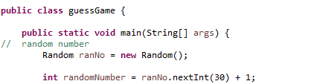
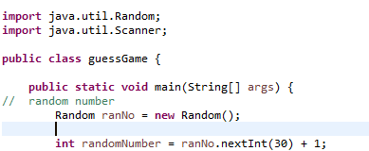
Logic behind the code:
1. Need a variable to store the random number
Random number till 30
But here there will be one error as we haven't imported
import java.util.Random;

Slide 3

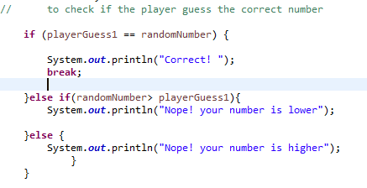
2. Now we will take a variable to store number from the player1:
Here we have specified that the number to be guessed is between 1-30
In this step we will check if the number guessed by the player is correct or not,
Or if it is lesser or greater than the random number

Slide 4
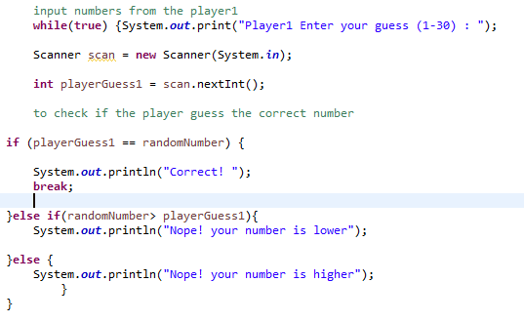
Now we will repeat the process till the correct number is guessed,
so we will apply while loop here
4. Repeat the same code for other 2 players.

Slide 5
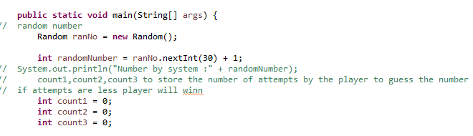
As it is a game we want to see who will be the winner.
In this game the player who takes less number of guesses to guess the correct number will be the winner.
So in now we will imitate counting of number of attempts.
Count1 for player1; Count2 for player2; and Count3 for player3;

Slide 6
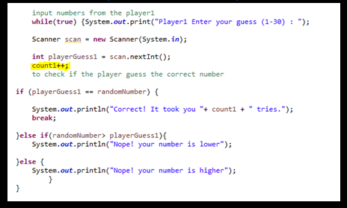
Now we will increment count1 ,count2 and count3 as required.
Now it has to be implemented in all the 3 loops

Slide 7
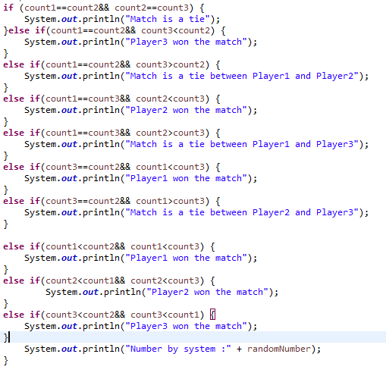
8. Now we will have to compare the results and see who won the match

