Slide 1
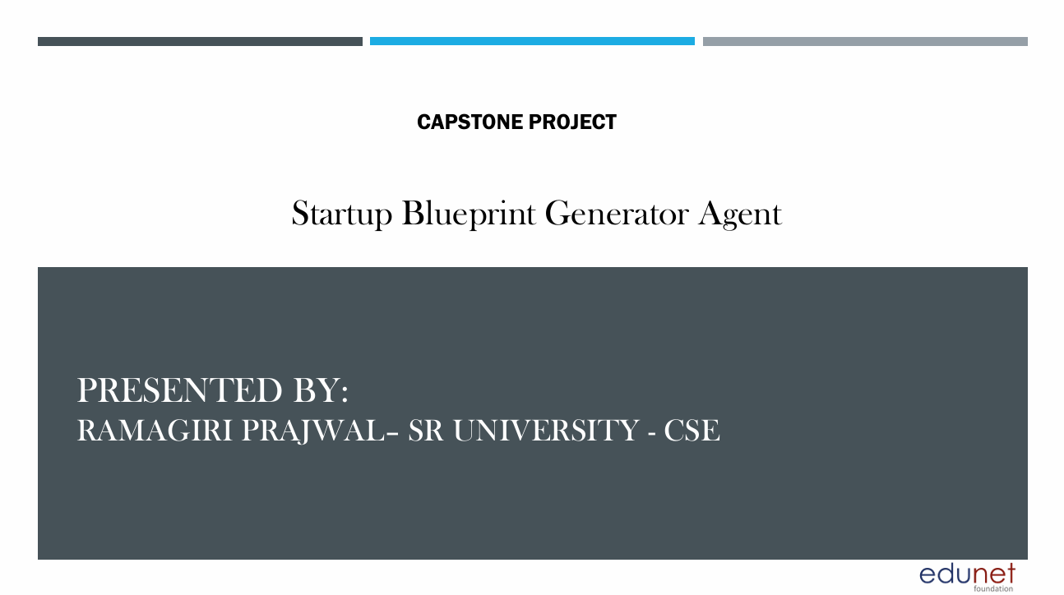

Slide 2
OUTLINE
1. Problem Statement
2. Proposed System/Solution
3. System Development Approach (Technology Used)
4. Algorithm & Deployment
5. Result (Output Image)
6. Conclusion
7. Future Scope
8. References

Slide 3
Problem Statement
Aspiring entrepreneurs often have great startup ideas but struggle to convert them into clear, structured business plans. Many face confusion when researching the market, exploring funding options, analyzing competitors, and understanding legal requirements. Without proper guidance, they spend too much time and effort trying to collect reliable information from different sources.
There is a strong need for an AI-powered assistant that removes this ambiguity and guides entrepreneurs step-by-step. A smart agent that retrieves relevant startup data and generates a complete, actionable blueprint can help people move confidently from idea to execution — saving time, reducing guesswork, and increasing the chances of success

Slide 4
Proposed Solution
The Startup Blueprint Generator Agent, powered by Retrieval-Augmented Generation (RAG) on IBM Cloud, helps transform simple startup ideas into complete business blueprints.
Key features:
- Retrieve data on market trends, funding, and competition from trusted sources
- Generate a clear business model canvas
- Suggest revenue models and funding options
- Include legal steps, government schemes, and compliance checks
- Provide a go-to-market strategy and estimated budget

Slide 5
System Development Approach
System Requirements:
- IBM Cloud Lite
- Watsonx Assistant
- Watson Discovery
- IBM Granite Foundation Model
Libraries/Services:
- Retrieval (Watson Discovery)
- Generation (Granite LLM)
- RAG system to combine search and generation
- Chatbot interface (Watsonx Assistant)
Architecture:
Input → Retrieve Relevant Data → Generate Blueprint → Display to User

Slide 6
Algorithm & Deployment
Steps:
1. Input: User submits a simple startup idea description
2. Retrieve: Watson Discovery gathers real data on market, funding, competitors, policies
3. Generate: Granite LLM builds a structured plan (business model canvas, budget, go-to-market strategy)
4. Deploy: Agent accessible through Watsonx Assistant on IBM Cloud.

Slide 7
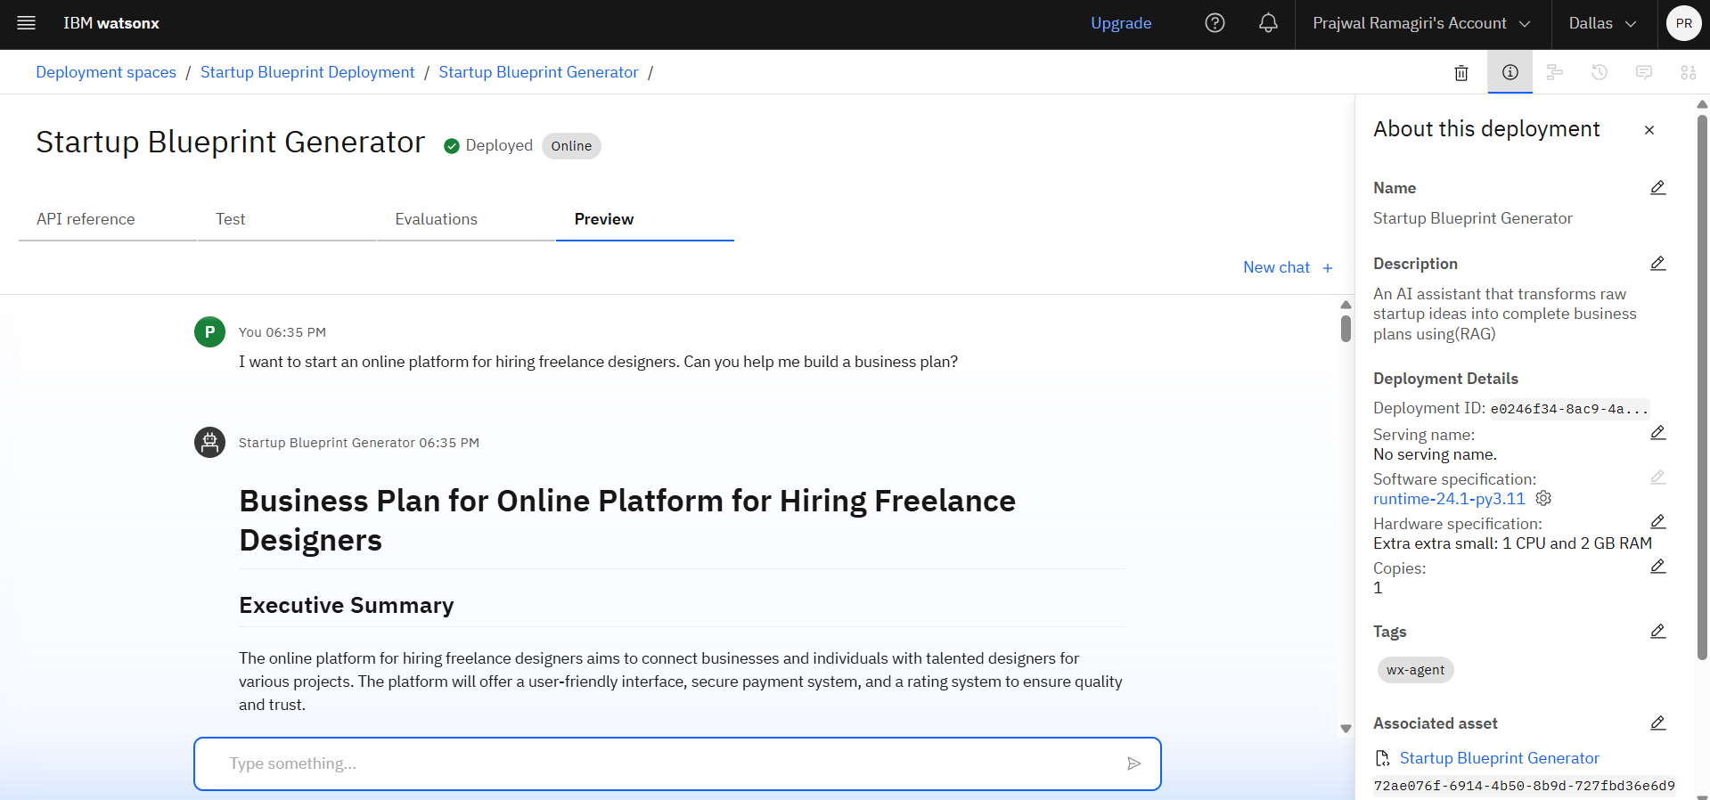
Result

Slide 8
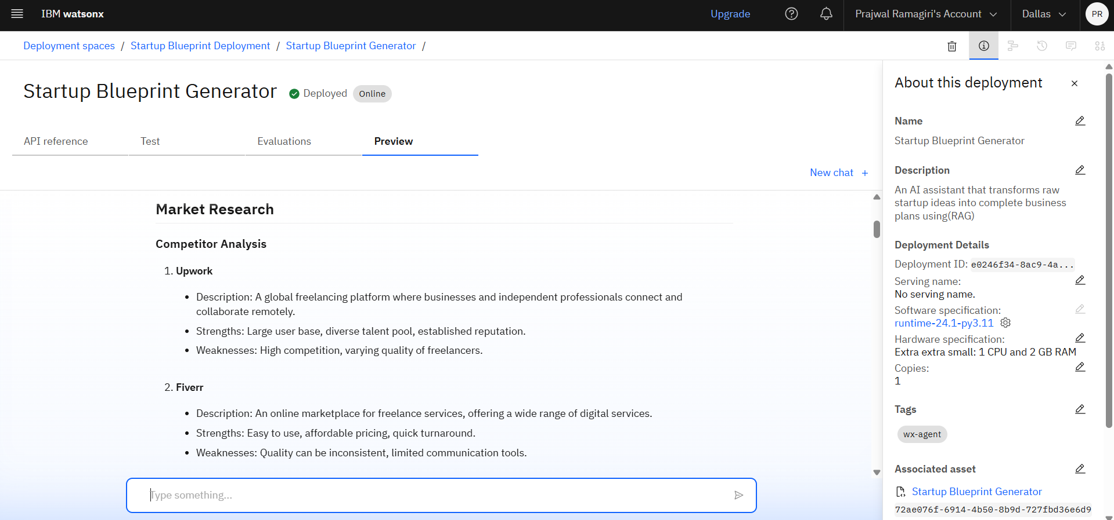
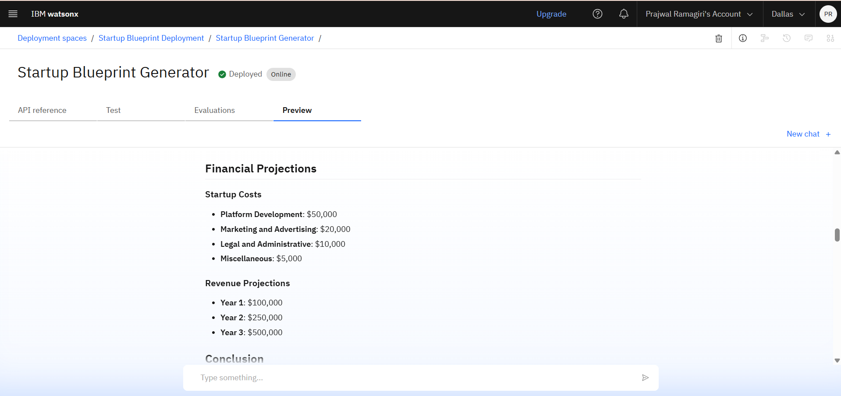

Slide 9
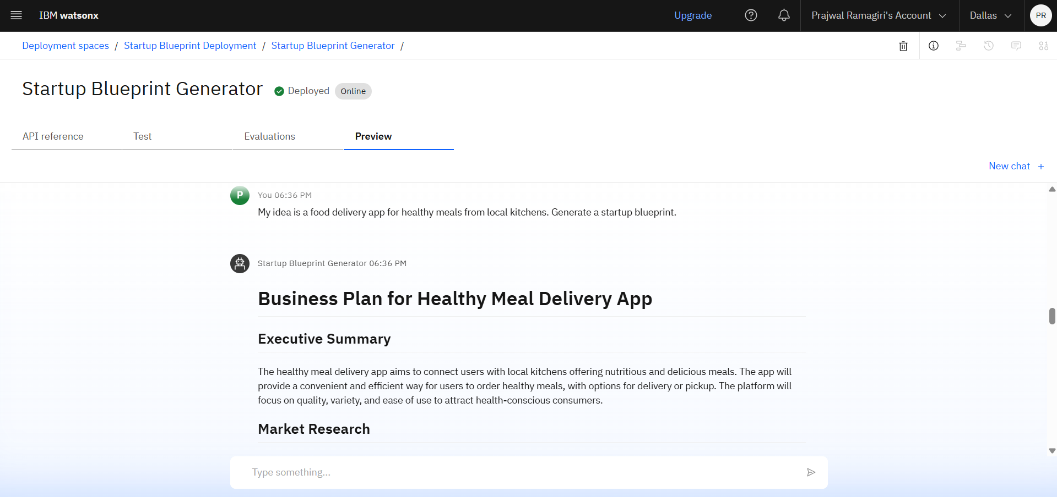
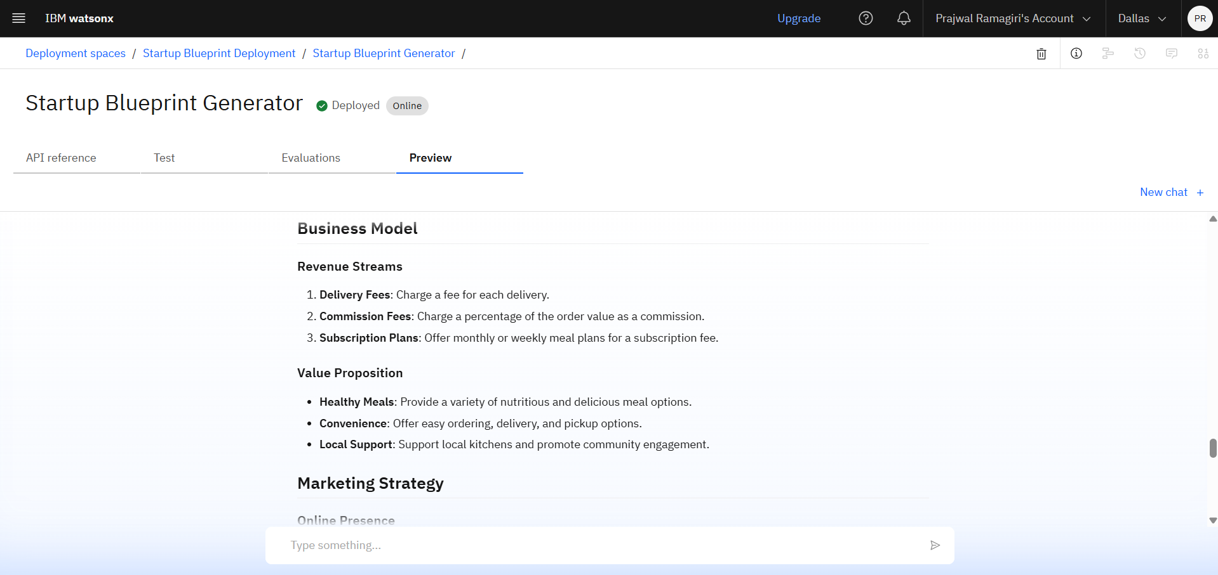
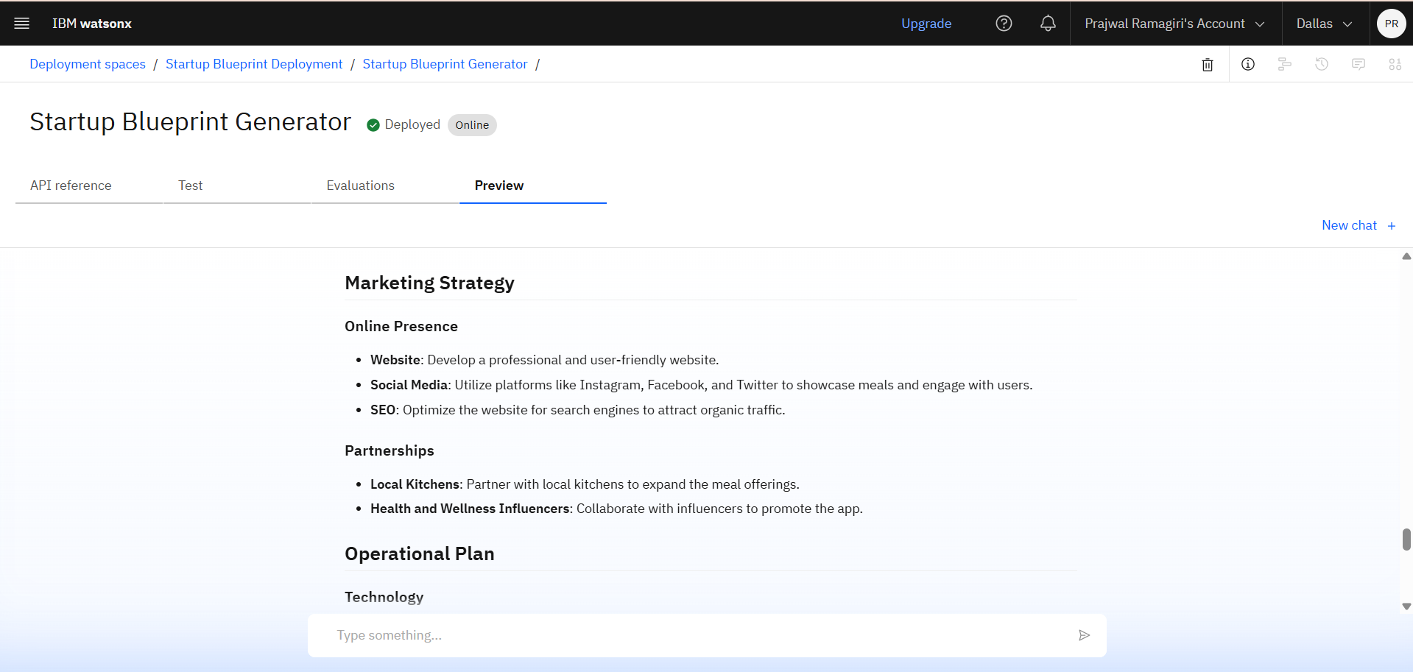

Slide 10
Conclusion
The Startup Blueprint Generator Agent bridges the gap between an initial idea and an executable startup plan. By combining Retrieval-Augmented Generation (RAG) with IBM Cloud services, it provides aspiring entrepreneurs with a clear roadmap covering market research, revenue models, funding opportunities, legal steps, and go-to-market strategies.
This AI-driven solution empowers users to launch their ventures with confidence and clarity. It makes startup planning faster, smarter, and more accessible for everyone — turning raw ideas into realistic, investor-ready blueprints and supporting the growth of innovation and entrepreneurship.

Slide 11
Future Scope
- Integrate direct investor and incubator matching
- Include real-time updates on startup policies and schemes
- Expand to support regional languages for wider reach
- Add financial modeling tools for detailed cost analysis
- Develop mobile app version for on-the-go access

Slide 12
References
1. IBM Cloud Docs
2. Watsonx Assistant Docs
3. Granite Model Docs
4. Maps/Weather API Docs

Slide 13
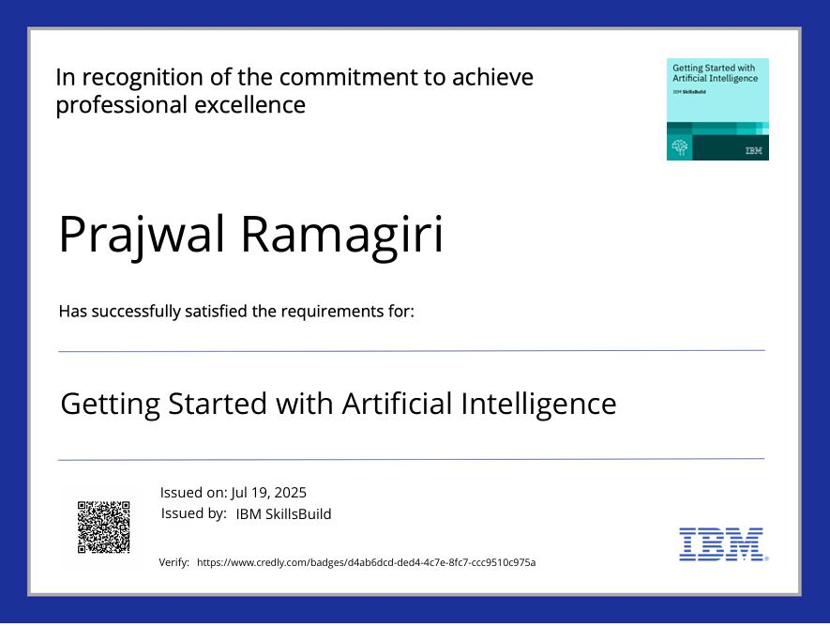
Ibm certifications

Slide 14
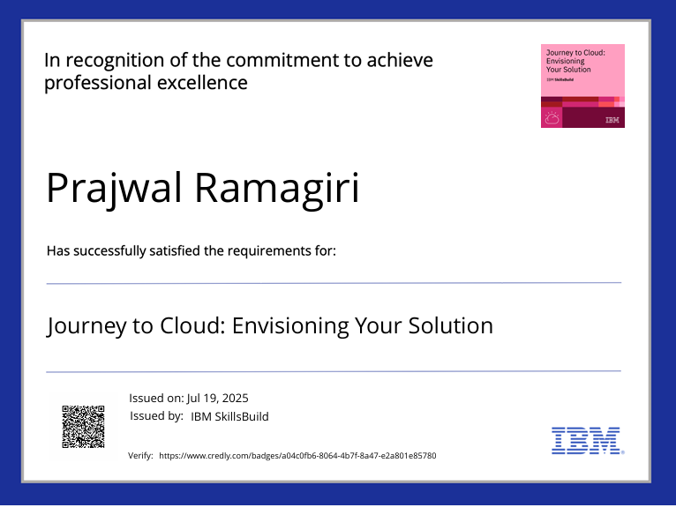
Ibm certifications

Slide 15
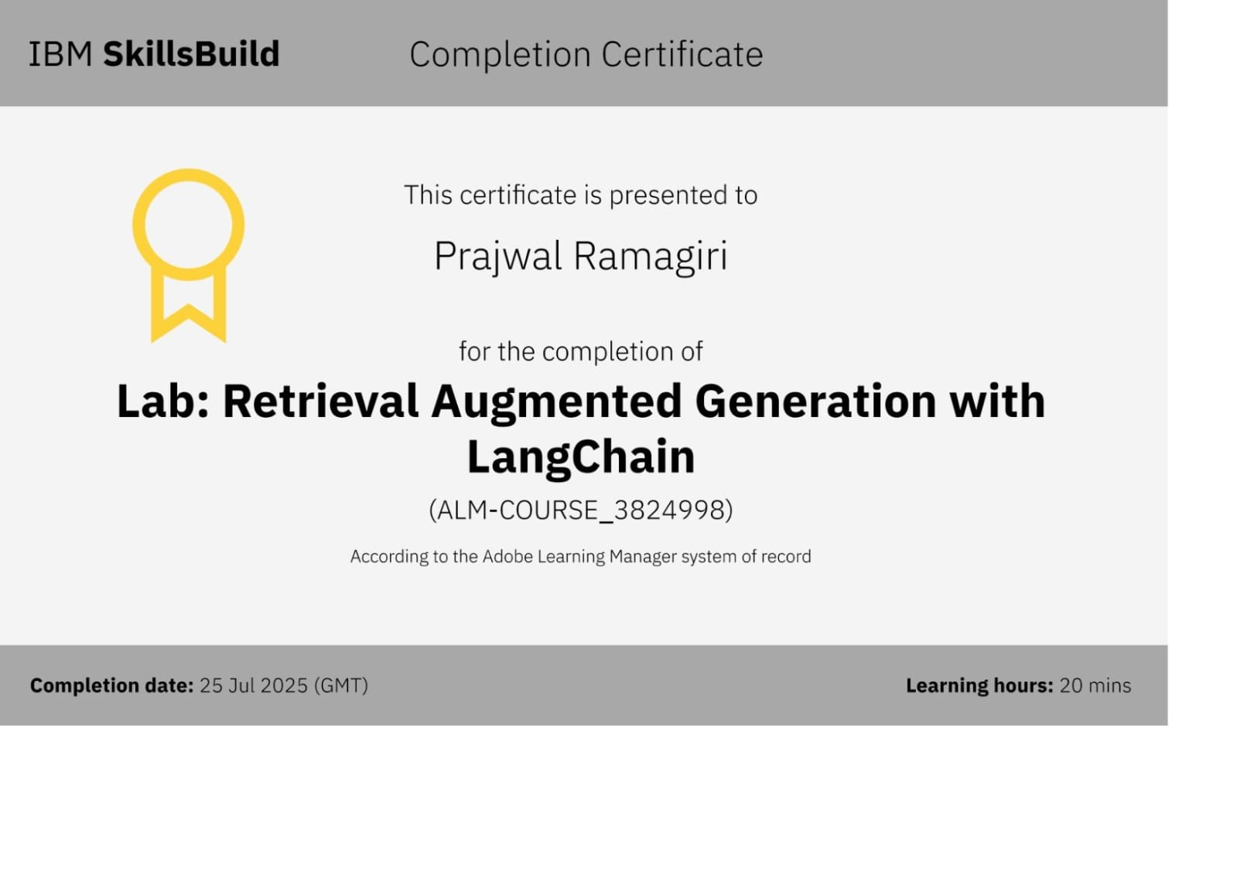
Ibm certifications

Slide 16
THANK YOU!

