Slide 1
Supervised Learning: Regression
Ayal Gussow

Slide 2
Supervised Learning Module
Supervised learning 1: Regression problems
Supervised learning 2: Overfitting, regularization, hyperparameter optimization, and cross-validation
Supervised learning 3: Classification problems

Slide 3
Machine-Learning Basic Process
Training data:
Features (Outcome)
Model
Trained Model
Data:
Features
Predict

Slide 4
Supervised Learning Module
Training samples are provided with the desired output.
Example:
Predicting the price of a house based on its attributes.

Slide 5

Supervised Learning Module
Square feet
Number of bedrooms
Size of backyard
etc
$800,000

Slide 6
Supervised Learning: Regression
Regression: The predicted variable takes continuous values (IE house prices).
Classification: The predicted variable takes labels (IE color).

Slide 7
Ames Dataset
Dataset of houses in Ames, Iowa with 79 features per house, including:
Square footage
Number of bathrooms
Number of fireplaces
etc
Price

Slide 8
Ames Dataset
Dataset of houses in Ames, Iowa.
Features:
Square footage of first floor
Square footage of second floor
Predict: Price

Slide 9
Sample Problem
Given the first and second floor square footage of a house in Ames, Iowa, can you predict the house’s price?

Slide 10
Machine-Learning Basic Process
Training data
Features: Sqr feet 1, Sqr feet 2
Outcome: Housing price
Model
Linear regression
Trained Model
Sqr feet 1, Sqr feet 2
Predict House Price

Slide 11
Evaluation
Sum of squared residuals.
Sum of the difference between the model’s predictions and the true values.

Slide 12
Today’s Outline
Linear regression
Decision Trees
Ensemble learning (Random Forest)
Homework

Slide 13
Ames Dataset
Training data is 1500 houses with the following features:
Square footage for the first floor
We want to predict: House Price

Slide 14
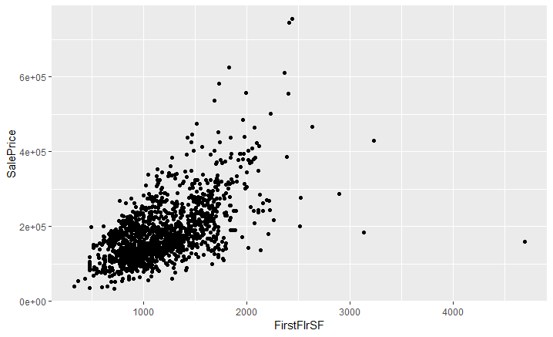
Plot of first floor square footage

Slide 15

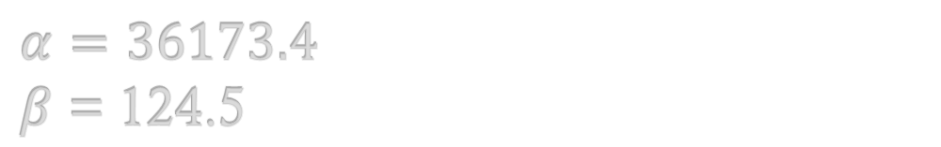
Predict by first floor square footage
We want to predict: Sale Price
y – sale price
x – square footage of 1st floor.
$$y=α+βx$$
$$α=36173.4$$
$β$ = 124.5

Slide 16

Predict by first floor square footage
y – sale price
x – square footage of 1st floor.
$$y=36173.4+\text{124.5}x$$
Example – 1,145:
$$y=36173.4+\text{124.5} ∗1,145=$$
178,725.9
Actual price:
160,200

Slide 17
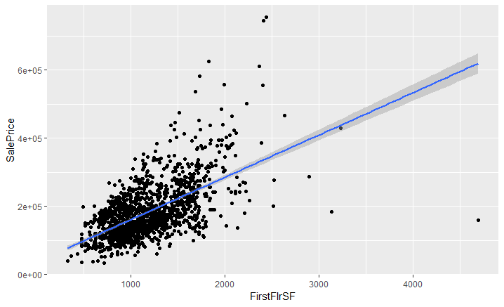
Plot of first floor square footage

Slide 18

Linear Regression
$$y=Xβ$$

Slide 19
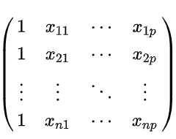
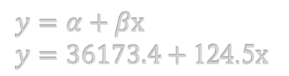

Linear Regression
$$y=Xβ$$
y = $β_{0}$ * 1 + $β_{1}$ * square_feet
$$y=α+βx$$
$$y=36173.4+\text{124.5}x$$

Slide 20


Linear Regression
$$y=Xβ$$
y = $β_{0}$ * 1 + $β_{1}$ * $X_{1}$ + $β_{2}$ * $X_{2}$
Extra reading: Least Squares.
y = prices on house.
X = features, such as sqr feet.
Beta = coefficient, a multiplier.
Intercept = $β_{0}$

Slide 21
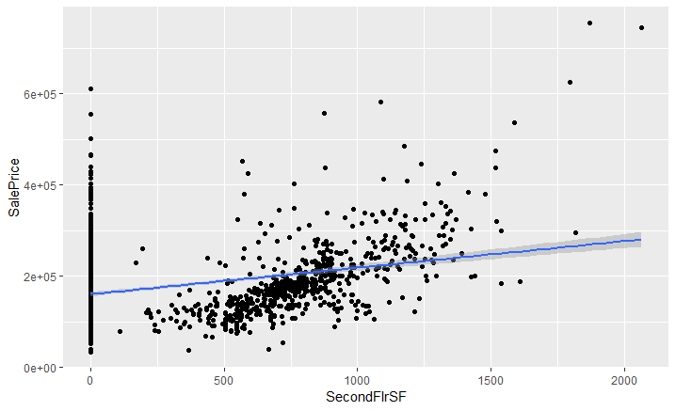
Plot of second floor square footage

Slide 22
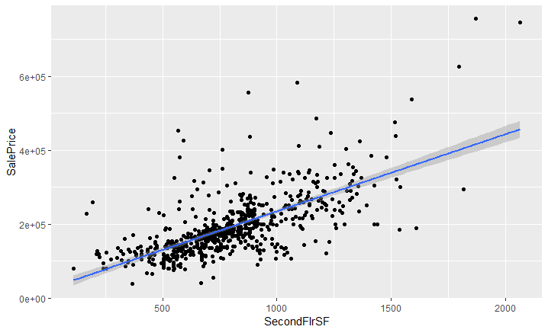
Plot of second floor square footage (no 0s)

Slide 23
Notebook: Ames Dataset
Training data is 1500 houses with the following features:
Square footage for the first floor
Square footage for the second floor
We want to predict: House Price

Slide 24
Decision Trees
Conceptually simple method that assigns values based on a series of splits in the data.
Can model non-linear relationships and interactions between features.

Slide 25
Plot of first floor square footage

Slide 26
Plot of first floor square footage

Slide 27
Plot of first floor square footage

Slide 28
Plot of first floor square footage

Slide 29
Plot of first floor square footage
1
2
3
4

Slide 30
Sample Decision Tree
1
2
3
4
X > 1500?
X < 1000?
X > 2000?
Mean Region 1
Mean Region 2
Mean Region 3
Mean Region 4

Slide 31
Sample Decision Tree
X1 > 1500?
X2 < 1000?

Slide 32
Decision Trees
Can model non-linear relationships and interactions between features.
No need for scaling
Internal feature selection
Prone to overfitting.

Slide 33
Random Forest
A collection of decision trees. Each tree votes and the average is taken.

Slide 34
Random Forest
A collection of decision trees. Each tree votes and the average is taken.
X1 > 1500?
X2 < 1000?
X3 > 2000?
Mean Region 1
Mean Region 2
Mean Region 3
Mean Region 4

Slide 35

Random Forest
A collection of decision trees. Each tree votes and the average is taken.

Slide 36
Random Forest
A collection of decision trees. Each tree votes and the average is taken.

Slide 37
Random Forest
A collection of decision trees. Each tree votes and the average is taken.

Slide 38
Random Forest
A collection of decision trees. Each tree votes and the average is taken.

Slide 39
Random Forest
A collection of decision trees. Each tree votes and the average is taken.
Data is subset for each tree.
Features to split by are selected randomly.

Slide 40
Random Forest
A collection of decision trees. Each tree votes and the average is taken.
This helps reduce overfitting, but we lose interpretability.
Easiest method to use OOTB.
Parameters: n_trees, criterion for splits, max_depth

