Slide 1
Neural Networks and Deep Learning
Day 1
Salah Ashraf Salah
ASR Team Leader, RDI

Slide 2
Content
Introduction
Neural Networks
The Perceptron
Multi-Layer perceptron
Hyper Parameters

Slide 3
Introduction

Slide 4

Introduction
Machine Learning (ML)
“an application of artificial intelligence (AI) that provides systems the ability to automatically learn and improve from experience without being explicitly programmed”

Slide 5
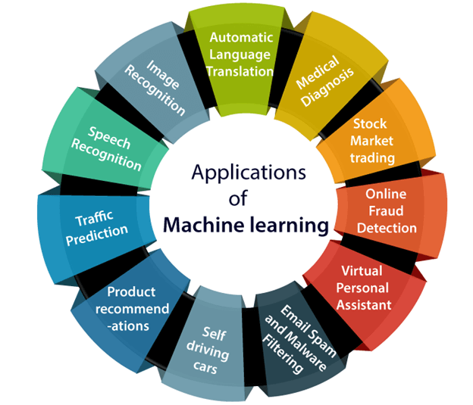
Introduction

Slide 6
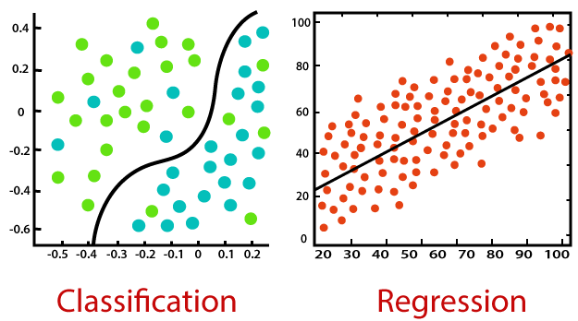

















Introduction
ML tasks can be categorized into 2 groups
Regression
Classification

Slide 7
Introduction
ML algorithms can be categorized into 3 groups
Supervised Learning
Unsupervised Learning
Reinforcement Learning

Slide 8
Introduction
Supervised Learning Algorithms
Linear regression
Logistic regression
K-nearest neighbors
Support Vector Machines
Decision trees
Neural Networks

Slide 9
Neural Networks

Slide 10
Neural Networks
What??
Why??

Slide 11
The perceptron

Slide 12
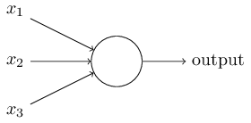
The perceptron
Single Neuron
Takes single/multiple inputs
Outputs a single value
Can be used as a binary classifier
Output: 0 or 1

Slide 13
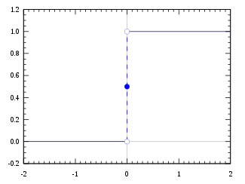
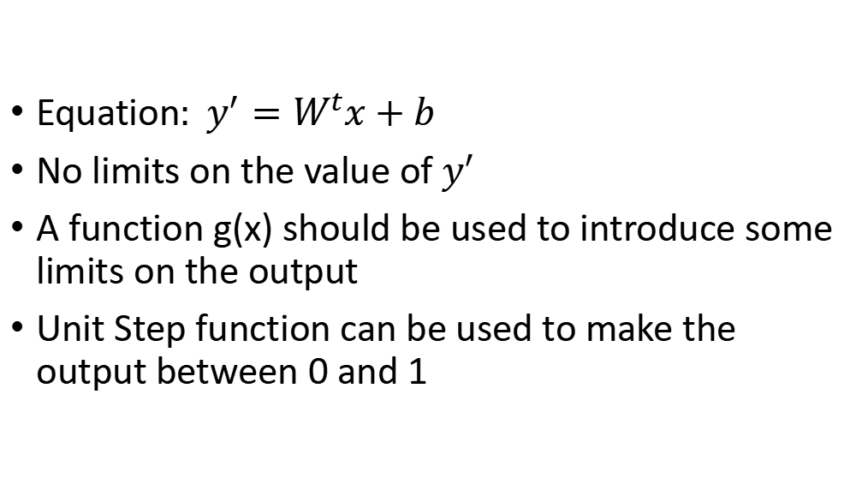
The perceptron
Equation$: y^{′}=W^{t}x+b$
No limits on the value of $y^{′}$
A function g(x) should be used to introduce some limits on the output
Unit Step function can be used to make the output between 0 and 1

Slide 14
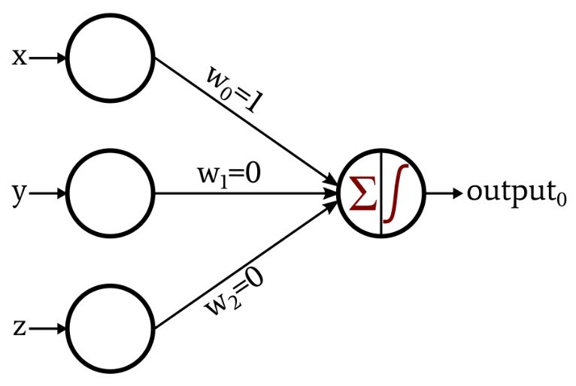
The perceptron

Slide 15
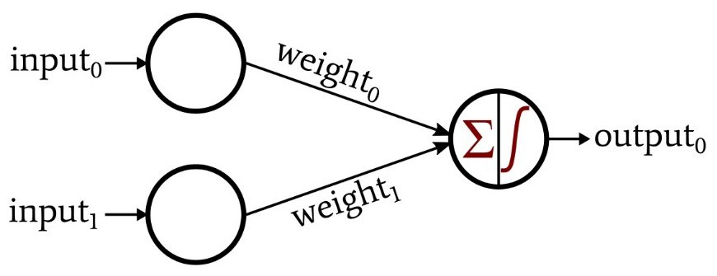

The perceptron
Use Perceptron to implement Logical Functions
OR
Input0 | Input1 | Output
0 | 0 | 0
0 | 1 | 1
1 | 0 | 1
1 | 1 | 1
$$w_{0}=1, w_{1}=1, b=−0.5$$

Slide 16

The perceptron
Use Perceptron to implement Logical Functions
AND
Input0 | Input1 | Output
0 | 0 | 0
0 | 1 | 0
1 | 0 | 0
1 | 1 | 1
$$w_{0}=1, w_{1}=1, b=−1.5$$

Slide 17
The perceptron
Use Perceptron to implement Logical Functions
XOR
Input0 | Input1 | Output
0 | 0 | 0
0 | 1 | 1
1 | 0 | 1
1 | 1 | 0
$$Can^{′}t be implemented with single perceptron$$

Slide 18
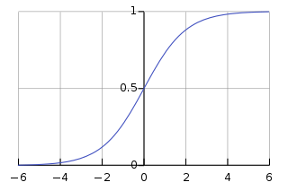
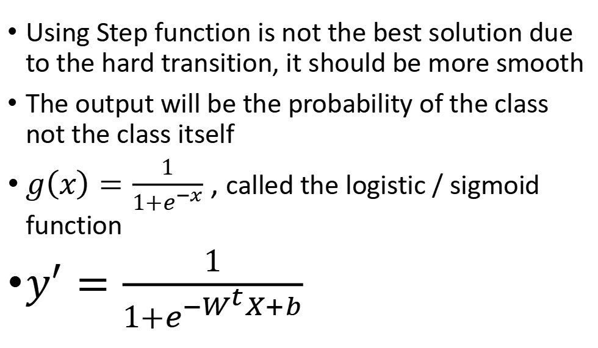
The perceptron
Using Step function is not the best solution due to the hard transition, it should be more smooth
The output will be the probability of the class not the class itself
$g\left(x\right)=\frac{1}{1+e^{−x}}$ , called the logistic / sigmoid function
$y^{′}=\frac{1}{1+e^{−W^{t}X+b}}$

Slide 19
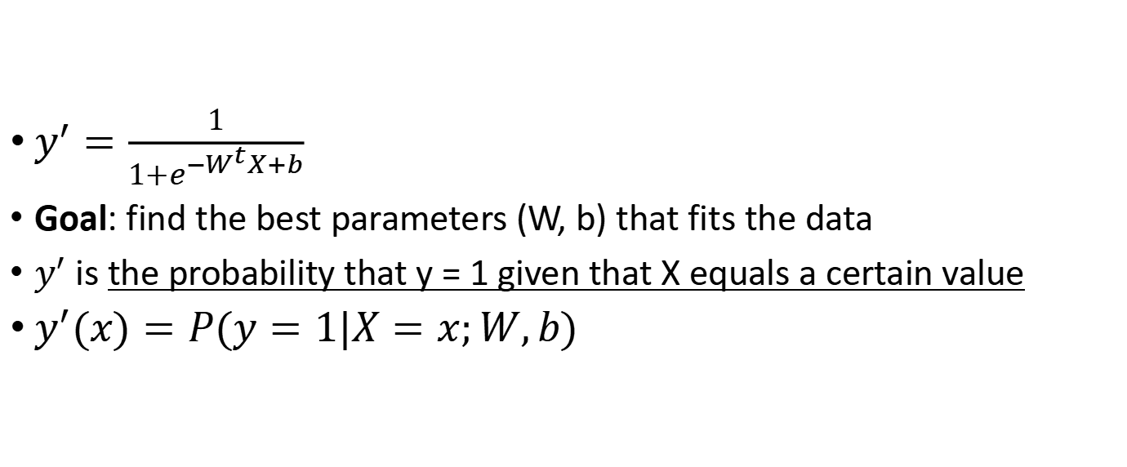
The perceptron
$y^{′}=\frac{1}{1+e^{−W^{t}X+b}}$
Goal: find the best parameters (W, b) that fits the data
$y^{′}$is the probability that y = 1 given that X equals a certain value
$y^{′}(x)=P(y=1|X=x;W,b)$

Slide 20
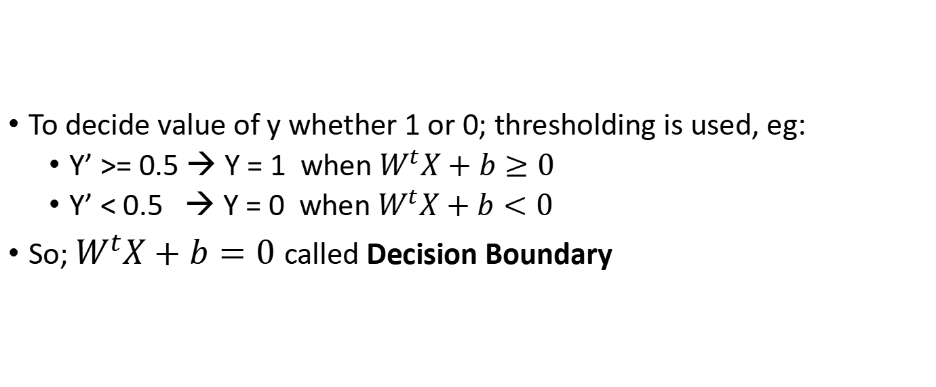
The perceptron
To decide value of y whether 1 or 0; thresholding is used, eg:
Y’ >= 0.5 → Y = 1 when $W^{t}X+b≥0$
Y’ < 0.5 → Y = 0 when $W^{t}X+b<0$
So; $W^{t}X+b=0$called Decision Boundary

Slide 21
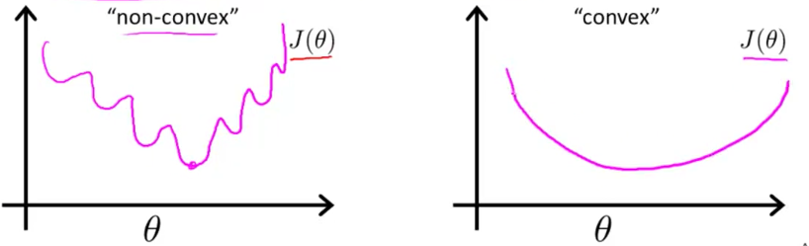
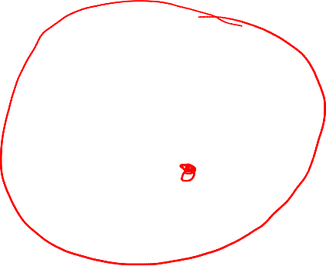
The perceptron
To find the best parameters, a cost function should be minimized
A cost function should be a convex function with single global minimum

Slide 22
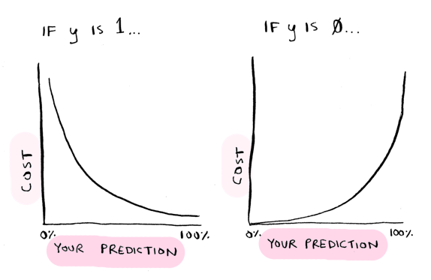
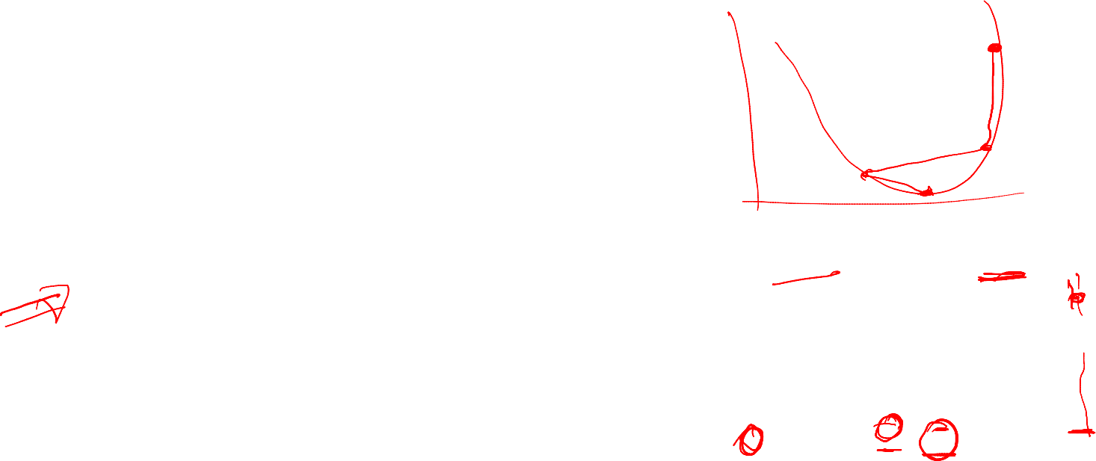
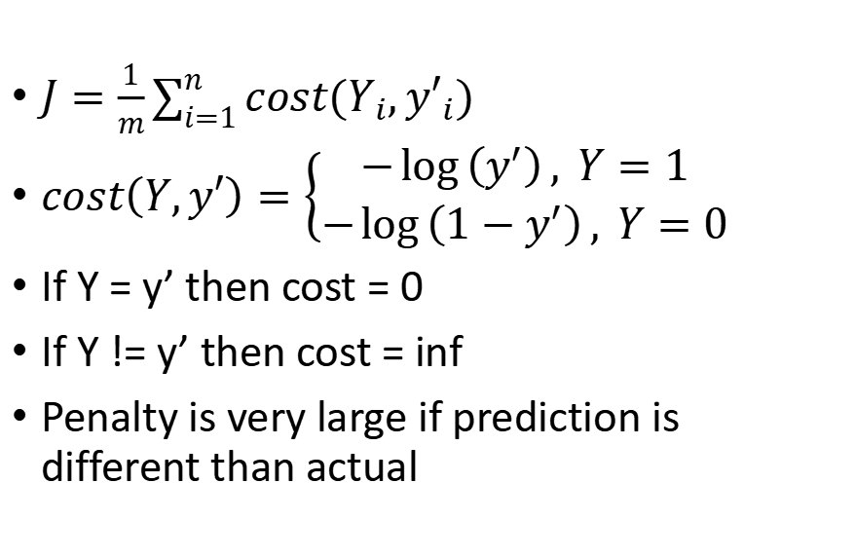
The perceptron
$J=\frac{1}{m}\sum_{i=1}^{n}{cost(Y_{i},{y′}_{i})}$
$cost\left(Y,y′\right)=\left\{\begin{aligned}−\log\left(y^{′}\right), Y=1 \\ −\log\left(1−y^{′}\right), Y=0\end{aligned}\right.$
If Y = y’ then cost = 0
If Y != y’ then cost = inf
Penalty is very large if prediction is different than actual

Slide 23

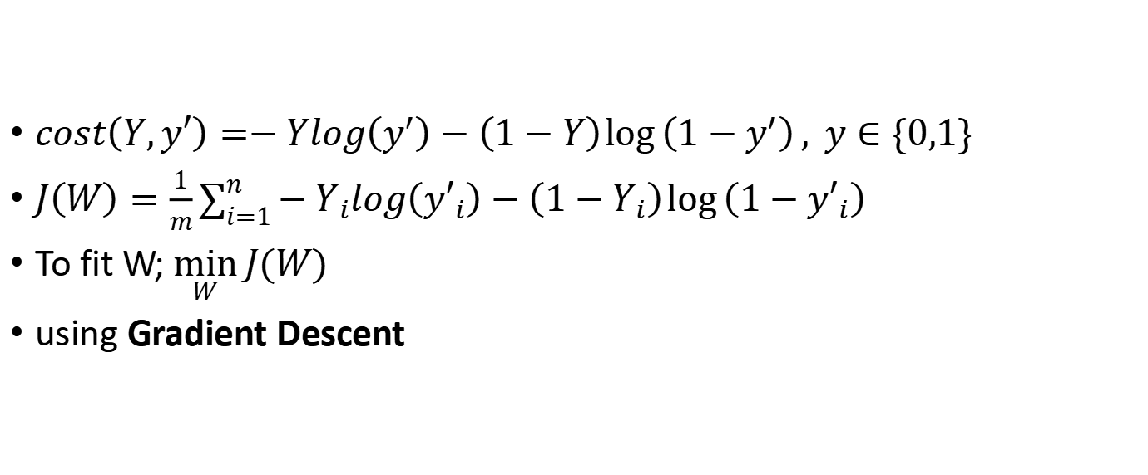
The perceptron
$cost\left(Y,y′\right)=−Ylog\left(y^{′}\right)−\left(1−Y\right)\log\left(1−y^{′}\right), y∈\{0,1\}$
$J\left(W\right)=\frac{1}{m}\sum_{i=1}^{n}{−Y_{i}log\left({y′}_{i}\right)−\left(1−Y_{i}\right)\log\left(1−{y′}_{i}\right)}$
To fit W; $\min_{W}{J(W)}$
using Gradient Descent

Slide 24

The perceptron
$J\left(W\right)=\frac{1}{m}\sum_{i=1}^{n}{−Y_{i}log\left({y′}_{i}\right)−\left(1−Y_{i}\right)\log\left(1−{y′}_{i}\right)}$
Repeat
$W_{jnew}≔W_{jold}−α\frac{∂J(W)}{∂W_{j}}$
$\frac{∂J(W)}{∂W_{j}}=\frac{1}{m}\sum_{i=1}^{m}{\left({y^{′}}_{i}−Y_{i}\right)∗x_{i}^{j}}$

Slide 25
Multi-Layer Perceptron (MLP)

Slide 26
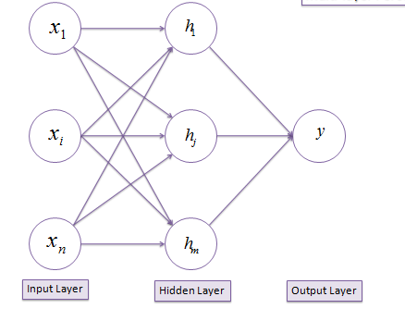

Multi-Layer perceptron (MLP)

Slide 27
























































Slide 28

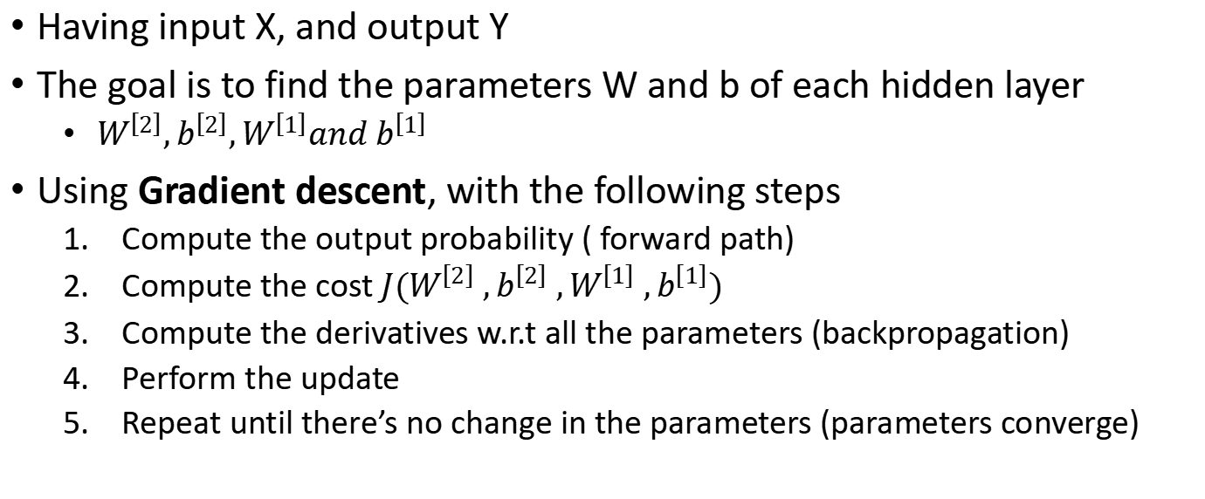
Multi-Layer perceptron (MLP)
Having input X, and output Y
The goal is to find the parameters W and b of each hidden layer
$W^{\left[2\right]},b^{\left[2\right]},W^{\left[1\right]}and b^{\left[1\right]}$
Using Gradient descent, with the following steps
Compute the output probability ( forward path)
Compute the cost ${J(W^{\left[2\right]} ,b^{\left[2\right]} ,W^{\left[1\right]} ,b}^{\left[1\right]})$
Compute the derivatives w.r.t all the parameters (backpropagation)
Perform the update
Repeat until there’s no change in the parameters (parameters converge)

Slide 29
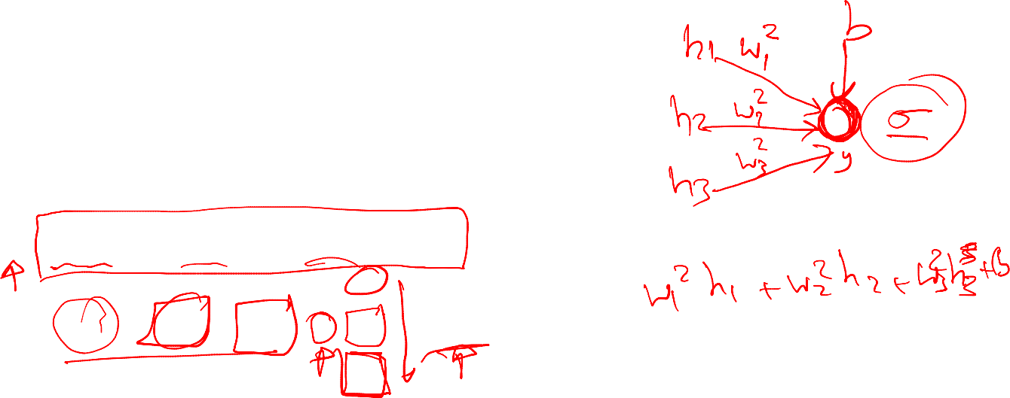
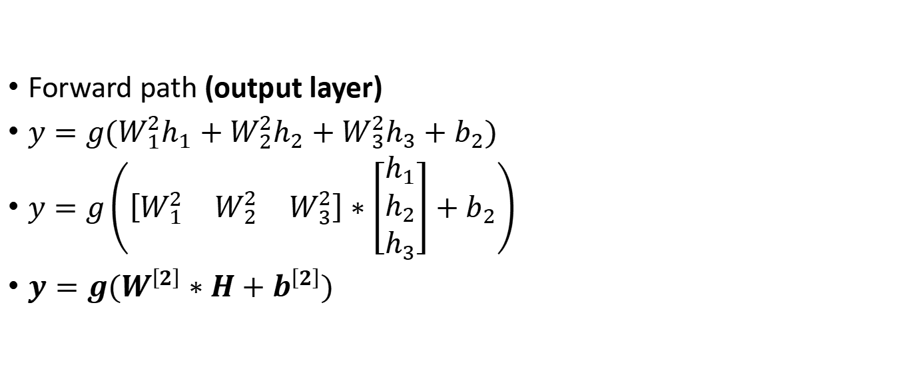
Multi-Layer perceptron (MLP)
Forward path (output layer)
$y=g(W_{1}^{2}h_{1}+W_{2}^{2}h_{2}+W_{3}^{2}h_{3}+b_{2})$
$y=g\left(\left[\begin{matrix}W_{1}^{2} & W_{2}^{2} & W_{3}^{2}\end{matrix}\right]∗\left[\begin{matrix}h_{1} \\ h_{2} \\ h_{3}\end{matrix}\right]+b_{2}\right)$
$y=g(W^{\left[2\right]}∗H+b^{\left[2\right]})$

Slide 30
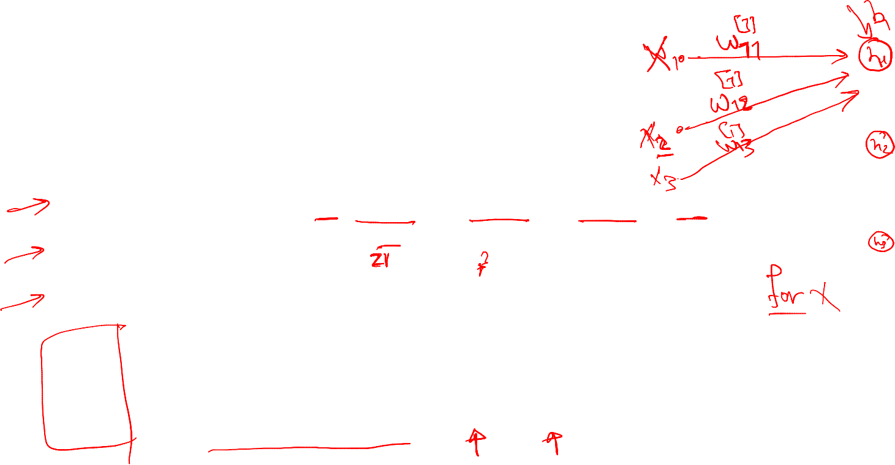
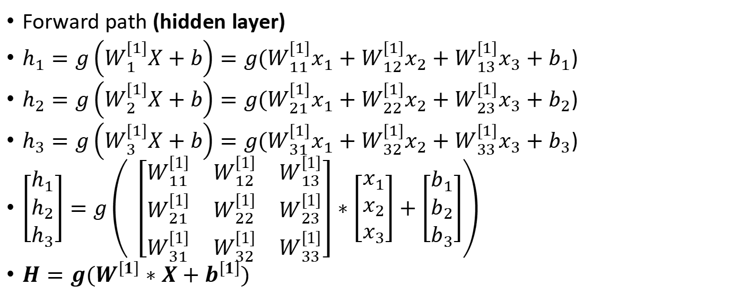
Multi-Layer perceptron (MLP)
Forward path (hidden layer)
$h_{1}=g\left(W_{1}^{[1]}X+b\right)=g(W_{11}^{[1]}x_{1}+W_{12}^{[1]}x_{2}+W_{13}^{[1]}x_{3}+b_{1}$)
$h_{2}=g\left(W_{2}^{[1]}X+b\right)=g(W_{21}^{[1]}x_{1}+W_{22}^{[1]}x_{2}+W_{23}^{[1]}x_{3}+b_{2}$)
$h_{3}=g\left(W_{3}^{[1]}X+b\right)=g(W_{31}^{[1]}x_{1}+W_{32}^{[1]}x_{2}+W_{33}^{[1]}x_{3}+b_{3}$)
$\left[\begin{matrix}h_{1} \\ h_{2} \\ h_{3}\end{matrix}\right]=g\left( \left[\begin{matrix}W_{11}^{\left[1\right]} & W_{12}^{\left[1\right]} & W_{13}^{\left[1\right]} \\ W_{21}^{\left[1\right]} & W_{22}^{\left[1\right]} & W_{23}^{\left[1\right]} \\ W_{31}^{\left[1\right]} & W_{32}^{\left[1\right]} & W_{33}^{\left[1\right]}\end{matrix}\right]∗\left[\begin{matrix}x_{1} \\ x_{2} \\ x_{3}\end{matrix}\right]+\left[\begin{matrix}b_{1} \\ b_{2} \\ b_{3}\end{matrix}\right]\right)$
$H=g(W^{\left[1\right]}∗X+b^{\left[1\right]})$

Slide 31


Multi-Layer perceptron (MLP)
Forward path
$H=g(W^{\left[1\right]}∗X+b^{\left[1\right]})$
$y=g(W^{\left[2\right]}∗H+b^{\left[2\right]})$

Slide 32
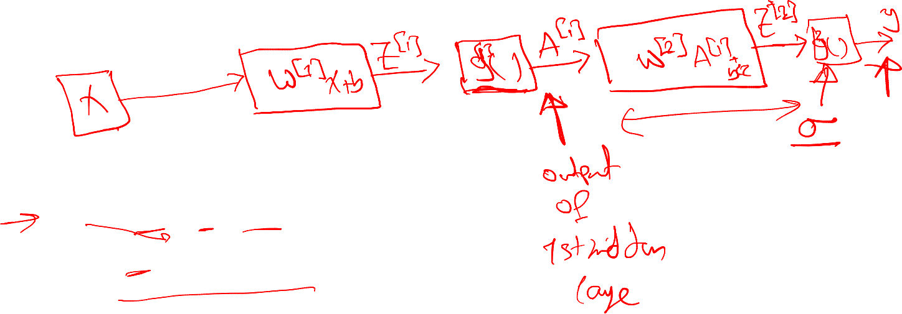

Multi-Layer perceptron (MLP)
Forward path for simplification reasons
$Z^{\left[1\right]}=W^{\left[1\right]}∗X+b^{\left[1\right]}$
$A^{\left[1\right]}=g(Z^{\left[1\right]})$
$Z^{\left[2\right]}{=W}^{\left[2\right]}∗A^{\left[1\right]}+b^{\left[2\right]}$
$y=A^{\left[2\right]}=g\left(Z^{\left[2\right]}\right)=σ(Z^{\left[2\right]})$

Slide 33
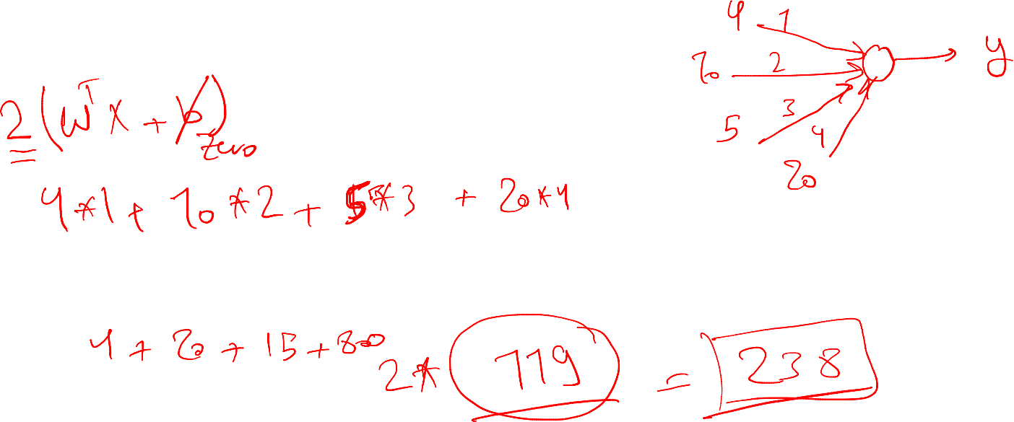
Multi-Layer perceptron (MLP)
https://strawpoll.com/6jxp33jwv

Slide 34
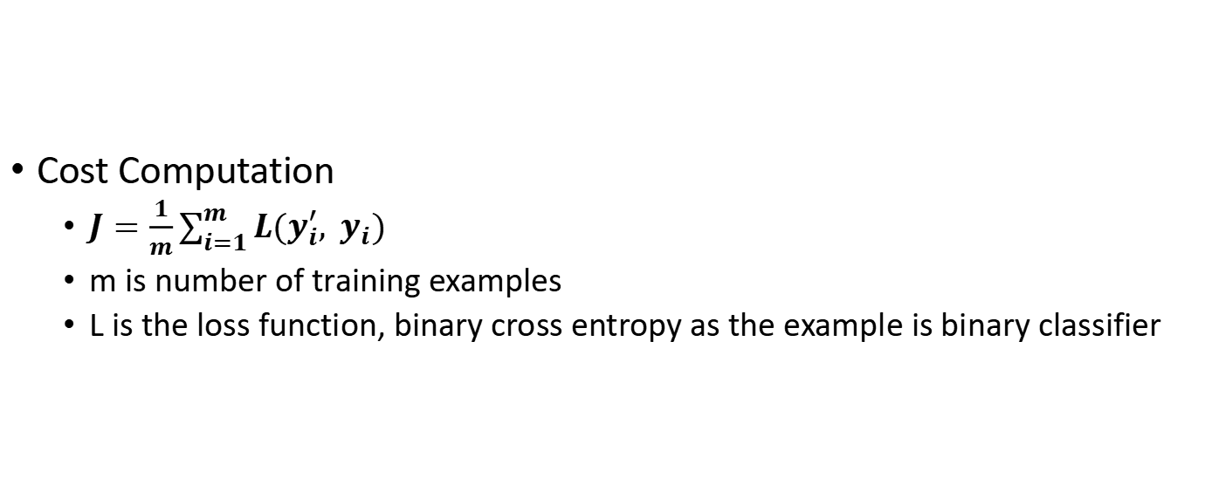
Multi-Layer perceptron (MLP)
Cost Computation
$J=\frac{1}{m}\sum_{i=1}^{m}{L(y_{i}^{′}, y_{i})}$
m is number of training examples
L is the loss function, binary cross entropy as the example is binary classifier

Slide 35
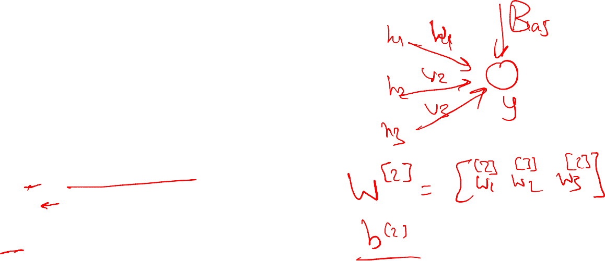

Multi-Layer perceptron (MLP)
Backpropagation (output layer)
$dW^{[2]}=\frac{∂J}{∂W^{[2]}}$
$db^{[2]}=\frac{∂J}{∂b^{[2]}}$
Chain rule is used for computation

Slide 36

Multi-Layer perceptron (MLP)
Backpropagation (hidden layer)
$dW^{[1]}=\frac{∂J}{∂W^{[1]}}$
$db^{[1]}=\frac{∂J}{∂b^{[1]}}$
Chain rule is used for computation

Slide 37
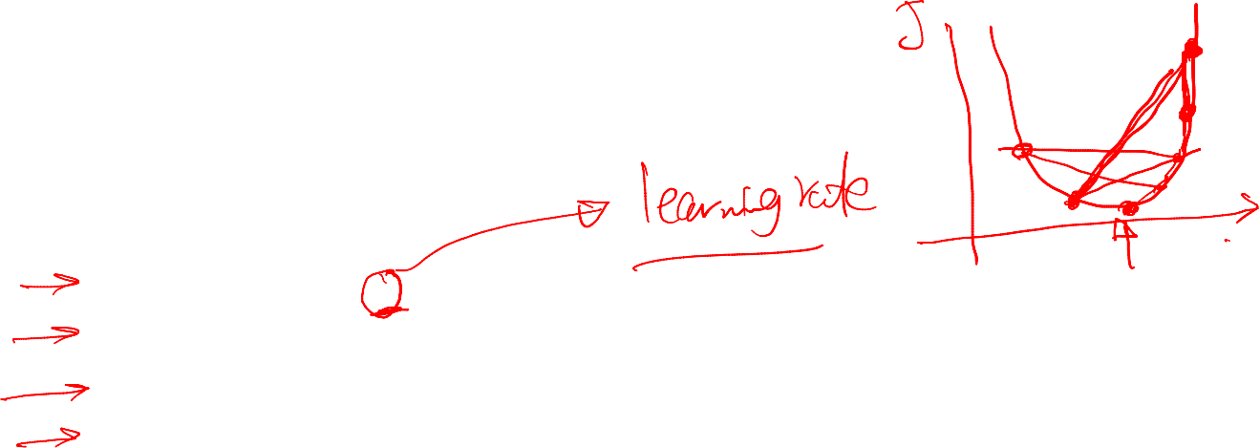

Multi-Layer perceptron (MLP)
Parameters update
$W^{[1]} ≔W^{\left[1\right]}−α∗dW^{\left[1\right]}$
$b^{[1]} ≔b^{\left[1\right]}−α∗db^{[1]}$
$W^{[2]} ≔W^{\left[2\right]}−α∗dW^{[2]}$
$b^{[2]} ≔b^{\left[2\right]}−α∗db^{[2]}$

Slide 38
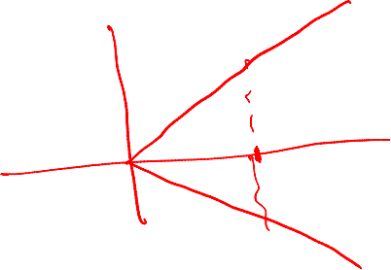
Multi-Layer perceptron (MLP)
Activation functions
Introduces non-linearity to implement complex functions
Should be differentiable at each single point

Slide 39

Multi-Layer perceptron (MLP)
Activation functions
Sigmoid function
$g\left(x\right)=\frac{1}{1+e^{−x}}$

Slide 40
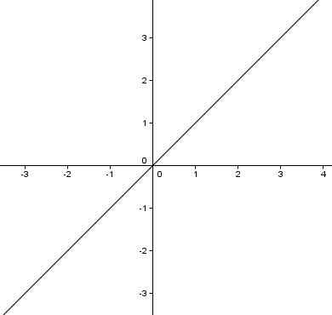


Multi-Layer perceptron (MLP)
Activation functions
Linear function
$g\left(x\right)=x$

Slide 41
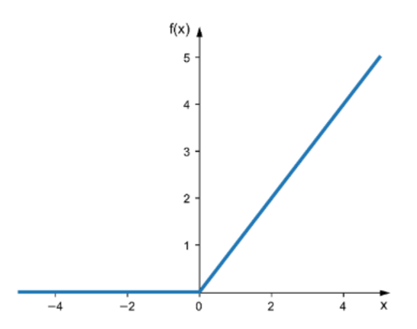


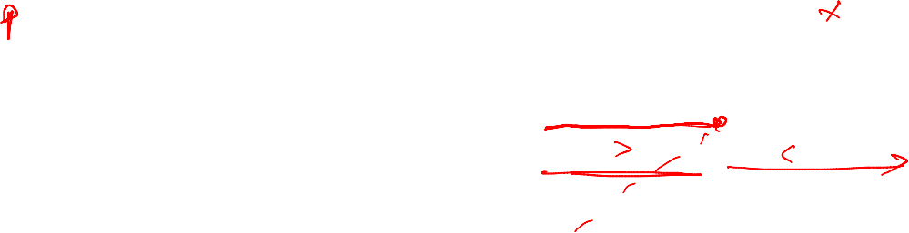


Multi-Layer perceptron (MLP)
Activation functions
Relu function
$g\left(x\right)=max⁡(x,0)$

Slide 42
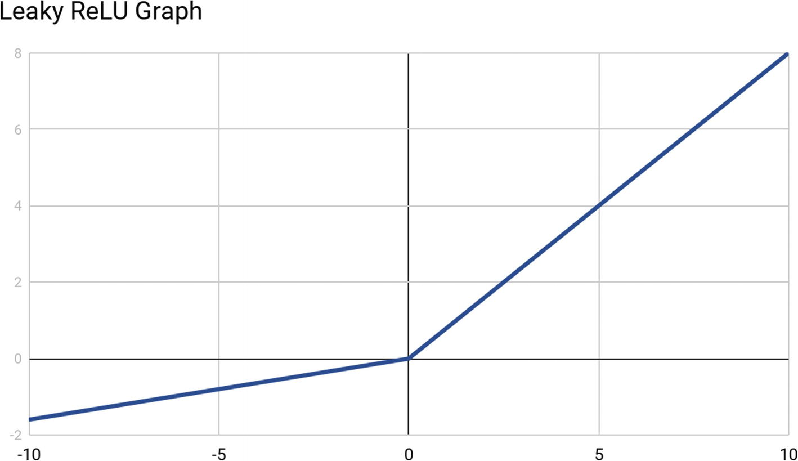

Multi-Layer perceptron (MLP)
Activation functions
Leaky - Relu function
$g\left(x\right)=max⁡(x, 0.01∗x)$

Slide 43
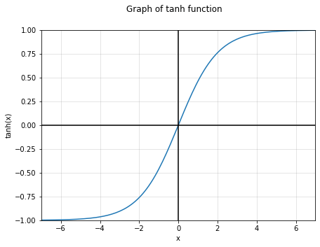


Multi-Layer perceptron (MLP)
Activation functions
Tanh function
$g\left(x\right)=tanh⁡(x)$

Slide 44
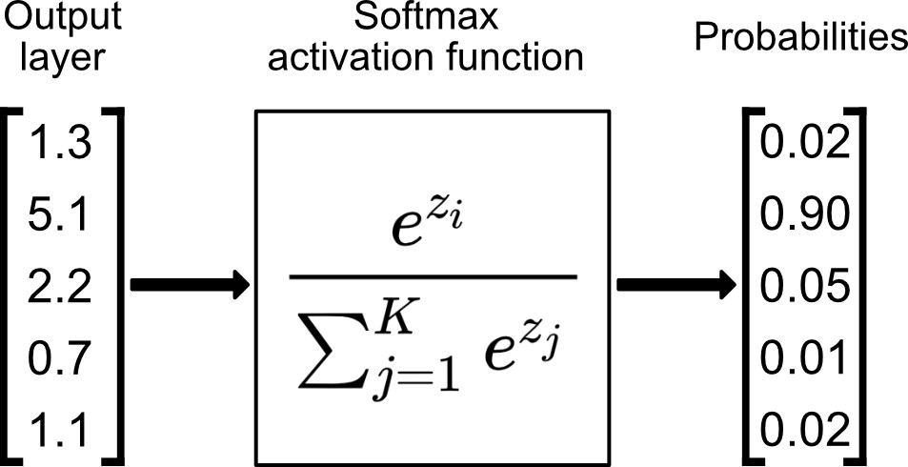
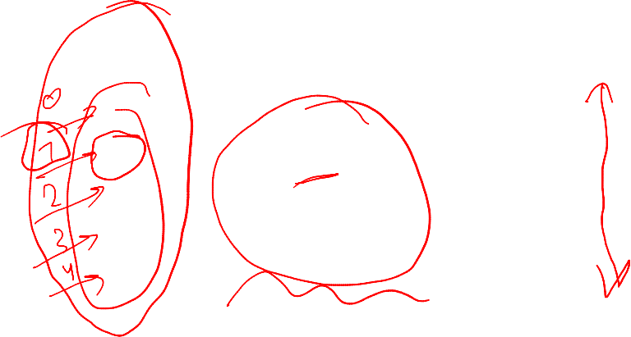

Multi-Layer perceptron (MLP)
Activation functions
Softmax function
For the output layer only
$g\left(x\right)=softmax⁡(x)$

Slide 45
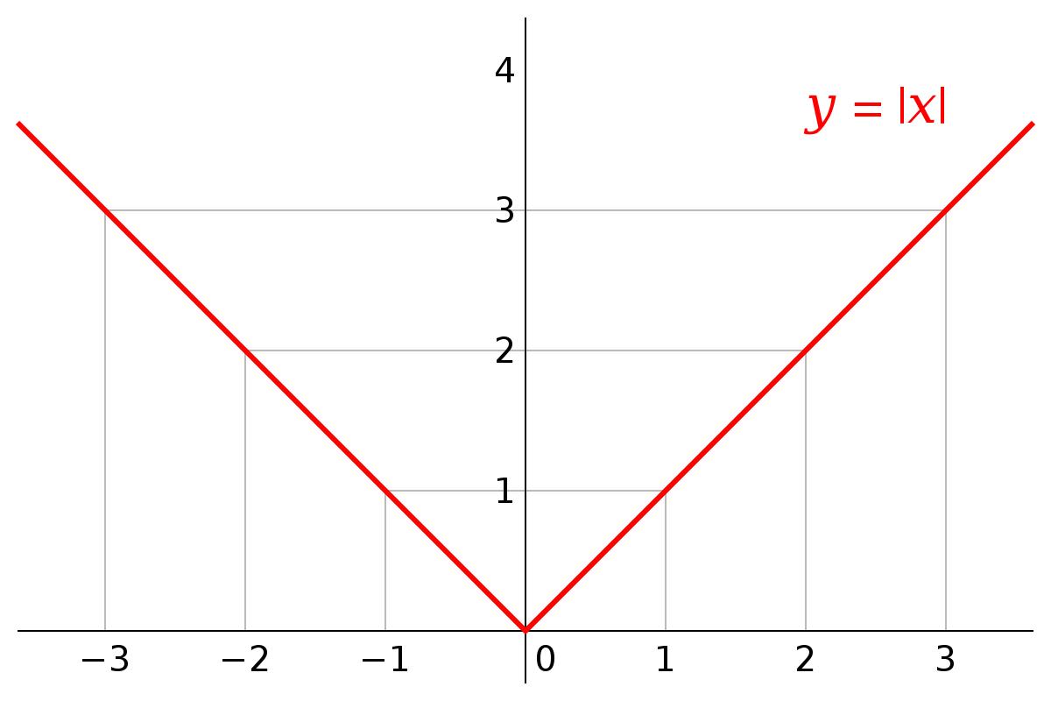
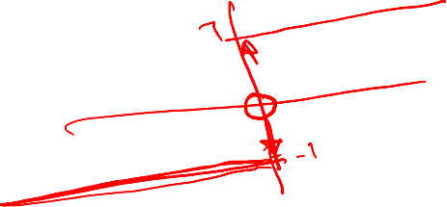

Multi-Layer perceptron (MLP)
Activation functions
Absolute Function
$g\left(x\right)=abs⁡(x)$
Can be used or not??
https://strawpoll.com/p5c3b3eve

Slide 46
Multi-Layer perceptron (MLP)
Which activation function should be used
Hidden Layers
Relu is the state of the art
Leaky-Relu/ Linear can be used

Slide 47

Multi-Layer perceptron (MLP)
Which activation function should be used
Output Layers
Depends on the task whether it is classification or regression
Regression:
Linear: no limits on the output
Relu: output is positive
Sigmoid: output between 0 and 1
Tanh: output between -1 and 1

Slide 48
Multi-Layer perceptron (MLP)
Which activation function should be used
Output Layers
Depends on the task whether it is classification or regression
Classification: (probability of class)
Binary classifier: sigmoid
Multi-class classifier: softmax

Slide 49
Multi-Layer perceptron (MLP)
Loss function
A function that judge whether the computed output in the forward path is close to the actual output (targets) or not
Should be a convex function with a single global minimum (the point with best learned parameters)
Should be computed over the whole training examples

Slide 50

Multi-Layer perceptron (MLP)
Loss function
Mean absolute error (MAE)
$g\left(x\right)=\frac{1}{m}∗\sum_{i=1}^{m}{|y_{i}^{′}−y_{i}|}$

Slide 51

Multi-Layer perceptron (MLP)
Loss function
Mean squared error (MSE)
$g\left(x\right)=\frac{1}{m}∗\sum_{i=1}^{m}{{(y_{i}^{′}−y_{i})}^{2}}$

Slide 52

Multi-Layer perceptron (MLP)
Loss function
Binary Cross Entropy
$g\left(x\right)=\frac{1}{m}\sum_{i=1}^{n}{Y_{i}log\left({y′}_{i}\right)+\left(1−Y_{i}\right)\log\left(1−{y′}_{i}\right)}$

Slide 53
Multi-Layer perceptron (MLP)
Loss function
Categorical Cross Entropy
Same as the binary one but for multiple classes

Slide 54

Multi-Layer perceptron (MLP)
How to decide which loss function to use ??

Slide 55
Multi-Layer perceptron (MLP)
How to decide number of hidden layers and number of neurons of each layer??

Slide 56
Multi-Layer perceptron (MLP)
Hyper Parameters
Learning Rate
Optimizer
Batch size
Number of epochs

Slide 57
Practical

Slide 58

Practical
Using
Python 3.X
Tensorflow 2.X and the Keras API
For installation (preferred)
Install anaconda3
Install Tensorflow
>> conda install tensorflow-gpu

Slide 59
Practical
Labs will be from C1 from the Tensorflow developer certificate
https://github.com/https-deeplearning-ai/tensorflow-1-public/tree/main/C1

Slide 60

Practical
Lab01: build a regression model
https://colab.research.google.com/drive/1yEXC-HYG77UBGDQroL2mbbOqjmLYXx2p?usp=sharing

Slide 61

Practical
Lab02: build an image classifier model using the Sequential API
https://colab.research.google.com/drive/1m7yKudreYZedPy8LnT0BlNxCp0hPTF01?usp=sharing

Slide 62


Practical
Lab03: build image classifier model using the functional API
https://colab.research.google.com/drive/1gJMiieuPzwTCr-nlkurFJ8NW-ujgHM2Z?usp=sharing

Slide 63


Slide 65
Practical
Lab04: use callbacks with image classifier model
https://colab.research.google.com/drive/1wtpz9f43z_62eIhlL_YqBL0B0nNIefOk?usp=sharing

Slide 66
Practical
Lab05: Save and Load a model
https://colab.research.google.com/drive/1EFY07s9n_4fbupZYfgsJs0cn1pzTbrKJ?usp=sharing

