Slide 1
Session: Training Deep Neural Networks
Training a deep DNN isn’t a walk in the park. Here are some of the problems you could run into:
The Vanishing & Exploding Gradients Problems
Non-saturating Activation Function
Gradient Clipping
Weights Initialization.
Batch Normalization
Reusing Pretrained Layers
Transfer Learning.
Faster Optimizers
Learning Rate Scheduling
Avoiding Overfitting Through Regularization

Slide 2
The Vanishing Gradients Problem
As known, the backpropagation algorithm works by going from the output layer to the input layer, propagating the error gradient along the way.
Once the algorithm has computed the gradient of the cost function with regard to each parameter in the network, it uses these gradients to update each parameter with a Gradient Descent step.
Unfortunately, gradients often get smaller and smaller as the algorithm progresses down to the lower layers.

Slide 3
The Vanishing Gradients Problem
As a result, the Gradient Descent update leaves the lower layers’ connection weights virtually unchanged, and training never converges to a good solution. We call this the vanishing gradients problem.
In a 2010 paper by Xavier Glorot and Yoshua Bengio. The authors found a few suspects, including the combination of the popular logistic sigmoid activation function and the weight initialization technique that was most popular at the time (i.e., a normal distribution with a mean of 0 and a standard deviation of 1).

Slide 4
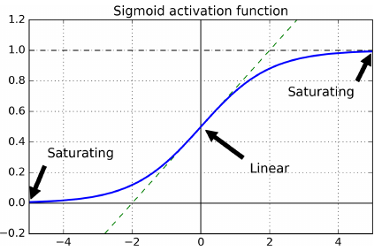
The Vanishing Gradients Problem
Looking at the logistic activation function you can see that when inputs become large (negative or positive), the function saturates at 0 or 1, with a derivative extremely close to 0.

Slide 5

The Vanishing Gradients Problem
Thus, the little gradient exists keeps getting diluted as backpropagation progresses down through the top layers, so there is really nothing left for the lower layers.
Solution: is to use a different combinations of activation functions and the weight initialization technique as shown in below table.
By default, Keras uses Glorot initialization with a uniform distribution.

Slide 6
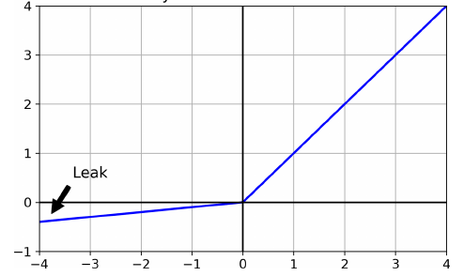
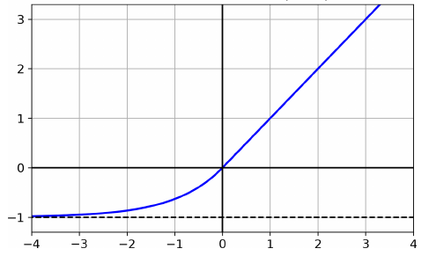
Non-saturating Activation Functions
Leaky ReLU: like ReLU, but with a small slope for negative values.
ELU activation function

Slide 7
Weights initialization
Zero Initialization : If all the weights are initialized with 0, the derivative with respect to loss function is the same for every w in W[l], thus all weights have the same value in subsequent iterations. This makes hidden units symmetric and continues for all the n iterations i.e. setting weights to 0 does not make it better than a linear model.
Random Initialization : Assigning random values to weights is better than just 0 assignment, but the probability of having too large or too low initial weights is so disturbing (causing vanishing gradients).
Xavier(Glorot) Initialization : multiplies the random approach by a specific formula to pick the initial weights from normal distribution.
He(Kamming) Indianization

Slide 8
Batch Normalization
Although using He initialization along with ELU (or any variant of ReLU) can significantly reduce the danger of the vanishing/exploding gradients problems at the beginning of training, it doesn’t guarantee that they won’t come back during training.

Slide 9
Batch Normalization
In a 2015 paper,8 Sergey Ioffe and Christian Szegedy proposed a technique called Batch Normalization (BN) that addresses these problems.
The technique consists of adding an operation in the model just before or after the activation function of each hidden layer. This operation simply lets the model learn the optimal scale and mean of each of the layer’s inputs. In many cases, if you add a BN layer as the very first layer of your neural network, you do not need to standardize your training set (e.g., using a StandardScaler).

Slide 10
Batch Normalization
Ioffe and Szegedy demonstrated that BN considerably improved all the deep neural networks they experimented with, leading to a huge improvement in the ImageNet classification task.
Also, BN makes network less sensitive to the weight initialization requirement to overcome the vanishing gradients problem.

Slide 11
Reusing Pretrained Layers
It is generally not a good idea to train a very large DNN from scratch: instead, you should always try to find an existing neural network that accomplishes a similar task to the one you are trying to tackle then reuse the lower layers of this network. This technique is called transfer learning.

Slide 12
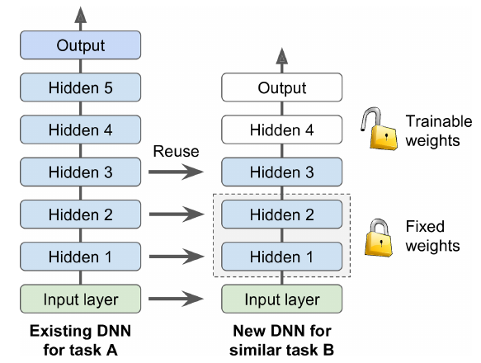
Transfer Learning
It will not only speed up training considerably, but also require significantly less
training data.
Prepared by: Ahmed Imam

Slide 13
Faster Optimizers
Training a very large deep neural network can be painfully slow. So far we have seen four ways to speed up training (and reach a better solution):
Applying a good initialization strategy for the connection weights,
Using a good activation function,
Using Batch Normalization, and
Reusing parts of a pretrained network
Another huge speed boost comes from using a faster optimizer than the regular Gradient Descent optimizer.

Slide 14
Faster Optimizers
The most popular algorithms:
Momentum optimization,
Nesterov
Accelerated Gradient,
AdaGrad,
RMSProp,
Adam
Nadam optimization.

Slide 15
What optimizers do ?
Adapt the “gradient component” (∂L/∂w) Instead of using only one single gradient like in stochastic gradient descent to update the weight, take an aggregate of multiple gradients. Specifically, these optimisers use the exponential moving average of gradients.
Adapt the “learning rate component” (α) Instead of keeping a constant learning rate, adapt the learning rate according to the magnitude of the gradient(s).
Both (1) and (2) Adapt both the gradient component and the learning rate component.
Notes:
https://towardsdatascience.com/10-gradient-descent-optimisation-algorithms-86989510b5e9

Slide 16
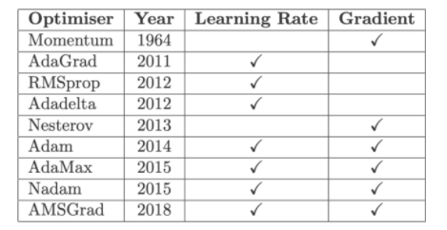
What do optimizers do?

Slide 17
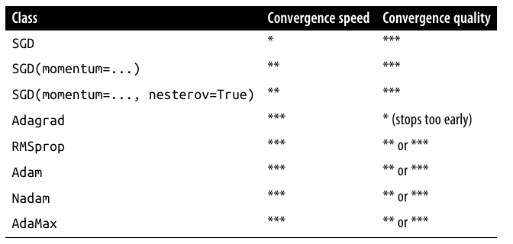
Optimizer Comparison

Slide 18
Learning Rate Scheduling
Finding a good learning rate is very important. If you set it much too high, training may diverge. If you set it too low, training will eventually converge to the optimum, but it will take a very long time.
But you can do better than a constant learning rate: if you start with a large learning rate and then reduce it once training stops making fast progress, you can reach a good solution faster than with the optimal constant learning rate.

Slide 19
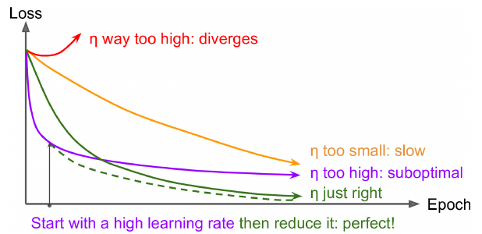
Learning Rate Scheduling

Slide 20
Avoiding Overfitting Through Regularization
One of the best regularization techniques is early stopping through which we stop training process in case of the continuity of making good performance in training and fixed performance in validation process.
Moreover, even though Batch Normalization was designed to solve the unstable gradients problems, it also acts like a pretty good regularizer.

Slide 21
Avoiding Overfitting Through Regularization
For simple linear models, you can use l2 regularization to constrain a neural network’s connection weights, and/or l1 regularization if you want a sparse model (with many weights equal to 0).
Dropout is one of the most popular regularization techniques for deep neural networks.

Slide 22
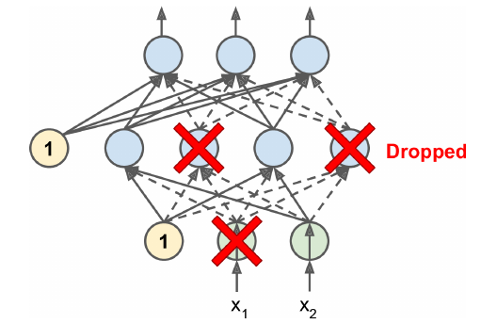
Avoiding Overfitting Through Regularization
Dropout is a fairly simple algorithm: at every training step, every neuron (including the input neurons, but always excluding the output neurons) has a probability “p” of being temporarily “dropped out,” meaning it will be entirely ignored during this training
step, but it may be active during the next step.

