Slide 1

AI and IoT Powered Smart Stick For Personal Safety
Presented by
CH. Suraya Tej(231FA18218)
J. Sai Pradeep(231FA18264)
A. Bhanu Sri (231FA18274)
CH. Ramaiah(231FA18288)
Under the Supervision of
Dr. A.V.Nageswara Rao
Assistant Professor, ACSE
Department of Advanced Computer Science and Engineering
School of Computing and Informatics
Vignan’s Foundation for Science, Technology & Research
(Deemed to be University)

Slide 2
Index
Introduction
Objectives
Literature Review
Problem Statement
Motivation
Methodology
Results and Analysis
Conclusion
References

Slide 3
Introduction
Human–wildlife conflict is increasing in areas near forests and farms. Due to forest destruction and expansion of villages, animals are entering human areas more frequently. Sudden animal encounters can cause injuries, loss of life, and property damage, especially for farmers and forest workers.
Currently, there is no simple and portable safety system that can warn people in real time when an animal is nearby.
To solve this problem, we propose an AI and IoT-based Smart Stick that uses an ESP32-CAM and a YOLOv8 deep learning model to detect animals in real time and give immediate alerts to the user.

Slide 4
Objectives
Build a real-time animal detection system using YOLOv8
Use ESP32-CAM to capture and send images wirelessly
Provide instant alerts when an animal is detected
Design a low-cost and easy-to-use safety device

Slide 5
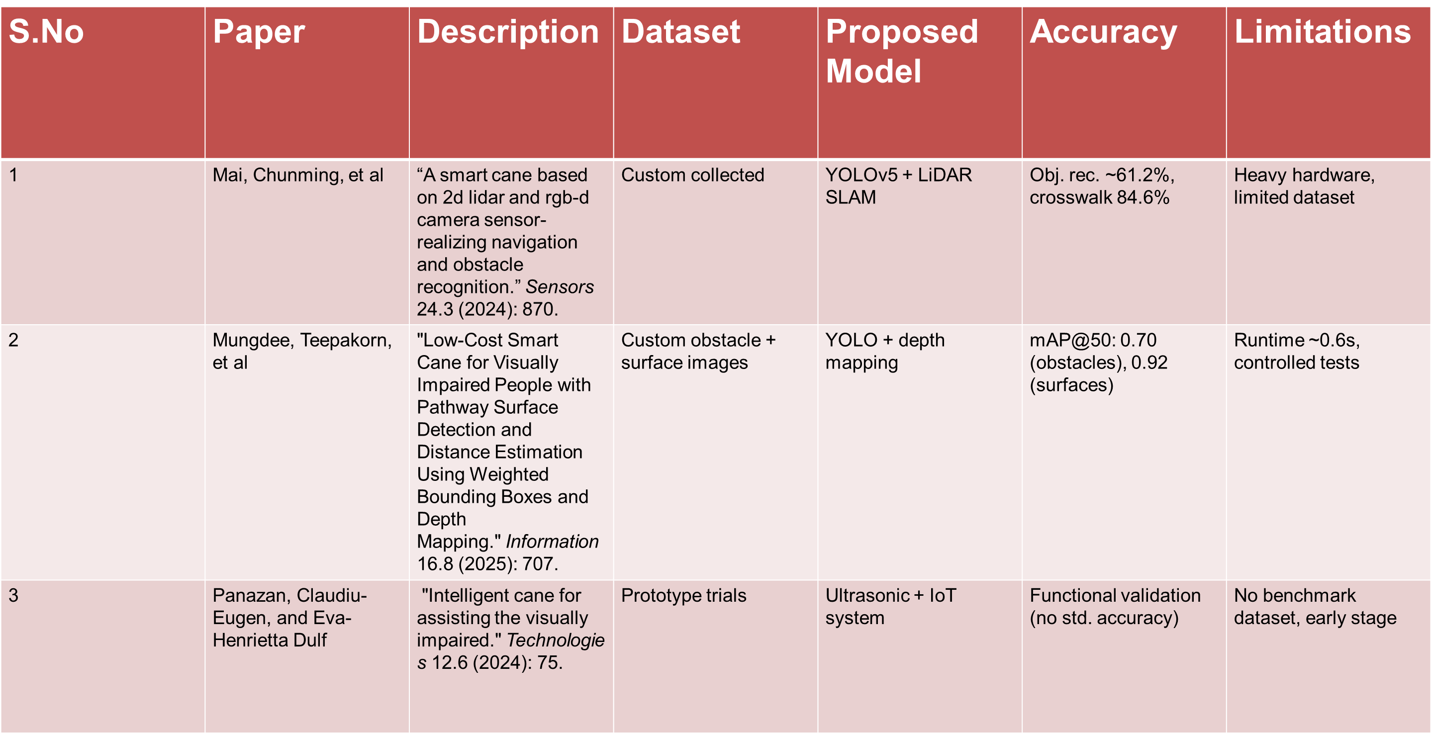
Literature Review

Slide 6
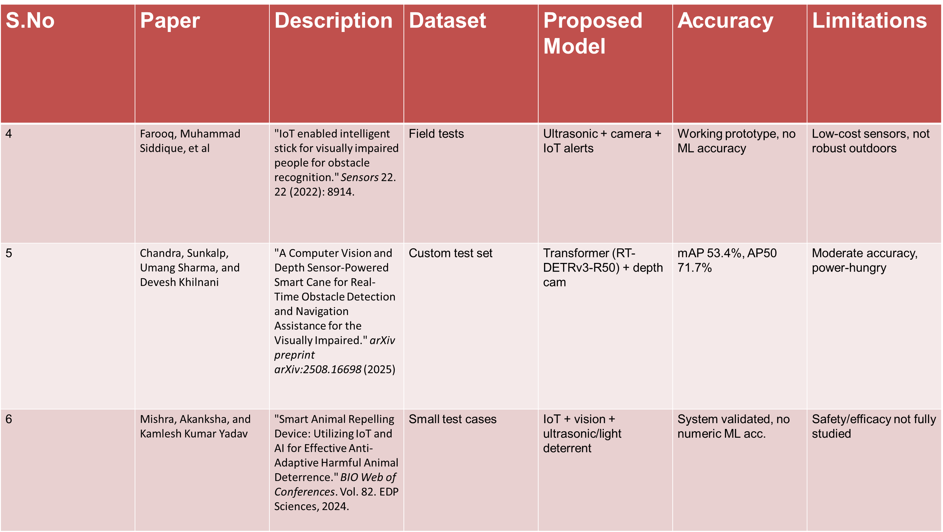

Slide 7
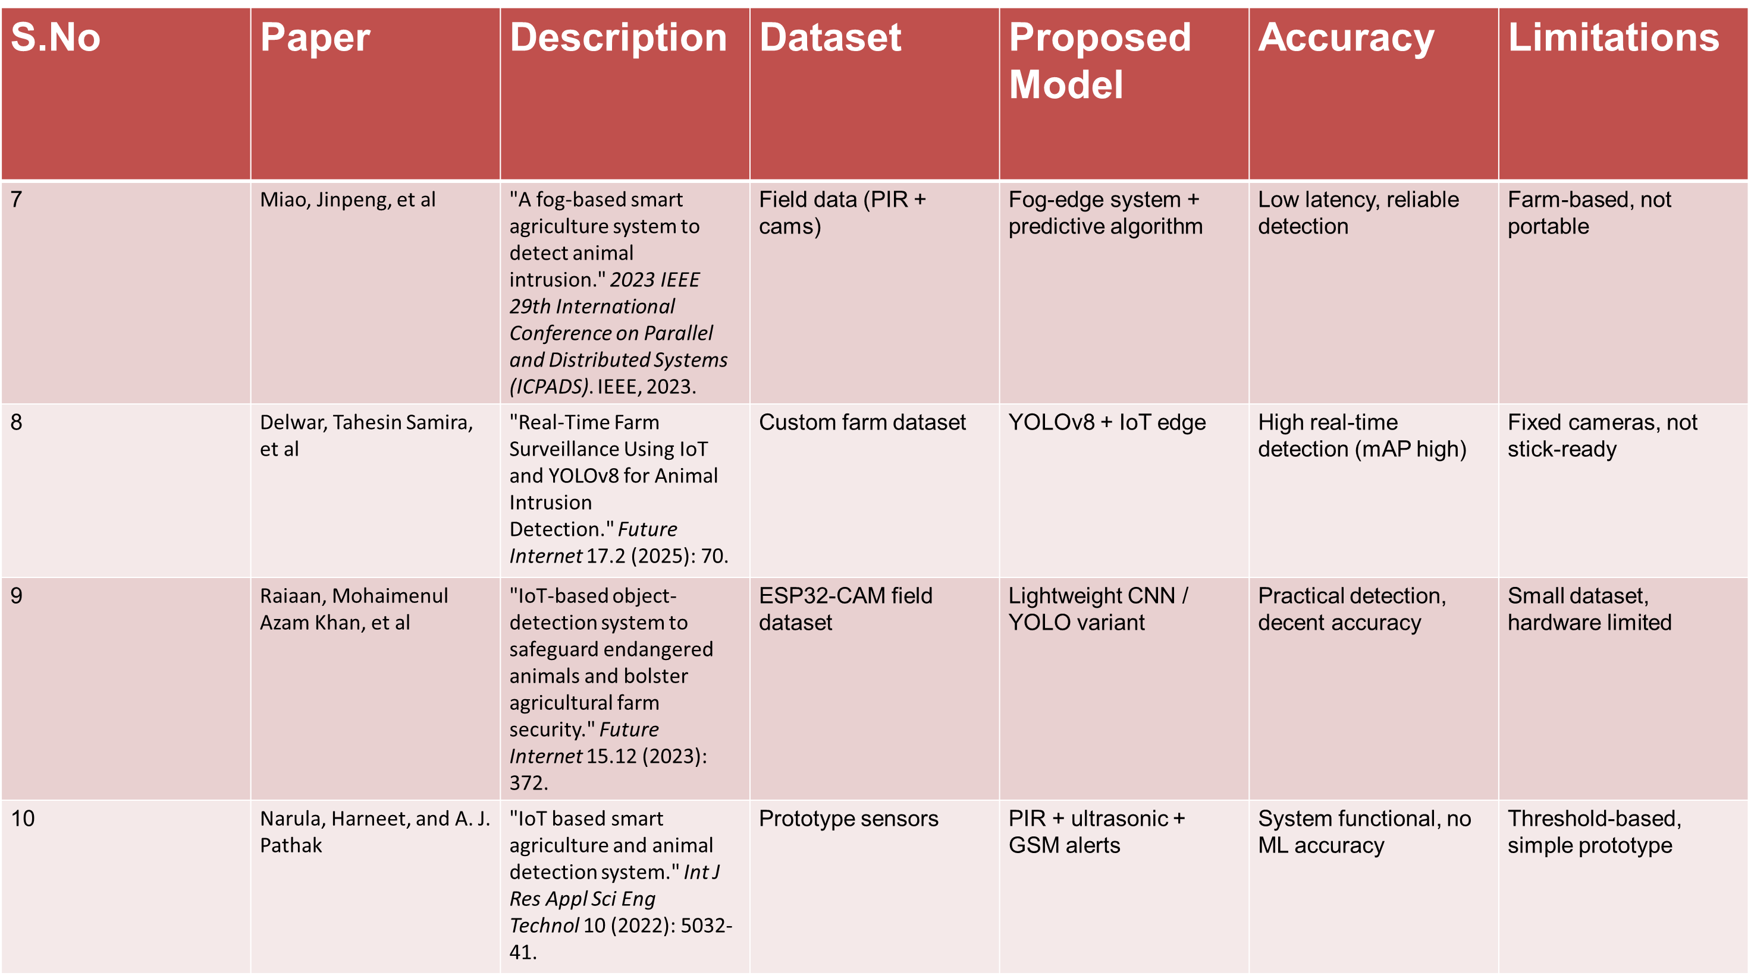

Slide 8
Problem Statement
Current wildlife safety systems mainly focus on monitoring and do not provide real-time personal alerts. There is no low-cost, portable solution that combines AI-based animal detection with IoT. As a result, farmers and forest workers remain vulnerable to sudden animal encounters.

Slide 9
Motivation
Increasing human–wildlife conflicts in forest-border and rural areas
Sudden animal attacks cause injuries, fatalities, and economic loss
Lack of affordable and portable real-time safety solutions
Need for low-cost AI and IoT-based protection systems for rural communities
Personal interest in applying AI for practical societal impact

Slide 10
Methodology
Approach
The ESP32-CAM captures images and sends them to a Flask server, where a YOLOv8 model detects animals and returns the result for alert generation.
Technologies Used
Python (Flask Backend)
YOLOv8 (Object Detection Model)
ESP32-CAM (Image Capture & IoT Device)
WiFi Communication (HTTP Requests)
ngrok (Server Access)
Project Phases
Data Collection Annotation Model Training Testing Deployment IoT Integration

Slide 11
Algorithm / Pseudocode
Main Algorithm Used
YOLOv8 (You Only Look Once) Real-Time Object Detection Model
Algorithm
Capture image using ESP32-CAM
Send image to Flask server via HTTP POST
Preprocess image (resize, normalize)
Input image into YOLOv8 model
Predict bounding boxes and class probabilities
Filter detections based on confidence threshold
If animal detected Send JSON response
Trigger alert on detection

Slide 12
Mathematical Formulation (YOLO Loss Function)
Total Loss = Localization Loss + Confidence Loss + Classification Loss
Localization Loss Measures bounding box accuracy
Confidence Loss Measures object detection confidence
Classification Loss Measures class prediction accuracy

Slide 13
Architecture / System Diagram
IoT Layer
ESP32-CAM
Captures image
Connects via WiFi
Sends image to server
Cloud Layer
Flask API Server
Receives image
Handles API request
Stores debug copy
ML Layer
YOLOv8 Model
Preprocess image
Detect animals
Return JSON result
User Interface
Alert System
Console log
Serial monitor output
Detection notification
HTTP POST / WiFi
Image Processing
Detection Response

Slide 14
Results and Analysis
Hardware
ESP32-CAM (Image Capture)
Laptop/PC (Flask Server)
WiFi Communication
Model
YOLOv8 Medium
Evaluation Metrics
Precision
Recall
Accuracy
Inference Time

Slide 15
Model Performance
High detection accuracy
Real-time inference (< 1 sec)
Stable detection in test scenarios
Comparison Table
Model | Accuracy | Speed
YOLOv8 Nano | Moderate | Faster
YOLOv8 Medium (Proposed) | High | Fast

Slide 16
Server JSON Response Showing Detected Animal
Alert Triggered After Animal Detection
Sample Test Image (Cat)

Slide 17
Key Findings
Real-time animal detection achieved
Reliable ESP32 + Flask integration
Efficient wireless image transfer
Advantages
Low-cost solution
Portable and scalable
Fast detection speed
Limitations
Performance affected in low-light
Requires stable internet connection

Slide 18
Conclusion
The proposed system provides a real-time animal detection solution using YOLOv8 with ESP32-CAM and a Flask backend. It enables wireless image capture, AI-based detection, and instant alerts. The system offers a practical and low-cost safety solution for wildlife-prone areas.
Future Scope
Deploy the system fully on cloud infrastructure
Integrate drone-based monitoring for wider coverage
Enhance night-time detection using thermal/IR cameras
Optimize the system for full edge-device deployment

Slide 19
References
[1] J. Redmon, S. Divvala, R. Girshick, and A. Farhadi, “You Only Look Once: Unified, Real-Time Object Detection,” Proc. IEEE Conf. Computer Vision and Pattern Recognition (CVPR), pp. 779–788, 2016.
[2] A. Bochkovskiy, C. Y. Wang, and H. Y. M. Liao, “YOLOv4: Optimal Speed and Accuracy of Object Detection,” arXiv preprint arXiv:2004.10934, 2020.
[3] G. Jocher et al., “YOLOv8: Next-Generation Ultralytics Object Detection Model,” Ultralytics Documentation, 2023.
[4] M. Tan and Q. Le, “EfficientNet: Rethinking Model Scaling for Convolutional Neural Networks,” Proc. Int. Conf. Machine Learning (ICML), 2019.
[5] T. Chen et al., “Deep Learning-Based Wildlife Monitoring Using Camera Traps,” IEEE Access, vol. 8, pp. 123456–123467, 2020.

Slide 20
[6] S. S. Raut and V. B. Mane, “IoT-Based Smart Monitoring System Using ESP32,” Proc. IEEE Int. Conf. IoT and Smart Systems, 2021.
[7] A. Krizhevsky, I. Sutskever, and G. E. Hinton, “ImageNet Classification with Deep Convolutional Neural Networks,” Advances in Neural Information Processing Systems, 2012.
[8] K. Simonyan and A. Zisserman, “Very Deep Convolutional Networks for Large-Scale Image Recognition,” arXiv preprint arXiv:1409.1556, 2014.
[9] R. Girshick, “Fast R-CNN,” Proc. IEEE Int. Conf. Computer Vision (ICCV), pp. 1440–1448, 2015.
[10] H. Zhang et al., “Real-Time Animal Detection Using Deep Learning Models,” IEEE Sensors Journal, vol. 21, no. 5, pp. 7890–7899, 2021.

Slide 21
THANK YOU

