Slide 1

Banking dataset
A Comprehensive Data-Driven Approach to Understanding and Engaging Clients
Presented by: Ramakant paul

Slide 2
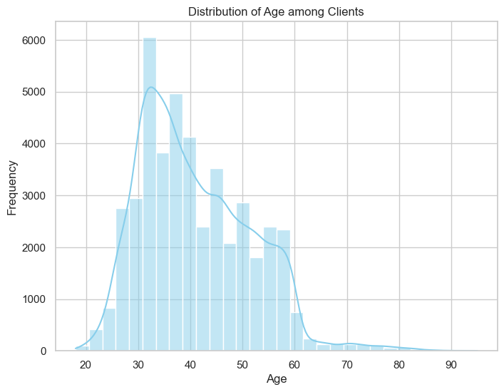
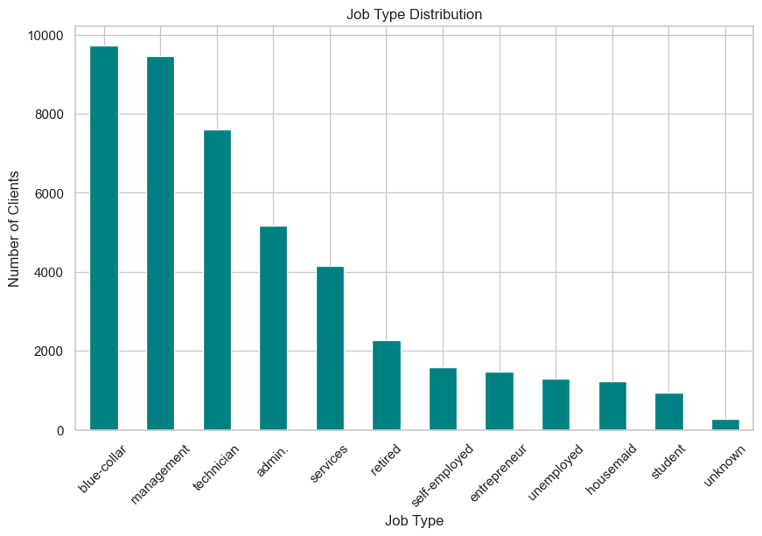
Age Distribution
The majority of clients are between 30 to 50 years, suggesting that this age group forms the core customer base.
Younger and older age groups are underrepresented, potentially indicating untapped market segments.
Job Type
Clients are predominantly employed in sectors like management, technicians, and blue-collar jobs.
Minimal representation in categories like unemployed or students suggests a focus on financially stable demographics.

Slide 3
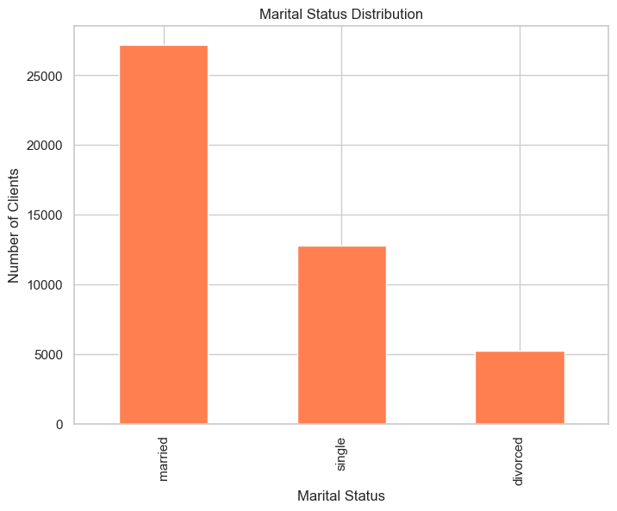
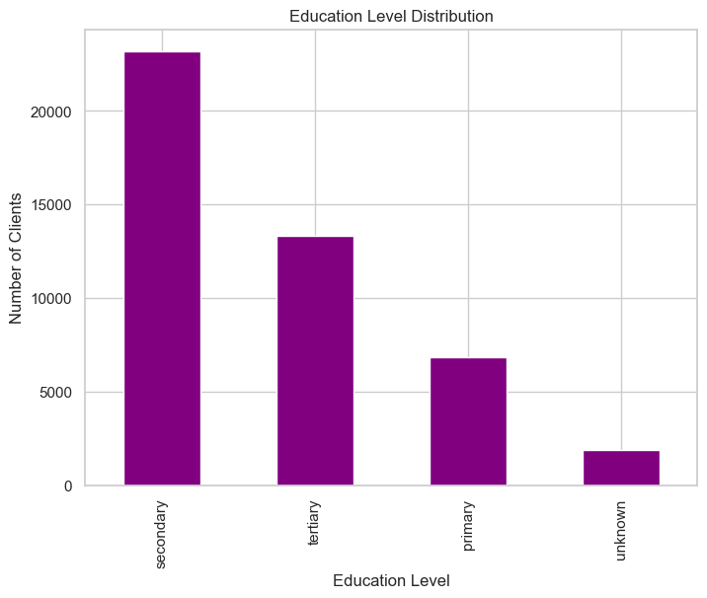
Marital Status
A significant proportion of clients are married (~60%), followed by single clients (~30%).
Strategies can be developed to better engage single clients who may have different financial needs.
Education Level
Most clients have at least a secondary education, with a notable segment holding tertiary qualifications.
Higher education levels correlate with greater financial awareness and product adoption.

Slide 4
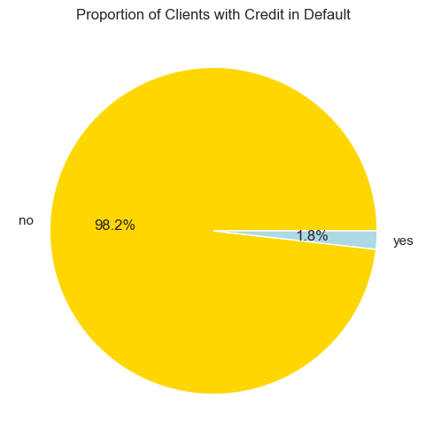
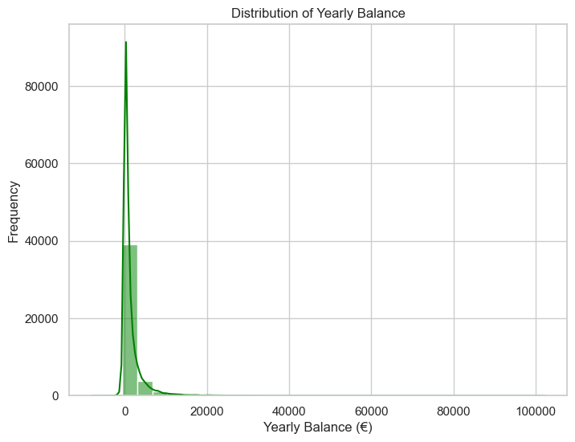
Credit in Default
Only a small proportion (~2%) of clients have credit in default, indicating a largely creditworthy client base.
Defaulting clients may require closer monitoring and tailored financial solutions.
Yearly Balance Distribution
The average yearly balance distribution is highly skewed, with a majority having balances under €5,000.
High-balance clients could be targeted for premium financial services.

Slide 5
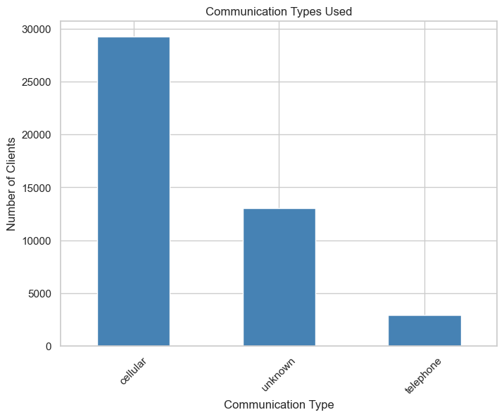
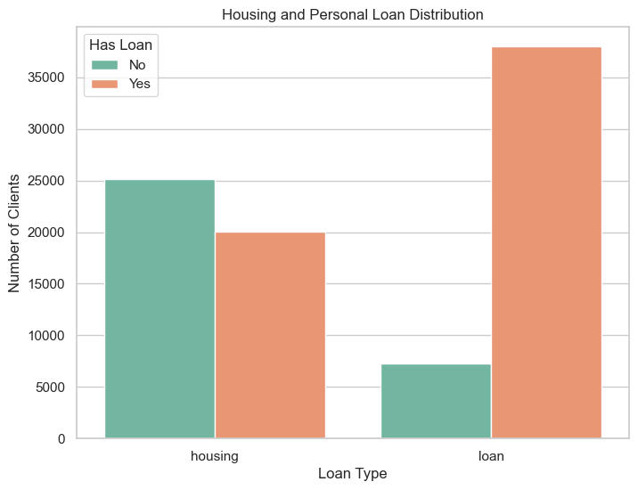
Housing Loans
Around 55% of clients have housing loans, signifying the importance of housing-related financial products.
Personal Loans
A smaller portion (~20%) of clients have personal loans, indicating room for expansion in this product category.

Slide 6
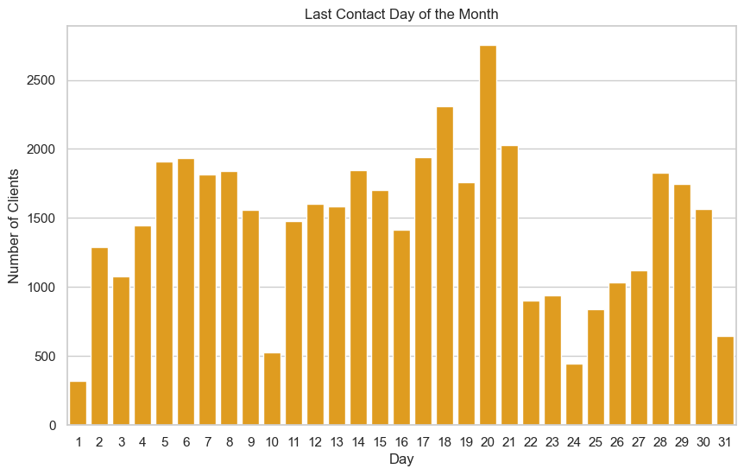
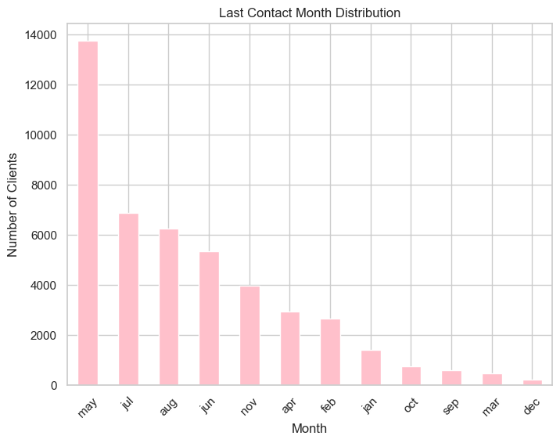
Communication Types
The most common communication method is cellular calls, followed by telephone landlines.
Email and other digital methods are underutilized, presenting an opportunity for digital engagement.
Last Contact Day of the Month
Most client interactions occur in the middle of the month, suggesting a strategic scheduling pattern.

Slide 7
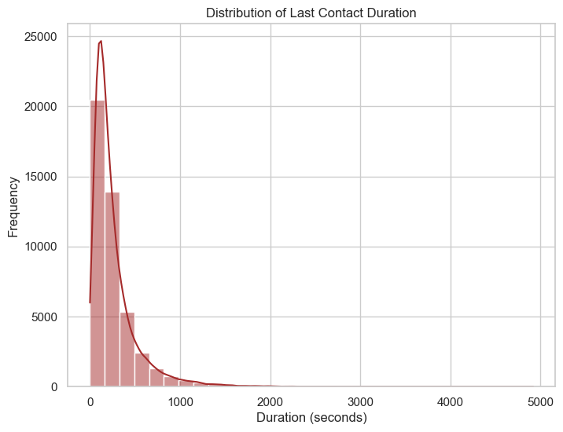
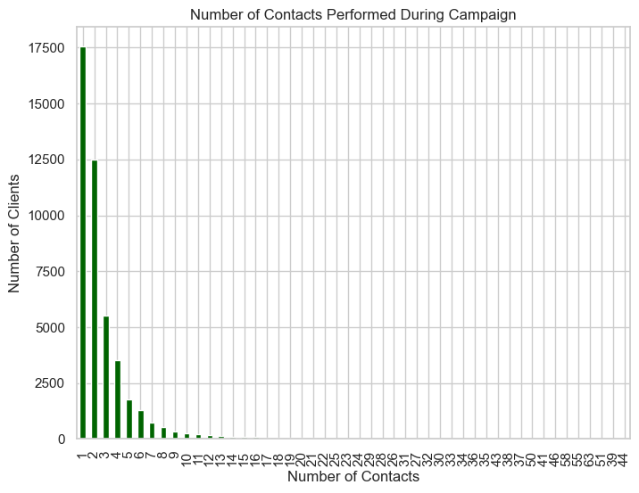
Last Contact Month
The majority of contacts were made in May, followed by August.
Off-peak months could be leveraged for additional campaigns.
Duration of Last Contact
Longer call durations generally correlate with better client engagement.
Calls under 3 minutes often result in lower conversion rates.

Slide 8
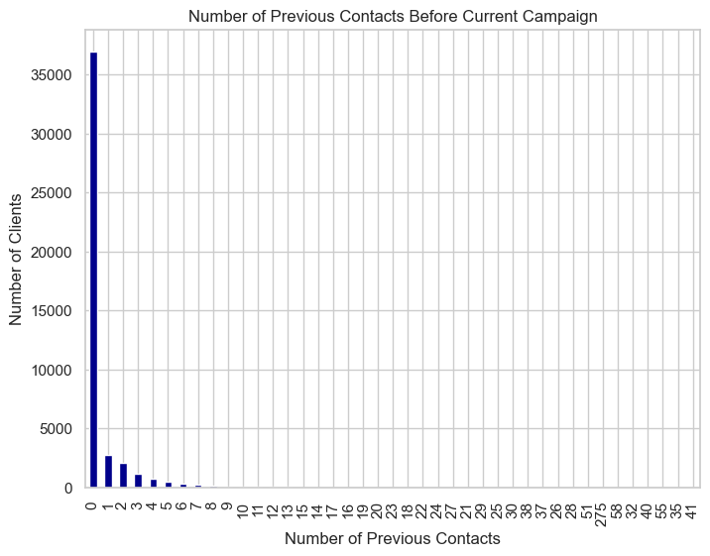
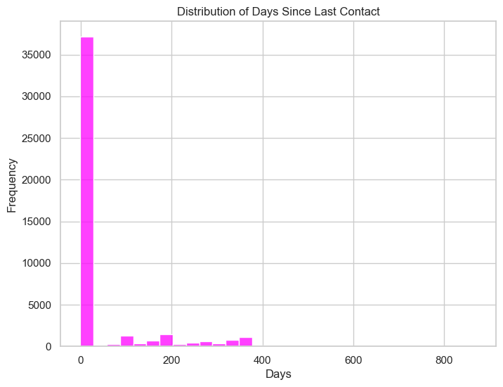
Days Since Last Contact
A significant number of clients had not been contacted for over 100 days, highlighting the need for regular follow-ups.
Previous Contacts
Clients with multiple previous contacts exhibit a higher likelihood of conversion.

Slide 9
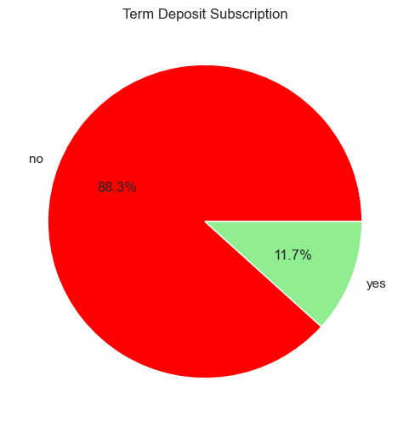
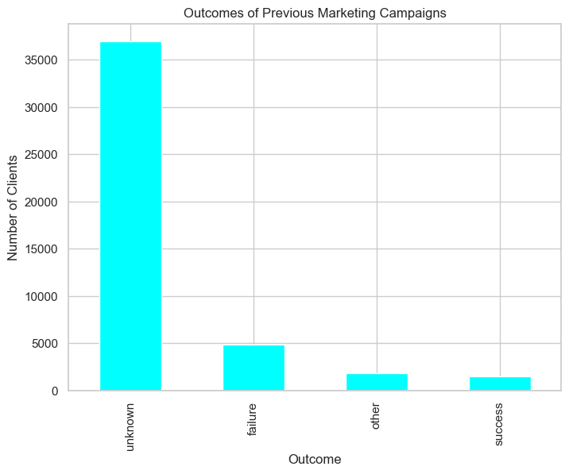
Outcomes of Previous Campaigns
The most frequent outcomes were non-subscription and no response, pointing to potential areas for process improvement.
Term Deposit Subscription
Around 12% of clients subscribed to term deposits, leaving significant room for growth in this product category.

Slide 10
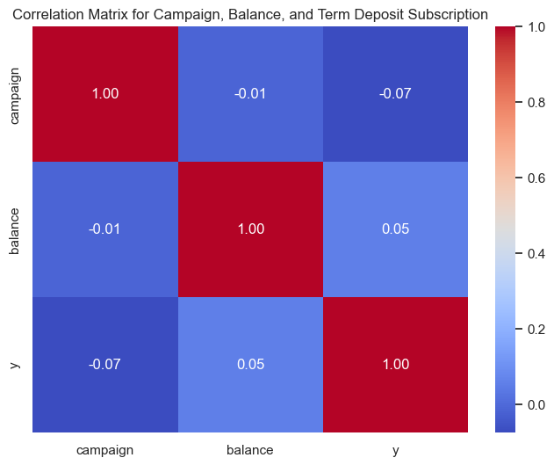
Correlation Analysis:
The correlation between balance and term deposit subscription (y) is typically positive. Clients with higher average yearly balances are more likely to subscribe to a term deposit.
The correlation between campaign (number of contacts during the campaign) and term deposit subscription is weak or slightly negative. Excessive contacts might indicate reluctance from the client, which could reduce subscription likelihood.
Balance is a strong indicator of client segmentation for targeting term deposits.

Slide 11
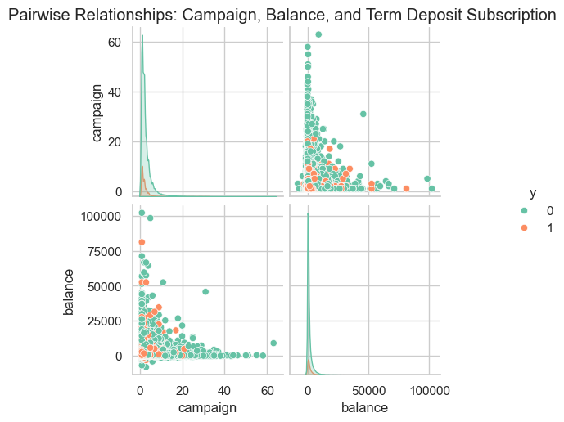
Scatterplot Observations:
From the scatterplot in the pairwise relationships, clusters for balance vs. campaign suggest that clients with very low balances and frequent contacts are less likely to subscribe.
Clients who subscribed (y = yes) tend to have higher balances and were contacted fewer times during the campaign.
Campaign efforts should focus on optimizing the number of contacts, avoiding over-contacting clients with low balances, as it can decrease subscription likelihood.

Slide 12

THANK YOU!

