Slide 1
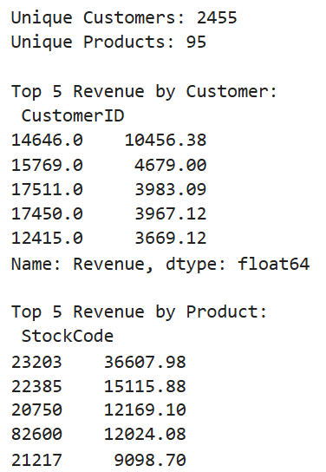
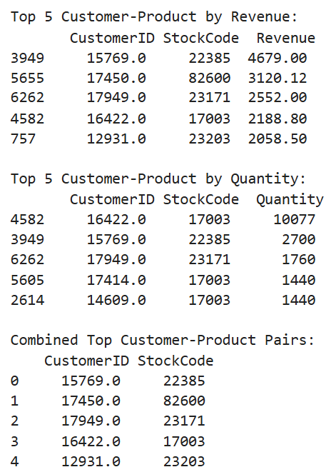
Summary Set 1

Slide 2
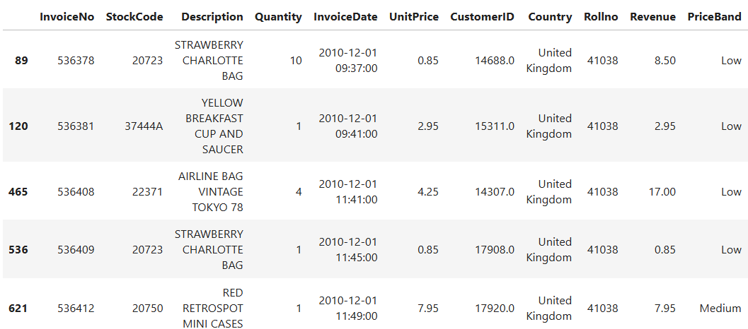
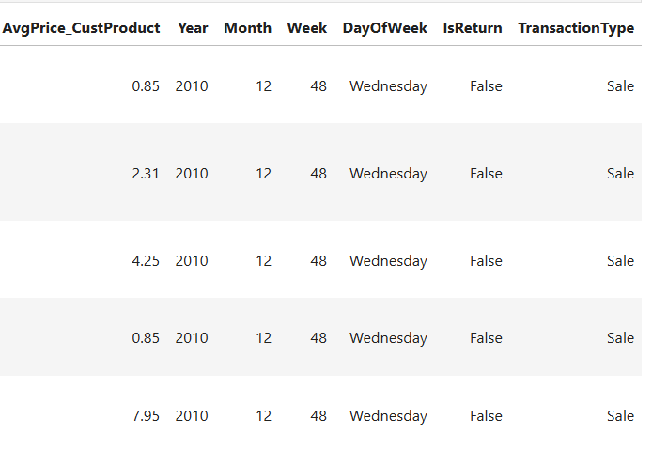
TOP customer - Product combinations (based on revenue)

Slide 3
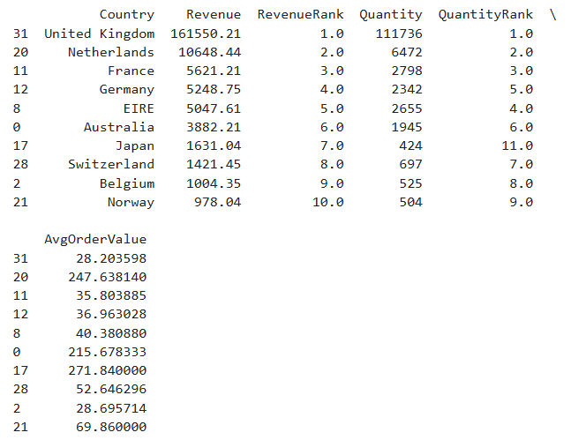
Summary Set 2

Slide 4

Weekday sales by Product

Slide 5
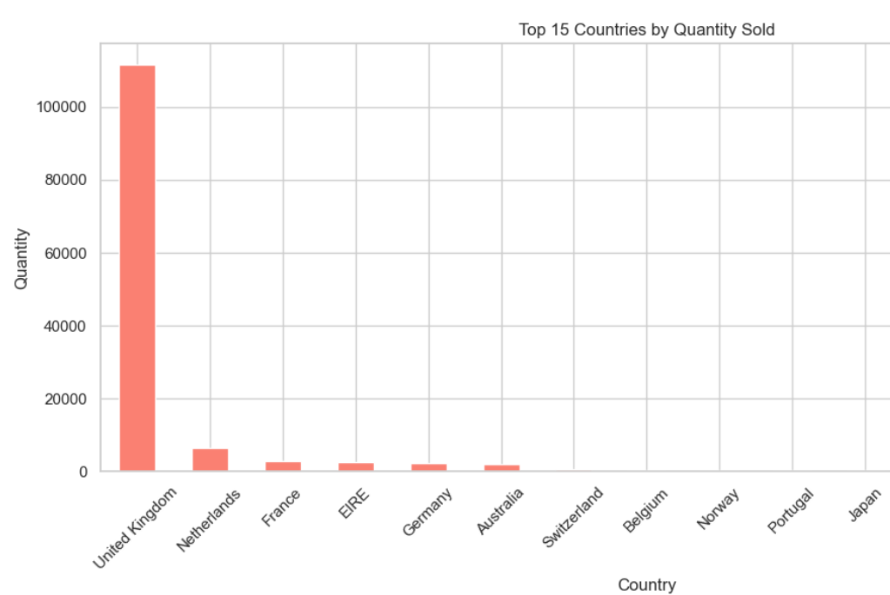
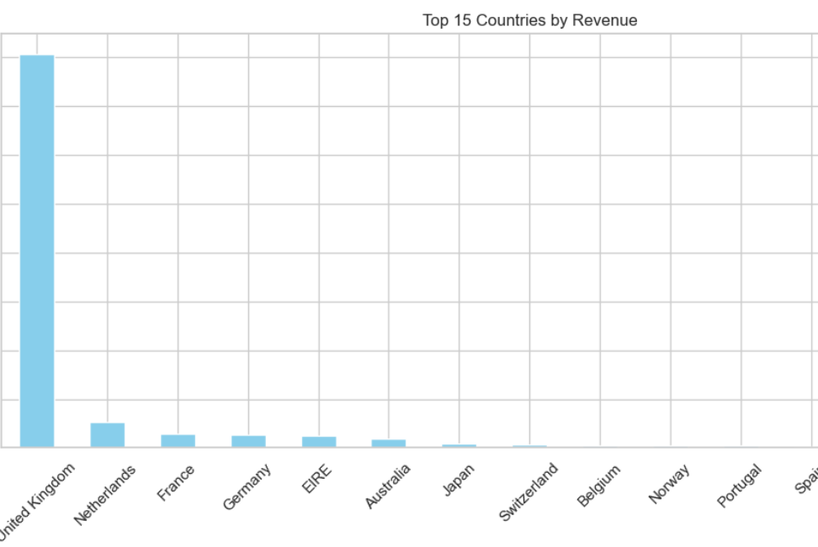
Top 15 Countries by Quantities & Revenue

Slide 6
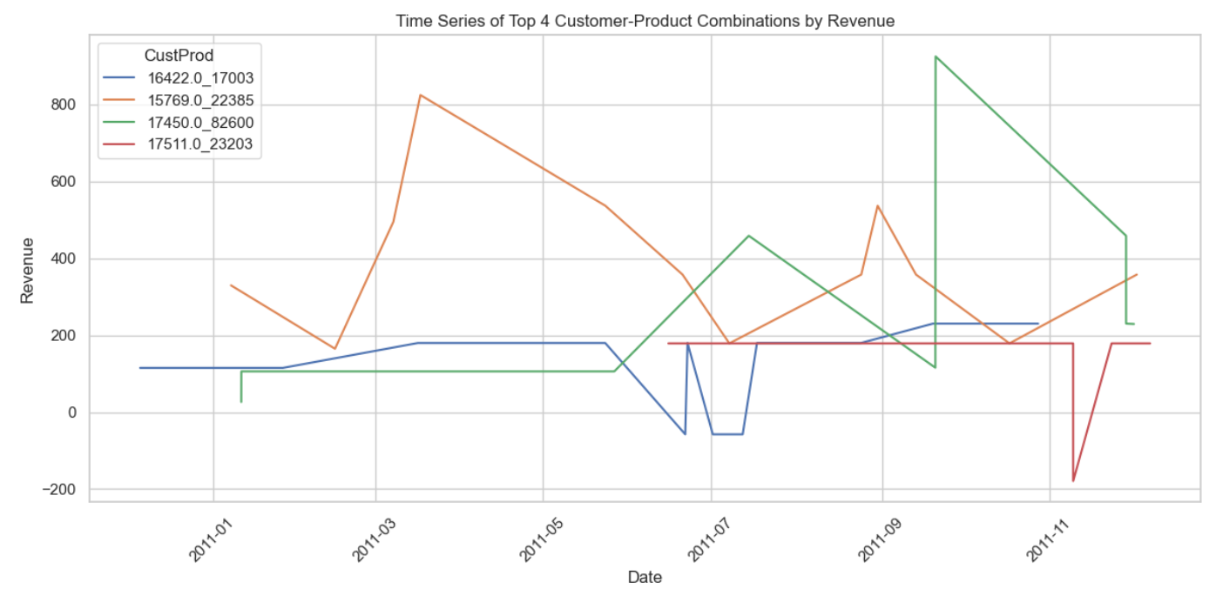
Top 4 Customers Product combinations by Revenue

Slide 7
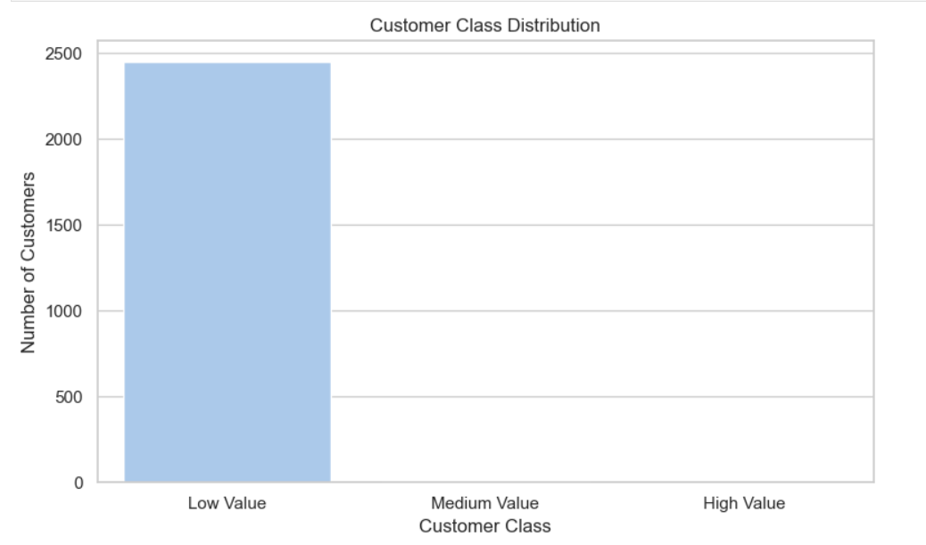
Customer Class Distribution

