Slide 1
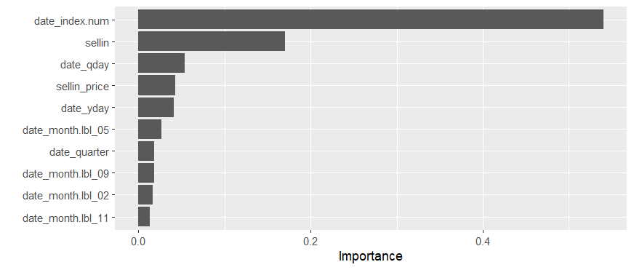
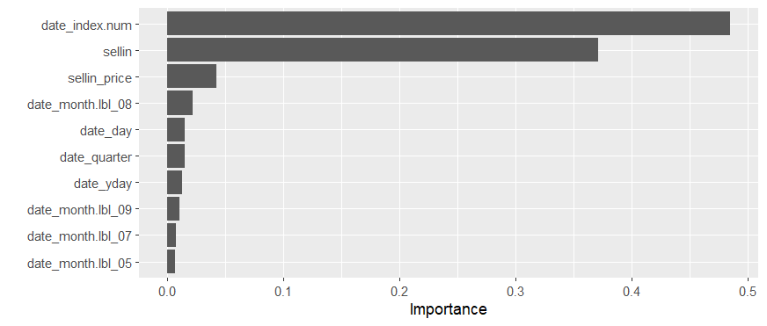
MILESTONE 4

Slide 2
1. Date index (time trend) and sell-in volumes are the most important drivers across all three policies.
2. Sell-in price shows moderate influence, reflecting some level of price sensitivity.
3. Calendar variables (quarter, day, month labels) contribute very little compared to trend and supply factors.
4. This suggests that demand is more trend- and supply-driven than seasonality-driven.
5. Hence, fixed order policies should focus on time progression and sell-in adjustments, rather than seasonal effects.

Slide 3
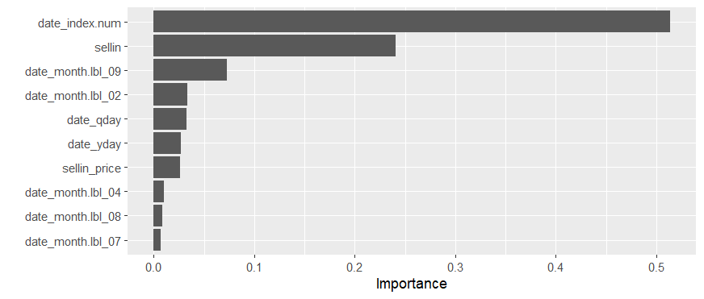

Slide 4
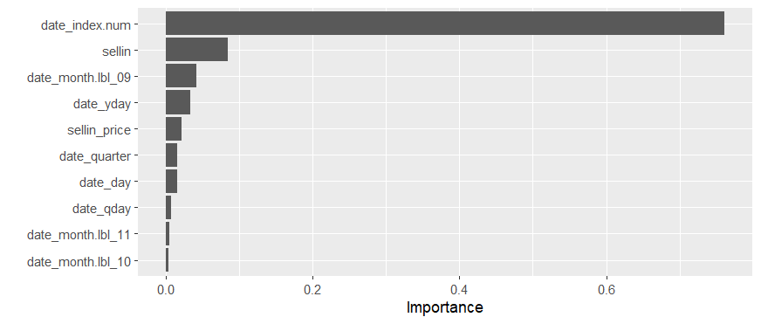
Date index (time factor) remains the most critical variable, showing demand is largely trend-driven.
Sell-in volumes consistently rank second, highlighting their role in shaping forecast coverage.
Sell-in price plays only a minor role, suggesting that price changes have limited effect on forecast cover policies.
Month labels and calendar features contribute slightly, indicating weaker but present seasonal influences.
Overall, forecast cover policies should be anchored on time trends and supply inputs, with minor adjustments for seasonality.

Slide 5
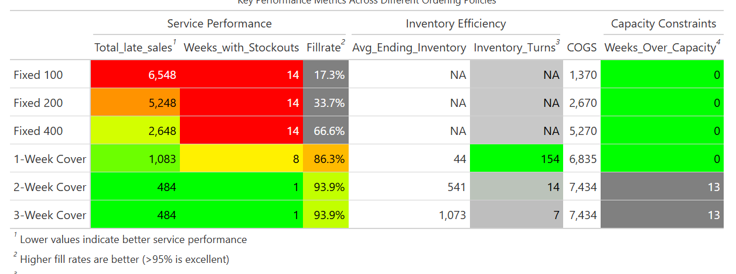
From a Service Performance perspective, the 2-Week and 3-Week Cover policies perform the best with very low late sales (484) and only 1 week of stockouts, achieving a high fill rate of 93.9%.
From an Inventory Efficiency perspective, the 1-Week Cover policy is superior with 154 inventory turns, showing extremely efficient inventory usage.
3. Fixed-order policies underperform significantly due to higher late sales and poor fill rates.
4. If the priority is service reliability, the 2-Week Cover policy is best. If the focus is on inventory efficiency, the 1-Week Cover policy is best. From a Service Performance perspective, the 2-Week and 3-Week Cover policies perform the best with very low late sales (484) and only 1 week of stockouts, achieving a high fill rate of 93.9%.

