Slide 1

Title: Analysis of Facebook Live Sellers Dataset
Objective: This analysis evaluates engagement patterns and identifies actionable insights for Facebook Live Sellers in Thailand.

Slide 2
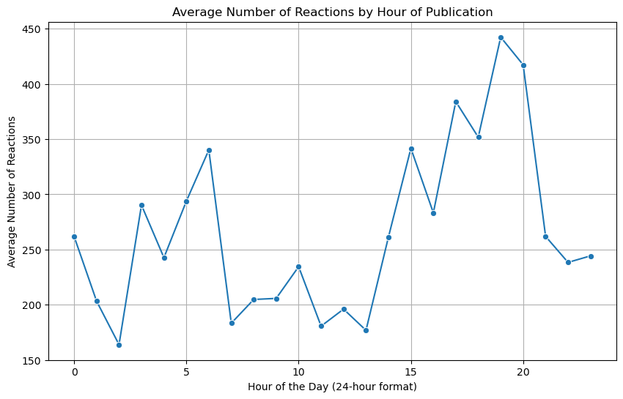
1. Effect of Time on Reactions
Objective: The time of posting significantly influences the number of reactions (num_reactions).
Methodology:
The status_published column was converted to datetime format and analyzed by hour of publication.
Average reactions per hour were calculated and visualized in a line graph.
Insights:
Peak engagement occurs during specific hours, making it crucial to post during these times for maximum reactions.
Posting during off-peak hours results in reduced engagement.

Slide 3
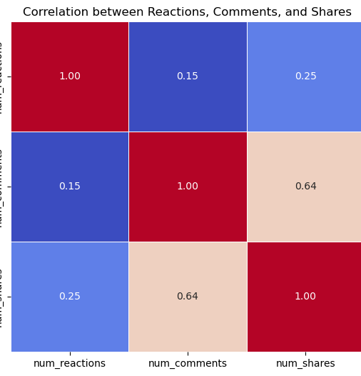
2. Correlation Analysis
Objective: A strong correlation exists between num_reactions, num_comments, and num_shares.
Methodology:
A correlation matrix was computed and visualized using a heatmap.
Insights:
Positive correlations indicate that increasing one engagement metric (e.g., shares) is likely to boost others.
These findings validate the interconnected nature of user interactions on posts.

Slide 4
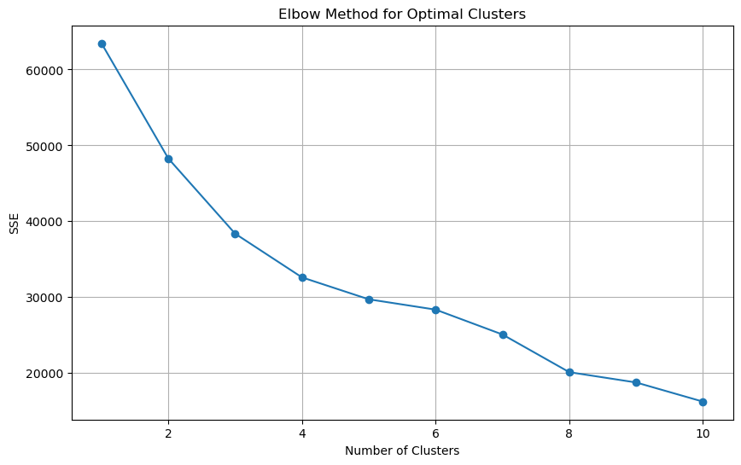
3. Optimal Number of Clusters (Elbow Method)
Objective: The elbow method identified the optimal number of clusters for meaningful segmentation.
Methodology:
Sum of Squared Errors (SSE) was calculated for cluster counts from 1 to 10.
The elbow point on the graph indicated 10 clusters as the optimal choice.
Insights:
Ten distinct clusters provide a balanced segmentation without overfitting.
The visualization of clusters with centers confirms the robustness of the model.

Slide 5
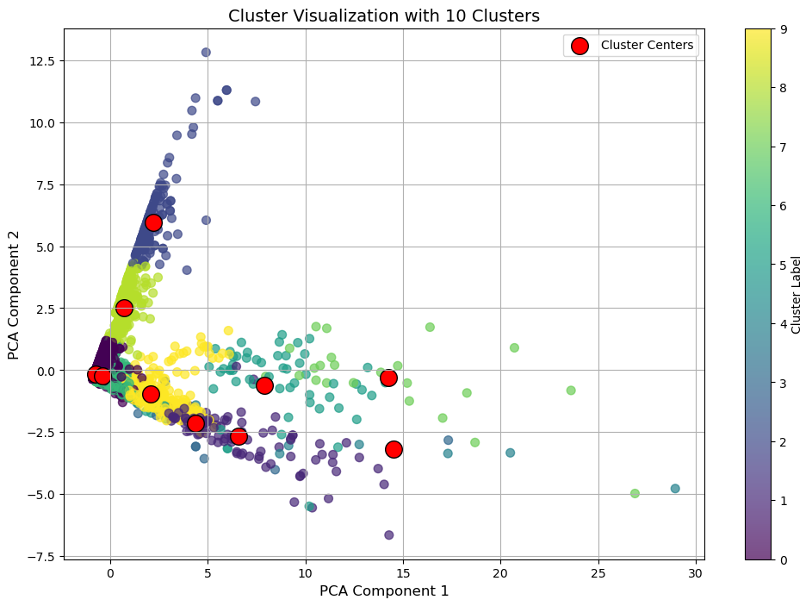
4. K-Means Clustering
Objective: Posts were segmented into clusters based on their engagement metrics to uncover patterns.
Methodology:
K-Means clustering was applied to features such as status_type, num_reactions, num_comments, and other reaction metrics.
Data was preprocessed with standardization and encoding for categorical values.
Insights:
Each cluster represents a group of posts with similar engagement characteristics.
The segmentation reveals distinct patterns, enabling tailored engagement strategies for each cluster.

Slide 6
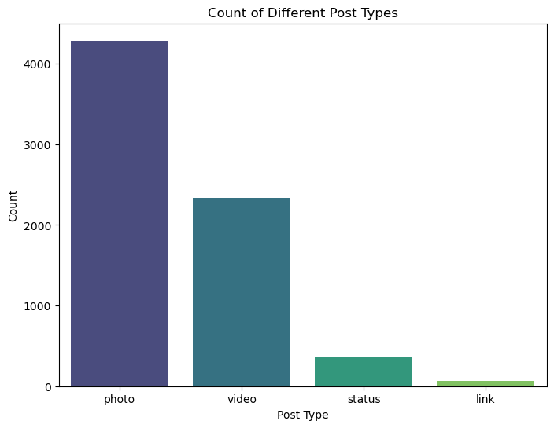
5. Post Type Distribution
Objective: The dataset shows a clear distribution of post types (status_type).
Methodology:
Post type frequencies were counted and visualized using a bar chart.
Insights:
Some post types, such as videos and photos, dominate in frequency.
Understanding the distribution helps prioritize content formats that align with audience behavior.

Slide 7
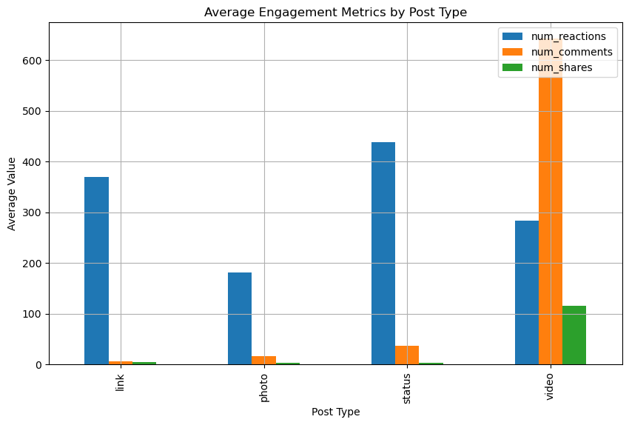
6. Engagement by Post Type
Objective: Engagement metrics vary significantly across post types.
Methodology:
The dataset was grouped by status_type, and average values for num_reactions, num_comments, and num_shares were computed.
A bar chart highlighted differences in engagement levels across post types.
Insights:
Specific post types consistently outperform others in reactions, comments, and shares.
Leveraging high-engagement post types ensures optimal audience interaction.

Slide 8

Conclusion
The analysis identifies peak posting hours, demonstrates correlations among engagement metrics, and validates the effectiveness of clustering.
High-performing post types should be prioritized to maximize audience interaction.
The segmentation model provides actionable insights for tailored content strategies.

