Slide 1
StateViewer:
A New Tool for Graphics State Anaylsis
Rama Hoetzlein, NVIDIA Devtech, 2013

Slide 2
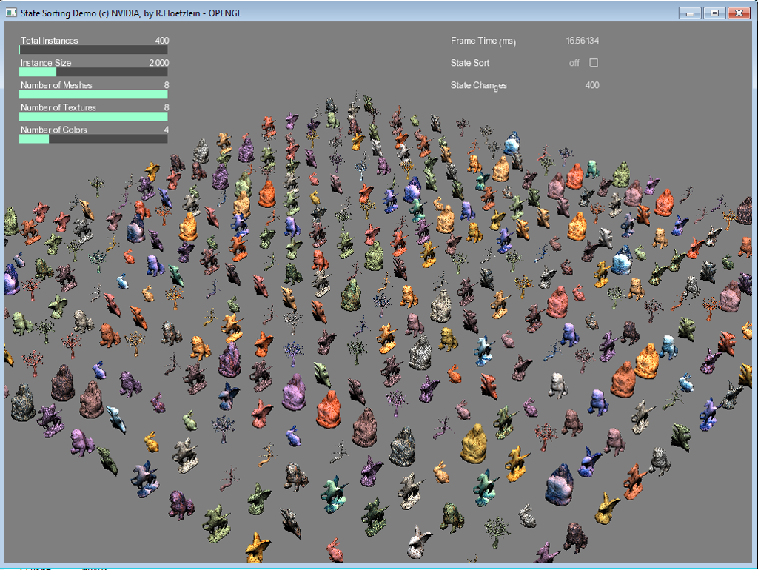
Use Case - State Sorting Demo
400 instances
8 unique meshes, 8 unique textures
Each instance randomly selects a mesh & texture
Unsorted: 400 state changes, Sorted: 64 state changes

Slide 3
Observations:
- Modern GPUs have many states:
VS/PS Shader, Texture, Const buffer, VBO, Index, Raster, Stencil
- To accurately track states you need to look at
data transfers, not just the buffer names. E.g.
buf->Map ( WRITE, .. , sysmem );
memcpy ( sysmem, data1, 128 );
buf->UnMap
buf->Map ( WRITE, .. , sysmem );
memcpy ( sysmem, data2, 128 ); // same buf, different “state”
buf->UnMap
- There are three possible state changes:
1. Create/write
2. Switch what we typically call a state ‘change’
3. Reuse

Slide 4
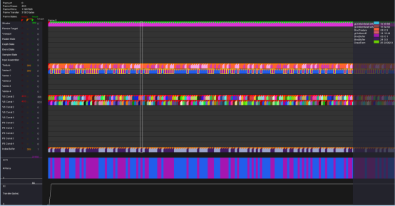
Workflow
Application
App Replay
run
replay
track state
visualize data
.trace
d3dretrace
glretrace
.raw
apitrace
stateviewer

Slide 5
Visualization
Colored rectangles map state values.
Value of this buffer stays the same for the first 4 draws. Then, value flip-flops between 2 values.
Colors are random.. It’s about seeing patterns.
Colored flags map state changes.
Create/write – app is allocating a new buffer, or rewriting it.
Switch – app is switching to another buffer.
Reuse – app is reusing buffer from last draw, no switch.

Slide 6
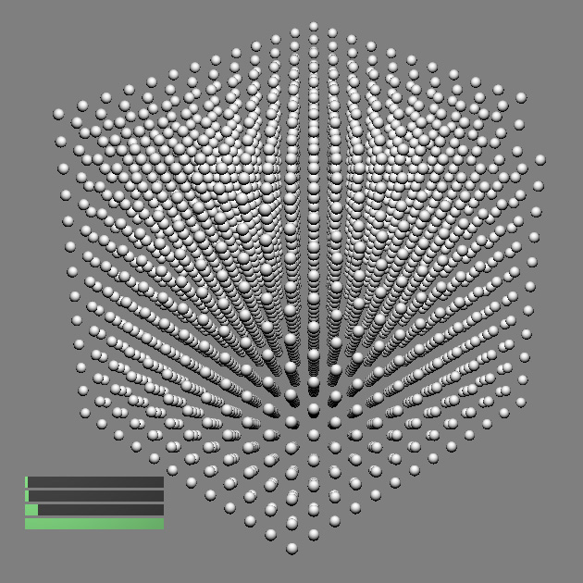
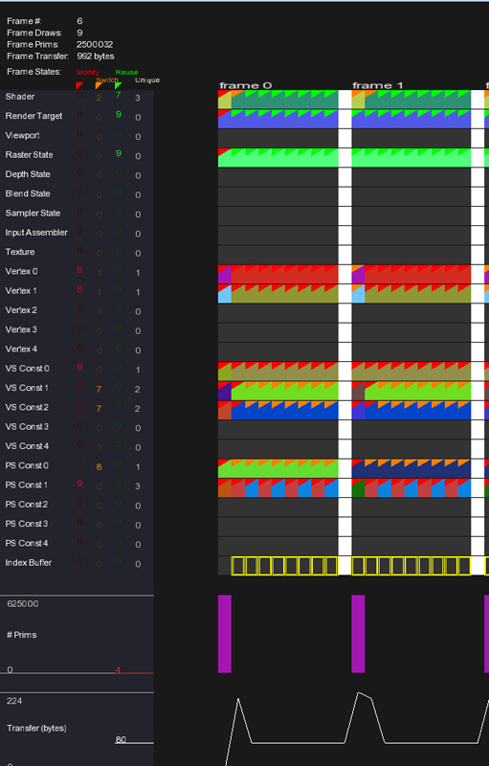
Workflow
Simple app: 3D instances spheres.
Simple Example:
1. There are 9 draw
calls total per frame.
2. Two Shaders are
used: One for 3D
and one for 2D guis.
3. The first draw uses 1x VBO, which is reused (orange flag). This is the VBO for a 3D sphere!
The other 8 draws are another VBO, which is rewritten on each call. This a re-used VBO for each of 4x 2D GUI rectangles.
4. Flip-flop pattern is setting the grey and green colors of the rectangles from app.
5. Number of total primitives clearly tells us
first draw is the 3D sphere instancing.

Slide 7
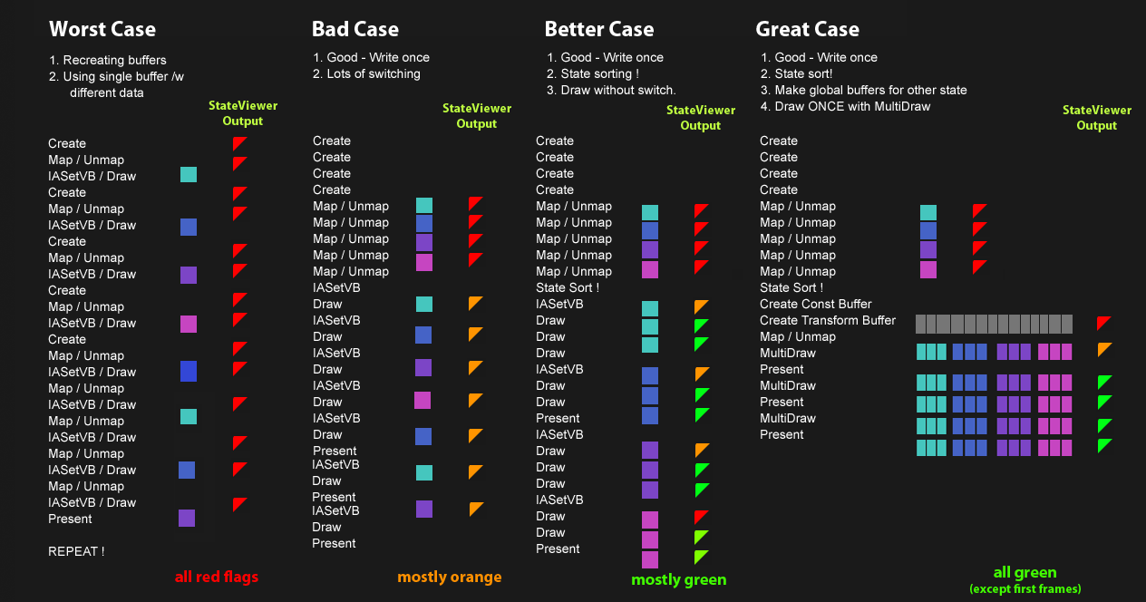

Slide 8
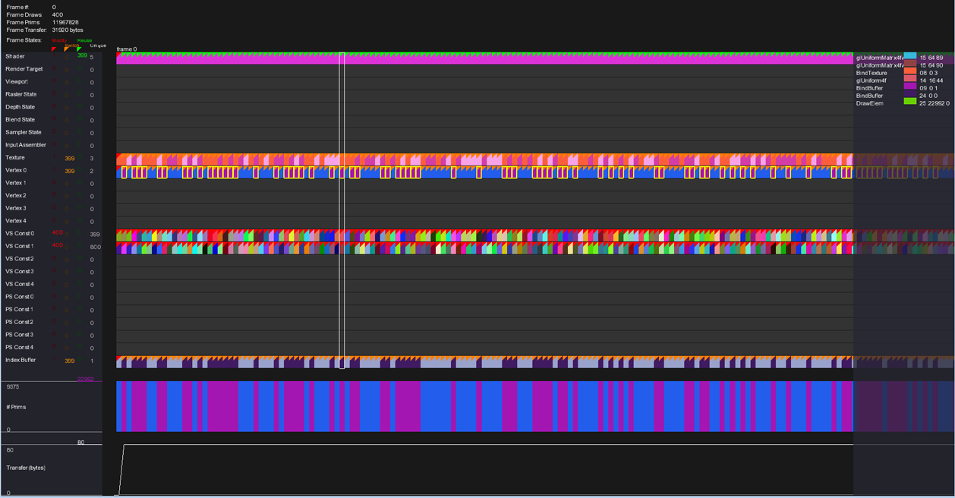
State Bins
Changes
Red = create/write, Orange = switch, Green = reuse
State Calls
per Draw
StateViewer Playback - Data Visualization
This app reuses the same value many times, incurring a lot of switches.

Slide 9
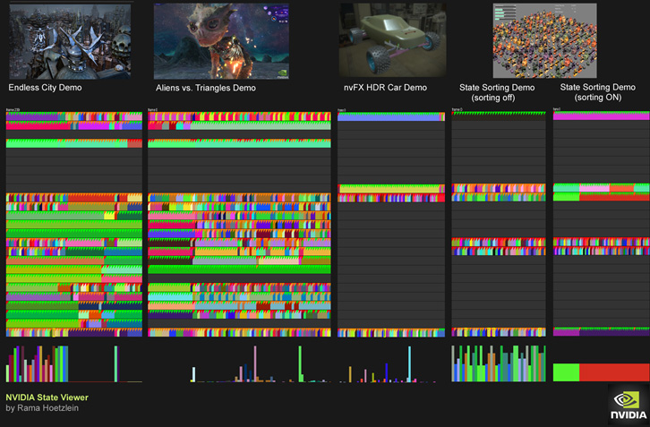
“Good” apps use many bins, with lots of reuse.
“Bad” apps use few bins, with lots of switches.

Slide 10
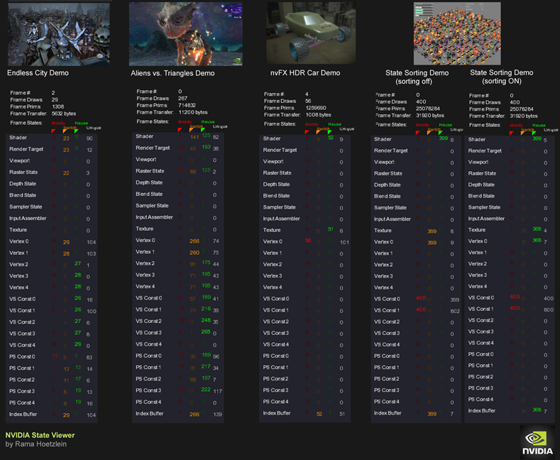
Summarize – Shows total writes, switches, and reuse per bin.

