Slide 1
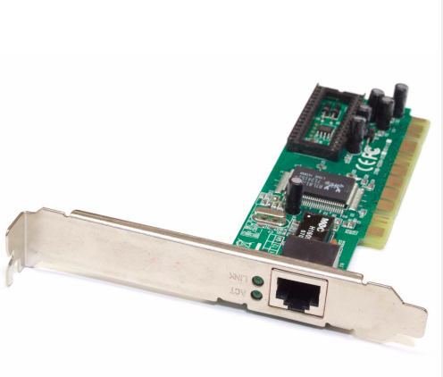
Linux Ethernet Driver

Slide 2
Contents
- How Ethernet driver works?
- Flow sequence
- Data Path
- Control Path
PCI bus based Ethernet drivers Realtek/Intel IGB
https://elixir.bootlin.com/linux/v6.3.2/source/drivers/net/ethernet/realtek/8139cp.c
https://elixir.bootlin.com/linux/v6.3.2/source/drivers/net/ethernet/intel/igb/igb_main.c
Platform Ethernet driver
https://elixir.bootlin.com/linux/v6.3.2/source/drivers/net/ethernet/xilinx/xilinx_axienet_main.c

Slide 3
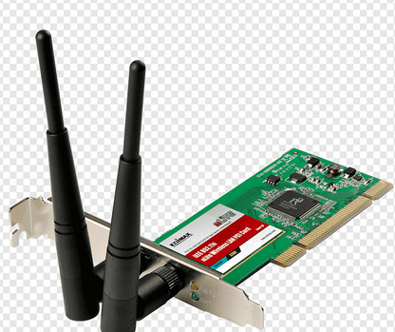
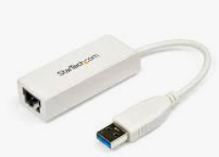
Interfaces in Network Stack
Application
User space
System Call/Socket Calls
Network Stack
Kernel space
eth0
wifi0
usb0
Ethernet Driver
Wireless Driver
USB Network Driver
Ethernet Controller
Wireless Controller
USB Controller
Hardware

Slide 4
Wired Ethernet Interface | TX Flow: Application → Socket API → IP/TCP layer → net_device_ops →ndo_start_xmit() → Driver-specific xmit() (e.g., e1000_xmit_frame) → DMA descriptor ring setup → PCI Bus (via DMA) → Ethernet Controller (MAC + PHY) → RJ45 Port → Network Cable | RX Flow: Network Cable → RJ45 Port→ Ethernet Controller (PHY + MAC)→ PCI Bus (via DMA)→ DMA Descriptor Ring (RX ring)→ Driver-specific RX function → (e.g., e1000_clean_rx_irq) → netif_receive_skb() → IP/TCP layer → Socket API → Application
Wireless Ethernet Interface | Application →Socket API →IP/TCP layer →net_device_ops-→ndo_start_xmit() → mac80211 stack (software MAC) → Driver-specific xmit() (e.g., iwlwifi_tx_skb) → Firmware / Hardware offload → Radio PHY (802.11 frames) → Antenna → Air medium | Antenna → PHY Layer → Wi-Fi NIC (MAC + Firmware)→ Kernel Driver (cfg80211 / mac80211) → → Network Stack (IP / TCP / UDP) → Socket Layer → Application
USB Ethernet Interface | Application → Socket API → IP/TCP layer→ net_device_ops→ ndo_start_xmit()→ usbnet_start_xmit() → usb_submit_urb() → USB Controller → Device | Device → USB Interrupt → URB completion handler→ usbnet_bh() → netif_rx() → IP stack → Socket → Application
Data Flow in the Network Stack

Slide 5
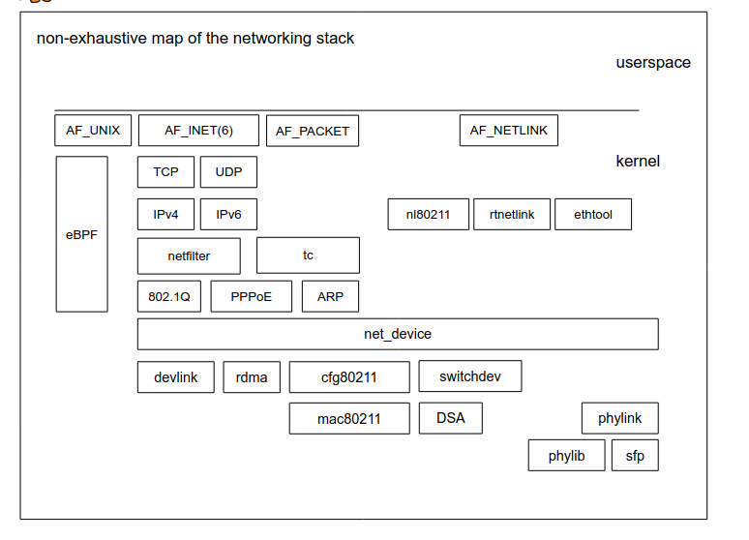
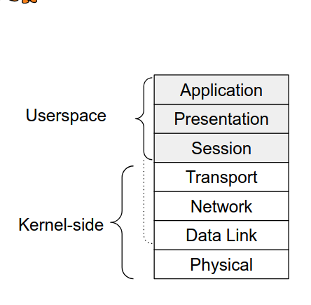
The Linux Kernel Networking Stack
▶ Abstracts the Network Devices
Implements some OSI Layers :
Provides a set of APIs to userspace
• Layer 1 (PHY) : Ethernet, WiFi, CAN, etc.
• Layer 2 (MAC) : Bridging, VLANs, etc.
• Layer 3 (Network) : IPv4, IPv6, etc.
• Layer 4 (Transport) : TCP, UDP, etc
• Socket API and io_uring
• Control through ioctl and Netlink
io_uring is a high-performance asynchronous I/O interface in Linux designed to drastically reduce syscall overhead and context switches compared to traditional async I/O (aio, epoll, select, etc.).

Slide 6
Physical and MAC support
▶The Networking stack provides a framework for Layer 2 drivers :
struct net_device
▶ Used by Ethernet, Wifi, Bluetooth, CAN, 802.15.4, Radio, etc.
▶ PHY drivers have their dedicated frameworks
• phylib for Ethernet PHYs
• mac80211 and wiphy for 802.11 PHYs
▶ A lot of communication technologies are handled through the network stack
• Ethernet
• Wifi
• Bluetooth and Bluetooth Low Energy
• Infiniband
• 802.15.4, radio, X.25
• CAN Bus
Userspace Networking
▶ Userspace applications can also access traffic at various points in the stack
through sockets :
▶ AF_PACKET Sockets allow raw Layer 2 access
• Can be used for custom protocol support in userspace
• Used by libpcap and traffic monitoring tools like tcpdump and wireshark
▶ socket(AF_PACKET, SOCK_DGRAM, 0) sockets expose raw IPv4 and IPv6 packets
▶ Some protocols only have userspace implementations by design :
• QUIC : Not in the kernel when the protocol was first introduced
Rationale was to prevent ossification
Recent kernel-side implementation submitted for inclusion in the kernel

Slide 7
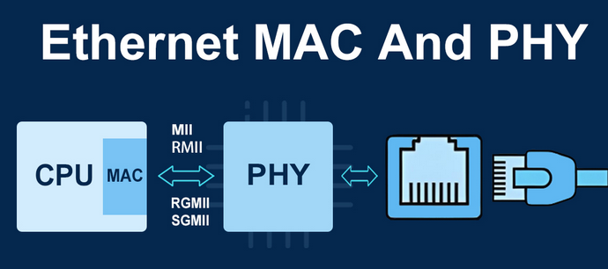
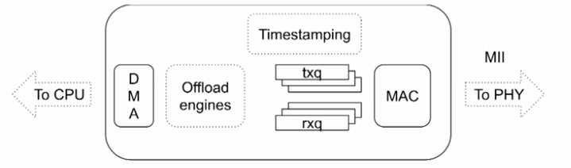
Inside Ethernet Controller
→ MII Interface to PHY
→ Queues and DMA
→ Internal Engines
(Time stamping,Filtering, Parsing, Encryption..
MAC: 802.3 Operations(Collision management, Flow control)

Slide 8
In UNIX systems, the common saying is that ”everything is a file”
▶ Most classes of devices follow that rule, and expose block and char devices in /dev
• /dev/mmcblk0 : eMMC device 0
• /dev/i2c-3 : I2C bus number 3
• /dev/input/* : HID devices
▶ Network devices don’t follow that rule, as they are rarely directly accessed
▶ The Linux Kernel provides access to Layers 2, 3 and 4 through the socket API
▶ Network devices appear as interfaces under /sys/class/net
▶ The sysfs API is only for limited control and device information
struct net_device
Represent a network interface
Back bone of driver
The probe function of driver usually registers via register_netdev()
net_devices are network interfaces visible via ip link show/ifconfig -a
Each net_device has unique if_index within its name space (struct net)

Slide 9
• net devices can be part of hierarchy: lower and upper
• Allocated through (devm_)alloc_etherdev_(mqs)
• Driver specified data retrieved using netdev_priv(dev)
• Used for physical interfaces and virtual interfaces
• Abstract interfaces can be used for vlan, bridging, tap, veth, etc.
▶ Userspace sees a netdev as an interface
• Listed with ip link show or ifconfig
• Also appearing under /sys/class/net/
▶ Interfaces have a name, which may change
▶ Interfaces also have an index (ifindex) that uniquely identifies them
▶ They have attributes, changeable or not, depending on their type :
• Addresses : IPv4, IPv6, MAC, etc.
• Properties : MTU, Queue length, etc.
• Statistics : RX/TX packets, link events, etc.
• State : Link up or down, admin state, Promiscuous, etc.

Slide 10
This entire flow will be examined in detail in the following sections.
Ethernet driver initialization and registration with PCI/Platform bus
Init_module
module_pci_driver/
pci_register_driver/
module_platform_driver
igb_probe/cp_init_one/
axienet_probe
Initialization (Init_module)
A driver registers an initialization function which is called by the kernel when the driver is loaded. This function is registered by using the module_init macro.. The igb initialization function (igb_init_module)
/**
* igb_init_module - Driver Registration Routine
*
* igb_init_module is the first routine called when the driver is
* loaded. All it does is register with the PCI subsystem.
**/
static int __init igb_init_module(void)
{
int ret;
pr_info("%s\n", igb_driver_string);
pr_info("%s\n", igb_copyright);
ret = pci_register_driver(&igb_driver);
return ret;
}
module_init(igb_init_module);
static struct pci_driver cp_driver = {
.name = DRV_NAME,
.id_table = cp_pci_tbl,
.probe = cp_init_one,
.remove = cp_remove_one,
.driver.pm = &cp_pm_ops,
};
module_pci_driver(cp_driver);
module_platform_driver(axienet_driver);

Slide 11
PCI initialization
The Intel I350 and Realtek network cards are PCI express. PCI devices identify themselves with a series of registers in the PCI Configuration Space.
When a device driver is compiled, a macro named MODULE_DEVICE_TABLE (from include/module.h) is used to export a table of PCI device IDs identifying devices that the device driver can control. The table is also registered as part of a structure.The kernel uses this table to determine which device driver to load to control the device.Thats how the OS can figure out which devices are connected to the system and which driver should be used to talk to the device.This table and the PCI device IDs for the igb driver can be found in drivers/net/ethernet/intel/igb/igb_main.c and drivers/net/ethernet/intel/igb/e1000_hw.h, respectively: Similary PCI device id for realtek card can be found in https://elixir.bootlin.com/linux/v6.3.2/source/drivers/net/ethernet/realtek/8139cp.c
static const struct pci_device_id igb_pci_tbl[] = { { PCI_VDEVICE(INTEL, E1000_DEV_ID_I354_BACKPLANE_1GBPS) }, { PCI_VDEVICE(INTEL, E1000_DEV_ID_I354_SGMII) }, { PCI_VDEVICE(INTEL, E1000_DEV_ID_I354_BACKPLANE_2_5GBPS) }, }; MODULE_DEVICE_TABLE(pci, igb_pci_tbl); | static const struct pci_device_id cp_pci_tbl[] = { { PCI_DEVICE(PCI_VENDOR_ID_REALTEK, PCI_DEVICE_ID_REALTEK_8139), }, { PCI_DEVICE(PCI_VENDOR_ID_TTTECH, PCI_DEVICE_ID_TTTECH_MC322), }, { }, }; MODULE_DEVICE_TABLE(pci, cp_pci_tbl);
Xilinx Platform Ethernet driver, will bind according to Device tree /* Match table for of_platform binding */ static const struct of_device_id axienet_of_match[] = { { .compatible = "xlnx,axi-ethernet-1.00.a", }, { .compatible = "xlnx,axi-ethernet-1.01.a", }, { .compatible = "xlnx,axi-ethernet-2.01.a", }, {}, }; MODULE_DEVICE_TABLE(of, axienet_of_match);

Slide 12
static struct pci_driver igb_driver = { .name = igb_driver_name, .id_table = igb_pci_tbl, .probe = igb_probe, .remove = igb_remove, .shutdown = igb_shutdown, .sriov_configure = igb_pci_sriov_configure, .err_handler = &igb_err_handler }; | static struct pci_driver cp_driver = { .name = DRV_NAME, .id_table = cp_pci_tbl, .probe = cp_init_one, .remove = cp_remove_one, .driver.pm = &cp_pm_ops, };
Xilinx AXI Ethernet driver probe will happen with device tree match node “.compatible” string. static struct platform_driver axienet_driver = { .probe = axienet_probe, .remove = axienet_remove, .shutdown = axienet_shutdown, .driver = { .name = "xilinx_axienet", .pm = &axienet_pm_ops, .of_match_table = axienet_of_match, }, };

Slide 13
PCI probe
Once a device has been identified by its PCI IDs, the kernel can then select the proper driver to use to control the device. Each PCI driver registers a probe function with the PCI system in the kernel. The kernel calls this function for devices which have not yet been claimed by a device driver. Once a device is claimed, other drivers will not be asked about the device. Most drivers have a lot of code that runs to get the device ready for use. The exact things done vary from driver to driver.Some typical operations to perform include:
1. Enabling the PCI device.
2. Requesting memory ranges and IO ports.
3. Setting the DMA mask.
4. The ethtool functions the driver supports are registered.
5. Any watchdog tasks needed (for example, e1000e has a watchdog task to check if the hardware is hung). Other device specific stuff like workarounds or dealing with hardware specific quirks or similar.
6. The creation, initialization, and registration of a struct net_device_ops structure. This structure contains function pointers to the various functions needed for opening the device, sending data to the network, setting the MAC address, and more.
7. The creation, initialization, and registration of a high level struct net_device which represents a network device.
The following code from the igb_probe function and cp_init_one function does some basic PCI configuration.
err = pci_enable_device_mem(pdev); err = dma_set_mask_and_coherent(&pdev->dev, DMA_BIT_MASK(64)); err = pci_request_selected_regions(pdev, pci_select_bars(pdev, IORESOURCE_MEM), igb_driver_name); pci_enable_pcie_error_reporting(pdev); pci_set_master(pdev); pci_save_state(pdev); | rc = pci_enable_device(pdev); rc = pci_set_mwi(pdev); rc = pci_request_regions(pdev, DRV_NAME); pciaddr = pci_resource_start(pdev, 1); rc =pci_resource_len(pdev, 1); regs = ioremap(pciaddr, CP_REGS_SIZE); pci_set_drvdata(pdev, dev); pci_set_master(pdev);

Slide 14
First, the device is initialized with pci_enable_device_mem. This will wake up the device if it is suspended, enable memory resources, and more. Next, the DMA mask will be set. This device can read and write to 64bit memory addresses, so dma_set_mask_and_coherent is called with DMA_BIT_MASK(64).
Memory regions will be reserved with a call to pci_request_selected_regions, PCI Express Advanced Error Reporting is enabled (if the PCI AER driver is loaded), DMA is enabled with a call to pci_set_master, and the PCI configuration space is saved with a call to pci_save_state.
On the other hand platform bus based drivers allocate registger space using below command
/* Map device registers */ lp->regs = devm_platform_get_and_ioremap_resource(pdev, 0, &ethres); if (IS_ERR(lp->regs)) { ret = PTR_ERR(lp->regs); goto cleanup_clk; }
▶ alloc_etherdev_mqs() : Allocate a new struct net_device for Ethernet :
▶ Sets the number of queues passed as parameters
▶ Creates a default name using the "eth\%d" template
▶ Sets all the Ethernet-specific default parameters :
• MTU, Header len, Address len, etc
Network device initialization
The igb_probe/cp_init_one/axienet_probe function does some important network device initialization. In addition to the PCI specific work, it will do more general networking and network device work:
-> The struct net_device_ops is registered.
-> ethtool operations are registered.
-> The default MAC address is obtained from the NIC.
-> net_device feature flags are set.
The struct net_device_ops contains function pointers to lots of important operations that the network subsystem needs to control the device. We’ll be mentioning this structure many times throughout the rest of this post.

Slide 15
struct net_device_ops
Call backs that driver exposes to the net core
Referred to as “NDO”
Some are on data path, some are on control path
One is mandatory
→ ndo_start_xmit() to transmit data
Others might be required depending on exposed features
Specified at init time before registration
→ static const struct net_device_ops rtl_netdev_ops = {
.ndo_open = rtl_open,
.ndo_stop = rtl8169_close,
.ndo_get_stats64 = rtl8169_get_stats64,
.ndo_start_xmit = rtl8169_start_xmit,
.ndo_features_check = rtl8169_features_check,
.ndo_tx_timeout = rtl8169_tx_timeout,
.ndo_validate_addr = eth_validate_addr,
.ndo_change_mtu = rtl8169_change_mtu,
.ndo_fix_features = rtl8169_fix_features,
.ndo_set_features = rtl8169_set_features,
.ndo_set_mac_address = rtl_set_mac_address,
.ndo_eth_ioctl = phy_do_ioctl_running,
.ndo_set_rx_mode = rtl_set_rx_mode,
};
dev->netdev_ops = &rtl_netdev_ops;

Slide 16
▶ register_netdevice() : Registers the struct net_device, in the netdev->net
namespace
• Allocates the interface index
• Makes the device visible from userspace
• From this point on, NDOs may be called
• Assumes RTNL (Routing Netlink lock) is held.
▶ Sometimes the Network Stack’s Big Kernel Lock
• Its scope is slowly getting removed, replaced with more specific locks
• .ndo_init is called at that stage, if provided
▶ register_netdev() : Calls register_netdevice() with RTNL held
• Used mostly in drivers, as the device driver’s .probe() doesn’t hold RTNL

Slide 17
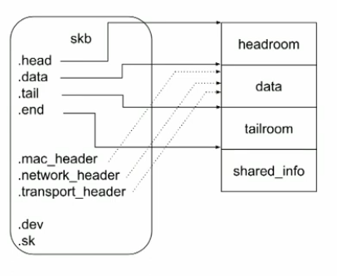
Data Path: struct sk_buff
struct sk_buff {
struct sk_buff *next; // Next packet in queue
struct sk_buff *prev; // Previous packet in queue
struct sock *sk; // Associated socket (if any)
struct net_device *dev; // Network device (NIC)
unsigned int len; // Total packet length
unsigned char *head; // Start of allocated buffer
unsigned char *data; // Start of actual packet data
unsigned char *tail; // End of packet data
unsigned char *end; // End of allocated area
struct timeval timestamp; // Arrival time
};
RX Path: struct sk_buff *skb = netdev_alloc_skb(dev, length); skb_put_data(skb, data, length); //Fill the data(DMA)
netif_rx(skb); // Pass to network upper layers
TX Path:
dev_queue_xmit(skb);

Slide 18
→ Run in softirq context, can be switched into threads.
→ Also works for TX, for processing TX completions
→ NAPI is not a batch processing mechanism, which is achievable through interrupt
Coalescing . Interrupt coalescing is a performance optimization where hardware groups multiple events into a single interrupt instead of interrupting the CPU for every event. Several packets → one interrupt
→ Multiple NAPI instances can be registered, Usually one per channel or per CPU
Packet timestamping can be done in RX and TX
▶ Hardware timestamping is configured in the .ndo_ioctl()
• Being replaced in favor of .ndo_timestamping()
▶ Timestamp is stored in the skb_shared_info
▶ On TX timestamping, the skb is cloned, timestamp is attached to the clone
• The clone is sent back to the socket error queue
static int igb_ioctl(struct net_device *netdev,
struct ifreq *ifr, int cmd)
{
switch (cmd) {
case SIOCSHWTSTAMP:
return igb_hwtstamp_set(netdev, ifr);
case SIOCGHWTSTAMP:
return igb_hwtstamp_get(netdev, ifr);
}
}

Slide 19
Offloading
▶ Most modern controllers can perform themselves some operations on packets
▶ checksumming offload makes so the CPU doesn’t have to check or compute checksums
▶ filtering offloads makes so that the MAC drops unknown MAC addresses and VLANs
▶ classification-capable controllers may implement more powerful features :
• header hashing computes a hash of a specific set of fields in the header. Useful for
RSS.
• flow steering allows specific actions (enqueueing, drop, redirection) to be done
based on specific header values
▶ crypto offload for some tunneling technologies such as MACSec
▶ Offloading can however make debugging harder, as decisions are taken before
packets reach the CPU
• Most controllers will expose counters, accessible over ethtool -S <iface>

Slide 20
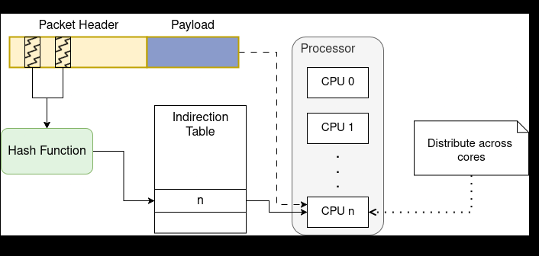
In networking, Receive Side Scaling (RSS) header hashing is a hardware-offload mechanism used by Network Interface Cards (NICs) to distribute incoming network traffic across multiple CPU cores for parallel processing. The NIC extracts specific fields from the headers of incoming packets and applies a hash function to them to generate a hash value. Header Field Selection: Common fields used for hashing include the Source/Destination IP addresses (L3) and Source/Destination Port numbers (L4). Hash Algorithms: The most common algorithm used is Toeplitz, but some hardware also supports a simple XOR function. Indirection Table: The resulting hash value is used as an index into a "redirection" or "indirection" table, which maps the packet to a specific RX (receive) queue assigned to a CPU core. Packet arrives at NIC 1. NIC computes a hash of header fields 2. Hash is mapped to an RX queue 3. That queue triggers an interrupt / NAPI poll on a specific CPU This ensures: Packets from the same flow go to the same queue (ordering preserved) Different flows are balanced across CPUs

Slide 21
In networking, flow steering refers to the mechanisms used to direct specific packet flows to particular CPU cores for processing. While RSS (Receive Side Scaling) uses a hash-based approach to distribute traffic broadly across cores, flow steering techniques provide more surgical control to improve application locality and reduce cache misses Traffic is classified based on specific fields : src/dst MAC, src/dst IP, src/dst Port, VLAN, etc
TCAM in flow steering refers to using Ternary Content-Addressable Memory (TCAM) to match packets against flow rules and steer them to the correct processing path (queue, core, VF, tunnel, or action).
What is flow steering? Flow steering means directing packets of a specific flow (e.g., TCP 5-tuple) to: A specific RX queue A specific CPU core A Virtual Function (SR-IOV) A network function (firewall, load balancer, etc.) This improves performance, cache locality, and scalability.

Slide 22
NAPI → New API → NAPI
→ Processed RX packets in budgeted poll loops after a first packet is received.
→ NAPI instances are registered through netif_napi_add() passing a poll callback
1. The first RX packet raises interrupt
2. Driver calls napi_schedule() and keeps interrupt disabled
3. The poll callback of driver called, with a budget of N packets to process at most.
4. Once N or all packets processed, the interrupt is re-enabled.
▶ NAPI does not stand for New API
• it was new in Linux v2.4, today NAPI means NAPI
▶ Designed to avoid interrupt interference, as traffic often occurs in bursts
▶ The first packet of a burst is handled through interrupt
▶ The interrupt stays disabled, each subsequent packet is pulled using polling
▶ The polling stops when the budget is exhausted (by default, 50 packets)
▶ The driver must then re-enable the interrupts for further processing

Slide 23
IRQ’s
When a data frame is written to RAM via DMA, how does the NIC tell the rest of the system that data is ready to be processed?
Traditionally, a NIC would generate an interrupt request (IRQ) indicating data had arrived. There are three common types of IRQs: MSI-X, MSI, and legacy IRQs. These will be touched upon shortly. A device generating an IRQ when data has been written to RAM via DMA is simple enough, but if large numbers of data frames arrive this can lead to a large number of IRQs being generated. The more IRQs that are generated, the less CPU time is available for higher level tasks like user processes. The New Api (NAPI) was created as a mechanism for reducing the number of IRQs generated by network devices on packet arrival. While NAPI reduces the number of IRQs, it cannot eliminate them completely.
NAPI allows a device driver to register a poll function that the NAPI subsystem will call to harvest data frames.
1. The intended use of NAPI in network device drivers is as follows:
2. NAPI is enabled by the driver, but is in the off position initially.
3. A packet arrives and is DMA to memory by the NIC.
4. An IRQ is generated by the NIC which triggers the IRQ handler in the driver.
5. The driver wakes up the NAPI subsystem using a softirq. This will begin harvesting packets by calling the drivers registered poll function in a separate thread of execution.
6. The driver should disable further IRQs from the NIC. This is done to allow the NAPI subsystem to process packets without interruption from the device.
Once there is no more work to do, the NAPI subsystem is disabled and IRQs from the device are re-enabled.The process starts back at step 2.
The device driver implements a poll function and registers it with NAPI by calling netif_napi_add. When registering a NAPI poll function with netif_napi_add, the driver will also specify the weight. Most of the drivers hardcode a value of 64. Typically, drivers register their NAPI poll functions during driver initialization.
netif_napi_add(ndev, &lp->napi_rx, axienet_rx_poll);
netif_napi_add(ndev, &lp->napi_tx, axienet_tx_poll);
netif_napi_add_weight(dev, &cp->napi, cp_rx_poll, 16);
netif_napi_add(adapter->netdev, &q_vector->napi, igb_poll);

Slide 24
static irqreturn_t cp_interrupt (int irq, void *dev_instance) { if (napi_schedule_prep(&cp->napi)) { cpw16_f(IntrMask, cp_norx_intr_mask); __napi_schedule(&cp->napi); } } | static irqreturn_t igb_msix_ring(int irq, void *data) { struct igb_q_vector *q_vector = data; /* Write the ITR value calculated from the previous interrupt. */ igb_write_itr(q_vector); napi_schedule(&q_vector->napi); return IRQ_HANDLED; }
root@rama-Inspiron-3501:/home/rama# cat /proc/net/dev
Inter-| Receive | Transmit
face |bytes packets errs drop fifo frame compressed multicast|bytes packets errs drop fifo colls carrier compressed
lo: 78648 861 0 0 0 0 0 0 78648 861 0 0 0 0 0 0
enp1s0: 0 0 0 0 0 0 0 0 0 0 0 0 0 0 0 0
wlp2s0: 19579109 17479 0 0 0 0 0 0 1601701 6250 0 0 0 0 0 0
docker0: 0 0 0 0 0 0 0 0 0 0 0 0 0 0 0 0
root@rama-Inspiron-3501:/home/rama# cat /proc/softirqs
CPU0 CPU1 CPU2 CPU3
HI: 4034 9380 39306 7424
TIMER: 28734 35230 57754 32040
NET_TX: 1 0 6 3
NET_RX: 283 21893 26053 347
BLOCK: 1805 2099 2856 2292
IRQ_POLL: 0 0 0 0
TASKLET: 39 78 62 314
SCHED: 77103 89026 104056 74772
HRTIMER: 0 0 0 0
RCU: 63961 68038 69233 63023
root@rama-Inspiron-3501:/home/rama#

Slide 25
net_device_ops structure
static const struct net_device_ops axienet_netdev_ops = { .ndo_open = axienet_open, .ndo_stop = axienet_stop, .ndo_start_xmit = axienet_start_xmit, .ndo_get_stats64 = axienet_get_stats64, .ndo_change_mtu = axienet_change_mtu, .ndo_set_mac_address = netdev_set_mac_address, .ndo_validate_addr = eth_validate_addr, .ndo_eth_ioctl = axienet_ioctl, .ndo_set_rx_mode = axienet_set_multicast_list, #ifdef CONFIG_NET_POLL_CONTROLLER .ndo_poll_controller = axienet_poll_controller, #endif }; static const struct net_device_ops cp_netdev_ops = { .ndo_open = cp_open, .ndo_stop = cp_close, .ndo_validate_addr = eth_validate_addr, .ndo_set_mac_address = cp_set_mac_address, .ndo_set_rx_mode = cp_set_rx_mode, .ndo_get_stats = cp_get_stats, .ndo_eth_ioctl = cp_ioctl, .ndo_start_xmit = cp_start_xmit, .ndo_tx_timeout = cp_tx_timeout, .ndo_set_features = cp_set_features, .ndo_change_mtu = cp_change_mtu, .ndo_features_check = cp_features_check, #ifdef CONFIG_NET_POLL_CONTROLLER .ndo_poll_controller = cp_poll_controller, #endif }; | static const struct net_device_ops igb_netdev_ops = { .ndo_open = igb_open, .ndo_stop = igb_close, .ndo_start_xmit = igb_xmit_frame, .ndo_get_stats64 = igb_get_stats64, .ndo_set_rx_mode = igb_set_rx_mode, .ndo_set_mac_address = igb_set_mac, .ndo_change_mtu = igb_change_mtu, .ndo_eth_ioctl = igb_ioctl, .ndo_tx_timeout = igb_tx_timeout, .ndo_validate_addr = eth_validate_addr, .ndo_vlan_rx_add_vid = igb_vlan_rx_add_vid, .ndo_vlan_rx_kill_vid = igb_vlan_rx_kill_vid, .ndo_set_vf_mac = igb_ndo_set_vf_mac, .ndo_set_vf_vlan = igb_ndo_set_vf_vlan, .ndo_set_vf_rate = igb_ndo_set_vf_bw, .ndo_set_vf_spoofchk = igb_ndo_set_vf_spoofchk, .ndo_set_vf_trust = igb_ndo_set_vf_trust, .ndo_get_vf_config = igb_ndo_get_vf_config, .ndo_fix_features = igb_fix_features, .ndo_set_features = igb_set_features, .ndo_fdb_add = igb_ndo_fdb_add, .ndo_features_check = igb_features_check, .ndo_setup_tc = igb_setup_tc, .ndo_bpf = igb_xdp, .ndo_xdp_xmit = igb_xdp_xmit, };

Slide 26
ethtool_ops
netdev->ethtool_ops = &igb_ethtool_ops; static const struct ethtool_ops igb_ethtool_ops = { .supported_coalesce_params = ETHTOOL_COALESCE_USECS, .get_drvinfo = igb_get_drvinfo, .get_regs_len = igb_get_regs_len, .get_regs = igb_get_regs, .get_wol = igb_get_wol, .set_wol = igb_set_wol, .get_msglevel = igb_get_msglevel, .set_msglevel = igb_set_msglevel, .nway_reset = igb_nway_reset, .get_link = igb_get_link, .get_eeprom_len = igb_get_eeprom_len, .get_eeprom = igb_get_eeprom, .set_eeprom = igb_set_eeprom, .get_ringparam = igb_get_ringparam, .set_ringparam = igb_set_ringparam, .get_pauseparam = igb_get_pauseparam, .set_pauseparam = igb_set_pauseparam, .self_test = igb_diag_test, .get_strings = igb_get_strings, .set_phys_id = igb_set_phys_id, .get_sset_count = igb_get_sset_count, .get_ethtool_stats = igb_get_ethtool_stats, .get_coalesce = igb_get_coalesce, .set_coalesce = igb_set_coalesce, .get_ts_info = igb_get_ts_info, .get_rxnfc = igb_get_rxnfc, .set_rxnfc = igb_set_rxnfc, .get_eee = igb_get_eee, .set_eee = igb_set_eee, .get_module_info = igb_get_module_info, .get_module_eeprom = igb_get_module_eeprom, .get_rxfh_indir_size = igb_get_rxfh_indir_size, .get_rxfh = igb_get_rxfh, .set_rxfh = igb_set_rxfh, .get_channels = igb_get_channels, .set_channels = igb_set_channels, .get_priv_flags = igb_get_priv_flags, .set_priv_flags = igb_set_priv_flags, .begin = igb_ethtool_begin, .complete = igb_ethtool_complete, .get_link_ksettings = igb_get_link_ksettings, .set_link_ksettings = igb_set_link_ksettings, }; | dev->ethtool_ops = &cp_ethtool_ops; static const struct ethtool_ops cp_ethtool_ops = { .get_drvinfo = cp_get_drvinfo, .get_regs_len = cp_get_regs_len, .get_sset_count = cp_get_sset_count, .nway_reset = cp_nway_reset, .get_link = ethtool_op_get_link, .get_msglevel = cp_get_msglevel, .set_msglevel = cp_set_msglevel, .get_regs = cp_get_regs, .get_wol = cp_get_wol, .set_wol = cp_set_wol, .get_strings = cp_get_strings, .get_ethtool_stats = cp_get_ethtool_stats, .get_eeprom_len = cp_get_eeprom_len, .get_eeprom = cp_get_eeprom, .set_eeprom = cp_set_eeprom, .get_ringparam = cp_get_ringparam, .get_link_ksettings = cp_get_link_ksettings, .set_link_ksettings = cp_set_link_ksettings, }; | ndev->ethtool_ops = &axienet_ethtool_ops; static const struct ethtool_ops axienet_ethtool_ops = { .supported_coalesce_params = ETHTOOL_COALESCE_MAX_FRAMES | ETHTOOL_COALESCE_USECS, .get_drvinfo = axienet_ethtools_get_drvinfo, .get_regs_len = axienet_ethtools_get_regs_len, .get_regs = axienet_ethtools_get_regs, .get_link = ethtool_op_get_link, .get_ringparam = axienet_ethtools_get_ringparam, .set_ringparam = axienet_ethtools_set_ringparam, .get_pauseparam = axienet_ethtools_get_pauseparam, .set_pauseparam = axienet_ethtools_set_pauseparam, .get_coalesce = axienet_ethtools_get_coalesce, .set_coalesce = axienet_ethtools_set_coalesce, .get_link_ksettings = axienet_ethtools_get_link_ksettings, .set_link_ksettings = axienet_ethtools_set_link_ksettings, .nway_reset = axienet_ethtools_nway_reset, };

Slide 27
Overview of network driver flow path
The below network driver concepts are explained with respect to RealTek 8139C+ PCI, Intel IGB driver, and Xilinx AXI platform ethernet driver(Linux Kernel version 6.0)
The high level path a packet takes from arrival to socket receive buffer is as follows:
1. Driver is loaded and initialized.
2. Packet arrives at the NIC from the network.
3. Packet is copied (via DMA) to a ring buffer in kernel memory.
4. Hardware interrupt is generated to let the system know a packet is in memory.
5. Driver calls into NAPI to start a poll loop if one was not running already.
6. ksoftirqd processes run on each CPU on the system. They are registered at boot time. The ksoftirqd processes pull packets off the ring buffer by calling the NAPI poll function that the device driver registered during initialization.
7. Memory regions in the ring buffer that have had network data written to them are unmapped.
8. Data that was DMA into memory is passed up the networking layer as an skb for more processing.
9. Incoming network data frames are distributed among multiple CPUs if packet steering is enabled or if the NIC has multiple receive queues.
10. Network data frames are handed to the protocol layers from the queues.
11. Protocol layers process data.
12. Data is added to receive buffers attached to sockets by protocol layers.

Slide 28
https://github.com/torvalds/linux/blob/v6.19-rc3/drivers/net/ethernet/intel/igb/igb_main.c
Network Device Driver
The igb initialization function (igb_init_module) and its registration with module_init
/**
* igb_init_module - Driver Registration Routine
*
* igb_init_module is the first routine called when the driver is
* loaded. All it does is register with the PCI subsystem.
**/
static int __init igb_init_module(void)
{
int ret;
pr_info("%s - version %s\n", igb_driver_string, igb_driver_version);
pr_info("%s\n", igb_copyright);
/* ... */
ret = pci_register_driver(&igb_driver);
return ret;
}
module_init(igb_init_module);
PCI initialization: The Intel I350 network card is a PCI express device. PCI devices identify themselves with a series of registers in the PCI Configuration Space. static DEFINE_PCI_DEVICE_TABLE(igb_pci_tbl) = {
{ PCI_VDEVICE(INTEL, E1000_DEV_ID_I354_BACKPLANE_1GBPS) },
{ PCI_VDEVICE(INTEL, E1000_DEV_ID_I354_SGMII) },
{ PCI_VDEVICE(INTEL, E1000_DEV_ID_I354_BACKPLANE_2_5GBPS) },
/* ... */
};
MODULE_DEVICE_TABLE(pci, igb_pci_tbl);
static struct pci_driver igb_driver = {
.name = igb_driver_name,
.id_table = igb_pci_tbl,
.probe = igb_probe,
.remove = igb_remove,
/* ... */
};

Slide 29
PCI probe
Once a device has been identified by its PCI IDs, the kernel can then select the proper driver to use to control the device. Each PCI driver registers a probe function with the PCI system in the kernel.
Some typical operations to perform include:
1. Enabling the PCI device.
2. Requesting memory ranges and IO ports.
3. Setting the DMA mask.
4. The ethtool (described more below) functions the driver supports are registered.
5. Any watchdog tasks needed (for example, e1000e has a watchdog task to check if the hardware is hung).
6. Other device specific stuff like workarounds or dealing with hardware specific quirks or similar.
7. The creation, initialization, and registration of a struct net_device_ops structure. This structure contains function pointers to the various functions needed for opening the device, sending data to the network, setting the MAC address, and more.
8. The creation, initialization, and registration of a high level struct net_device which represents a network device.

Slide 30
err = pci_enable_device_mem(pdev);
/* ... */
err = dma_set_mask_and_coherent(&pdev->dev, DMA_BIT_MASK(64));
/* ... */
err = pci_request_selected_regions(pdev, pci_select_bars(pdev,
IORESOURCE_MEM),
igb_driver_name);
pci_enable_pcie_error_reporting(pdev);
pci_set_master(pdev);
pci_save_state(pdev);
First, the device is initialized with pci_enable_device_mem. This will wake up the device if it is suspended, enable memory resources, and more.
Next, the DMA mask will be set. This device can read and write to 64bit memory addresses, so dma_set_mask_and_coherent is called with DMA_BIT_MASK(64).
Memory regions will be reserved with a call to pci_request_selected_regions, PCI Express Advanced Error Reporting is enabled (if the PCI AER driver is loaded), DMA is enabled with a call to pci_set_master, and the PCI configuration space is saved with a call to pci_save_state.
The struct net_device_ops contains function pointers to lots of important operations that the network subsystem needs to control the device. We’ll be mentioning this structure many times throughout the rest of this post. This net_device_ops structure is attached to a struct net_device in igb_probe.
static const struct net_device_ops igb_netdev_ops = {
.ndo_open = igb_open,
.ndo_stop = igb_close,
.ndo_start_xmit = igb_xmit_frame,
.ndo_get_stats64 = igb_get_stats64,
.ndo_set_rx_mode = igb_set_rx_mode,
.ndo_set_mac_address = igb_set_mac,
.ndo_change_mtu = igb_change_mtu,
.ndo_do_ioctl = igb_ioctl,
/* ... */
static int igb_probe(struct pci_dev *pdev, const struct pci_device_id *ent)
{
/* ... */
netdev->netdev_ops = &igb_netdev_ops;

Slide 31
ethtool registration
ethtool is a command line program you can use to get and set various driver and hardware options. You can install it on Ubuntu by running apt-get install ethtool. A common use of ethtool is to gather detailed statistics from network devices. Other ethtool settings of interest will be described later. The ethtool program talks to device drivers by using the ioctl system call. The device drivers register a series of functions that run for the ethtool operations and the kernel provides the glue.
static int igb_probe(struct pci_dev *pdev, const struct pci_device_id *ent)
{
/* ... */
igb_set_ethtool_ops(netdev);
void igb_set_ethtool_ops(struct net_device *netdev)
{
SET_ETHTOOL_OPS(netdev, &igb_ethtool_ops);
}
static const struct ethtool_ops igb_ethtool_ops = {
.get_settings = igb_get_settings,
.set_settings = igb_set_settings,
.get_drvinfo = igb_get_drvinfo,
.get_regs_len = igb_get_regs_len,
.get_regs = igb_get_regs,
/* ... */
static int igb_alloc_q_vector(struct igb_adapter *adapter,
int v_count, int v_idx,
int txr_count, int txr_idx,
int rxr_count, int rxr_idx)
{
/* ... */
/* allocate q_vector and rings */
q_vector = kzalloc(size, GFP_KERNEL);
if (!q_vector)
return -ENOMEM;
/* initialize NAPI */
netif_napi_add(adapter->netdev, &q_vector->napi, igb_poll, 64);
/* ... */

Slide 32
Bringing a network device up
Recall the net_device_ops structure we saw earlier which registered a set of functions for bringing the network device up, transmitting packets, setting the MAC address, etc.
When a network device is brought up (for example, with ifconfig eth0 up), the function attached to the ndo_open field of the net_device_ops structure is called.
The ndo_open function will typically do things like:
1. Allocate RX and TX queue memory
2. Enable NAPI
3. Register an interrupt handler
4. Enable hardware interrupts
static int igb_request_irq(struct igb_adapter *adapter)
{
struct net_device *netdev = adapter->netdev;
struct pci_dev *pdev = adapter->pdev;
int err = 0;
if (adapter->msix_entries) {
err = igb_request_msix(adapter);
if (!err)
goto request_done;
/* fall back to MSI */
/* ... */
}
/* ... */
if (adapter->flags & IGB_FLAG_HAS_MSI) {
err = request_irq(pdev->irq, igb_intr_msi, 0,
netdev->name, adapter);
if (!err)
goto request_done;
/* fall back to legacy interrupts */
/* ... */
}
err = request_irq(pdev->irq, igb_intr, IRQF_SHARED,
netdev->name, adapter);
if (err)
dev_err(&pdev->dev, "Error %d getting interrupt\n", err);
request_done:
return err;
}
static void igb_irq_enable(struct igb_adapter *adapter)
{
/* ... */
wr32(E1000_IBM, IMS_ENABLE_MASK | E1000_IMS_DRSTA);
wr32(E1000_IAM, IMS_ENABLE_MASK | E1000_IMS_DRSTA);
/* ... */
}

Slide 33
Control Plane
→ Ethernet controllers are highly configurable
→ Status reporting at various levels (per queue, MAC, PHY, Internal engines)
→ Offload configuration: Vlan filters, classification, check summing
→ Ethernet configuration: MTU, Link, Speed, Flow control
▶ Controller and driver behaviour, through ethtool, e.g. set the link speed
▶ Interface configuration, with iproute2, e.g. configure the IP address
▶ System-wide configuration, e.g. enable IP forwarding
▶ Per-connection configuration, e.g. select the TCP congestion-control algorithm
• The setsockopts() syscall is covered later in this training.

Slide 34
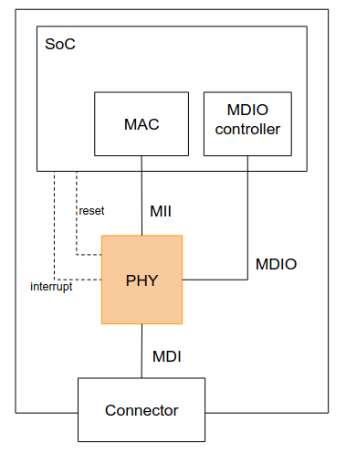
PHY devices
▶ Ethernet PHYs handle Layer 1 of the OSI model
▶ Standardized by IEEE 802.3
▶ Media Independent Interface
• Communication bus between MAC and PHY
▶ Media Dependent Interface
• Communication medium with the link partner
• Can be Cat6 cable, Fiber, Coax, backplane, etc.
▶ Management Data Input Output
• Control bus for PHY devices
• Can be shared by multiple PHYs
• Allows accessing PHY registers
▶ Optionally, PHYs can raise interrupts
• e.g. to report link status changes
▶ Optionally, PHYs can have a reset line
▶ MDIO Most common bus to access Ethernet PHYs
▶ Addressable, 32 addresses
▶ Physically very similar to i2c
• An adapter initiates all transfers to devices
• 2 physical signals : MDC for the clock, MDIO for data

Slide 35
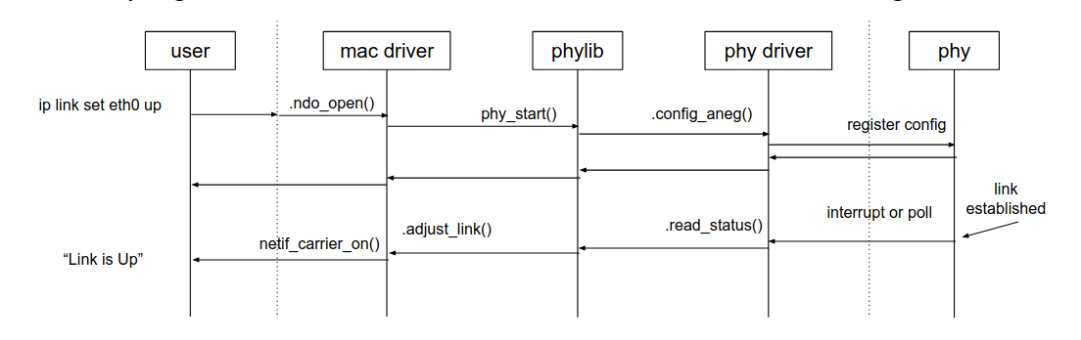
phylib usage in MAC drivers
▶ MAC drivers that use phylib directly call phy_connect() to link with the PHY
• Their .ndo_open() calls phy_start() to establish the link
• Their .ndo_close() calls phy_stop() to quiesce it
▶ They register an .adjust_link callback to the phydev for link change notification

Slide 36
AXI Ethernet Driver – Control Plane Functions
Function | Reason
axienet_probe | Hardware discovery and device setup
axienet_open / axienet_stop | Bring network interface up/down
axienet_set_mac_address / netdev_set_mac_address | Configure MAC address
axienet_set_multicast_list | Configure multicast filters
axienet_setoptions | Set VLAN, jumbo frames, flow control
axienet_change_mtu | Change MTU settings
axienet_ethtool_* | ethtool configuration operations
axienet_ethtool_get_settings / set_settings | PHY settings control
axienet_ethtool_get_drvinfo | Report driver information
axienet_device_reset | Reset hardware state
PHY management (MDIO) | PHY configuration and management

Slide 37
AXI Ethernet Driver – Data Plane Functions
Function | Reason
axienet_start_xmit | Transmit packets into hardware (data path)
axienet_rx_submit_desc | Post receive buffer descriptors
DMA buffer management (axienet_dma_bd_init, axienet_dma_bd_release) | Manage TX/RX descriptor rings
Interrupt handlers (TX/RX completion) | Handle completed packet I/O (RX/TX)
DMA I/O helpers (axienet_dma_in32, axienet_dma_out32) | Direct data plane register access

