Slide 1
Memory mapped and IO mapped in Linux

Slide 2
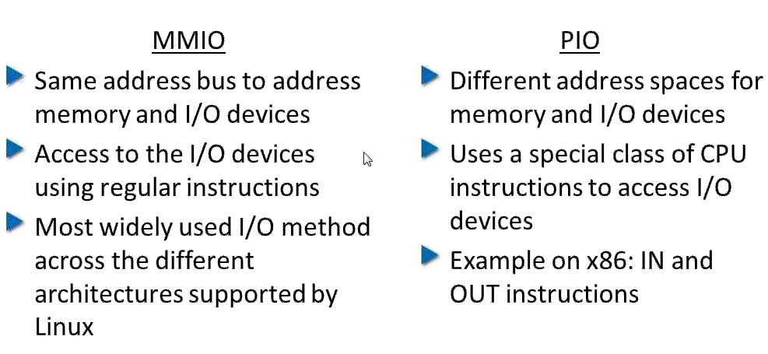
Memory Mapped I/O Vs Port I/O
Cat /proc/ioports --- To display port mapped I/O
Cat /proc/iomem -- To display memory mapped I/O Ports

Slide 3
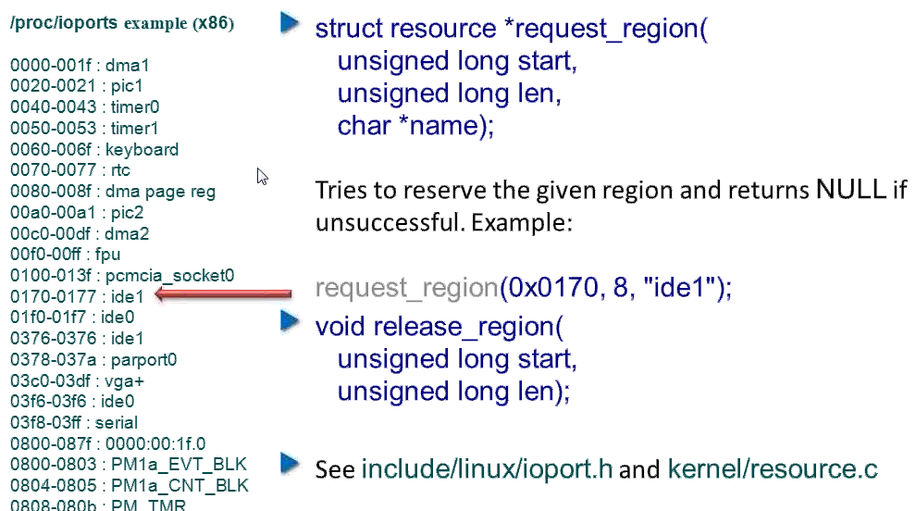
Requesting I/O ports

Slide 4
Application can access port mapped devices in 2 ways
Running as root application using IOPERM system call
Using operation on the special device file /dev/port (Old method)
addr = 0x378;
int result = ioperm(addr,5,1);
unsigned char data;
data = inb(addr);
outb(data,addr);
short data;
data = inw(addr);
outw(data,addr);
long data;
data = inl(addr);
outl(data,addr);

Slide 5
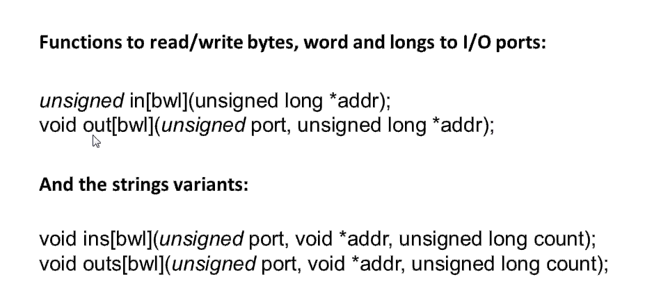
Accessing IO Ports:

Slide 6
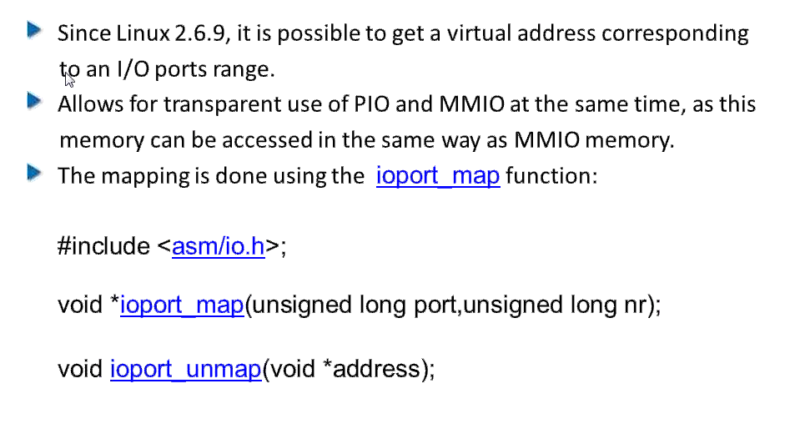
Mapping IO Ports in Virtual Memory

Slide 7
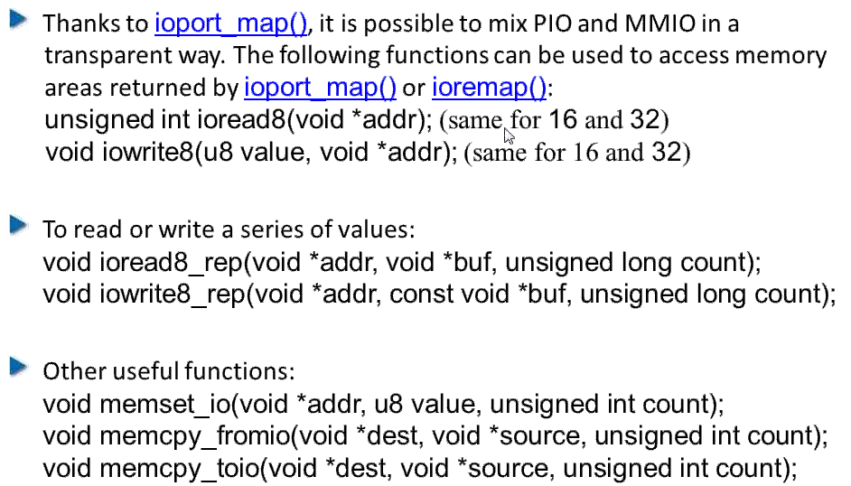
Accessing I/O memory

Slide 8
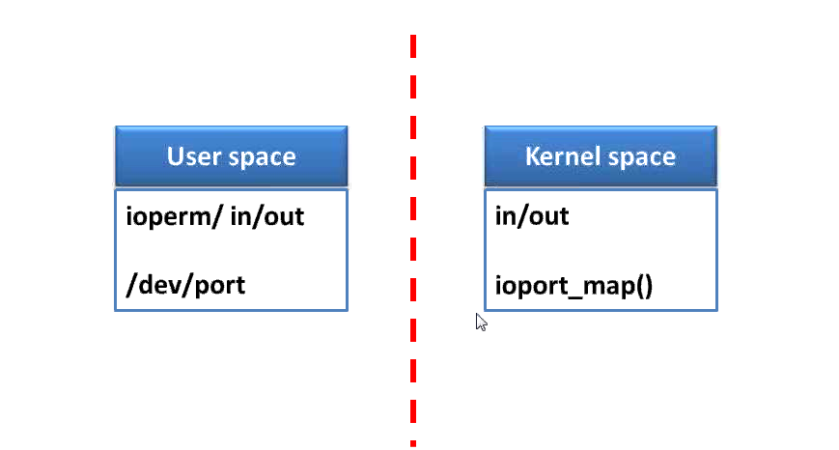
Port Mapped I/O Execution
Go through CMOS driver

Slide 9
Requesting I/O Memory in User Space
/dev/mem Provides access to the computer's physical memory.
void *mmap(void *addr, size_t length, int prot, int flags, int fd, off_t offset); -> man mmap
uint8_t *virt_addr;
fd = open("/dev/mem", O_RDWR);
if (-1 == fd)
{
perror("Mem open failed:");
return -1;
}
virt_addr = (uint8_t *)mmap(NULL, size , PROT_READ | PROT_WRITE, MAP_SHARED, fd, base_addr);
if (NULL == virt_addr)
{
perror("mmap failed:");
return -1;
}
Go to mmap and mmap with /dev/mem examples

Slide 10
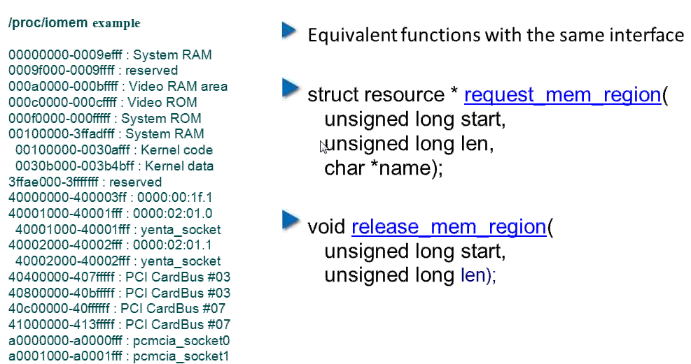
Requesting I/O Memory in Kernel Space

Slide 11
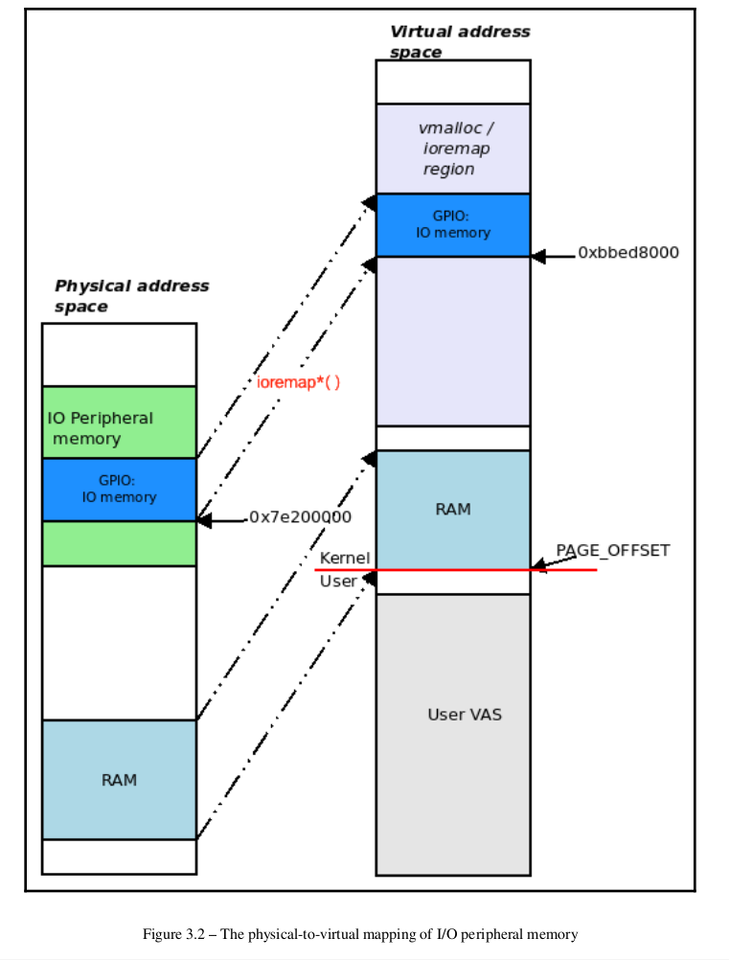

Slide 12
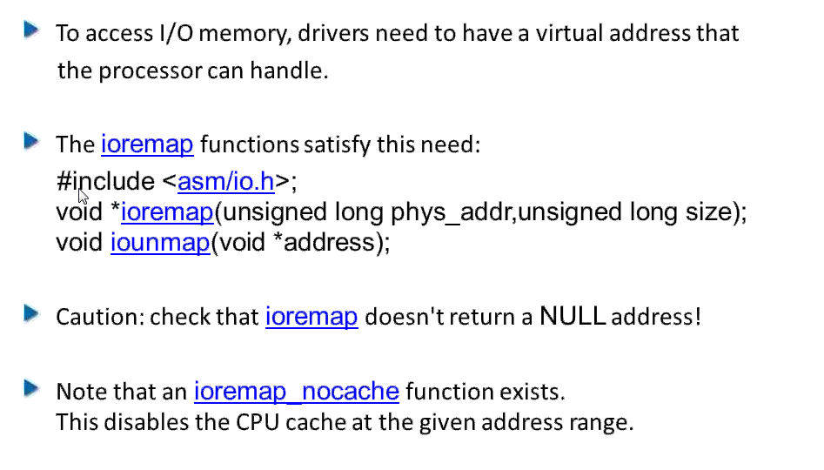
Mapping I/O Memory in Virtual address
devm_ioremap_resource() managed API performs the job of (validity) checking the requested I/O memory region, requesting it from the kernel (internally via
the devm_request_mem_region() API), and remapping it (internally via
devm_ioremap() )

Slide 13
char val;
void __iomem *base = devm_ioremap_resource(dev, r);
[...]
val = ioread8(base+3);
memory barrier. What does it mean?
Sometimes, a program flow becomes unknown to the human programmer as
the microprocessor, the memory controllers, and the compiler can reorder memory reads
and writes. In the majority of cases, these "tricks" remain benign and optimized. But there
are cases – typically across hardware boundaries, such as CPU cores on multicore systems,
CPU to peripheral device, and vice versa on UniProcessor (UP) – where this reordering
should not occur; the original and intended memory load and store sequences must
be honored. The memory barrier (typically machine-level instructions embedded within the
*mb*() macros) is a means to suppress such reordering; it's a way to force both the
CPU/memory controllers and the compiler to order instruction/data in a desired sequence.

Slide 14
Memory barriers can be placed into the code path by using the following
macros: #include <asm/barrier.h> :
rmb() : Inserts a read (or load) memory barrier into the instruction stream
wmb() : Inserts a write (or store) memory barrier into the instruction stream
mb() : A general memory barrier gives a guarantee that all the LOAD and
STORE operations specified before the barrier will appear to happen before all the LOAD and STORE operations specified after the barrier with respect to the other components of the system."
// drivers/net/ethernet/realtek/8139cp.c
[ ... ]
static netdev_tx_t cp_start_xmit([...])
{
[ ... ]
len = skb->len;
mapping = dma_map_single(&cp->pdev->dev, skb->data, len,
PCI_DMA_TODEVICE);
[ ... ]
struct cp_desc *txd;
[ ... ]
txd->opts2 = opts2;
txd->addr = cpu_to_le64(mapping);
wmb();
opts1 |= eor | len | FirstFrag | LastFrag;
txd->opts1 = cpu_to_le32(opts1);
wmb();

Slide 15
Before discussing about the memory mapping mechanism over a device, we will present some of the basic structures used by the Linux memory management subsystem.
Some of the basic structures are: struct page, struct vm_area_struct, struct mm_struct.
struct page is used to embed information about all physical pages in the system. The kernel has a struct page structure for all pages in the system.
There are many functions that interact with this structure:
• virt_to_page() returns the page associated with a virtual address
• pfn_to_page() returns the page associated with a page frame number
• page_to_pfn() return the page frame number associated with a struct page
• page_address() returns the virtual address of a struct page; this functions can be called only for pages from lowmem
• kmap() creates a mapping in kernel for an arbitrary physical page (can be from highmem) and returns a virtual address that can be used to directly reference the page
struct vm_area_struct
struct vm_area_struct holds information about a contiguous virtual memory area. The memory areas of a process can be viewed by inspecting the maps attribute of the process via procfs:
root@qemux86:~# cat /proc/1/maps
#address perms offset device inode pathname
08048000-08050000 r-xp 00000000 fe:00 761 /sbin/init.sysvinit
08050000-08051000 r--p 00007000 fe:00 761 /sbin/init.sysvinit
08051000-08052000 rw-p 00008000 fe:00 761 /sbin/init.sysvinit
092e1000-09302000 rw-p 00000000 00:00 0 [heap]
4480c000-4482e000 r-xp 00000000 fe:00 576 /lib/ld-2.25.so
4482e000-4482f000 r--p 00021000 fe:00 576 /lib/ld-2.25.so
4482f000-44830000 rw-p 00022000 fe:00 576 /lib/ld-2.25.so
44832000-449a9000 r-xp 00000000 fe:00 581 /lib/libc-2.25.so
449a9000-449ab000 r--p 00176000 fe:00 581 /lib/libc-2.25.so
449ab000-449ac000 rw-p 00178000 fe:00 581 /lib/libc-2.25.so
449ac000-449af000 rw-p 00000000 00:00 0
b7761000-b7763000 rw-p 00000000 00:00 0
b7763000-b7766000 r--p 00000000 00:00 0 [vvar]
b7766000-b7767000 r-xp 00000000 00:00 0 [vdso]
bfa15000-bfa36000 rw-p 00000000 00:00 0 [stack]

Slide 16
A memory area is characterized by a start address, a stop address, length, permissions.
A struct vm_area_struct is created at each mmap() call issued from user space. A driver that supports the mmap() operation must complete and initialize the associated struct vm_area_struct. The most important fields of this structure are:
• vm_start, vm_end - the beginning and the end of the memory area, respectively (these fields also appear in /proc/<pid>/maps);
• vm_file - the pointer to the associated file structure (if any);
• vm_pgoff - the offset of the area within the file;
• vm_flags - a set of flags;
vm_ops - a set of working functions for this area
vm_next, vm_prev - the areas of the same process are chained by a list structure

Slide 17
struct mm_struct
struct mm_struct encompasses all memory areas associated with a process. The mm field of struct task_struct is a pointer to the struct mm_struct of the current process.
Device driver memory mapping
Memory mapping is one of the most interesting features of a Unix system. From a driver's point of view, the memory-mapping facility allows direct memory access to a user space device.
To assign a mmap() operation to a driver, the mmap field of the device driver's struct file_operations must be implemented. If that is the case, the user space process can then use the mmap() system call on a file descriptor associated with the device.
The mmap system call takes the following parameters:
void *mmap(caddr_t addr, size_t len, int prot,
int flags, int fd, off_t offset);
To map memory between a device and user space, the user process must open the device and issue the mmap() system call with the resulting file descriptor.
The device driver mmap() operation has the following signature:
int (*mmap)(struct file *filp, struct vm_area_struct *vma);
The filp field is a pointer to a struct file created when the device is opened from user space. The vma field is used to indicate the virtual address space where the memory should be mapped by the device.

Slide 18
A driver should allocate memory (using kmalloc(), vmalloc(), alloc_pages()) and then map it to the user address space as indicated by the vma parameter using helper functions such as remap_pfn_range().
remap_pfn_range() will map a contiguous physical address space into the virtual space represented by vm_area_struct:
int remap_pfn_range (structure vm_area_struct *vma, unsigned long addr,
unsigned long pfn, unsigned long size, pgprot_t prot);
remap_pfn_range() expects the following parameters:
• vma - the virtual memory space in which mapping is made;
• addr - the virtual address space from where remapping begins; page tables for the virtual address space between addr and addr + size will be formed as needed
• pfn - the page frame number to which the virtual address should be mapped
• size - the size (in bytes) of the memory to be mapped
• prot - protection flags for this mapping

Slide 19
To obtain the page frame number of the physical memory we must consider how the memory allocation was performed. For each kmalloc(), vmalloc(), alloc_pages(), we must used a different approach.
For kmalloc() we can use something like:
static char *kmalloc_area;
unsigned long pfn = virt_to_phys((void *)kmalloc_area)>>PAGE_SHIFT;
while for vmalloc():
static char *vmalloc_area;
unsigned long pfn = vmalloc_to_pfn(vmalloc_area);
and finally for alloc_pages():
struct page *page;
unsigned long pfn = page_to_pfn(page);

