Slide 1
I2C Subystem in Linux

Slide 2

I²C (Inter-IC) Bus : Serial protocols: I²C
In consumer electronics, telecommunications and industrial electronics, there are often many similarities between seemingly unrelated designs. For example,
• Some intelligent control, usually a single-chip microcontroller
• General-purpose circuits like LCD and LED drivers, remote I/O ports, RAM, EEPROM, real-time clocks or A/D and D/A converters
• Application-oriented circuits such as digital tuning and signal processing circuits for radio and video systems, temperature sensors, and smart cards
To exploit these similarities to the benefit of both systems designers and equipment manufacturers, as well as to maximize hardware efficiency and circuit simplicity, Philips Semiconductors (now NXP Semiconductors) developed a simple bidirectional 2-wire bus for efficient inter-IC control. This bus is called the Inter IC or I2C-bus
Features:
Only two bus lines are required; a serial data line (SDA) and a serial clock line (SCL).
Each device connected to the bus is software addressable by a unique address and simple master/slave relationships exist at all times; masters can operate as master-transmitters or as master-receivers.
It is a true multi-master bus including collision detection and arbitration to prevent data corruption if two or more masters simultaneously initiate data transfer.
Serial, 8-bit oriented, bidirectional data transfers can be made at up to 100 kbit/s in the Standard-mode, up to 400 kbit/s in the Fast-mode, up to 1 Mbit/s in Fast-mode Plus, or up to 3.4 Mbit/s in the High-speed mode
Serial, 8-bit oriented, unidirectional data transfers up to 5 Mbit/s in Ultra Fast-mode
On-chip filtering rejects spikes on the bus data line to preserve data integrity.
I2C SCL clock frequency

Slide 3
I2C Bus
Structure
SDA
SDA
SDA
SDA
SCL
SCL
SCL
SCL
Start condition
Sending 0
Sending 1
Stop condition
From Servant
From receiver
D
C
ST
ART
A6
A5
A0
R/w
ACK
D8
D7
D0
ACK
ST
OP
Typical read/write cycle
Example of I2C BUS application with I2C Bus controller and I2C Multiplexer with T1042
I2C1
I2C MUX0
EEPROM 0xA4
GPS 0x32
Power Monitor
0
I2C2
RTC 0x40
RTC 0x39
T1042
I2C3
1
I2C MUX0
PS0 0x41
I2C4
2
PS1 0x42
3
PCIe S/W0
PCIe S/W1

Slide 4
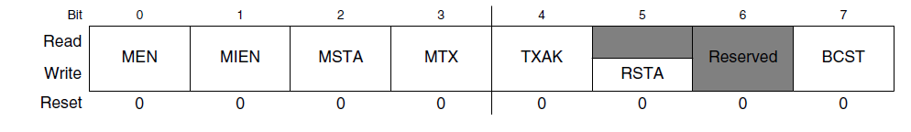
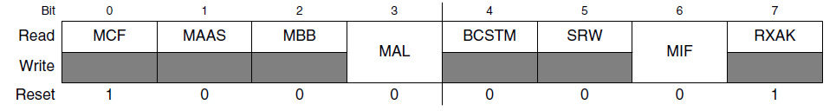
I2C Memory map (Reference taken from Free scale processor T1040)
I2C address register (I2CADR) specifies the address to which the I2C module responds if the I2C is addressed as a slave. This is not the address sent on the bus during the address-calling cycle when the I2C module is in master mode.
I2C frequency divider register (I2CFDR), specifies the ratio used to prescale the clock for selecting a specific bit rate.
I2C control register (I2CCR) contains fields for controlling several actions, modes,
messages, conditions, and capabilities.
MEN – I2C Module enable MIEN - Interrupt reporting from I2C Module enable
MSTA – Master /Slave mode START MTX – Transmit and Receive mode select
TXAK - Transfer Acknowledge RSTA – Repeat start condition is generated
BCST - The I2C is enabled to accept broadcast messages at address 0.
I2C status register (I2CSR) is read-only with the exception of the MIF and MAL fields, which can be cleared by software.
MCF – Data Transfer MAAS – Addressed as a slave MBB – Bus Busy
MAL – Arbitration lost BCSTM – Broad cast match SRW – Slave Read/write
MIF – Module interrupt RXACK – receive acknowledge
I2C data register I2CDR specifies the calling address and data to be transmitted (if the I2C is in master or slave transmit mode) or allows the I2C module to receive the next byte of data on the I2C module (if the I2C is in master or slave receive mode).
I2C digital filter sampling rate register specifies the sample rate for filtering out signal noise.

Slide 5
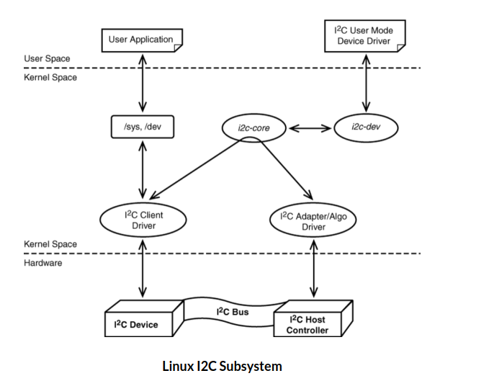
Any I2C client driver needs to be registered on the i2c-core which provides the functionalities for reading or writing on the I2C bus. For communicating the information read through the device, the driver could be implemented as char driver or sysfs could also be used.
I2C device driver registration:
1. Get the I2C adapter
2. Create the oled_I2C_board_info structure and create a device using that
3. Create the I2C_device_id for your slave device and register that
4. Create the I2C_driver structure and add that to the I2C subsystem
Now the driver is ready. So you can trasnfer data between master and slave
5. Once you are done remove the device

Slide 6
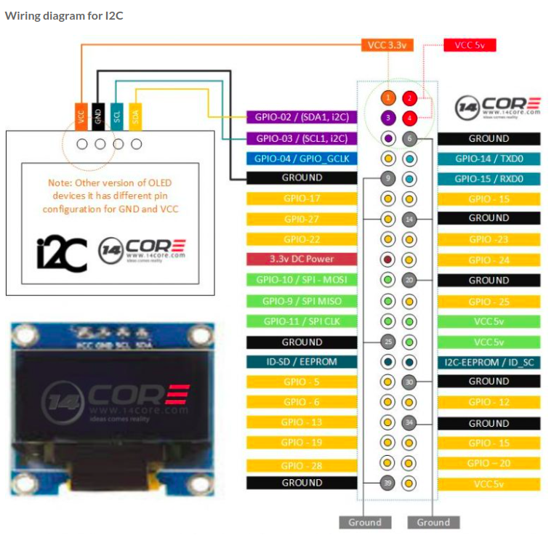

Slide 7
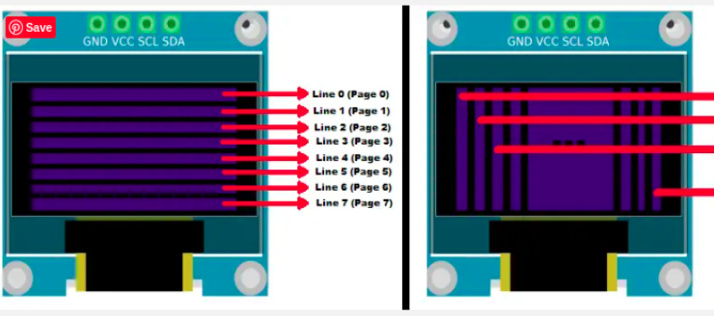
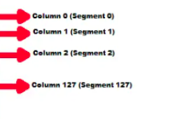
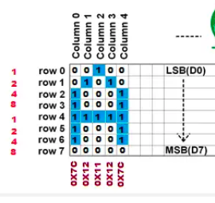
As per our understanding, it has 128 columns and 64 rows. So the size of GDDRAM is 128 x 64 bits and it is divided into eight pages, from PAGE0 to PAGE7,
which are used for monochrome 128—64 dot matrix display as shown in the above figure.
The below Image explains how to write our characters. In that, I have taken Page 0 row 0 to row 7 and column 0 to column 4 to explain how to write our characters.
I am trying to write the character A from row 0 and column 0. In order to write A I need to make the cursor on page 0 and column 0. Then write 0x7C, 0x12, 0x11, 0x12 and 0x7C. Look at the array SSD1306_font in the source code to get the data for almost all characters.

Slide 8
Get the I2C adapter
In raspberry Pi 3/4, the i2c-1 bus is available already. You can check that using the command
ls -al /sys/bus/i2c/devices/ So we will use the below API to get the adapter structure of this I2C bus.
struct i2c_adapter *i2c_get_adapter(int nr);
Where, nr I2C bus number. In our case (Raspberry Pi 4), it should be 1. It returns the struct i2c_adapter.
Create the board info
Once you get the adapter structure, then create the board info and using that board info, create the device.
Create Board info -> Just create the i2c_board_info structure and assign required members of that.
struct i2c_board_info {
char type[I2C_NAME_SIZE];
unsigned short flags;
unsigned short addr;
void * platform_data;
struct dev_archdata * archdata;
struct device_node * of_node;
struct fwnode_handle * fwnode;
int irq;
};
You can use I2C_BOARD_INFO macro to initialize the essential fields of struct i2c_board_info.
I2C_BOARD_INFO ( dev_type, dev_addr);
where,
dev_type identifies the device type
dev_addr the devices address on the bus
Create Device
Now board info structure is ready. Lets instantiate the device from that I2C bus.
struct i2c_client * i2c_new_device ( struct i2c_adapter * adap, struct i2c_board_info const * info);
where,
*adap Adapter structure that we got from i2c_get_adapter()
*info Board info structure that we have created
This will return the i2c_client structure. We can use this client for our future transfers.
If you are using the newer kernel (5.2 =<), then you must use the i2c_new_client_device API instead of i2c_new_device.

Slide 9
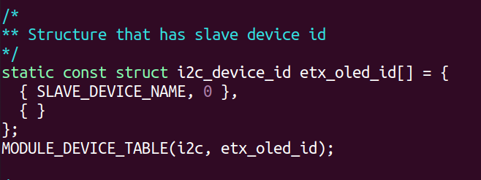
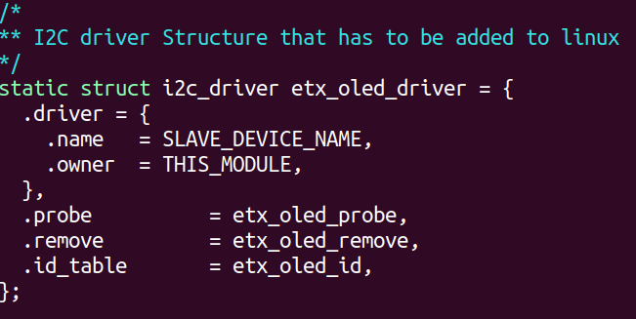
Create the device id
Just create the structure i2c_device_id and initialize the necessary members.
where,
Name Slave name driver_data Data private to the driver (This data will be passed to the respective driver)
After this, call MODULE_DEVICE_TABLE(i2c, my_id_table) in order to expose the driver along with its I2C device table IDs to userspace.
Create the i2c_driver
Now we have the i2c_driver structure. So we can add this structure to the I2C subsystem using the below API.
i2c_add_driver(struct i2c_driver *i2c_drive);
Where, i2c_drive -> The i2c_driver structure that we have created.
During the call to i2c_add_driver to register the I2C driver, all the I2C devices will be traversed. Once matched, the probe function of the driver will be executed.

Slide 10
SPI needs 4 wires at least. But some of the recent day devices support 3-pin mode and 4-pin modes also.
MOSI - Master Out Slave In
MISO - Master In Slave Out
SCLK - Serial Clock
SS/CS/CE Salve Select/Chip Select/Chip Enable
SPI Subsystem in Linux
The SPI device driver in Linux is mainly managed by the SPI subsystem, and it is divided into 3 sections.
-> SPI Core
-> SPI Controller Driver
-> SPI Protocol Driver
SPI Protocol Driver in Linux Kernel
Steps that involve writing the SPI protocol device driver are given below.
1. Get the SPI Controller driver
2. Add the slave device to the SPI Controller
3. Configure the SPI
Now the driver is ready. So you can transfer the data between master and slave.
Once you are done, then remove the device.

Slide 11
struct spi_board_info etx_spi_device_info =
{
.modalias = "etx-spi-ssd1306-driver",
.max_speed_hz = 4000000, // speed your device (slave) can handle
.bus_num = SPI_BUS_NUM, // SPI 1
.chip_select = 0, // Use 0 Chip select (GPIO 18)
.mode = SPI_MODE_0 // SPI mode 0
};
static struct spi_device *etx_spi_device;
etx_spi_device = spi_new_device( master, &etx_spi_device_info );
if( etx_spi_device == NULL )
{
pr_err("FAILED to create slave.\n");
return -ENODEV;
}
struct spi_master *master;
master = spi_busnum_to_master( 1 );
struct spi_board_info {
char modalias[SPI_NAME_SIZE];
const void *platform_data;
const struct property_entry *properties;
void *controller_data;
int irq;
u32 max_speed_hz;
u16 bus_num;
u16 chip_select;
u32 mode;
};
3. Configure the SPI
Till now, we have added the slave device to the controller driver. If we change any mode or clock frequency, then we have to call this below API to take effect on the bus.
int spi_setup(struct spi_device *spi)
4. Message Transfer.
int spi_sync_transfer(struct spi_device *spi, struct spi_transfer *xfers, unsigned int num_xfers)
This API is used to transfer the data asynchronously.This call may be used in_irq and other contexts which cant sleep,
int spi_async(struct spi_device *spi, struct spi_message *message)
where,
Spi - device with which data will be exchanged.
Message - describes the data transfers, including completion callback.
Return
It returns zero on success, or else a negative error code.

Slide 12
