Slide 1
Kernel Debugging

Slide 2
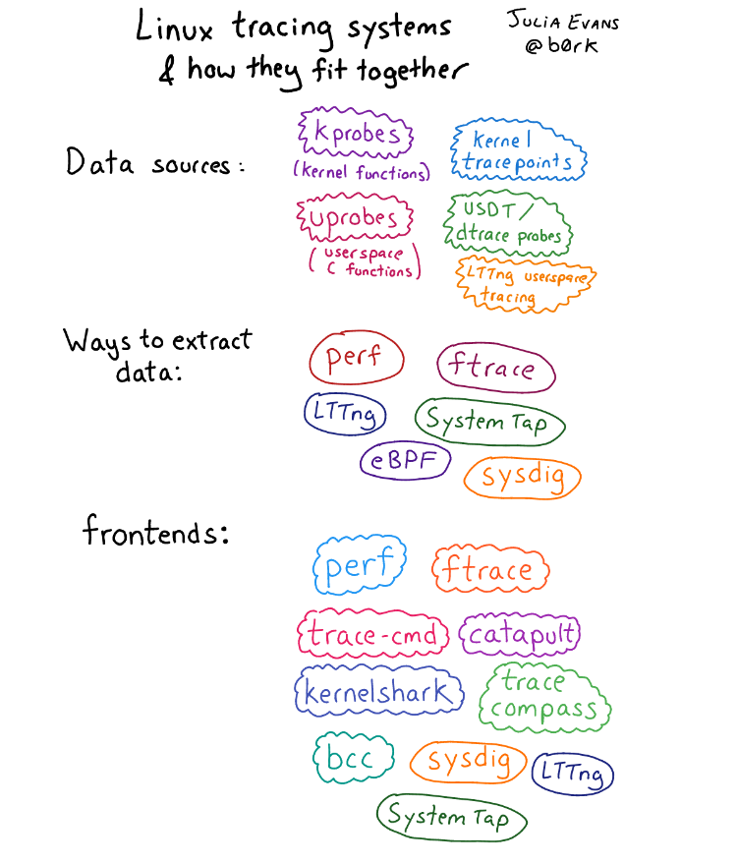
systemtap

Slide 3
kprobe
Kprobes enables you to dynamically break into any kernel routine and collect debugging and performance information non-disruptively. You can trap at almost any kernel code address, specifying a handler routine to be invoked when the breakpoint is hit
When a CPU hits the breakpoint instruction, a trap occurs, the CPU registers are saved, and control passes to Kprobes via the notifiercallchain mechanism. Kprobes executes the pre_handlers associated with the kprobe, passing the handler the addresses of the kprobe struct and the saved registers.
~ So basically it allows you to run 2 functions, prehandler and posthandler, every time the probed function is invoked
root@ip-172-31-3-95:~/lab#strace ls 2>&1 | less
root@ip-172-31-3-95:~/lab# grep sys_execve /proc/kallsyms
ffffffff864543c0 T __x64_sys_execve
ffffffff86454400 T __ia32_sys_execve
ffffffff86454440 T __x64_sys_execveat
ffffffff86454490 T __ia32_sys_execveat
ffffffff864544e0 T __ia32_compat_sys_execve
ffffffff86454520 T __ia32_compat_sys_execveat
Execute program on kprobe

Slide 4
perf
root@rama:/home/rama/linux# perf trace ls
Command 'perf' not found, but can be installed with:
apt install linux-intel-iotg-tools-common # version 5.15.0-1027.32, or
apt install linux-nvidia-tools-common # version 5.15.0-1023.23
apt install linux-tools-common # version 5.15.0-71.78
apt install linux-nvidia-5.19-tools-common # version 5.19.0-1009.9
apt install linux-nvidia-tegra-tools-common # version 5.15.0-1012.12
root@rama-Inspiron-3501:/home/rama# perf trace ls
? ( ): ls/9709 ... [continued]: execve()) = 0
0.053 ( 0.003 ms): ls/9709 brk() = 0x561ac2ca4000
0.063 ( 0.002 ms): ls/9709 arch_prctl(option: 0x3001, arg2: 0x7ffdffc50990) = -1 EINVAL (Invalid argument)
0.093 ( 0.008 ms): ls/9709 access(filename: 0x2add49e0, mode: R) = -1 ENOENT (No such file or directory)
0.108 ( 0.007 ms): ls/9709 openat(dfd: CWD, filename: 0x2add1b80, flags: RDONLY|CLOEXEC) = 3
0.118 ( 0.004 ms): ls/9709 fstat(fd: 3, statbuf: 0x7ffdffc4fb90) = 0
root@rama-Inspiron-3501:/home/rama# perf probe -x /lib/x86_64-linux-gnu/libc-2.31.so --add malloc
Added new events:
probe_libc:malloc (on malloc in /usr/lib/x86_64-linux-gnu/libc-2.31.so)
probe_libc:malloc (on malloc in /usr/lib/x86_64-linux-gnu/libc-2.31.so)
You can now use it in all perf tools, such as:
perf record -e probe_libc:malloc -aR sleep 1
root@rama-Inspiron-3501:/home/rama# perf record -e probe_libc:malloc -aR sleep 1
[ perf record: Woken up 1 times to write data ]
[ perf record: Captured and wrote 1.464 MB perf.data (475 samples) ]
root@rama-Inspiron-3501:/home/rama# perf report -n
root@rama-Inspiron-3501:/home/rama# perf sched record -- sleep 1
root@rama-Inspiron-3501:/home/rama# perf script --header
# for perf_events: CONFIG_PERF_EVENTS=y
# for stack traces: CONFIG_FRAME_POINTER=y
# kernel symbols: CONFIG_KALLSYMS=y
# tracepoints: CONFIG_TRACEPOINTS=y
# kernel function trace: CONFIG_FTRACE=y
# kernel-level dynamic tracing: CONFIG_KPROBES=y
CONFIG_KPROBE_EVENTS=y
# user-level dynamic tracing: CONFIG_UPROBES=y
CONFIG_UPROBE_EVENTS=y
# full kernel debug info: CONFIG_DEBUG_INFO=y
# kernel lock tracing: CONFIG_LOCKDEP=y
# kernel lock tracing: CONFIG_LOCK_STAT=y
# kernel dynamic tracepoint variables: CONFIG_DEBUG_INFO=y

Slide 5
Strave vs Perf
# dd if=/dev/zero of=/dev/null bs=512 count=10000k
5242880000 bytes (5.2 GB) copied, 3.53031 s, 1.5 GB/s
# perf stat -e 'syscalls:sys_enter_*' dd if=/dev/zero of=/dev/null bs=512 count=10000k
5242880000 bytes (5.2 GB) copied, 9.14225 s, 573 MB/s
# strace -c dd if=/dev/zero of=/dev/null bs=512 count=10000k
5242880000 bytes (5.2 GB) copied, 218.915 s, 23.9 MB/s
# perf stat -d gzip file1
#perf stat -d -e L1-dcache-loads,L1-dcache-load-misses,L1-dcache-stores gzip test.cpp
# Listing all currently known events:
perf list
# Listing sched tracepoints:
perf list 'sched:*'
# CPU counter statistics for the specified command:
perf stat command
# Detailed CPU counter statistics (includes extras) for the specified command:
perf stat -d command
# CPU counter statistics for the specified PID, until Ctrl-C:
perf stat -p PID
# CPU counter statistics for the entire system, for 5 seconds:
perf stat -a sleep 5
Execute program on perf_event systemcall

Slide 6
# Count system calls by type for the entire system, for 5 seconds:
perf stat -e 'syscalls:sys_enter_*' -a sleep 5
# Count scheduler events for the specified PID, until Ctrl-C:
perf stat -e 'sched:*' -p PID
# Count scheduler events for the specified PID, for 10 seconds:
perf stat -e 'sched:*' -p PID sleep 10
# Count ext4 events for the entire system, for 10 seconds:
perf stat -e 'ext4:*' -a sleep 10
# Count block device I/O events for the entire system, for 10 seconds:
perf stat -e 'block:*' -a sleep 10
# Count all vmscan events, printing a report every second:
perf stat -e 'vmscan:*' -a -I 1000
perf record -e block:block_rq_issue -ag
l^C
# ls -l perf.data
# perf report
# Add a tracepoint for the kernel tcp_sendmsg() function entry ("--add" is optional):
perf probe --add tcp_sendmsg
# Remove the tcp_sendmsg() tracepoint (or use "--del"):
perf probe -d tcp_sendmsg
#userspace function add to probe
gcc -g -o evenodd evenodd.c
#perf probe -x evenodd -a even
Added new event:
probe_evenodd:even (on even in /home/rama/Downloads/Corporate_trainings/HP_training/user_space/5-Debug/gdb_pc/evenodd)
You can now use it in all perf tools, such as:
perf record -e probe_evenodd:even -ag
perf report perf.data

Slide 7
addr2line
#gcc -g symbols.c
#nm a.out
#addr2line -e a.out 0x00000000000011a0

