Slide 1
Kernel Core Dump

Slide 2
Kernel Crash dump
A ‘kernel crash dump’ refers to a portion of the contents of volatile memory (RAM) that is copied to disk whenever the execution of the kernel is disrupted. The following events can cause a kernel disruption:
Kernel panic
Non-maskable interrupts (NMI)
Machine check exceptions (MCE)
Hardware failure
Manual intervention
For some of these events (kernel panic, NMI) the kernel will react automatically and trigger the crash dump mechanism through kexec. In other situations a manual intervention is required in order to capture the memory. Whenever one of the above events occurs, it is important to find out the root cause in order to prevent it from happening again. The cause can be determined by inspecting the copied memory contents.

Slide 3
When a kernel panic occurs, the kernel relies on the “Kexec” mechanism to quickly reboot a new instance of the kernel in a pre-reserved section of memory that had been allocated when the system booted. This permits the existing memory area to remain untouched in order to safely copy its contents to storage.
sudo apt install linux-crashdump (Kernel crash dump enabled by default)
kdump-config show
crashkernel=512M-2G:64M,2G-:128M
This would mean:
1) if the RAM is smaller than 512M, then don't reserve anything
(this is the "rescue" case)
2) if the RAM size is between 512M and 2G (exclusive), then reserve 64M
3) if the RAM size is larger than 2G, then reserve 128M
Boot the system kernel with the boot parameter "crashkernel=Y@X",
where Y specifies how much memory to reserve for the dump-capture kernel
and X specifies the beginning of this reserved memory. For example,
"crashkernel=64M@16M" tells the system kernel to reserve 64 MB of memory
starting at physical address 0x01000000 (16MB) for the dump-capture kernel.

Slide 4
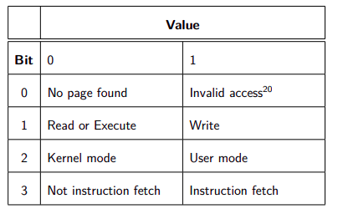
Kernel Panic
If a hard lockup is detected and "NMI watchdog" is configured, the system will boot into the dump-capture kernel (die_nmi() ).
If die() is called, and it happens to be a thread with pid 0 or 1, or die() is called inside interrupt context or die() is called and panic_on_oops is set, the system will boot into the dump-capture kernel.
sudo sysctl -w kernel.sysrq=1
For testing purposes, you can trigger a crash by using "ALT-SysRq-c",
"echo c > /proc/sysrq-trigger" or write a module to force the panic.
echo 1 > /proc/sys/kernel/sysrq
Write Out the Dump File
=======================
After the dump-capture kernel is booted, write out the dump file with
the following command:
cp /proc/vmcore <dump-file>
cat /proc/sys/kernel/tainted
CONFIG_KEXEC=y
MEMORY: 128MB
PANIC: "Oops: 0002"
PID:1696
COMMAND:"insmod"
CONFIG_PROC_VMCORE=y
CONFIG_CRASH_DUMP=y
0002 (dec) → 0010 (binary) → Not instruction fetch |
Kernel mode | Write |
CONFIG_DEBUG_INFO=y
Crash commands bt – backtrace, log, ps, exit
-> Execute Kernel Crash Program

Slide 5
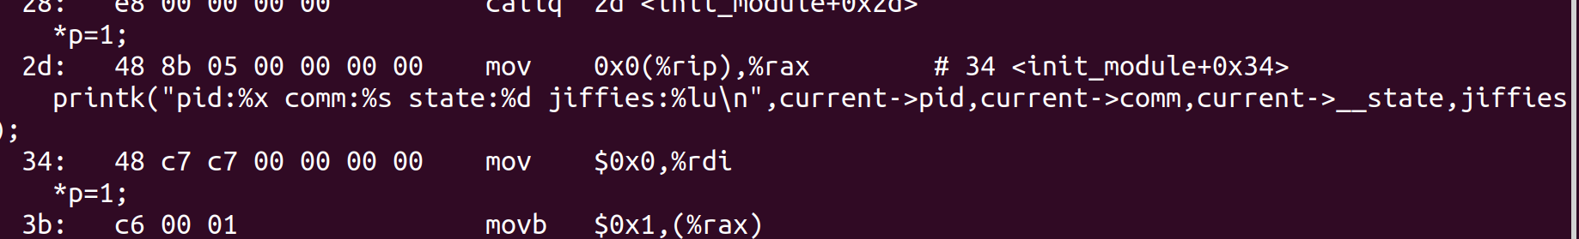
0010:khello_init+0x3b/0x1000 [khello]
[57308.205667] BUG: kernel NULL pointer dereference, address: 0000000000000000
[57308.205670] #PF: supervisor write access in kernel mode
[57308.205673] #PF: error_code(0x0002) - not-present page
[57308.205676] PGD 0 P4D 0
[57308.205681] Oops: 0002 [#1] SMP NOPTI
objdump -d -S null-pointer.ko

