Slide 1
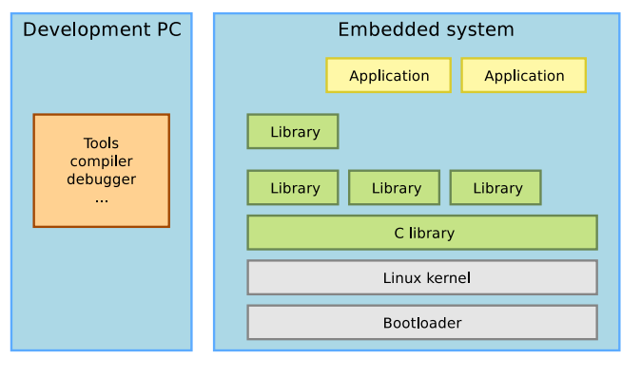
Embedded software development process
Embedded Linux System Architecture:
When doing embedded development, there is always a split between
The host, the development workstation, which is typically a powerful PC
The target, which is the embedded system under development
They are connected by various means: almost always a serial line for debugging purposes, frequently an Ethernet connection, sometimes a JTAG interface for low-level debugging

Slide 2
Introduction to Embedded Linux
Birth of free software:
1983, Richard Stallman, GNU project and the free software concept. Beginning of the development of gcc, gdb, glibc and other important tools
1991, Linus Torvalds, Linux kernel project, a Unix-like operating system kernel. Together with GNU software and many other open-source components: a completely free operating system, GNU/Linux
1995, Linux is more and more popular on server systems
2000, Linux is more and more popular on embedded systems
2008, Linux is more and more popular on mobile devices
2010, Linux is more and more popular on phones
Embedded Linux is the usage of the Linux kernel and various open-source components in embedded systems

Slide 3
Embedded Linux Hardware
Many Hardware Options Available
x86
ARM
IBM/Motorola Power PC
MIPS
Hitachi Super H
Motorola 68000

Slide 4
Embedded Linux Hardware
x86
Introduced by Intel in 1985
Large amounts of documentation available
Most widely used and tested on Linux platforms
Many applications developed on the x86 for the purpose of porting to other hardware.

Slide 5
Embedded Linux Hardware
ARM (Advanced RISC Machine)
No particular manufacturer, maintained by ARM Holdings Ltd.
ARM Holdings designs CPU cores and the ARM instruction set
Customers find their own manufacturer which allows for greater customization
Linux supports ten different ARM CPUs on sixteen different platforms, along with two hundred related boards.

Slide 6
Embedded Linux Hardware
Busses and Interfaces
PCI
PCMCIA
Parallel Port
SCSI
USB
FireWire
Serial Port
Linux also supports a wide variety IO devices
Printers
Mice
Sound
Storage
Display Devices
The Linux kernel has support for many common communication buses
I2C, SPI, CAN, 1-wire, SDIO, USB and also extensive networking support Ethernet, Wi, Bluetooth, CAN, etc

Slide 7
ARM introduction
ARM is a family of instruction set architectures for computer processors based on a reduced instruction set computing (RISC) architecture developed by British company ARM Holdings.
A RISC-based computer design approach means ARM processors require significantly fewer transistors than typical processors in average computers. This approach reduces costs, heat and power use. These are desirable traits for light, portable, battery-powered devices—including smartphones, laptops, tablet and notepad computers), and other embedded systems.
A simpler design facilitates more efficient multi-core CPUs and higher core counts at lower cost, providing higher processing power and improved energy efficiency for servers and supercomputers.
ARM Holdings develops the instruction set and architecture for ARM-based products, but does not manufacture products. The company periodically releases updates to its cores. Current cores from ARM Holdings support a 32-bit address space and 32-bit arithmetic; the recently introduced ARMv8-A architecture adds support for a 64-bit address space and 64-bit arithmetic
A architecture adds support for a 64-bit address space and 64-bit arithmetic.
ARM Holdings licenses the chip designs and the ARM instruction set architectures to third-parties, who design their own products that implement one of those architectures—including systems-on-chips (SoC) that incorporate memory, interfaces, radios, etc.
Apple first implemented the ARMv8-A architecture in the Apple A7 chip in the iPhone 5S.

Slide 8
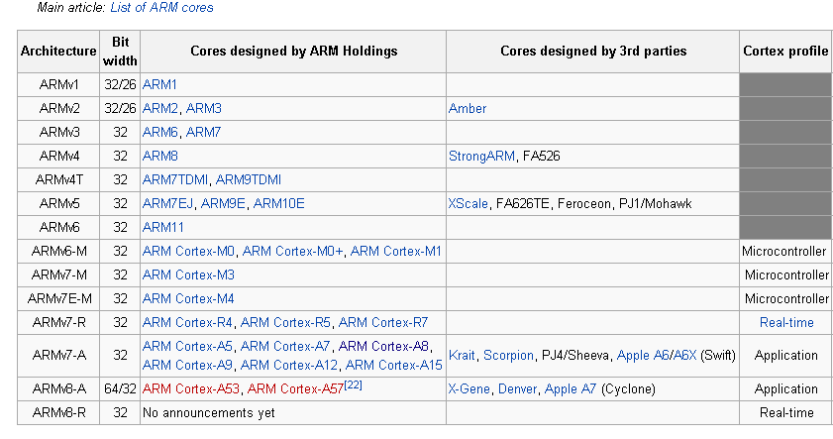
List of applications of ARM cores

Slide 9
ARM embedded boards
Beagle Board & Raspberry PI

Slide 10
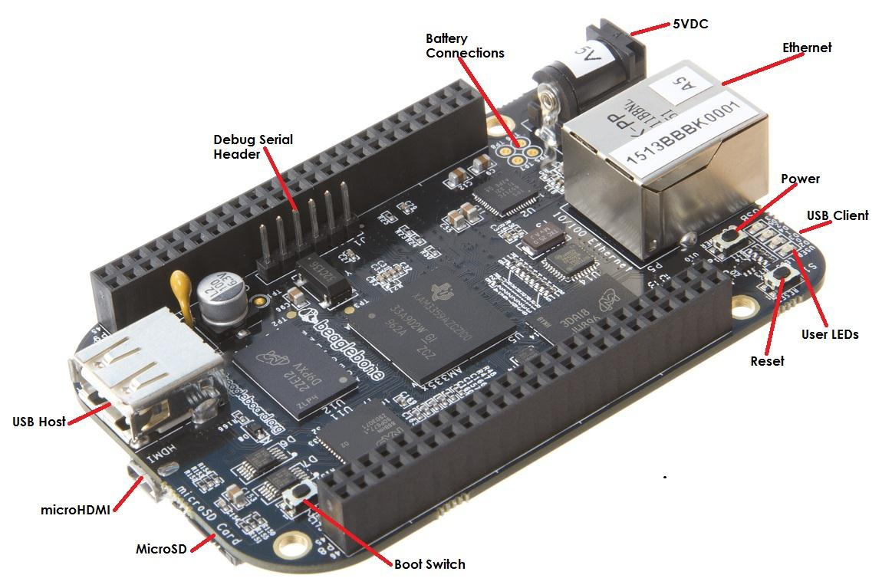
Parts of Beagle Board

Slide 11
Hardware Components
DC Power is the main DC input that accepts 5V power.
Power Button alerts the processor to initiate the power down sequence.
10/100 Ethernet is the connection to the LAN.
Serial Debug is the serial debug port.
USB Client is a miniUSB connection to a PC that can also power the board.
BOOT switch can be used to force a boot from the microSD card if the power is cycled on the board, removing power and reapplying the power to the board..

Slide 12
Hardware Components
There are four blue LEDS that can be used by the user.
Reset Button allows the user to reset the processor.
microSD slot is where a microSD card can be installed.
microHDMI connector is where the display is connected to.
USB Host can be connected different USB interfaces such as Wi-Fi, BT, Keyboard, etc.

Slide 13
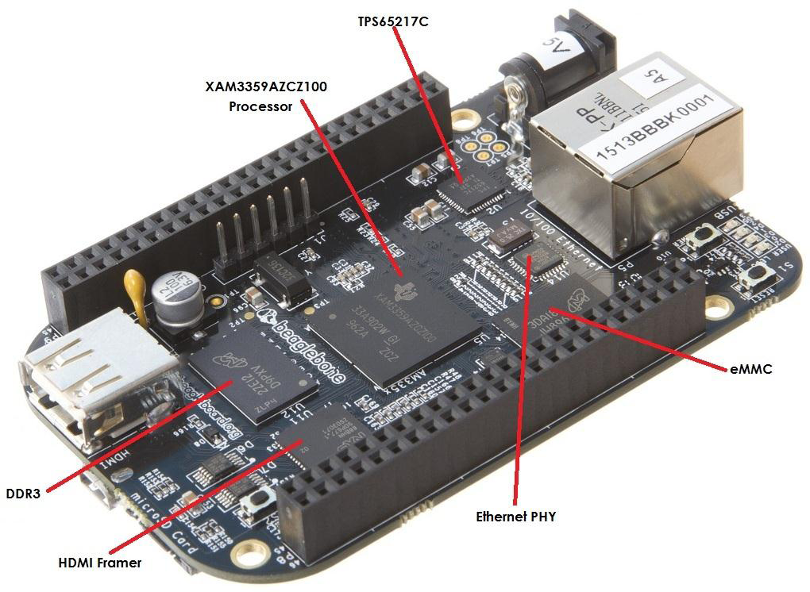
Key Components

Slide 14
Key Components
Sitara AM3359AZCZ100 is the processor for the board.
Micron 512MB DDR3L is the Dual Data Rate RAM memory.
TPS65217C PMIC provides the power rails to the various components on the board.
SMSC Ethernet PHY is the physical interface to the network.
Micron eMMC is an onboard MMC chip that holds up to 2GB of data.
HDMI Framer provides control for an HDMI or DVI-D display with an adapter.

Slide 15
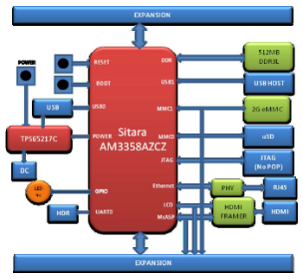
BeagleBone Black block diagram

Slide 16
• BeagleBoard.org designs have a common philosophy:
• Bring your own peripherals
• Entry level cost
• ARM Cortex-A8 (superscalar)
• Graphics (and possibly DSP) accelerated
• Linux and open source community
• Environment for innovators

Slide 17
Processor Features
Operating Systems : Linux, Android, Windows Embedded CE
Standby Power : 7mW
ARM CPU : 1 ARM Cortex-A8
ARM MHz(Max) : 275,500,600,800
ARM MIPS : 1000,1200,2000
On-Chip L1 Cache : 64KB
On-Chip L2 Cache : 256KB
General Purpose Memory : 1 16-bit (GPMC,NAND flash, NOR flash)
USB : 2
MMC/SD : 3
CAN : 2
UART (SCI) : 6
ADC : 8-ch 12-bit
PWM(ch) : 3
DMA(ch) : 64- Ch EDMA

Slide 18
Boot Modes
• eMMC Boot…This is the default boot mode and will allow for the fastest boot
time and will enable the board to boot out of the box without having to purchase
an SD card or an SD card writer.
• SD Boot…This mode will boot from the uSD slot. This mode can be used to
override what is on the eMMC device and can be used to program the eMMC
when used in the manufacturing process or for filed updates.
• Serial Boot…This mode will use the serial port to allow downloading of the
software direct. A separate serial cable is required to use this port.
• USB Boot…This mode supports booting over the USB port.

Slide 19
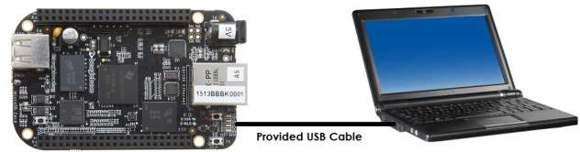
Connecting Up Your BeagleBone
Tethered to a PC and

Slide 20
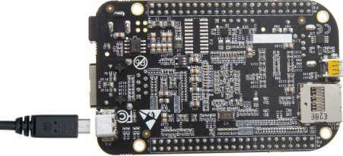
Connect the Cable to the Board
1. Connect the small connector on the USB cable to the board as shown in Figure
The connector is on the bottom side of the board.

Slide 21
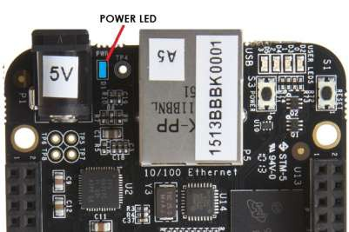
2. Connect the large connector of the USB
cable to your PC or laptop USB port.
3. The board will power on and the power LED
will be on as shown in Figure below.
Notes:
<number>

Slide 22
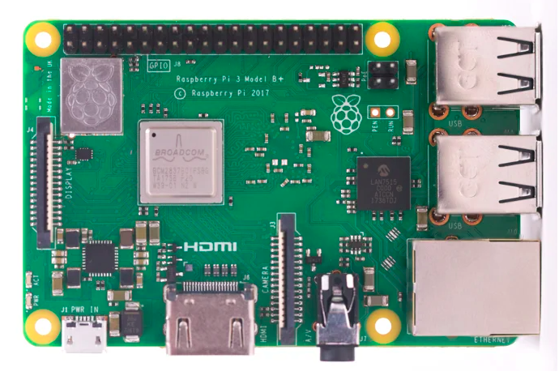
What is a Raspberry Pi?
Raspberry Pi is the name of a series of single-board computers made by theÂ Raspberry Pi Foundation, a UK charity that aims to educate people in computing and
create easier access to computing education.
The Raspberry Pi launched in 2012, and there have been several iterations and variations released since then. The original Pi had a single-core 700MHz CPU and just 256MB RAM, and the latest model has a quad-core CPU clocking in at over 1.5GHz, and 4GB RAM. The price point for Raspberry Pi has always been under $100 (usually around $35 USD), most notably the Pi Zero, which costs just $5.
Pi 1 Model B (2012)
Pi 1 Model A (2013)
Pi 1 Model B+ (2014)
Pi 1 Model A+ (2014)
Pi 2 Model B (2015)
Pi Zero (2015)
Pi 3 Model B (2016)
Pi Zero W (2017)
Pi 3 Model B+ (2018)
Pi 3 Model A+ (2019)
Pi 4 Model A (2019)
Pi 4 Model B (2020)
Pi 400 (2021)
https://www.youtube.com/watch?v=LSJys4vCfJE&t=305s

Slide 23
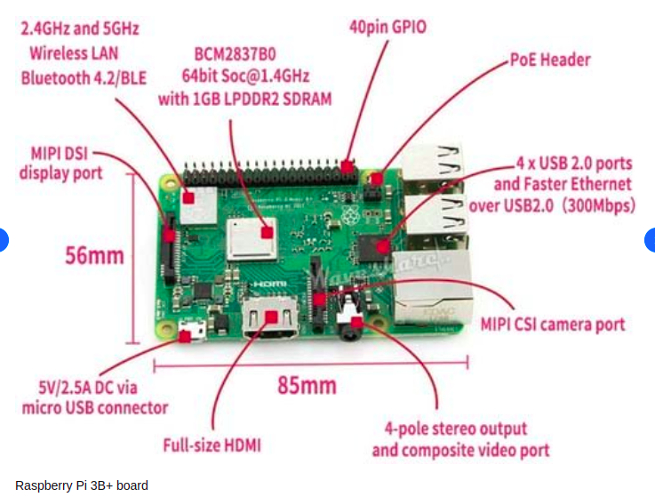

Slide 24
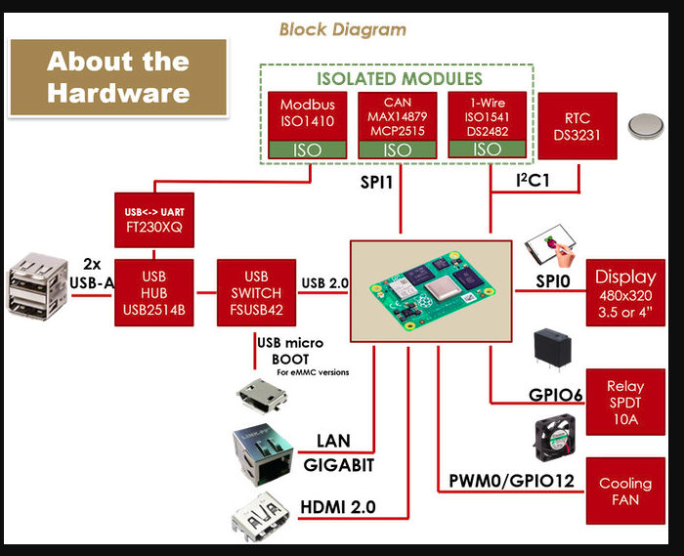

Slide 25
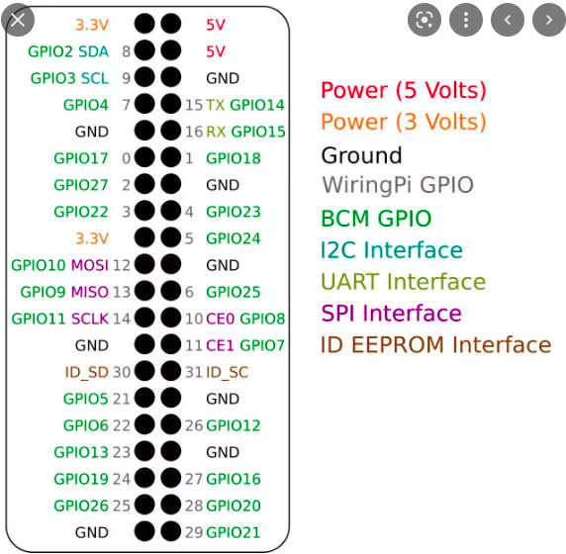

Slide 26
Development Tools and Environments
Cross-compilation tool chain
Compiler that runs on the development machine, but generates code
for the target
Boot loader
Started by the hardware, responsible for basic initialization, loading and executing the kernel
Linux Kernel
Contains the process and memory management, network stack,
device drivers and provides services to user space applications
C library
The interface between the kernel and the user space applications
Libraries and applications
Third-party or in-house

Slide 27
Cross compilation Tool chain:
To build tool chain from scratch
http://www.ifp.illinois.edu/~nakazato/tips/xgcc.html
On Ubuntu:
sudo apt-get update sudo apt-get install crossbuild-essential-armhf
To compile program:
arm-linux-gnueabihf-gcc file_name.c -o output
=> Execute simple programs on BBB/RB Pi
The gcc C compiler enables the embedding of assembly instructions in otherwise normal C functions.
Inline Assembly:
Gcc support this: The asm() compiler directive is used to inline assembly code. For example, this inline assembly directive executes the x86 processor’s rdtsc instruction, which returns the value of the timestamp (tsc) register:
unsigned int low, high;
asm volatile("rdtsc" : "=a" (low), "=d" (high));
/* low and high now contain the lower and upper 32-bits of the 64-bit tsc */

Slide 28
UEFI vs legacy BIOS
When you build your own PC, you need to configure some settings in the motherboard's BIOS (Basic Input/Output System) before installing an operating system. The BIOS is a firmware that controls the hardware components and boot process of your PC.
UEFI (Unified Extensible Firmware Interface) is a newer standard that replaces the legacy BIOS. UEFI offers more features and benefits, such as faster boot times, better security, larger disk support, and graphical user interface. Legacy BIOS is the old mode that uses a 16-bit code and a limited number of options. Some older hardware and software may not be compatible with UEFI, so legacy BIOS is still available as a fallback option
Boot Loaders:
The boot loader is a piece of code responsible for
Basic hardware initialization
Loading of an application binary, usually an operating system kernel, from flash storage, from the network, or from another type of non-volatile storage.
Possibly decompression of the application binary and execution of the application
It provides a way to upgrade the firmware without requiring access to internal storage. Used to upgrade firmware on devices,fix bugs, add new features or update security patches
In the event the OS becomes corrupted or fails to start, the boot loader can be used to recover the device
In some embedded systems, the boot loader can be used to operating system to boot, download new firmware from remote server and recover the device in case of disaster.

Slide 29
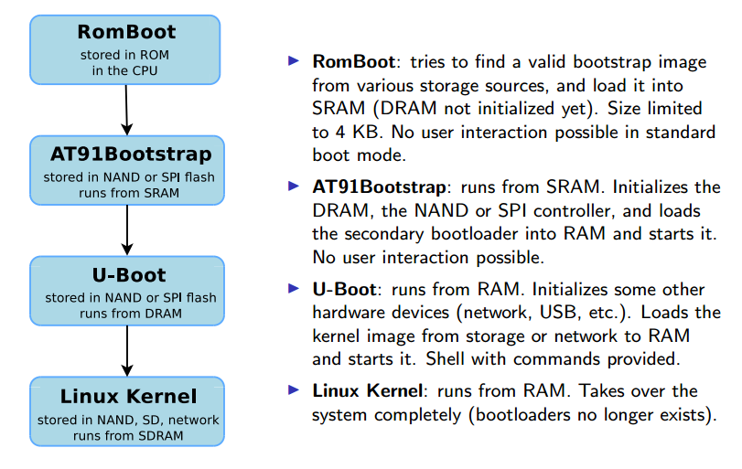
Booting on ARM Atmel AT91 Processor

Slide 30
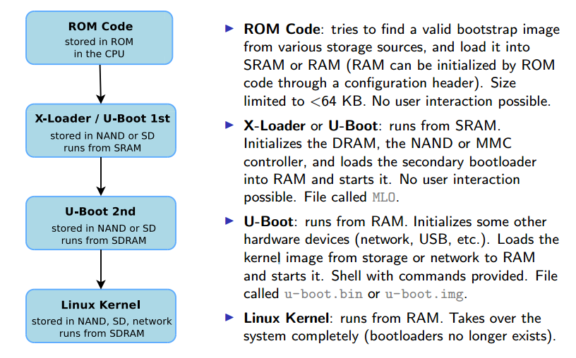
Booting on ARM TI OMAP Processor
Boot Beagle board/RP Stop
at Uboot prompt

Slide 31
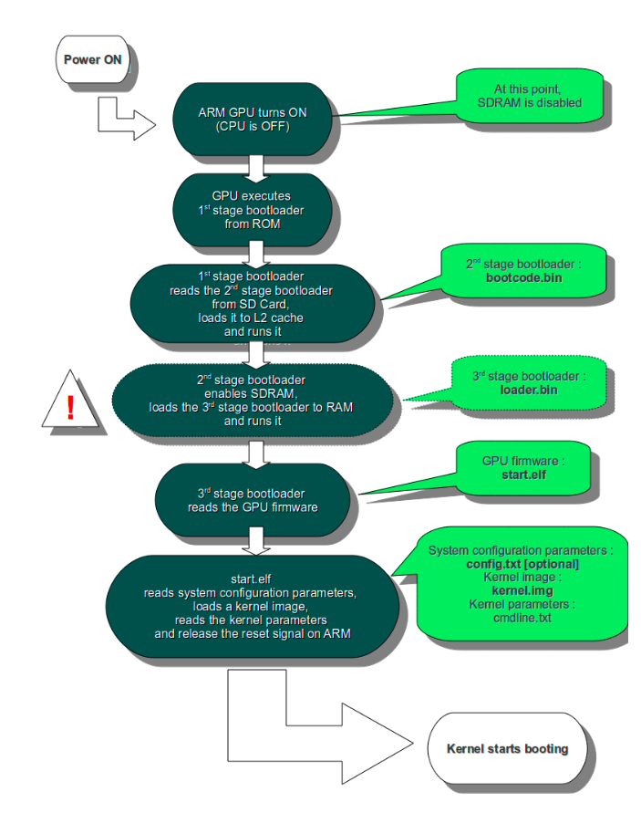
Raspberry PI boot process
Stage 1 boot is in the on-chip ROM. Loads Stage 2 in the L2 cache
Stage 2 is bootcode.bin. Enables SDRAM and loads Stage 3
Stage 3 is loader.bin. It knows about the .elf format and loads start.elf
start.elf loads kernel.img. It then also reads config.txt, cmdline.txt and bcm2835.dtb If the dtb file exists, it is loaded at 0x100 & kernel @0x8000. If disable_commandline_tags is set it loads kernel @0x0 Otherwise it loads kernel @0x8000 and put ATAGS at 0x100
kernel.img is then run on the ARM.

Slide 32
Uboot Commands:
Help, ping, printenv, setenv, ping, md, mm, reginfo…
TFTP transfer process:
Network transfer from the development workstation and U-Boot on the target takes place through TFTP
Trivial File Transfer Protocol
Somewhat similar to FTP, but without authentication and over UDP
A TFTP server is needed on the development workstation
sudo apt-get install tftpd-hpa
All files in /var/lib/tftpboot are then visible through TFTP
A TFTP client is available in the tftp-hpa package, for testing
A TFTP client is integrated into U-Boot
Configure the ipaddr and serverip environment variables
Use tftp <address> <filename> to load file
-> Go through U-boot source code files (Refer Doc)
-> Go through U-boot compilation for Freescale with Yocoto Environment
(Log into remote machine)

Slide 33
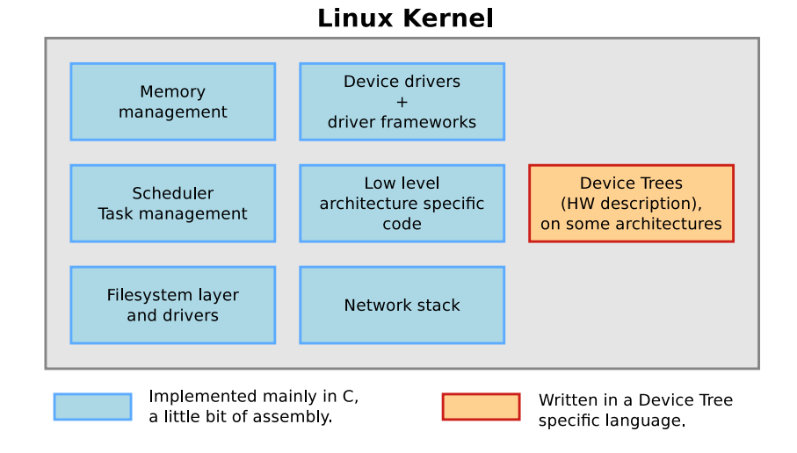
Cross-compiling Linux Kernel

Slide 34
Cross Compiling Kernel:
Define ARCH and CROSS_COMPILE as environment variables:
export ARCH=arm
export CROSS_COMPILE=arm-linux-guneabi-
(Expecting your Development machine contains arm cross compiler
sudo apt-get install gcc-arm-linux-gnueabi)
2. Now ﬁnd out the path and name of the cross-compiler executable by looking at the contents of the package:
dpkg -L gcc-arm-linux-gnueabi
3. Default configuration files available, per board or per-CPU family
They are stored in arch/<arch>/configs/, and are just minimal .config This is the most common way of configuring a kernel for embedded platforms
To load a default configuration , just run
make acme_defconfig I This will overwrite your existing .config To create your own default configuration make savedefconfig, to create a minimal configuration file
mv defconfig arch/<arch>/configs/myown_defconfig
-> make menuconfig
-> make
Copy the final kernel image to the target storage it can be
uImage, zImage, vmlinux, bzImage in arch/<arch>/boot
Copying the Device Tree Blob might be necessary as well, they are available in arch/<arch>/boot/dts

Slide 35
Device Tree:
Many embedded architectures have a lot of non-discoverable hardware.
Depending on the architecture, such hardware is either described using C code directly within the kernel, or using a special hardware description language in a Device Tree.
ARM, PowerPC, OpenRISC, ARC, Microblaze are examples of architectures using the Device Tree.
IA Device Tree Source, written by kernel developers, is compiled into a binary Device Tree Blob, passed at boot time to the kernel.
There is one different Device Tree for each board/platform supported by the kernel, available in arch/arm/boot/dts/<board>.dtb.
The boot loader must load both the kernel image and the Device Tree Blob in memory before starting the kernel
Run make Copy the final kernel image to the target storage
can be uImage, zImage, vmlinux, bzImage in arch/<arch>/boot
copying the Device Tree Blob might be necessary as well, they are available in
arch/<arch>/boot/dts
The typical boot process is therefore:
1. Load uImage at address X in memory
2. Load <board>.dtb at address Y in memory
3. Start the kernel with bootm X - Y

Slide 36
The outline steps are as fallows (bootm command)
1. Check the kernel image is in Legacy format, then check Magic, CRC,…
2. Check if the image type if Multi image,
If it is multi image then extract all information based on number of components in multi image. Based on standard multi image header, it will fill the fallowing fields in image structure with the structure variable name bootm_headers_t images;
3. It invokes int do_bootm_linux(int flag, int argc, char * const argv[], bootm_headers_t *images)
4 .static void boot_jump_linux(bootm_headers_t *images)
5 . (*kernel) (kbd, initrd_start, initrd_end, cmd_start, cmd_end, 0, 0);
Multi Component Image:
mkimage -A powerpc -O Linux -T multi -a 0x0000000 -e 0x000000 -n 'Multi image' -d zimage.bin.gz:fsl-image-core-p5040ds-20131215171719.rootfs.ext2.gz:uImage-p5040ds.dtb Multigrain1

Slide 37
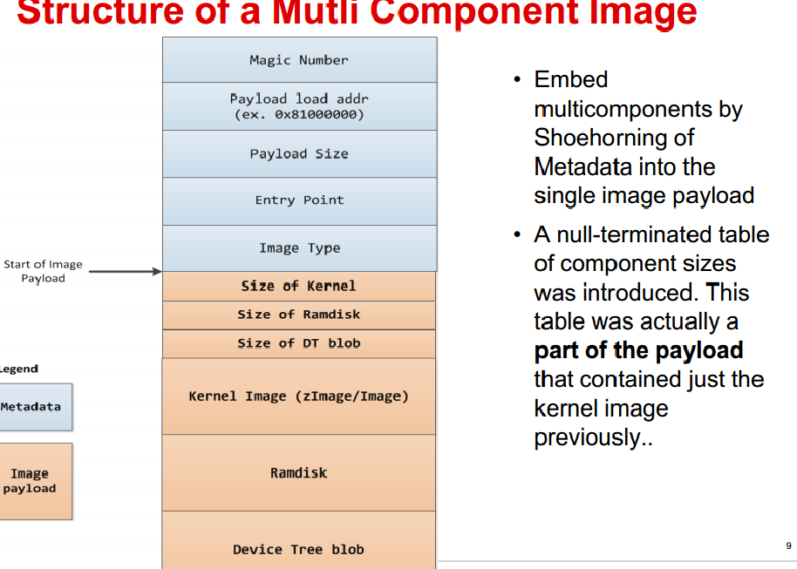

Slide 38
typedef struct image_header {
uint32_t ih_magic; /* Image Header Magic Number */
uint32_t ih_hcrc; /* Image Header CRC Checksum */
uint32_t ih_time; /* Image Creation Timestamp */
uint32_t ih_size; /* Image Data Size */
uint32_t ih_load; /* Data Load Address */
uint32_t ih_ep; /* Entry Point Address */
uint32_t ih_dcrc; /* Image Data CRC Checksum */
uint8_t ih_os; /* Operating System */
uint8_t ih_arch; /* CPU architecture */
uint8_t ih_type; /* Image Type */
uint8_t ih_comp; /* Compression Type */
uint8_t ih_name[IH_NMLEN]; /* Image Name */
} image_header_t;
typedef struct image_info {
ulong start, end; /* start/end of blob */
ulong image_start, image_len; /* start of image within blob, len of image */
ulong load; /* load addr for the image */
uint8_t comp, type, os; /* compression, type of image, os type */
} image_info_t;

Slide 39
/*
* Legacy and FIT format headers used by do_bootm() and do_bootm_<os>()
* routines.
*/
typedef struct bootm_headers {
/*
* Legacy os image header, if it is a multi component image
* then boot_get_ramdisk() and get_fdt() will attempt to get
* data from second and third component accordingly.
*/
image_header_t *legacy_hdr_os; /* image header pointer */
image_header_t legacy_hdr_os_copy; /* header copy */
ulong legacy_hdr_valid;
#if defined(CONFIG_FIT)
const char *fit_uname_cfg; /* configuration node unit name */
void *fit_hdr_os; /* os FIT image header */
const char *fit_uname_os; /* os subimage node unit name */
int fit_noffset_os; /* os subimage node offset */
void *fit_hdr_rd; /* init ramdisk FIT image header */
const char *fit_uname_rd; /* init ramdisk subimage node unit name */
int fit_noffset_rd; /* init ramdisk subimage node offset */
void *fit_hdr_fdt; /* FDT blob FIT image header */
const char *fit_uname_fdt; /* FDT blob subimage node unit name */
int fit_noffset_fdt;/* FDT blob subimage node offset */
#endif
#ifndef USE_HOSTCC
image_info_t os; /* os image info */
ulong ep; /* entry point of OS */
ulong rd_start, rd_end;/* ramdisk start/end */
#ifdef CONFIG_OF_LIBFDT
char *ft_addr; /* flat dev tree address */
#endif
ulong ft_len; /* length of flat device tree */
ulong initrd_start;
ulong initrd_end;
ulong cmdline_start;
ulong cmdline_end;
bd_t *kbd;
#endif
} bootm_headers_t;

