Slide 1
Mechanism vs Policy
Another principle that helps architectural coherence, along with keeping things small and well structured, is that of separating mechanism from policy. By putting the mechanism in the operating system and leaving the policy to user processes, the system itself can be left unmodified, even if there is a need to change policy.
Loadble modules
One of the good features of Linux is the ability to extend at runtime the set of features offered by the kernel. This means that you can add functionality to the kernel (and remove functionality as well) while the system is up and running. Each piece of code that can be added to the kernel at runtime is called a module. The Linux kernel offers support for quite a few different types (or classes) of modules, including, but not limited to, device drivers. Each module is made up of object code (not linked into a complete executable) that can be dynamically linked to the running kernel by the insmod program and can be unlinked by the rmmod program.
kernel module :
Modules are pieces of code that can be loaded and unloaded into the kernel upon demand. They extend the functionality of the kernel without the need to reboot the system.
Example: Any Linux Device driver
allowing modules to be loaded into the kernel. The mechanism concerns how they are inserted, how they are linked, what calls they can make, and what calls can be made on them. The policy is determining who is allowed to load a module into the kernel and which modules. Maybe only the superuser can load modules, but maybe any user can load a module that has been digitally signed by the appropriate authority.
Notes:
<number>

Slide 2
Definition
Device drivers provide interface between operating system and hardware itself.
Device drivers take on a special role in the Linux kernel. They are distinct “black boxes” that make a particular piece of hardware respond to a well-defined internal programming interface; they hide completely the details of how the device works.
When writing drivers, a programmer should pay particular attention to this fundamental concept: write kernel code to access the hardware, but don’t force particular policies on the user, since different users have different needs. The driver should deal with making the hardware available, leaving all the issues about how to use the hardware to the applications. A driver, then, is flexible if it offers access to the hardware capabilities without adding constraints
Notes:
<number>

Slide 3
Module Vs Application
A piece of kernel code outside of the kernel source tree, often referred to as "out-of-tree" code, keeping it independent from thekernel in a limited sense, and then insert it into or plug it into kernel memory, have it run and perform its job, and then remove it (or unplug it) from kernel memory.
=> Application starts with main() function and when main() function returns the application terminates. In kernel module, there will not be any main() function. However in the module there will be one function, which is identified as module initialization function. When the module is loaded into the kernel, this initialization function will run. When this initialization function returns, nothing special will happen. Our module continues to reside in the kernel.
→ For applications to run in unprivileged user mode.
→ For the kernel (and all its components) to run in privileged mode – kernel mode
=> All the standard C library functions are available to the application. But kernel module is not linked to C library or any user space libraries, so it cannot call standard library functions. It can call only kernel functions, which are present, in side the kernel.

Slide 4
=> When we build an application, it will get compiled and linked to libraries so that executable file will be generated. But when we build kernel module, it only will get compiled, it will not get linked to kernel functions, as kernel is not available as a library. When we load this module, into the kernel, at the load time this module will get dynamically linked to kernel functions. The loader will find the addresses of the kernel functions, and these addresses placed in the module code. If kernel module is calling a function, which is not present in the kernel, then the loading of module will fail. All user mode Linux applications (executables) are "auto-linked" into one important, always-used library: glibc
=> No Memory Protection When a user-space application attempts an illegal memory access, the kernel can trap the error, send the SIGSEGV signal, and kill the process. If the kernel attempts an illegal memory access, however, the results are less controlled. Memory violations in the kernel result in an oops, which is a major kernel error. It should go without saying that you must not illegally access memory, such as dereferencing a NULL pointer—but within the kernel, the stakes are much higher! Additionally, kernel memory is not pageable. Therefore, every byte of memory you consume is one less byte of available physical memory

Slide 5
=>Floating point operations: Unlike user-space, the kernel does not have the luxury of seamless support for floating point because it cannot easily trap itself. Using a floating point inside the kernel requires manually saving and restoring the floating point registers, among other possible chores. The short answer is: Don’t do it! Except in the rare cases, no floating-point operations are in the kernel
=>Stack:
User-space can get away with statically allocating many variables on the stack, including huge structures and thousand-element arrays. This behavior is legal because user-space has a large stack that can dynamically grow. The kernel stack is neither large nor dynamic; it is small and fixed in size. The exact size of the kernel’s stack varies by architecture. On x86, the stack size is configurable at compile-time and can be either 4KB or 8KB. Historically, the kernel stack is two pages, which generally implies that it is 8KB on 32-bit architectures and 16KB on 64-bit architectures—this size is fixed and absolute.

Slide 6
Kernel space components
Core kernel: This code handles the typical core work of any modern operating system, including (user and kernel) process and thread creation/destruction, CPU scheduling, synchronization primitives, signaling, timers, interrupt handling, namespaces, cgroups, module support, crypto, and more.
Memory Management (MM): This handles all memory-related work, including the setup and maintenance of kernel and process Virtual Address Spaces (VASes).
VFS (for filesystem support): The Virtual Filesystem Switch (VFS) is an abstraction layer over the actual filesystems implemented within the Linux kernel (for example, ext[2|4] , vfat , reiserfs , ntfs , msdos , iso9660 , JFFS2, and UFS).
Block IO: The code paths implementing the actual file I/O, from the VFS right down to the block device driver and everything in between (really, quite a lot!), is encompassed here.
Network protocol stack: Linux is well known for its precise, to-the-letter-of-the-RFC, high-quality implementation of the well-known (and not-so-well-known) network protocols at all layers of the model, with TCP/IP being perhaps the most famous.
Inter-Process Communication (IPC) support: The implementation of IPC mechanisms is done here; Linux supports message queues, shared memory, semaphores (both the older SysV and the newer POSIX ones), and other IPC mechanisms.
Sound support: All the code that implements audio is here, from the firmware to drivers and codecs.
Virtualization support: Linux has become extremely popular with large and small cloud providers alike, a big reason being its high-quality, low-footprint virtualization engine, Kernel-based Virtual Machine (KVM).

Slide 7
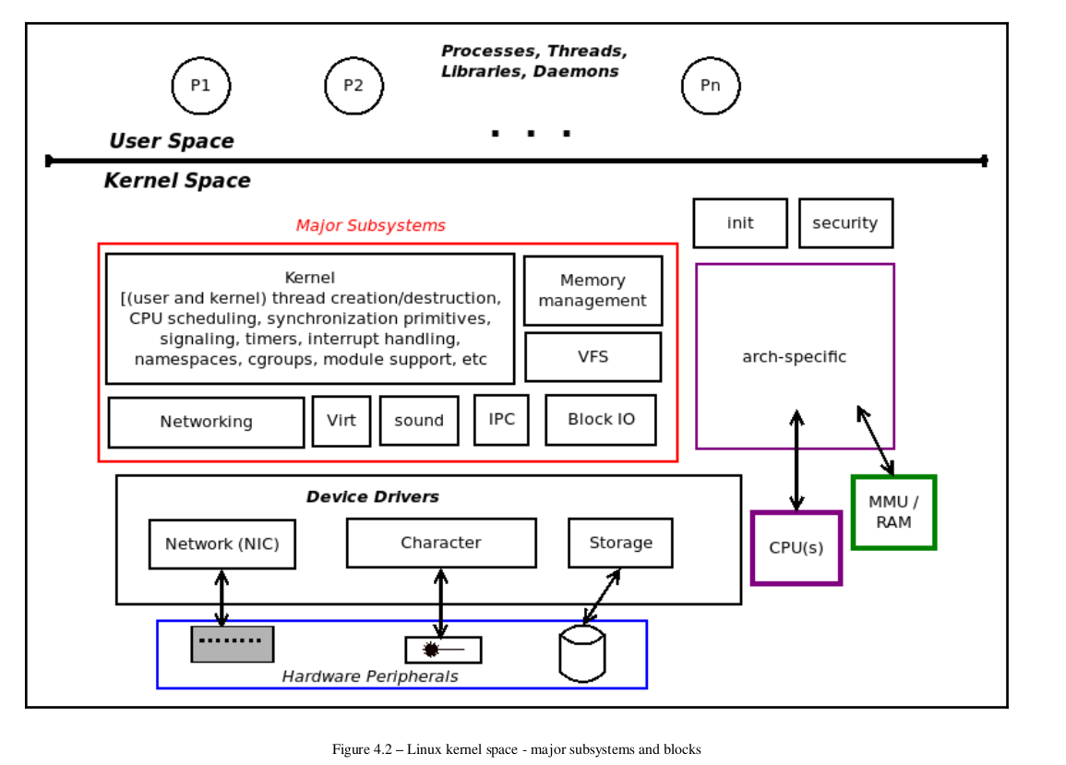

Slide 8
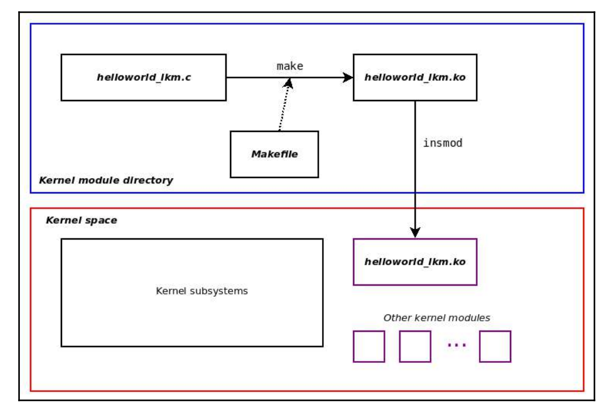

Slide 9
Module utilities:
insmod
This command is used to insert the module into kernel. While inserting a module, it is also
possible to pass options to the module. The function sys_init_module allocates kernel
memory to hold a module; it then copies the module text into that memory
region, resolves kernel references in the module via the kernel symbol table, and
calls the module’s initialization function to get everything going
lsmod
This command is to list all the modules that are loaded into the kernel.
rmmod
This command is used to remove (i.e. unload) a module from the kernel.
modprobe
This command is also to insert a module, like insmod command. But it additionally checks, if this module needs any other module, and loads those modules first and finally loads this module. It finds the dependent modules (modules needed by this module) by looking into the file 'modules.dep'. This file is generated by a utility program 'depmod'. It will be invoked during make install
systool -m khello -v

Slide 10
modinfo
This command is used to display the module information from the module file
Kernel modules must have at least two functions: a "init" (initialization) function,
Init: which is called when the module is insmoded into the kernel, and an
"exit" (cleanup) function, which is called just before it is rmmoded.
The init function is indicated by using ‘module_init’ macro and exit function with ‘module_exit’.
Execute Basic Module program:
Another way to gain useful information on the system, including information on kernel modules that are currently loaded up, is via the systool utility.
systool -m xhci_hcd -v
lsmod | head
journalctl -k |tail -n2
journalctl -k -b -1
cross-compiling our kernel module
make ARCH=arm CROSS_COMPILE=arm-linux-gnueabihf-

Slide 11
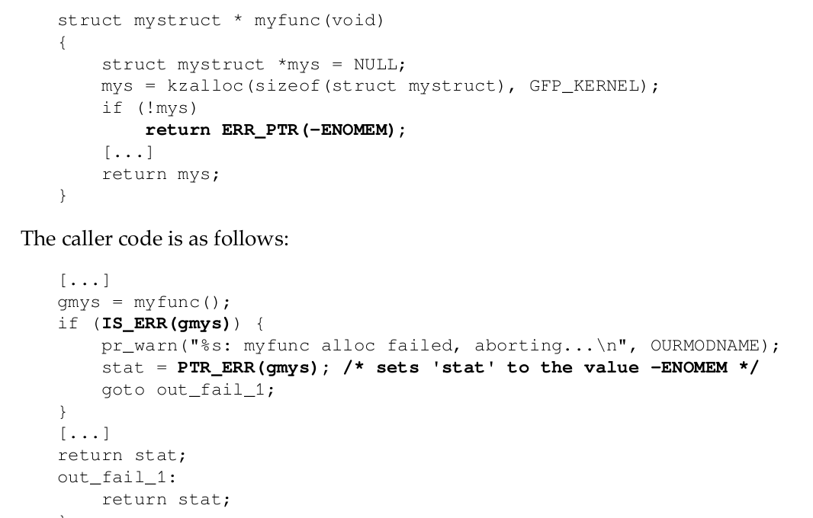
the kernel module's init routine must return an integer. What if you wish to return a pointer instead?
The ERR_PTR() inline function comes to our rescue, allowing us to return a pointer disguised as an integer simply by typecasting it as void *

Slide 12
The __init macro causes the init function to be discarded and its memory freed once the init function finishes. it is a hint to the kernel that the given function is used only at initialization time. The module loader drops the initialization function after the module is loaded, making its memory available for other uses. There is a similar tag (__initdata)for data used only during initialization. Use of __init and __initdata is optional, but it is worth the trouble. Just be sure not to use them for any function (or data structure)you will be using after initialization completes. The whole
point here is the code and data in the init function is used exactly once during initialization. Once it's invoked, it will never be called again; so, once called, it is then freed up (via free_initmem() ).
The __exit macro causes the omission of the function
Question:
Is built in module contains _exit macro?
Printk: If you don't specify a priority level, the default priority, DEFAULT_MESSAGE_LOGLEVEL, will be used
/include/linux/kern_levels.h
If both syslogd and klogd are running, then the message will also get appended to /var/log/messages, whether it got printed to the console or not. We use a high priority, like KERN_ALERT, to make sure the printk() messages get printed to your console rather than just logged to your logfile. Debian uses /var/log/syslog

Slide 13
Discuss Module Makefile:
# cat /var/log/messages
# dmesg
# dmesg | tail
Another way to change the console log level is to use dmesg with the -n parameter: dmesg -n 7
For example, -n 1 or -n emerg prevents all messages, except emergency (panic) messages, from appearing on the
Console.
echo ‘8 4 1 7’ > /proc/sys/kernel/printk
sysctl -w kernel.printk=’8 4 1 7’
root@rama: # cat /proc/sys/kernel/printk
4 4 1 7
We interpret the preceding four numbers as printk log levels (with 0 being the
highest and 7 the lowest in terms of "urgency"). The preceding four-integer
sequence's meaning is this:
The current (console) log level
- The implication being that all messages less than this value will appear on
the console device!
The default level for messages that lack an explicit log level
The minimum allowed log level
The boot-time default log level
sudo bash -c "echo Y > /sys/module/printk/parameters/ignore_loglevel"
cat /proc/sys/kernel/printk_ratelimit
/proc/sys/kernel/printk_ratelimit_burst
5
10
This implies that by default, up to 10 instances of the same message occurring within
a 5-second time interval can make it through before rate limiting kicks in. For example, think of a large-ish printk in an interrupt handler code path. What if the hardware interrupt is invoked at a frequency of, say, 100 Hz, that is, 100 times every single second!

Slide 14
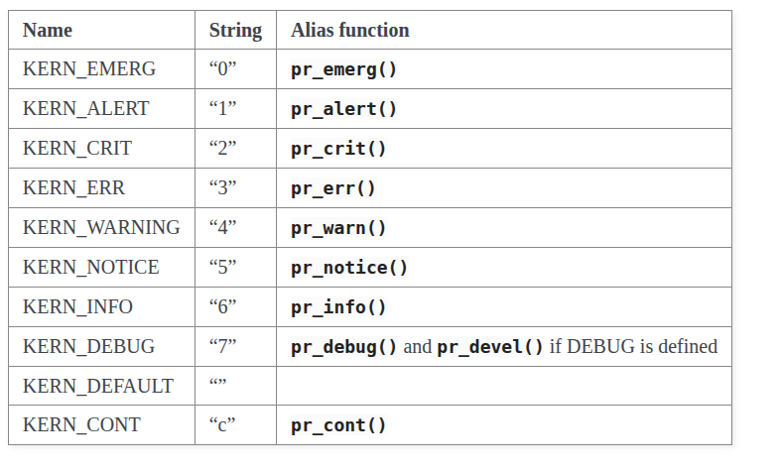
The location of the log file varies with the distro: conventionally, the Red Hat based ones write into the /var/log/messages file and the Debian-based ones into /var/log/syslog . Traditionally, the kernel printk would hook into the user space system logger daemon ( syslogd ) to perform file logging, thus automatically getting the benefit of more sophisticated features, such as log rotation, compression, and archival
systemd is now routinely used on even embedded Linux
devices. Within the systemd framework, logging is performed by a daemon process
called systemd-journal , and the journalctl(1) utility is the user interface to it.
$ journalctl -k |tail -n2
Show all kernel logs from previous boot:
journalctl -k -b -1
Show a live log display from a system service apache.service:
journalctl -f -u apache

Slide 15
CONFIG_DYNAMIC_DEBUG is a Linux kernel configuration option that enables dynamic debug support. When compiled into the kernel, it allows you to enable or disable specific pr_debug() and dev_dbg() messages at runtime, without needing to recompile or reboot the kernel.
# head -n10 /proc/dynamic_debug/control
# filename:lineno [module]function flags format
init/main.c:1142 [main]initcall_blacklist =p "blacklisting initcall %s\n"
init/main.c:1175 [main]initcall_blacklisted =p "initcall %s blacklisted\n"
init/main.c:1370 [main]run_init_process =p " with arguments:\n"
init/main.c:1372 [main]run_init_process =p " %s\n"
init/main.c:1373 [main]run_init_process =p " with environment:\n"
init/main.c:1375 [main]run_init_process =p " %s\n"
Enable all debug prints in a module:
echo 'module mydriver +p' > /sys/kernel/debug/dynamic_debug/control
Disable them:
echo 'module mydriver -p' > /sys/kernel/debug/dynamic_debug/control
Show current settings:
cat /sys/kernel/debug/dynamic_debug/control
Enable debug only for a specific function:
echo 'func my_function +p' > /sys/kernel/debug/dynamic_debug/control
%pK is a special printk format specifier in the Linux kernel for printing kernel pointers securely. If the process does not have CAP_SYSLOG (or dmesg_restrict=0 allows it), %pK will print: 00000000
If you try to print it with %lx or %llx, you risk truncation or warnings. %pa ensures the kernel prints the value correctly, regardless of platform.
%pI4 → print IPv4
%pI6 → print IPv6
Use %pIS if you want address + port in one shot.

Slide 16
Error Handling:
If you ever fail to unregister what you obtained, the kernel is left in an unstable state; it contains internal pointers to code that no longer exists. In such situations, the only recourse, usually, is to reboot the system
Error recovery is sometimes best handled with the goto statement. We normally hate
to use goto, but in our opinion, this is one situation where it is useful
Int __init my_init_function(void)
{
int err;
/* registration takes a pointer and a name */
err = register_this(ptr1, "skull");
if (err) goto fail_this;
err = register_that(ptr2, "skull");
if (err)
goto fail_that;
err = register_those(ptr3, "skull");
if (err) goto fail_those;
return 0; /* success */
fail_those: unregister_that(ptr2, "skull");
fail_that: unregister_this(ptr1, "skull");
fail_this: return err; /* propagate the error */
}
you should include <linux/errno.h> in order to use symbolic values such as -ENODEV, -ENOMEM, and so on. It is always good practice to return appropriate error codes, because user programs can turn them to meaningful strings using perror or similar means

Slide 17
Module Parameters
Modules can take command line arguments, but not with the argc/argv you might be used to. To allow arguments to be passed to your module, use the module_param() macro, (defined in linux/moduleparam.h)
module_param() macro takes 3 arguments:
The name of the variable
Type
The supported variable types are charp (character pointer) short, int, long, ushort, uint, and ulong.
Permissions mask (for the associated sysfs entry for this parameter).
The kernel, has a very small stack; it can be as small as a single, 4096-byte page. Your functions must share that stack with the entire kernel-space call chain. Thus, it is never a good idea to declare large automatic variables; if you need larger structures, you should allocate them dynamically at call time.
int myival = 3;
char *mysval = “Hello World”;
module_param(myival, int, S_IRUGO );
module_param(mysval, charp, S_IRUGO | S_IWUSR);
int myshortArray[4];
int size;
module_param_array (myshortArray, int, &size, S_IRUGO);
MODULE_PARM_DESC(), that is used to document arguments that the module can take.
Executer Programs on Module parameters & sys/module/*khello*/parameter

Slide 18
Modules Spanning Multiple Files
obj-m += startstop.o
startstop-objs := start.o stop.o
all:
make -C /usr/src/linux-headers-2.6.32.6 SUBDIRS=`pwd` modules
Execute Program on Multiple files
Module stacking and exporting symbols
Functions in one module can call functions of other modules
EXPORT_SYMBOL (myexportfun);
EXPORT_SYMBOL_GPL (myexportfun);
EXPORT_SYMBOL(request_threaded_irq);
Exports come in two flavors: vanilla (EXPORT_SYMBOL) and GPL-only (EXPORT_SYMBOL_GPL). The former are available to any kernel module, while the latter cannot be used by any modules which do not carry a GPL-compatible license
Execute Program on Module stacking
Name Space Pollution:
When writing kernel code, even the smallest module will be linked against the entire kernel, so this is definitely an issue. The best way to deal with this is to declare all your variables as static.
/proc/kallsyms (Kernel symbol table)

Slide 19
.
/etc/modules-load.d/modules.conf -> kernel modules load at boot time
sudo echo "test_script: msg 1" >/dev/kmsg
pr_warning("%s:%s():%d: kmalloc failed!\n", OURMODNAME,__func__,
__LINE__);

Slide 20

Adding a new module (hello) to the Build process
1. Make a directory - drivers/hello
Create or Copy file - Kconfig, Makefile, hello.c hello.c - A simple kernel module
Kconfig - Add following statements #
# Hello module configuration
menu "Hello Module support"
config HELLO
tristate "Include Hello module?"
help
Linux Kernel Module demonstration - Hello
endmenu
Makefile - Add foloowing statement obj-$(CONFIG_HELLO) += hello/

Slide 21
Adding a new module (hello) to the Build process…
2. Add the following statement before endmenu statement: source "drivers/hello/Kconfig"
And add the following statement at the end of file in Makefile: obj-$(CONFIG_HELLO) += hello.o
3. Config, Build and Deploy the kernel. make xconfig
Look at the menu item displayed under drivers. Select and save the configuration and exit. Look for CONFIG_HELLO in .config file.

