Slide 1
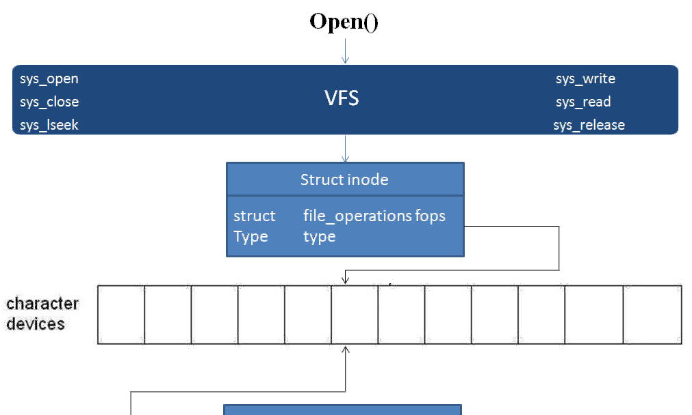

Slide 2
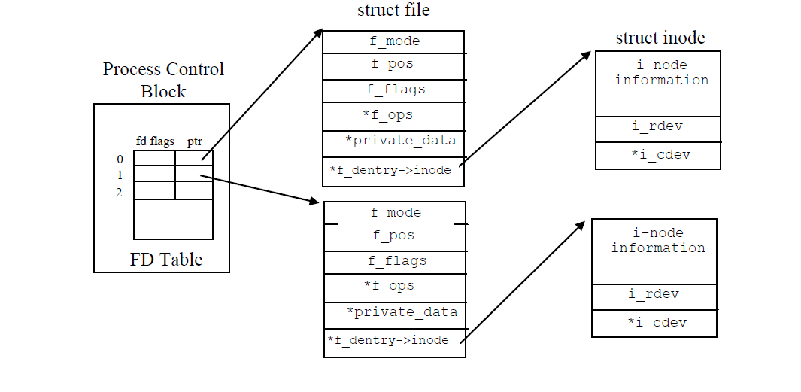

Slide 3
Within the kernel, the dev_t type (defined in <linux/types.h>) is used to hold device numbers—both the major and minor parts. As of Version 2.6.0 of the kernel, dev_t is a 32-bit quantity with 12 bits set aside for the major number and 20 for the minor number. Your code should, of course, never make any assumptions about the internal organization of device numbers; it should, instead, make use of a set of macros
found in <linux/kdev_t.h>. To obtain the major or minor parts of a dev_t, use:
MAJOR(dev_t dev);
MINOR(dev_t dev);
If, instead, you have the major and minor numbers and need to turn them into a dev_t,
use:
MKDEV(int major, int minor);
LANA (Linux assigned names and number authority)
https://www.kernel.org/doc/Documentation/admin-guide/devices.txt
if (scull_major) {
dev = MKDEV(scull_major, scull_minor);
result = register_chrdev_region(dev, scull_nr_devs, "scull");
} else {
result = alloc_chrdev_region(&dev, scull_minor, scull_nr_devs,
*

Slide 4
struct file_operations
{
struct module *owner; The first file_operations field is not an operation at all; it is a pointer to the module that “owns” the structure. This field is used to prevent the module from being unloaded while its operations are in use
loff_t(*llseek) (struct file *, loff_t, int);
ssize_t(*read) (struct file *, char __user *, size_t, loff_t *);
ssize_t(*aio_read) (struct kiocb *, char __user *, size_t, loff_t);
ssize_t(*write) (struct file *, const char __user *, size_t, loff_t *);
ssize_t(*aio_write) (struct kiocb *, const char __user *, size_t, loff_t);
int (*readdir) (struct file *, void *, filldir_t);
unsigned int (*poll) (struct file *, struct poll_table_struct *);
int (*ioctl) (struct inode *, struct file *, unsigned int, unsigned long);
unsigned int (*poll) (struct file *, struct poll_table_struct *);
int (*mmap) (struct file *, struct vm_area_struct *);
};
The poll method is the back end of three system calls: poll, epoll, and select, all of which are used to query whether a read or write to one or more file descriptors would block
mmap is used to request a mapping of device memory to a process’s address space. If this method is NULL, the mmap system call returns -ENODEV.

Slide 5
struct file, defined in <linux/fs.h>, is the second most important data structure used in device drivers. Note that a file has nothing to do with the FILE pointers of user-space programs. A FILE is defined in the C library and never appears in kernel code. A struct file, on the other hand, is a kernel structure that never appears inuser programs.
The file structure represents an open file. (It is not specific to device drivers; every open file in the system has an associated struct file in kernel space.) It is created by the kernel on open and is passed to any function that operates on the file, until the last close. After all instances of the file are closed, the kernel releases the data structure.
The file mode identifies the file as either readable or writable (or both), by means of the bits FMODE_READ and FMODE_WRITE.
loff_t f_pos; The current reading or writing position. loff_t is a 64-bit value on all platforms
unsigned int f_flags;
These are the file flags, such as O_RDONLY, O_NONBLOCK, and O_SYNC.
void *private_data;
The open system call sets this pointer to NULL before calling the open method for the driver. private_data is a useful resource for preserving state information across system calls

Slide 6
The inode Structure
The inode structure is used by the kernel internally to represent files. Therefore, it is different from the file structure that represents an open file descriptor. There can be numerous file structures representing multiple open descriptors on a single file, but they all point to a single inode structure.
The inode structure contains a great deal of information about the file. As a general rule, only two fields of this structure are of interest for writing driver code:
dev_t i_rdev;
For inodes that represent device files, this field contains the actual device number.
struct cdev *i_cdev;
struct cdev is the kernel’s internal structure that represents char devices; this field contains a pointer to that structure when the inode refers to a char device file.
As we mentioned, the kernel uses structures of type struct cdev to represent char devices internally. Before the kernel invokes your device’s operations, you must allocate and register one or more of these structures.* To do so, your code should include
<linux/cdev.h>, where the structure and its associated helper functions are defined. There are two ways of allocating and initializing one of these structures. If you wish to obtain a standalone cdev structure at runtime, you may do so with code such as:
struct cdev *my_cdev = cdev_alloc( );
my_cdev->ops = &my_fops;

Slide 7
int (*open)(struct inode *inode, struct file *filp);
The inode argument has the information we need in the form of its i_cdev field,
which contains the cdev structure we set up before. The only problem is that we do not normally want the cdev structure itself, we want the scull_dev structure that contains
that cdev structure
container_of(pointer, container_type, container_field);
struct scull_dev *dev; /* device information */
dev = container_of(inode->i_cdev, struct scull_dev, cdev);
filp->private_data = dev; /* for other methods */
unsigned long copy_to_user(void __user *to, const void *from, unsigned long count);
unsigned long copy_from_user(void *to, const void __user *from, unsigned long count);
Although these functions behave like normal memcpy functions, a little extra care must be used when accessing user space from kernel code. The user pages being addressed might not be currently present in memory, and the virtual memory subsystem can put the process to sleep while the page is being transferred into place. The role of the two functions is not limited to copying data to and from user-space:
they also check whether the user space pointer is valid. If the pointer is invalid, no copy is performed; if an invalid address is encountered during the copy, on the other hand, only part of the data is copied. In both cases, the return value is the amount of memory still to be copied

Slide 8
Copy from User/Copy to User:
These functions do a few things:
They check if the supplied userspace block is entirely within the user portion of the address space (access_ok()) - this prevents userspace applications from asking the kernel to read/write kernel addresses;
They return an error if any of the addresses are inaccessible, allowing the error to be returned to userspace (EFAULT) instead of crashing the kernel (this is implemented by special co-operation with the page fault handler, which specifically can detect when a fault occurs in one of the user memory access functions);
They allow architecture-specific magic, for example to ensure consistency on architectures with virtually-tagged caches, to disable protections like SMAP or to switch address spaces on architectures with separate user/kernel address spaces like S/390.
simple_read_from_buffer - copy data from the buffer to user space*@to: the user space buffer to read to*@count: the maximum number of bytes to read*@ppos: the current position in the buffer*@from: the buffer to read from*@available: the size of the
Proto:ssize_t simple_read_from_buffer(void __user *to, size_t count, loff_t *ppos, const void *from, size_t available)
simple_write_to_buffer - copy data from user space to the buffer

Slide 9
Character Driver Module-1:
Steps to implement Character driver:
Create Device Node
mknod /dev/coffee c 12 2
Implement driver operations and register with VFS layer
The file_operations structure is defined in linux/fs.h,
3. Insert the driver using kernel modules (insmod)
4. Write application that initiates operations on our driver through common file API

Slide 10
Character Driver Module-2:
Steps to implement Character driver:
Create Device Node dynamically in the driver code
alloc_chrdev_region(dev_t *dev, unsigned int firtminor, unsigned int count,
char *name); The kernel will happily allocate a major number for you on the fly,
2.Implement driver operations and register with VFS layer
The file_operations structure is defined in linux/fs.h,
struct file_operations
{
struct module *owner;
loff_t(*llseek) (struct file *, loff_t, int);
ssize_t(*read) (struct file *, char __user *, size_t, loff_t *);
ssize_t(*aio_read) (struct kiocb *, char __user *, size_t, loff_t);
ssize_t(*write) (struct file *, const char __user *, size_t, loff_t *);
ssize_t(*aio_write) (struct kiocb *, const char __user *, size_t, loff_t);
int (*readdir) (struct file *, void *, filldir_t);
unsigned int (*poll) (struct file *, struct poll_table_struct *);
int (*ioctl) (struct inode *, struct file *, unsigned int, unsigned long);
int (*mmap) (struct file *, struct vm_area_struct *);
};
3. Insert the driver using kernel modules (insmod)
4. Write application that initiates operations on our driver through common file API

Slide 11
Character Driver Module-3:
Steps to implement Character driver:
1. Request dynamic allocation of a device major number (alloc_chrdev_region)
Populate sysfs entries (class_create)
Connect the file operations with the cdev (cdev_init)
Connect the major/minor number to the cdev (cdev_add)
Send uevents to udev, so it'll create /dev nodes (device_create)
6. The file_operations structure is defined in linux/fs.h,
struct file_operations
{
struct module *owner;
loff_t(*llseek) (struct file *, loff_t, int);
ssize_t(*read) (struct file *, char __user *, size_t, loff_t *);
ssize_t(*aio_read) (struct kiocb *, char __user *, size_t, loff_t);
ssize_t(*write) (struct file *, const char __user *, size_t, loff_t *);
ssize_t(*aio_write) (struct kiocb *, const char __user *, size_t, loff_t);
int (*readdir) (struct file *, void *, filldir_t);
unsigned int (*poll) (struct file *, struct poll_table_struct *);
int (*ioctl) (struct inode *, struct file *, unsigned int, unsigned long);
int (*mmap) (struct file *, struct vm_area_struct *);
};
3. Insert the driver using kernel modules (insmod)
4. Write application that initiates operations on our driver through common file API

Slide 12
Ioctl:
Most drivers need—in addition to the ability to read and write the device—the ability
to perform various types of hardware control via the device driver. Most devices
can perform operations beyond simple data transfers; user space must often be able
to request, for example, that the device lock its door, eject its media, report error
information, change a baud rate, or self destruct. These operations are usually supported
via the ioctl method, which implements the system call by the same name.
In user space, the ioctl system call has the following prototype:
int ioctl(int fd, unsigned long cmd, ...);
The ioctl driver method has a prototype that differs somewhat from the user-space
version:
int (*ioctl) (struct inode *inode, struct file *filp,
unsigned int cmd, unsigned long arg);
Before performing a privileged operation, a device driver should check that the calling
process has the appropriate capability; failure to do so could result user processes
performing unauthorized operations with bad results on system stability or
security. Capability checks are performed with the capable function (defined in
<linux/sched.h>):
int capable(int capability);
if (! capable (CAP_SYS_ADMIN))
return -EPERM;

Slide 13
Every piece of kernel code is entered by and executes in one of two contexts:
Process context: The kernel is entered from a system call or processor exception (such as a page fault) and kernel code is executed, kernel data worked upon; it's synchronous (top down).
Interrupt context: The is kernel entered from a peripheral chip's hardware
interrupt and kernel code is executed, kernel data worked upon; it's asynchronous (bottom up)

Slide 14
Misc driver is the miscellaneous driver for miscellaneous devices. , if you don’t want to use the major number, then you can write this misc driver. Difference between character driver and misc driver
In misc driver, the major number will be 10 and the minor number is user convenient. Whereas, in character drivers, the user can select their own major and minor number if it is available.
The device node or device file will be automatically generated in misc drivers. Whereas, in character drivers, the user has to create the device node or device file using cdev_init, cdev_add, class_create, and device_create.
struct miscdevice {
int minor;
const char *name;
struct file_operations *fops;
struct miscdevice *next, *prev;
};
<minor>: You can assign your custom minor number to this. If you pass MISC_DYNAMIC_MINOR to this variable, then the misc driver will automatically generate the minor number and assign it to this variable.
<next> and <prev>: These are used to manage the circular linked list of misc drivers.
int misc_register(struct miscdevice * misc)
This one function will avoid the below functions used in the character device driver while registering the device.
alloc_chrdev_region(); – used for the major and minor number
cdev_init(); – used to initialize cdev
cdev_add(); – used to add the cdev structure to the device
class_create(); – used to create a class
device_create(); – used to create a device
misc_deregister(struct miscdevice * misc)
This one function will avoid the below functions used in the character device driver while un-registering the device.
cdev_del(); – used to delete cdev
unregister_chrdev_region(); – used to remove the major and minor number
device_destroy(); – used to delete the device
class_destroy(); – used to delete the class
Execute program on misc driver ->

