Slide 1
Yocto Build System

Slide 2
1. Overview of an embedded linux system architecture.
2. Usefulness of a build system.
3. Yocto poky reference build system.
4. Organization of project source tree.
5. Configuring the build system.
6. Organization of the build output.
7. Building a system image.
8. Writing a minimal recipe.
9. Adding dependencies.
10. Development workflow with bitbake.
11. Adding the custom application.
12. Adding the custom library dependent application.
13. Adding custom kernel module.

Slide 3
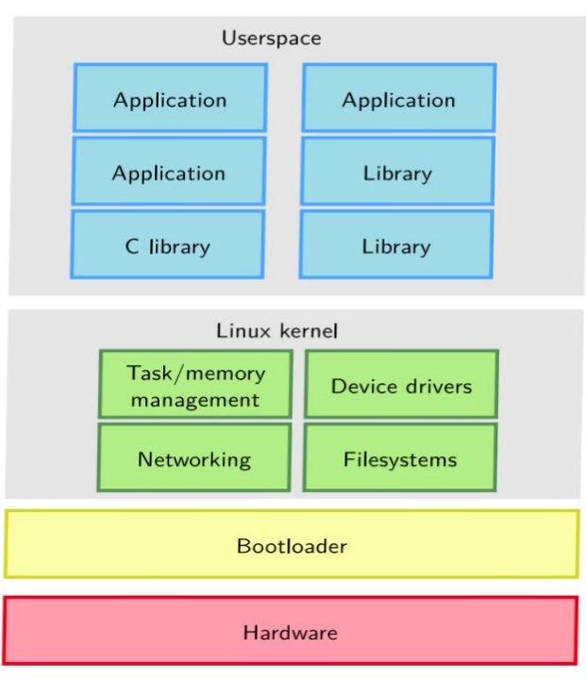
Overview of an Embedded Linux System Architecture
Mostly using ARM SoCs- which are cheap, low power, have lots of peripherals integrated into the chip

Slide 4
Usefulness of a Build system.
● Builds an embedded OS with a recent kernel along with a set of system commands
and libraries suitable for open embedded environment.
● Fully supports a wide range of hardware and device emulation through the QEMU.
● Provides a layered mechanism which allows to extent the system.
● Flexible to make customization and keep them organized.
Eg. yocto, buildroot etc.

Slide 5
Common Aspects (Yocto/Build root)
● Embedded Linux build systems
-> Goal is to build a complete, customized, embedded Linux system
-> Root filesystem, toolchain, kernel, bootloaders
● Build from scratch from source
● Using cross-compilation
● Very actively maintained and developed projects
● Widely used in the industry
● Well documented, training courses
● Free software

Slide 6
Build root
● Strong focus on simplicity
● Simple to use, but also simple to understand/extend
● Special use cases handled via extension scripts, rather than in Buildroot itself
● Re-use of existing technologies/languages: kconfig, make.
● Learning effort worth the investment
● Minimalist: small by default
● Purpose-agnostic
● Open community, no vendor or bureaucratic/corporate management
● Buildroot main product is a root filesystem image
● But also: toolchain, kernel image, bootloaders, etc.
● Many formats supported: ext2/3/4, ubifs, iso9660, etc.
● No binary packages, no package management system
● Re-uses kconfig from the Linux kernel
● Simple {menu,x,n,g}config interface
● Entire configuration stored in a single .config/defconfig

Slide 7
Yocto Project(https://www.yoctoproject.org)
● Support for the major architectures
OpenEmbedded: only qemu
Yocto Project: adds support for a few machines
● Only provides core recipes, use layers to get support for more packages and more machines
● Custom modifications should stay in a separate layer. Allow uses to create own distros
● Versaale build system: tries to be as fexible as possible and to handle most use cases
● Open community but the project is still governed by the Yocto Project Advisory
● Board made up of its corporate sponsors.
● OpenEmbedded is an independent community driven project.
● Builds distributions, the main output is a package feed the package management system is
optional on the target. it is possible to install or update only part of the system
● Also generates root flesystem images by installing those packages. Supports
the usual ext2/3/4, ubifs, iso9660, etc.. but also VM images: vmdk, vdi, qcow2
● Finally, images classes or a tool, wic, can be used to create disk images

Slide 8
Yocto Project: number/variety of packages
● Several thousand recipes: around 2200 for oe-core, meta-openembedded,
● meta-qt5. More than 8400 known by the Metadata Index (includes duplicates).
● Mostly the same packages as Buildroot
● Has layers for more languages: Java, Go, Rust, smalltalk
● Still has an active layer for Qt3
● meta-virtualization (Docker, KVM, LXC, Xen) and meta-openstack layers
● In the .core: ARM, MIPS, PowerPC, x86 and their 64-bit variants
● Usually silicon vendors maintain their own BSP layers:
● meta-intel
● meta-altera (both ARM and NIOSII)
● meta-atmel, meta-fsl, meta-ti, ...
● meta-xilinx (both ARM and Microblaze)

Slide 9
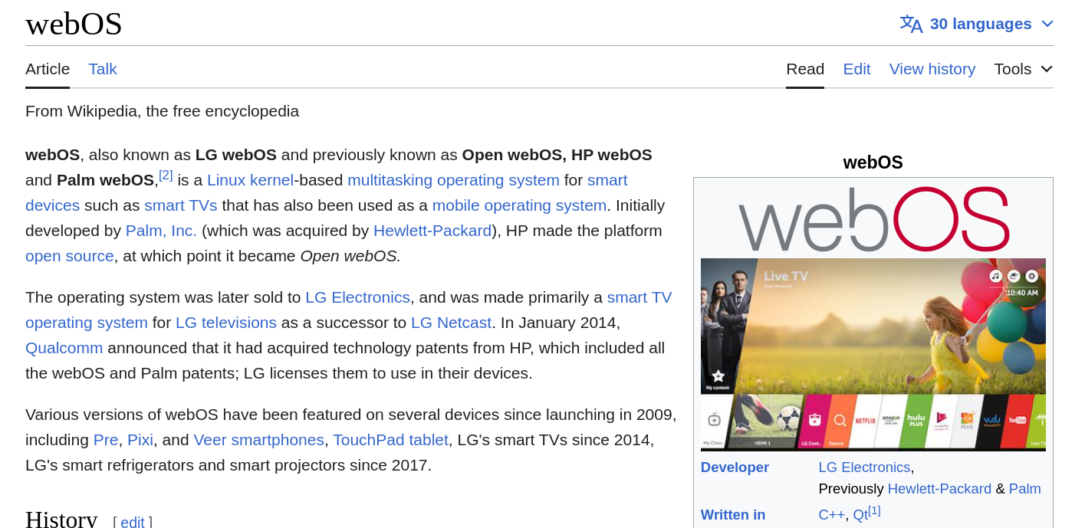
Who uses Yocto?

Slide 10
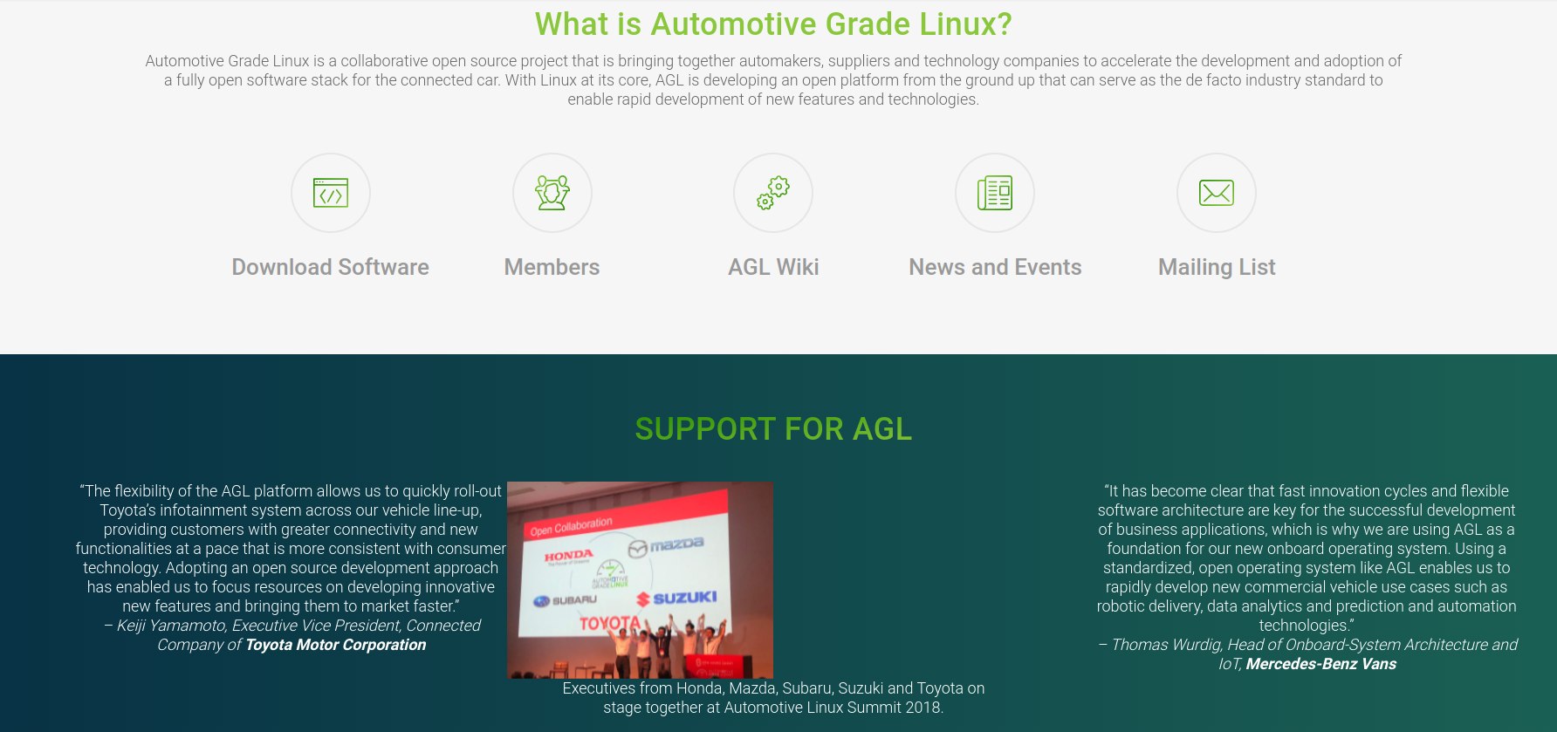
100 millions of devices running on yocto based build

Slide 11
Yocto poky reference build system
● Poky is the directory that contains openembedded build system and the meta layers
required to build our own distribution.
https://en.wikipedia.org/wiki/Yocto_Project
● Poky reference build system can be downloaded in a working directory as given below,
$ git clone --branch=branch_name git://git.yoctoproject.org/poky
● Where, branch_name: The poky branch to be cloned. Releases every 6 months
● Examples of poky branches are master, rocko, dunfell, zeus, warrior etc.
● If you dont specify --branch= in the above command it will directly clones the master branch.
https://wiki.yoctoproject.org/wiki/Releases

Slide 12
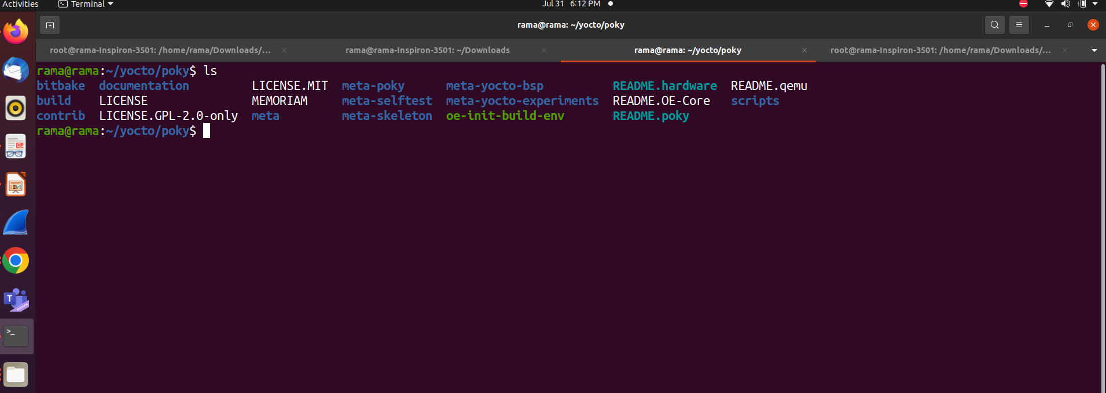
Organization of project source tree

Slide 13
Organization of project source tree contd..
Meta data is collection of – build instructions
Configuration files (.conf)
Recipes(.bb and .bbappend)
Classes(.bbclass)
Includes(.inc)
● Main parts of poky are:
● Bitbake:
* This is a tool written in python programming language.
* It interprets the metadata and decides what tasks are to be done.
* It uses the recipe files in order to execute the tasks.
● Layers:
* Layers allow you to isolate different types of customization from each other.
* Layers contain recipes, classess, configuration files, append files, patch files etc.
* Creating separate layers helps in modularizing the project.

Slide 14
Organization of project source tree contd..
Recipes:
* Recipes are the files with .bb extension used by the bitbake.
* It contains descriptive information about the package.
* It contains version of the recipes.
* Existing dependencies.
* Path to source code.
* Any patches needed by the source.
* How to compile the source code.
* Where to install the built images in the target machine.
Configuration files:
* These files have an extension of .conf
* Contains the various configuration variables that govern the project’s buildprocess.
* Contains machine configuration options, user configuration options etc.

Slide 15
● Classes:
* Contains information that is useful to share between metadata files.
* These files have an extension of .bbclass
* base.bbclass is the special file included in all the recipes.
* Class file contains standard basic tasks such as fetching, unpacking, configuring, compiling,
installing and packaging.
● Append files:
* Append files have an extension of .bbappend, which extends the build information of an
existing recipe.
* Bitbake expects every append file to have a corresponding recipe file and must use the
same root file name and it’s also version specific.
* eg. linux-yocto_1.0.bbappend file must have a linux-yocto_1.0.bb file.

Slide 16
OpenEmbedded Project vs Yocto project
OpenEmbedded Project vs Yocto project

Slide 17
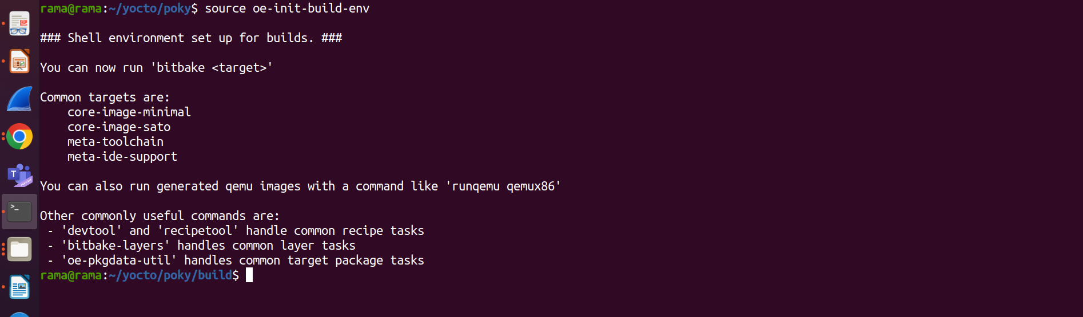
Configuring the build system
Run the oe-init-build-env script in the poky directory which will set the environment required
for the build in a build directoy.
$ source oe-init-build-env
●The above will create a build directory in poky by creating sub directory and setting up the
environment variables

Slide 18
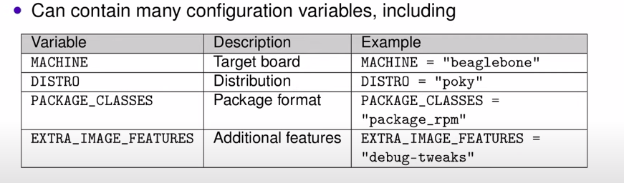
Board Support Packages
-> In Yocto project, a Board Support Package (BSP) is the meta layer which contains all the configuration specific to a particular board
-> Every project needs a BSP layer
-> The BSP is provided by either:
The company that sells the board
You, if you work for the company that makes the board
Local configuration:
-> it is in [build dir]/conf/local.conf

Slide 19
Configuring the build system
● The conf directory in the above image contains two required files i.e. local.conf and bblayer.conf
● The local.conf file will consists of the user configurations such as to which machine the user
wants to build the images for, what all the additional packages to be installed in the target
image while building.
● For configuring all the stuff user needs to use the configuration variables in the local.conf file.
● Bblayer.conf file consists of what all the layers the bitbake should parse during build.
● If any new layer is created that must be added to bblayer.conf file so that bitbake will consider
that file.
/poky/build/downloads
* The above directory contains all the source code fetched from the internet. Which will be
further used for build.
/poky/build/sstate-cache
* Bitbake stores the output of each task in directory in sstate-cache directory, Its location is
controlled by the SSTATE_DIR variable.
* Bitbake checks any recipes need not to be re compiled.

Slide 20
Organization of build output
The tmp directory in the build directory holds all the build system output.
/poky/build/tmp/buildstats
* Holds the build statistics for all built packages(CPU usage, timestamps etc).
● /poky/build/tmp/deploy
* Holds final output of the build.
● /poky/build/tmp/deploy/images
* Contains the embedded os images which can be flashed on the board.
● /poky/build/tmp/work:
* Set of specific work directories split by architecture.
* They are used to unpack, configure and build the package.
* Contains the patched sources, generated objects and logs.
● /poky/build/tmp/sysroots:
* Contains shared libraries and headers used to compile applications for the target.

Slide 21
Build a system image
Execute the following .command in order to build the system image,
$ bitbake .core-image-<target image variant>
Where target image variants are,
* .core-image-minimal
* .core-image-sato
* .core-image-base
* .core-image-x11 et.c.

Slide 22
Writing a minimal recipe
● The below recipe is written for a simple helloworld.
● Many applications may have more than one recipes, to support different versions.
● In that case the common meta data is included in each version specific recipe and is in
a .inc file.
Example:
* linux-yocto_5.4.bb, linux-yocto_5.7.bb files needs a linux-yocto.inc file.
● We can divide the recipe in main three parts:
● Header:
* header contains the configuration variables that describe the application.
* DESCRIPTION: Describe what application does.
* HOMEPAGE: URL to the project’s homepage.
* LICENSE: The applications license.
Source location:
* The source location contains the path to the source that need to be fetched.
* SRC_URI defines where and how to retrieve needed elements.
* The URI syntax : scheme://url;param1;param2
* The scheme might be a local or remote location.
* Local locations means the files present in working machine which are represented with file
scheme.
* Eg. file://defconfig, Where defconfig is the local file.
* Remote locations can be added using git, svn, http etc schemes.
* Eg. git://git.yoctoproject.org/linux-yocto.git

Slide 23
Development workflow with bitbake
Parsing the base configuration metadata:
* First bitbake parses the bblayer.conf in order to what all the layer to be recognized, all
necessary layer.conf files and bitbake.conf files.
* layer.conf file contains BBPATH and BBFILES variables which will give information about
the conf, class directory and the location of recipes respectively.
* The bitbake.conf file contains the metadata such as files specific to the architecture, the
machine, local environment and so forth.
* To know the configuration files and class files used in the execution environment, run the
below command,
$ bitbake -e > env_details.log

Slide 24
Tasks:
* Tasks define what to do with the source code.
* Packages are written in the form do_ format. Eg. do_fetch() etc.
* syntax of a task:
do_task() {
action 0
action 1
...
}
* Existing tasks can be extended using _append and _prepend.
do_compile() {
oe_runmake
}
do_install() {
install -d ${D}${bindir}
install -m 0755 hello ${D}${bindir}
}
=> Execute program in custom-app folder
(/home/XXX/yocto/poky/meta-yocto-experiments/recipes-experiments/custom-app)

Slide 25
Adding the custom application
● Here we are adding a simple calculator application as a bin utility.
● First Download the meta-yocto-experiments layer and add it to the poky source tree.
● Now source oe-init-build-env and inside the build/conf/bblayers.conf add absolute path of the
meta-yocto-experiments.
● Build the image using bitbake core-image-minimal command.
Now launch the qemu using runqemu command for more information follow the yocto-
experiments document.

Slide 26
Adding dependencies
● A recipe can have dependencies at build or run time. To reflect these requirements in the
recipe two variables are used.
* DEPENDS: List of recipe build time dependencies.
* RDEPENDS: List of the package runtime dependencies. Must be package specific.
● Examples:
* DEPENDS=”recipe-b” : The local do_configure task depends on the do_populate_sysroot
task of recipe-b.
* RDEPENDS_${PN}=”recipe-b” : The local do_build task depends on the
do_package_write_<archive-format> task of recipe-b.

Slide 27
Adding the custom library dependent application
Here we are adding a simple shared library with two functions and a dependent binary
application(hello) using those two functions.
● First Download the meta-yocto-experiments layer and add it to the poky source tree.
● Now source oe-init-build-env and inside the build/conf/bblayers.conf add absolute path of the
meta-yocto-experiments.
● Build the image using bitbake core-image-minimal command
Now launch the qemu using runqemu command for more information follow the yocto-
experiments document.
Execute program : yocto/poky/meta-yocto-experiments/recipes-experiments/custom-lib

Slide 28
Adding the custom kernel module
● Here we are adding a simple hello-mod.ko to the yocto build.
● First Download the meta-yocto-experiments layer and add it to the poky source tree.
● Now source oe-init-build-env and inside the build/conf/bblayers.conf add absolute path of the
Meta-yocto-experiments
MACHINE_ESSENTIAL_EXTRA_RRECOMMENDS += "hello-mod"
● Build the image using bitbake core-image-sato command.
Now launch the qemu using runqemu command for more information follow the yocto-
experiments document.
Execute program:
/home/rama/yocto/poky/meta-yocto-experiments/recipes-experiments/custom-mod

Slide 29
Procedure to change kernel configuration with menuconfig
$sudo apt-get install screen
$bitbake linux-yocto -c menuconfig
Where,
linux-yocto: is the name of kernel recipes(.bb) files which you can find them in
/opt/yocto/poky/meta/recipes-kernel/linux directory. In my case it is linux-yocto.
$bitbake core-image-sato
$runqemu qemux86-64 nographic
Verify new entry in the qemu build in following file
/lib/modules/5.4.228-yocto-standard/modules.builtin

Slide 30
Procedure to apply the kernel patch to existing kernel
In order to change the existing kernel recipes, first we need to create a new layer as given below,
1. go to poky directory in the yocto project and create the following directories and
subdirectories,
poky$ mkdir meta-mylayer
poky$ mkdir meta-mylayer/conf
poky$ mkdir meta-mylayer/recipes-kernel
poky$ mkdir meta-mylayer/recipes-kernel/linux
poky$ mkdir meta-mylayer/recipes-kernel/linux/linux-yocto
Where,
meta-mylayer -> The new layer created.
Just after creating the new layer (i.e. meta-mylayer in my case), add the new layer in bblayer.conf
2. Create layer.conf in the meta-mylayer/conf directory
In order to modify the existing kernel we have to follow the below steps:
1. Create the append file
2. Apply patches
3. Changing the configuration

Slide 31
1. Create the append file:
*We have to create a file with .bbappend extension in the meta-mylayer/recipes-kernel/linux/
directory with the name of the recipe you are using from meta/recipes-kernel/linux direcory.
Eg. In my case the recipe I am using is linux-yocto_5.4.bb, So I have created a file with a name of linux-yocto_5.4.bbappend in meta-mylayer/recipes-kernel/linux/ directory with the following content,
FILESEXTRAPATHS_prepend:="${THISDIR}/${PN}:"
SRC_URI_append += "0001-block-patches.patch"
Where,
The append file should initially extend the FILESPATH search path by prepending the directory that
contains your files to the FILESEXTRAPATHS.
For FILESPATH see base.bbclass in meta/classes directory.
${THISDIR}/${PN} - > expands to linux-yocto in the working directory.
0001-block-patches.patch is a patch file which I have created in
meta-mylayer/recipes-kernel/linux/linux-yocto directory.

Slide 32
2. Apply patches:
As explained above 0001-block-patches.patch is a patch file to be applied(In my case) to the existing kernel. You can apply any number of patches by creating patch files in
meta-mylayer/recipes-kernel/linux/linux-yocto directory and adding the file in .bbappend file as,
SRC_URI_append += “file://created_file.patch”
Where, created_file specifies the name of the patch file.
3. Changing the configuration:
execute find . -name .config command from ~/build directory to find the kernel configuration file.
Copy the file,
~/build/tmp/work/qemux86_64-poky-linux/linux-yocto/
5.8.18+gitAUTOINC+7883b60d32_3c5d210805-r0/linux-qemux86_64- standard-build/.config
to defconfig file created in the meta-mylayer/recipes-kernel/linux/linux-yocto directory.
Build the Kernel:
container@~ bitbake core-image-minimal
Now you can go to the ~/build/tmp/work-shared/qemux86-64/kernel- source/ directory and check wether the patches are applied or not based on to what source code of the kernel you applied the patches.

