Slide 1
mmap

Slide 2
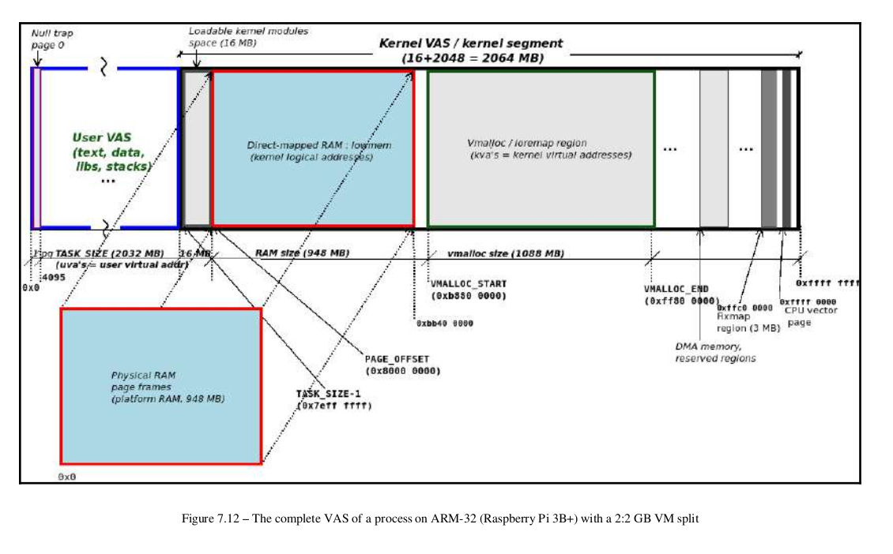

Slide 3
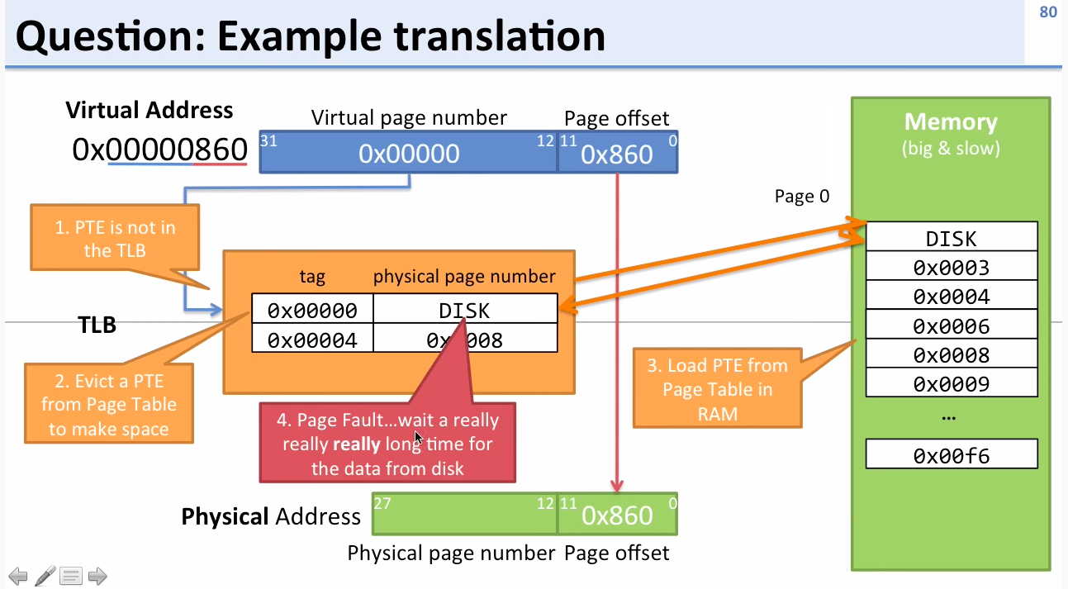
https://www.youtube.com/watch?v=95QpHJX55bM

Slide 4
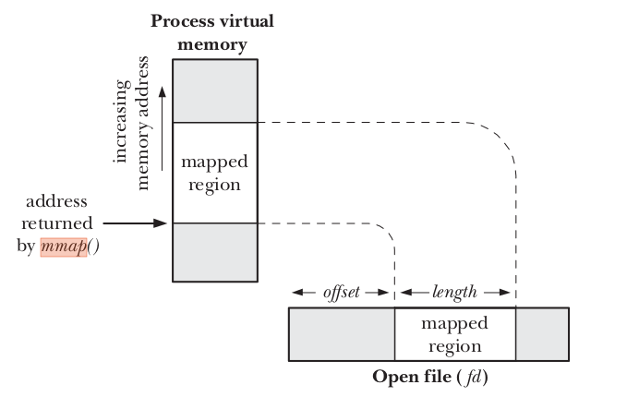
There are sound advantages to using mmap when it’s feasible to do so. X server, which transfers a lot of data to and from
video memory; mapping the graphic display to user space dramatically improves the throughput, as opposed to an lseek/write implementation. Another typical example is a program controlling a PCI device. Most PCI peripherals map their control registers to a memory address, and a high-performance application might prefer to have direct access to the registers instead of repeatedly having to call ioctl to get its work done.
#include <sys/mman.h>
void *mmap(void * addr , size_t length , int prot , int flags , int fd , off_t offset );
Returns starting address of mapping on success, or MAP_FAILED on error
#include <sys/mman.h>
int munmap(void * addr , size_t length );
Returns 0 on success, or –1 on error

Slide 5
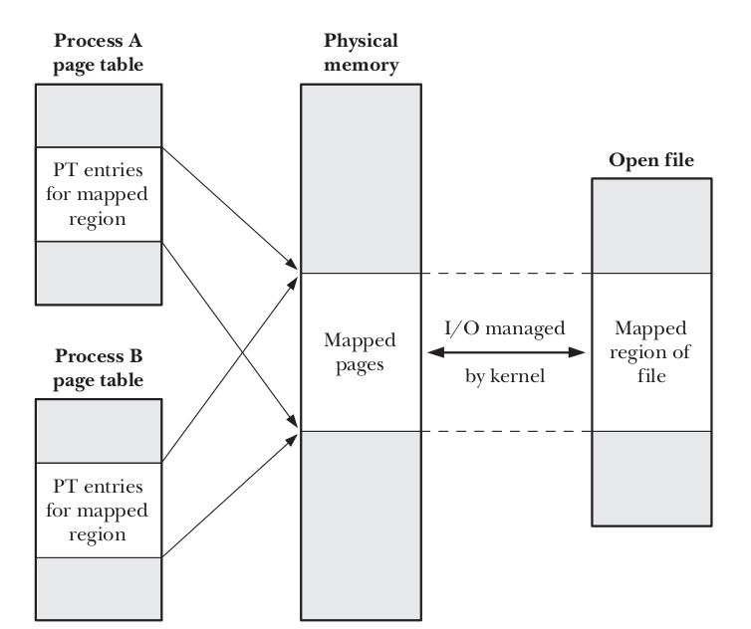
MAP_PRIVATE
Create a private mapping. Modifications to the contents of the region are not visible to other processes employing the same mapping, and, in the case of a file mapping, are not carried through to the underlying file.
MAP_SHARED
Create a shared mapping. Modifications to the contents of the region are visible to other processes mapping the same region with the MAP_SHARED attribute and, in the case of a file mapping, are carried through to the underlying file. Updates to the file are not guaranteed to be immediate;

Slide 6
Memory-mapped I/O has two potential advantages:
-> By replacing read() and write() system calls with memory accesses, it can simplify the logic of some applications.It can, in some circumstances, provide better performance than file I/O carried out using the conventional I/O system calls.
The kernel automatically carries modifications of the contents of a MAP_SHARED map-
ping through to the underlying file, but, by default, provides no guarantees about
when such synchronization will occur.
The msync() system call gives an application explicit control over when a shared mapping is synchronized with the mapped file. Synchronizing a mapping with the underlying file is useful in various scenarios. For example, to ensure data integrity, a database application may call msync() to force data to be written to the disk. Calling msync() also allows an application to ensure that updates to a writable mapping are visible to some other process that performs a read() on the file.
#include <sys/mman.h>
int msync(void * addr , size_t length , int flags );
Returns 0 on success, or –1 on error
MS_SYNC
Perform a synchronous file write. The call blocks until all modified pages of the memory region have been written to the disk.
MS_ASYNC
Perform an asynchronous file write. The modified pages of the memory region are written to the disk at some later point and are immediately made visible to other processes performing a read() on the corresponding file region.

Slide 7
In some applications, it is useful to lock part or all of a process’s virtual memory so that it is guaranteed to always be in physical memory. One reason for doing this is to improve performance. Accesses to locked pages are guaranteed never to be delayed by a page fault. This is useful for applications that must ensure rapid response times.
Another reason for locking memory is security. If a virtual memory page containing sensitive data is never swapped out, then no copy of the page is ever written to the disk. If the page was written to the disk, it could, in theory, be read directly from the disk device at some later time.
#include <sys/mman.h>
int mlock(void * addr , size_t length );
int munlock(void * addr , size_t length );
Both return 0 on success, or –1 on error

Slide 8
Before discussing about the memory mapping mechanism over a device, we will present some of the basic structures used by the Linux memory management subsystem.
Some of the basic structures are: struct page, struct vm_area_struct, struct mm_struct.
struct page is used to embed information about all physical pages in the system. The kernel has a struct page structure for all pages in the system.
There are many functions that interact with this structure:
• virt_to_page() returns the page associated with a virtual address
• pfn_to_page() returns the page associated with a page frame number
• page_to_pfn() return the page frame number associated with a struct page
• page_address() returns the virtual address of a struct page; this functions can be called only for pages from lowmem
• kmap() creates a mapping in kernel for an arbitrary physical page (can be from highmem) and returns a virtual address that can be used to directly reference the page
struct vm_area_struct
struct vm_area_struct holds information about a contiguous virtual memory area. The memory areas of a process can be viewed by inspecting the maps attribute of the process via procfs:
root@qemux86:~# cat /proc/1/maps
#address perms offset device inode pathname
08048000-08050000 r-xp 00000000 fe:00 761 /sbin/init.sysvinit
08050000-08051000 r--p 00007000 fe:00 761 /sbin/init.sysvinit
08051000-08052000 rw-p 00008000 fe:00 761 /sbin/init.sysvinit
092e1000-09302000 rw-p 00000000 00:00 0 [heap]
4480c000-4482e000 r-xp 00000000 fe:00 576 /lib/ld-2.25.so
4482e000-4482f000 r--p 00021000 fe:00 576 /lib/ld-2.25.so
4482f000-44830000 rw-p 00022000 fe:00 576 /lib/ld-2.25.so
44832000-449a9000 r-xp 00000000 fe:00 581 /lib/libc-2.25.so
449a9000-449ab000 r--p 00176000 fe:00 581 /lib/libc-2.25.so
449ab000-449ac000 rw-p 00178000 fe:00 581 /lib/libc-2.25.so
449ac000-449af000 rw-p 00000000 00:00 0
b7761000-b7763000 rw-p 00000000 00:00 0
b7763000-b7766000 r--p 00000000 00:00 0 [vvar]
b7766000-b7767000 r-xp 00000000 00:00 0 [vdso]
bfa15000-bfa36000 rw-p 00000000 00:00 0 [stack]

Slide 9
A memory area is characterized by a start address, a stop address, length, permissions.
A struct vm_area_struct is created at each mmap() call issued from user space. A driver that supports the mmap() operation must complete and initialize the associated struct vm_area_struct. The most important fields of this structure are:
• vm_start, vm_end - the beginning and the end of the memory area, respectively (these fields also appear in /proc/<pid>/maps);
• vm_file - the pointer to the associated file structure (if any);
• vm_pgoff - the offset of the area within the file;
• vm_flags - a set of flags;
vm_ops - a set of working functions for this area
vm_next, vm_prev - the areas of the same process are chained by a list structure
struct mm_struct
struct mm_struct encompasses all memory areas associated with a process. The mm field of struct task_struct is a pointer to the struct mm_struct of the current process.
Device driver memory mapping
Memory mapping is one of the most interesting features of a Unix system. From a driver's point of view, the memory-mapping facility allows direct memory access to a user space device.
To assign a mmap() operation to a driver, the mmap field of the device driver's struct file_operations must be implemented. If that is the case, the user space process can then use the mmap() system call on a file descriptor associated with the device.
The mmap system call takes the following parameters:
void *mmap(caddr_t addr, size_t len, int prot,
int flags, int fd, off_t offset);
To map memory between a device and user space, the user process must open the device and issue the mmap() system call with the resulting file descriptor.
The device driver mmap() operation has the following signature:
int (*mmap)(struct file *filp, struct vm_area_struct *vma);
The filp field is a pointer to a struct file created when the device is opened from user space. The vma field is used to indicate the virtual address space where the memory should be mapped by the device.

Slide 10
A driver should allocate memory (using kmalloc(), vmalloc(), alloc_pages()) and then map it to the user address space as indicated by the vma parameter using helper functions such as remap_pfn_range().
remap_pfn_range() will map a contiguous physical address space into the virtual space represented by vm_area_struct:
int remap_pfn_range (structure vm_area_struct *vma, unsigned long addr,
unsigned long pfn, unsigned long size, pgprot_t prot);
remap_pfn_range() expects the following parameters:
• vma - the virtual memory space in which mapping is made;
• addr - the virtual address space from where remapping begins; page tables for the virtual address space between addr and addr + size will be formed as needed
• pfn - the page frame number to which the virtual address should be mapped
• size - the size (in bytes) of the memory to be mapped
• prot - protection flags for this mapping

Slide 11
To obtain the page frame number of the physical memory we must consider how the memory allocation was performed. For each kmalloc(), vmalloc(), alloc_pages(), we must used a different approach.
For kmalloc() we can use something like:
static char *kmalloc_area;
unsigned long pfn = virt_to_phys((void *)kmalloc_area)>>PAGE_SHIFT;
while for vmalloc():
static char *vmalloc_area;
unsigned long pfn = vmalloc_to_pfn(vmalloc_area);
and finally for alloc_pages():
struct page *page;
unsigned long pfn = page_to_pfn(page);

