Slide 1
Memory Management
in Linux

Slide 2
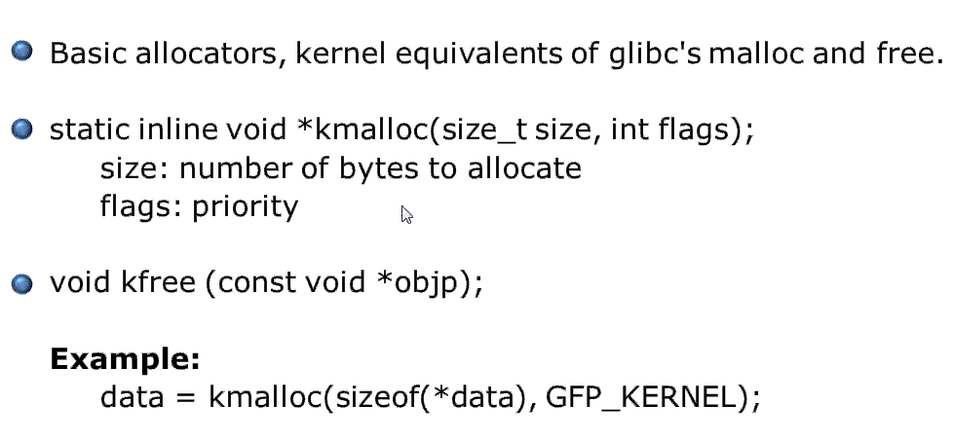

Slide 3
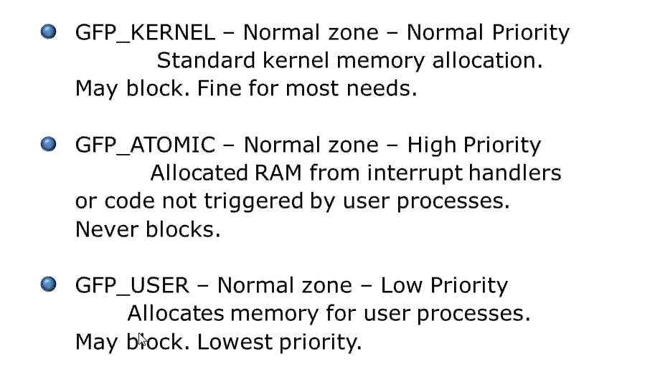

Slide 4
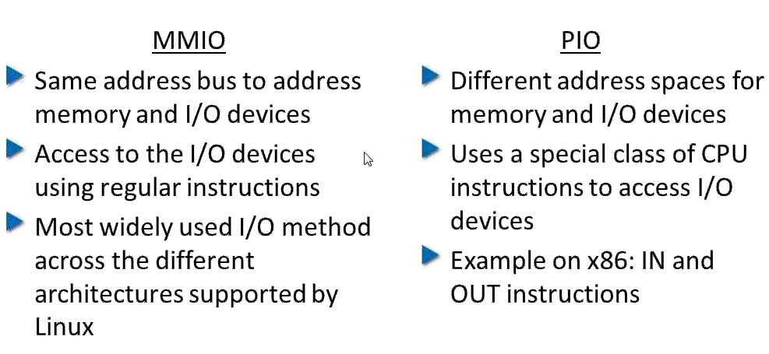
Memory Mapped I/O Vs Port I/O
Cat /proc/ioports --- To display port mapped I/O
Cat /proc/iomem -- To display memory mapped I/O Ports

Slide 5
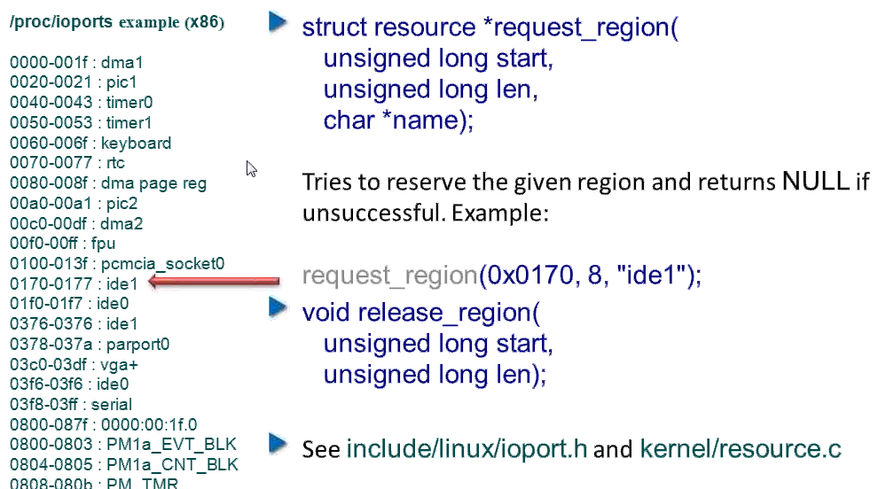
Requesting I/O ports

Slide 6
Application can access port mapped devices in 2 ways
Running as root application using IOPERM system call
Using operation on the special device file /dev/port (Old method)
addr = 0x378;
int result = ioperm(addr,5,1);
unsigned char data;
data = inb(addr);
outb(data,addr);
short data;
data = inw(addr);
outw(data,addr);
long data;
data = inl(addr);
outl(data,addr);

Slide 7
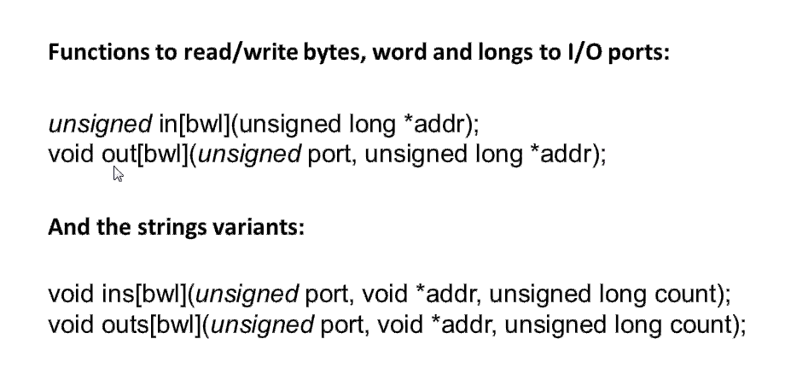
Accessing IO Ports:

Slide 8
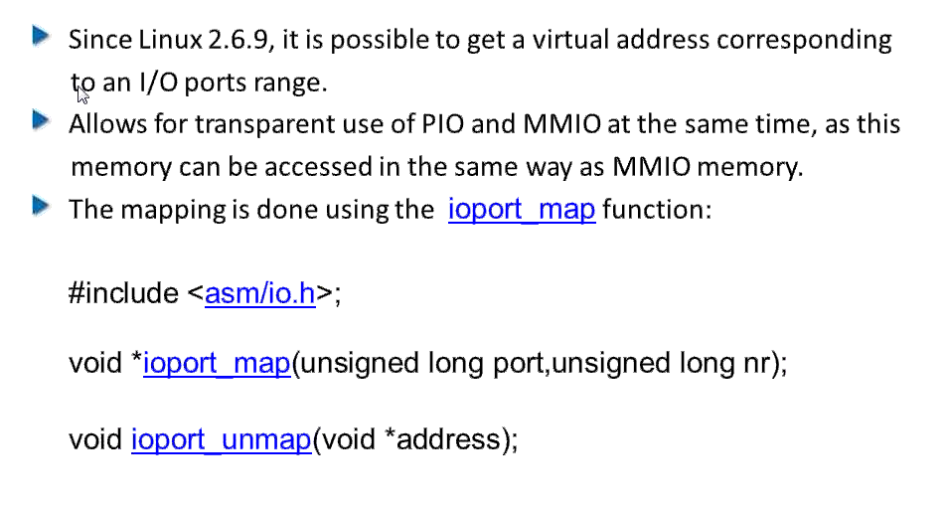
Mapping IO Ports in Virtual Memory

Slide 9
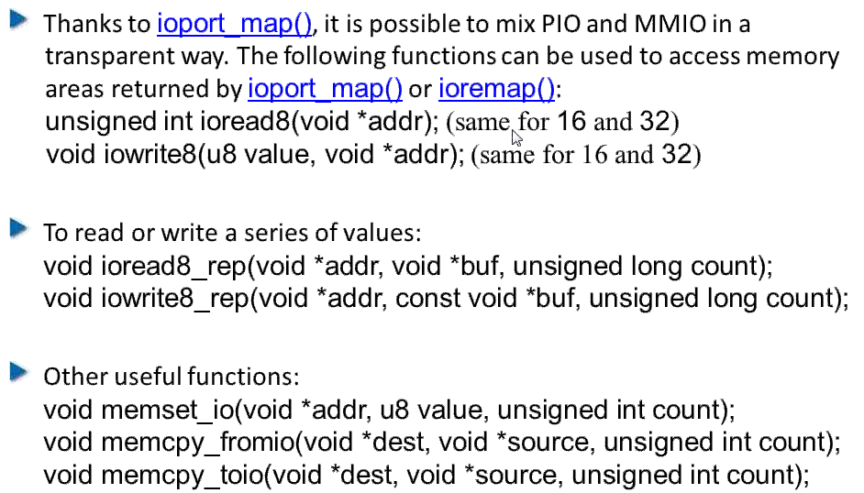
Accessing I/O memory

Slide 10
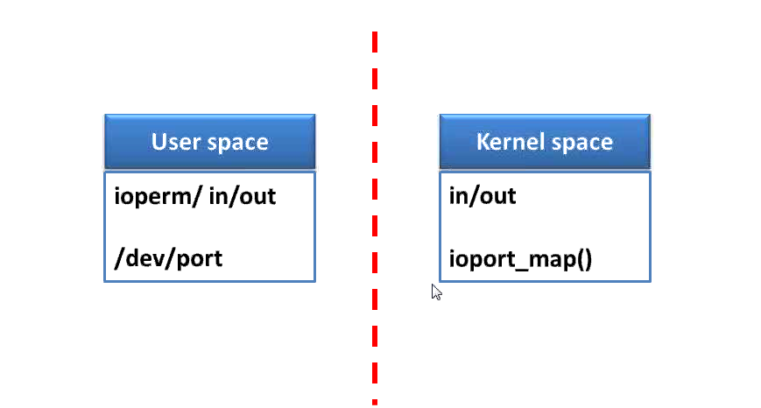
Port Mapped I/O Execution
Go through CMOS driver

Slide 11
Requesting I/O Memory in User Space
/dev/mem Provides access to the computer's physical memory.
void *mmap(void *addr, size_t length, int prot, int flags, int fd, off_t offset); -> man mmap
uint8_t *virt_addr;
fd = open("/dev/mem", O_RDWR);
if (-1 == fd)
{
perror("Mem open failed:");
return -1;
}
virt_addr = (uint8_t *)mmap(NULL, size , PROT_READ | PROT_WRITE, MAP_SHARED, fd, base_addr);
if (NULL == virt_addr)
{
perror("mmap failed:");
return -1;
}
Go to mmap and mmap with /dev/mem examples

Slide 12
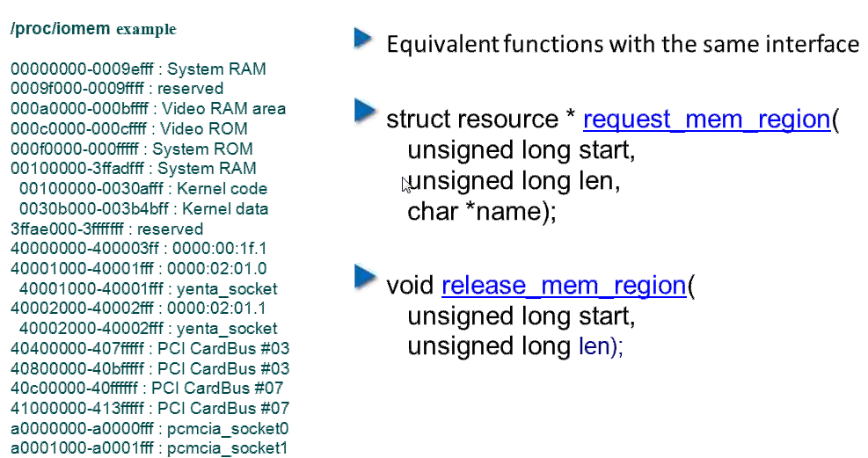
Requesting I/O Memory in Kernel Space

Slide 13
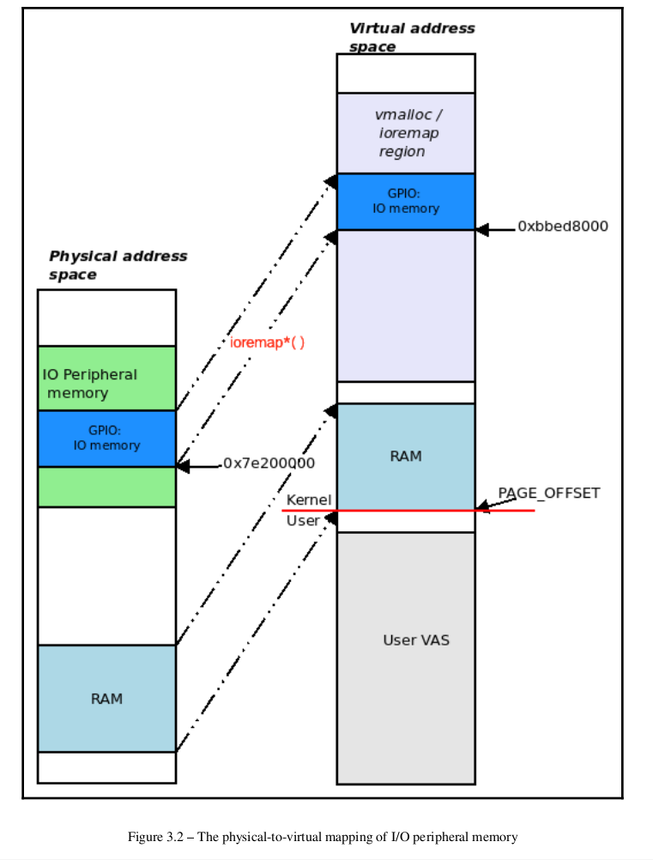

Slide 14
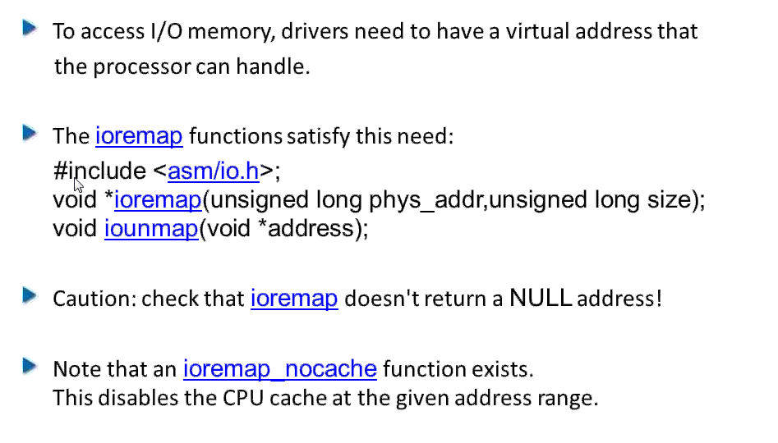
Mapping I/O Memory in Virtual address
devm_ioremap_resource() managed API performs the job of (validity) checking the
requested I/O memory region, requesting it from the kernel (internally via
the devm_request_mem_region() API), and remapping it (internally via
devm_ioremap() )

Slide 15
char val;
void __iomem *base = devm_ioremap_resource(dev, r);
[...]
val = ioread8(base+3);
memory barrier. What does it mean?
Sometimes, a program flow becomes unknown to the human programmer as
the microprocessor, the memory controllers, and the compiler can reorder memory reads
and writes. In the majority of cases, these "tricks" remain benign and optimized. But there
are cases – typically across hardware boundaries, such as CPU cores on multicore systems,
CPU to peripheral device, and vice versa on UniProcessor (UP) – where this reordering
should not occur; the original and intended memory load and store sequences must
be honored. The memory barrier (typically machine-level instructions embedded within the
*mb*() macros) is a means to suppress such reordering; it's a way to force both the
CPU/memory controllers and the compiler to order instruction/data in a desired sequence.

Slide 16
Memory barriers can be placed into the code path by using the following
macros: #include <asm/barrier.h> :
rmb() : Inserts a read (or load) memory barrier into the instruction stream
wmb() : Inserts a write (or store) memory barrier into the instruction stream
mb() : A general memory barrier gives a guarantee that all the LOAD and
STORE operations specified before the barrier will appear to happen before all the LOAD and STORE operations specified after the barrier with respect to the other components of the system."
// drivers/net/ethernet/realtek/8139cp.c
[ ... ]
static netdev_tx_t cp_start_xmit([...])
{
[ ... ]
len = skb->len;
mapping = dma_map_single(&cp->pdev->dev, skb->data, len,
PCI_DMA_TODEVICE);
[ ... ]
struct cp_desc *txd;
[ ... ]
txd->opts2 = opts2;
txd->addr = cpu_to_le64(mapping);
wmb();
opts1 |= eor | len | FirstFrag | LastFrag;
txd->opts1 = cpu_to_le32(opts1);
wmb();

