Slide 1
XEN – Hypervisor
Virtulization

Slide 2
Introduction to Virtualization
Virtualization is something not real. It is broad concept. There are different areas where we can use of virtualization.
Process level virtualization
Storage virtualization
Network virtulization
Operating system level virtualization
System virtualization

Slide 3
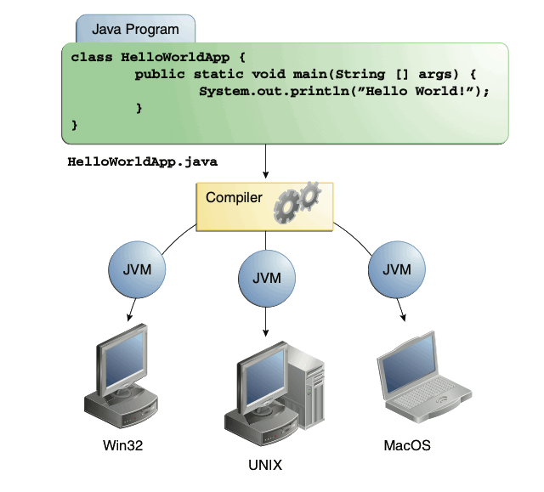
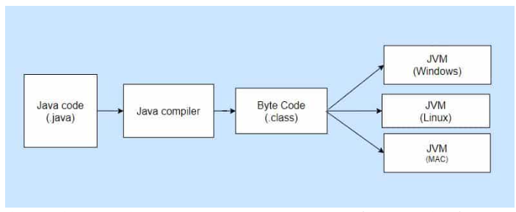
Process level virtualization
Achieve portability among different platforms.

Slide 4
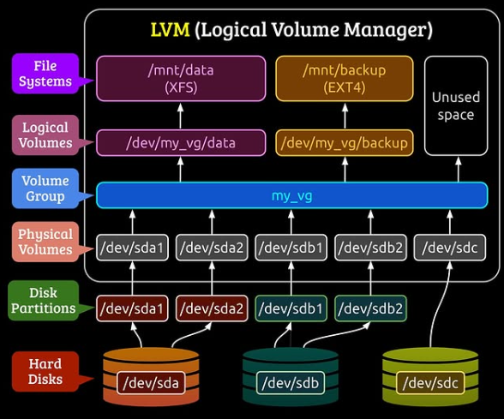
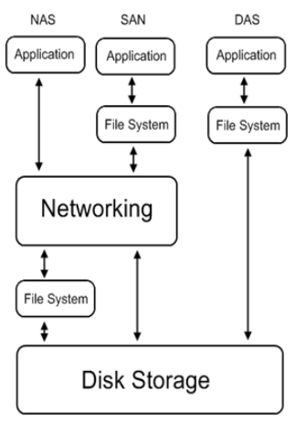
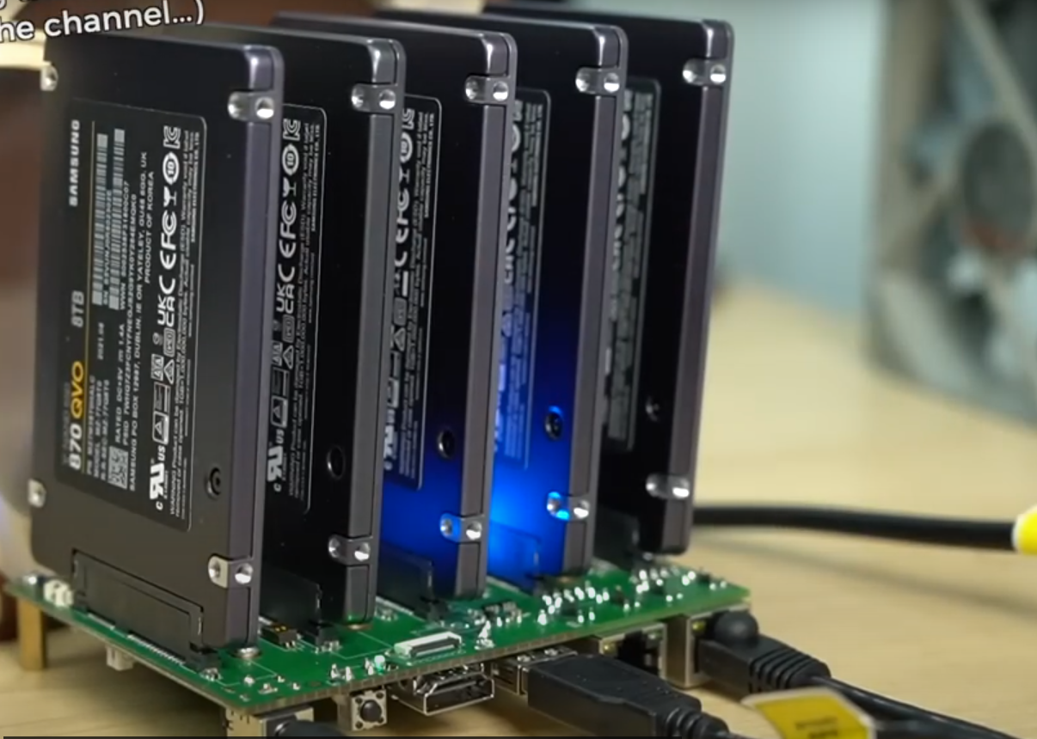
Storage virtualization
Consists of presenting a logical view of physical storage resources to a host computer. LVM is a disk management system that combines physical disks into a storage pool, enabling the creation of flexible logical volumes that can be resized or modified dynamically without rebooting the system.
NAS with RP5

Slide 5
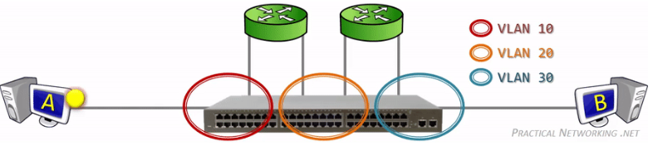
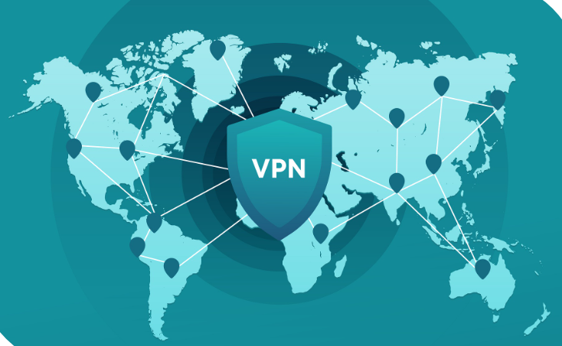
Network virtulization
Network virtualization encompasses technologies like VLANs and VPNs, which both create virtual networks, but VLANs segment a physical network into logical networks, while VPNs establish secure, encrypted connections over a public network.

Slide 6
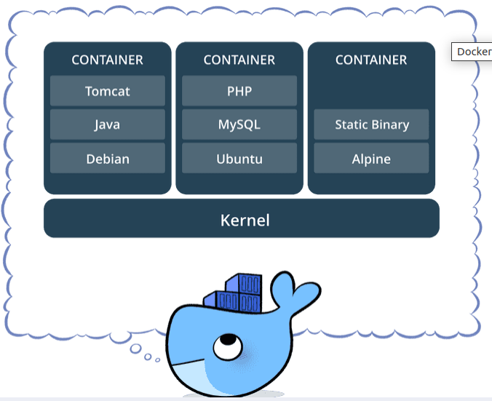
Operating system level virtualization
Also known as containerization, refers to an OS feature in which the kernel allows the existence of multiple isolated user-space instances.
- Docker images are executable packages that include everything needed to run an application
- Docker containers are a runtime instance of an image

Slide 7
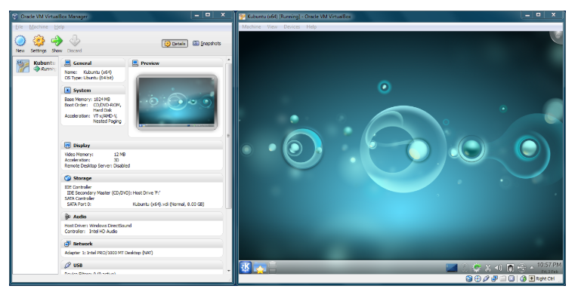
System virtualization
It refers to the creation of a virtual machine that acts like a real computer with an operating system. For example, a computer that is running Windows OS may host a virtual machine which runs Ubuntu, both running at the same time.

Slide 8
Why Virtulize?
Let's illustrate that with a real life example. Usually a company use multiple tools:
An issue tracking and project management software like jira.
A version control repository for code like gitlab.
A continuos integration software like jenkins.
A mail server for their emails like MS exchange server.
Without virtualization, you would probably need multiple servers to host all these services, as some of them would requires Windows as a host, others would need Linux as their base OS
With virtualization, you can use one single server to host multiple virtual machine at the same time, which each runs on a different OS

Slide 9
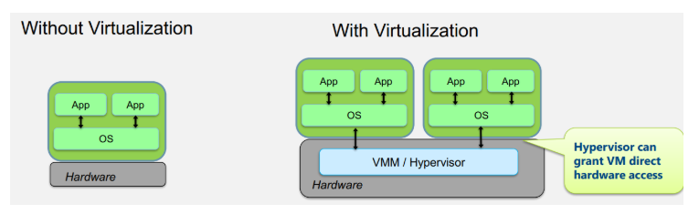
Hypervisor
Hypervisor is a peace of software which creates the illusion of multiple (virtual) machines on the same physical hardware.
There is 3 areas of the system which need to be considered when writing hypervisors.
1. CPU and memory virtualization (privileged instructions, MMU).
2. Platform virtualization (interrupts, timers, ...).
3. IO devices virtualization (network, disk, bios, ...).

Slide 10
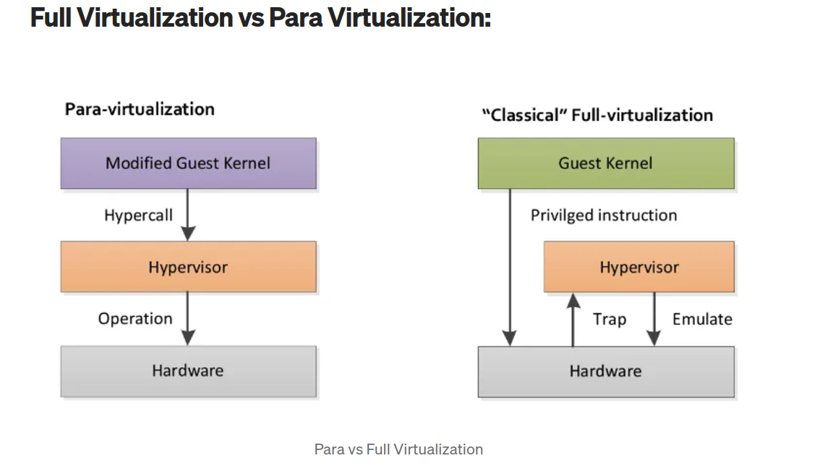

Slide 11
Hardware-Assisted Virtualization is a type of Full Virtualization where the microprocessor architecture has special instructions to aid the virtualization of hardware. These instructions might allow a virtual context to be setup so that the guest can execute privileged instructions directly on the processor without affecting the host.

