Slide 1
Kernel Core Dump

Slide 2
Kernel Crash dump
A ‘kernel crash dump’ refers to a portion of the contents of volatile memory (RAM) that is copied to disk whenever the execution of the kernel is disrupted. The following events can cause a kernel disruption:
Kernel panic
Non-maskable interrupts (NMI)
Machine check exceptions (MCE)
Hardware failure
Manual intervention
For some of these events (kernel panic, NMI) the kernel will react automatically and trigger the crash dump mechanism through kexec. In other situations a manual intervention is required in order to capture the memory. Whenever one of the above events occurs, it is important to find out the root cause in order to prevent it from happening again. The cause can be determined by inspecting the copied memory contents.

Slide 3
When a kernel panic occurs, the kernel relies on the “Kexec” mechanism to quickly reboot a new instance of the kernel in a pre-reserved section of memory that had been allocated when the system booted. This permits the existing memory area to remain untouched in order to safely copy its contents to storage.
sudo apt install linux-crashdump (Kernel crash dump enabled by default)
kdump-config show
crashkernel=512M-2G:64M,2G-:128M
This would mean:
1) if the RAM is smaller than 512M, then don't reserve anything
(this is the "rescue" case)
2) if the RAM size is between 512M and 2G (exclusive), then reserve 64M
3) if the RAM size is larger than 2G, then reserve 128M
Boot the system kernel with the boot parameter "crashkernel=Y@X",
where Y specifies how much memory to reserve for the dump-capture kernel
and X specifies the beginning of this reserved memory. For example,
"crashkernel=64M@16M" tells the system kernel to reserve 64 MB of memory
starting at physical address 0x01000000 (16MB) for the dump-capture kernel.

Slide 4
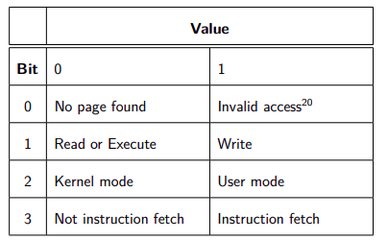
Kernel Panic
If a hard lockup is detected and "NMI watchdog" is configured, the system will boot into the dump-capture kernel (die_nmi() ).
If die() is called, and it happens to be a thread with pid 0 or 1, or die() is called inside interrupt context or die() is called and panic_on_oops is set, the system will boot into the dump-capture kernel.
sudo sysctl -w kernel.sysrq=1
For testing purposes, you can trigger a crash by using "ALT-SysRq-c",
"echo c > /proc/sysrq-trigger" or write a module to force the panic.
echo 1 > /proc/sys/kernel/sysrq
Write Out the Dump File
=======================
After the dump-capture kernel is booted, write out the dump file with
the following command:
cp /proc/vmcore <dump-file>
cat /proc/sys/kernel/tainted
CONFIG_KEXEC=y
MEMORY: 128MB
PANIC: "Oops: 0002"
PID:1696
COMMAND:"insmod"
CONFIG_PROC_VMCORE=y
CONFIG_CRASH_DUMP=y
0002 (dec) → 0010 (binary) → Not instruction fetch |
Kernel mode | Write |
CONFIG_DEBUG_INFO=y
Crash commands bt – backtrace, log, ps, exit
-> Execute Kernel Crash Program

Slide 5
Step-Step process for kernel panic capture
Step-0: Pre-crash Preparation
Before any crash occurs, kexec and kdump are enabled on the system. A special dump-capture kernel is preloaded into a reserved portion of memory using the crashkernel boot parameter. This reserved memory is isolated and remains untouched during normal system operation.
kexec is enabled → Allows booting new kernel without going through BIOS/UEFI
kdump service is running → crashkernel= (That memory never touched by running kernel)
Step-1: Kernel Panic Occurs
A fatal error such as a hardware failure, driver bug, or memory corruption causes the running kernel to panic. The kernel determines it cannot continue safe execution and stops normal processing.
Step-2: Panic Handler Activates kdump
The kernel panic handler takes control. All CPUs are stopped, interrupts are disabled, and normal shutdown procedures are skipped. Since kdump is enabled, the kernel prepares to collect crash data instead of rebooting normally.
Step-3: kexec Switches to Dump-Capture Kernel
Using kexec, the system jumps directly to the preloaded dump-capture kernel without rebooting through BIOS or UEFI. This preserves the system’s memory so the crash data remains intact. After the system boots normally, administrators analyze the saved vmcore file using debugging tools such as crash and vmlinux to determine the root cause of the kernel panic.

Slide 6
Step-4: Dump-Capture Kernel Boots
The dump-capture kernel boots with minimal drivers and services. It does not use or overwrite the crashed kernel’s memory and runs only what is necessary to save the crash dump. Often uses initramfs
Step-5: Crashed Kernel Memory Exposed as /proc/vmcore
The memory image of the crashed kernel is made available as a virtual file named /proc/vmcore. This file contains the full crash information, including kernel state and memory contents.
Step-6: Saving the Crash Dump
The dump-capture kernel copies /proc/vmcore to a persistent storage location such as /var/crash, NFS, or a remote system. Tools like cp or makedumpfile are used to save the dump file.
Step-7: Dump Completion
Once the crash dump is successfully written, the dump-capture kernel reports completion. The dump is now safely stored for later analysis.
Step-8: System Reboot or Shutdown
After saving the dump, the system either reboots automatically or powers off, depending on the configuration.
Step-9: Post-Crash Analysis

Slide 7
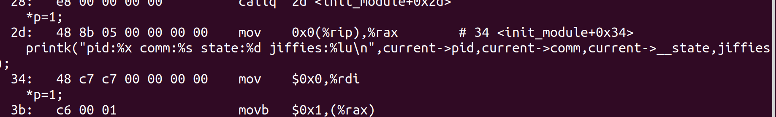
0010:khello_init+0x3b/0x1000 [khello]
[57308.205667] BUG: kernel NULL pointer dereference, address: 0000000000000000
[57308.205670] #PF: supervisor write access in kernel mode
[57308.205673] #PF: error_code(0x0002) - not-present page
[57308.205676] PGD 0 P4D 0
[57308.205681] Oops: 0002 [#1] SMP NOPTI
objdump -d -S null-pointer.ko

Slide 8
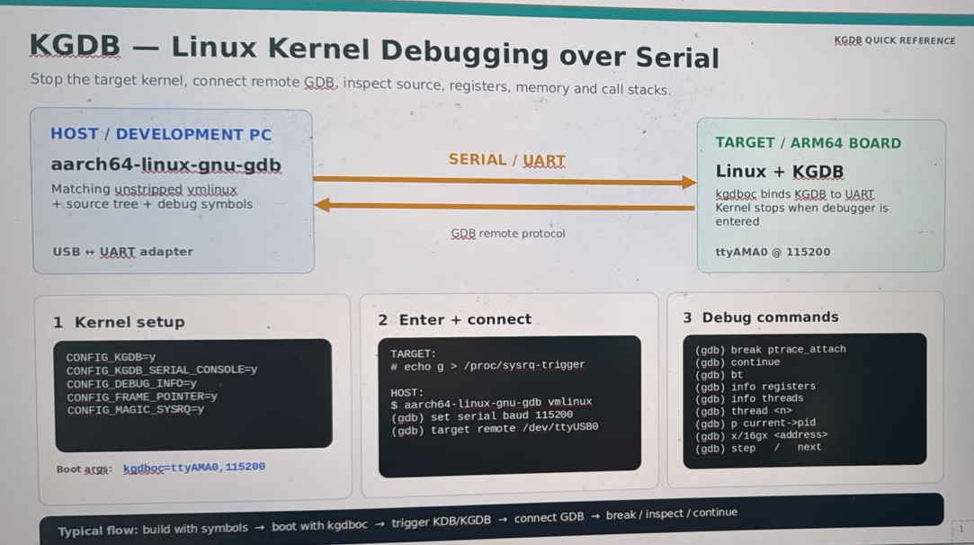


Slide 9


